Slide 1
Friday 22 May 2020 Bonjour P2! Ca va bien? Comme ci comme ca? Ca va mal? https://www.bbc.co.uk/teach/supermovers/ks1--ks2-mfl-french-greetings-with-ben-shires/zdpdvk7

Slide 2
Assembly
Please enjoy this week’s assembly. It’s all about reading today. (Please check email for assembly this week).
.

Slide 3
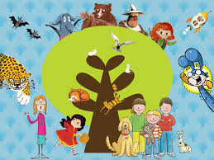
Reading Books
To make it easier to select books from oxford owl, I have set up a class password. Click on the link and enter the login details then choose a book that is suitable for the age and stage of your child.
https://www.oxfordowl.co.uk/
Username: p2 lbps Password: Marshall

Slide 4
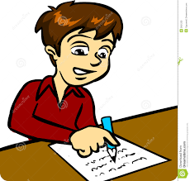
Dictation
Mum is slicing a cake and dad is laying the plates on the mats.
The twins are sharing toys with friends because they are kind boys.
I could be lazing in the sun but I have work to do.
Remember to –
Choose one sentence
Read the sentence aloud
Ask your child to repeat the sentence
Ask some questions to ensure understanding
Ask them to write the sentence 3 words at a time

Slide 5
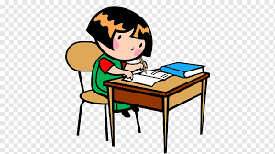
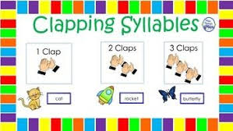
Spelling Words
Time for your spelling test.
I can use my spelling strategies to help me spell my words.
baking
racing
hiding
sharing
caring
liking
biting
naming
enough
almost
mountain

Slide 6
Number Talks
How many ways can you make the number 35?
Can you add, subtract and group objects?
Target Number
35

Slide 7
Friday Super Movers
https://www.bbc.co.uk/teach/supermovers/ks1-english-syllables-with-joe-tracini/znt4nrd

Slide 8
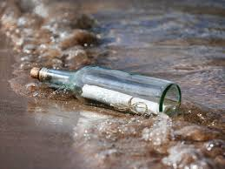
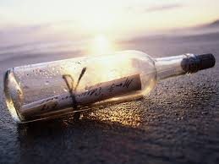
Big Talk
The saying goes, if the children can’t say it, the children can’t write it.
Every Friday (in place of ‘show and tell’) there will be a topic to talk about as a family. Please encourage your child to use interesting vocabulary, to speak in full sentences and to use eye contact. Thank you.
Imagine that you are on the beach and you have discovered a message in a bottle? What does it say?

Slide 9
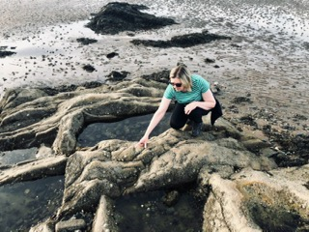
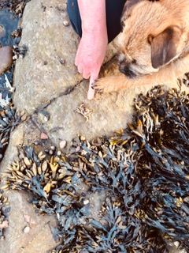
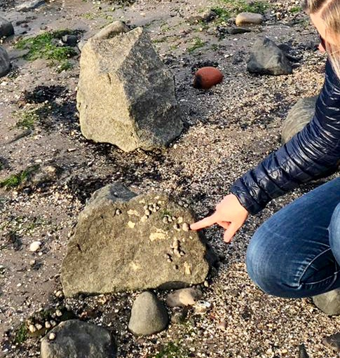
Enjoy your Weekend
Have a lovely weekend everyone, I hope it is a sunny one!
Emma and I did a spot of rock pooling this week. I wonder if you can recognise any of the things I found?

