Slide 1
Wednesday 20 May 2020
Bien? Regular? Mal?
https://www.bbc.co.uk/teach/supermovers/ks1--ks2-mfl-spanish-greetings-with-ben-shires/zfksqp3

Slide 2
Writing A Seaside Poem
To help me communicate effectively in and out of school, I will-
Say- Read the poem on the next page. Close your eyes and imagine you are at the beach. What can you see, hear, smell, taste and feel at the seaside?
Make – Draw detailed pictures of your ideas.
Write – Write a poem using your ideas, use the template to help you.
Do – Read your poem to your mum or dad, does it make sense? Did you use your core targets?

Slide 3
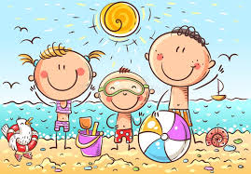
Seaside Poem
I go to the seaside and what do I see?
Bucket’s and spades, that’s what I see.
I go to the seaside and what do I smell?
Fish, chips and vinegar, that’s what I smell.
I go to the seaside and what do I hear?
Seagulls crying, that’s what I hear.
I go to the seaside and what do I taste?
My favourite ice cream, that’s what I taste!
I go to the seaside and what do I feel?
Hot sand on my feet, that’s what I feel.
Can you think of your own ideas for the sentences in purple?

Slide 5
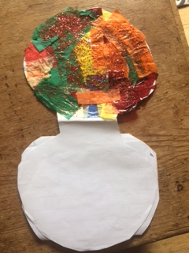
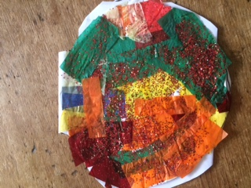
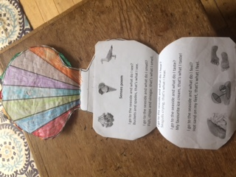
Seaside Poem
If you like you could put your poem into a piece of art. I have stuck mine into a glittery shell.

Slide 6
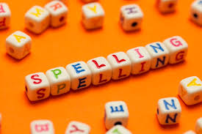
Spelling Words
baking
racing
hiding
sharing
caring
liking
biting
naming
enough
almost
mountain
Here are your spelling words for the week. Choose 3 words each day to practise.
Remember to..
Read the word
Clap the syllables
Use your sound box to sound out the sounds.
Write out the words

Slide 7
Reading Detectives
I can read the sentences
I can find the vowel digraphs, tricky words, and words ending in ‘ing’.
I can up level the sentence to make it more interesting
I can identify the nouns and verbs.
The teacher was wiping the whiteboard with one hand and pointing to the open door with another.

Slide 8
Story Time
https://www.youtube.com/watch?v=HX8vgBF1_G8

Slide 9
Maths and Numeracy
I am learning to add and subtract to 20 and beyond
To explore numbers, understand quantities, use strategies to help me work with numbers I can
Say- count forwards and backwards to and from 50 in 5s, throw and catch a ball with someone as you do it.
Make – Play ‘Duck Shoot’ on www.ictgames.com to help you practice counting up to 100 in 2s, 5s and 10s from any given number.
Write-Complete the ‘Add Equal Groups’ sheet

Slide 10
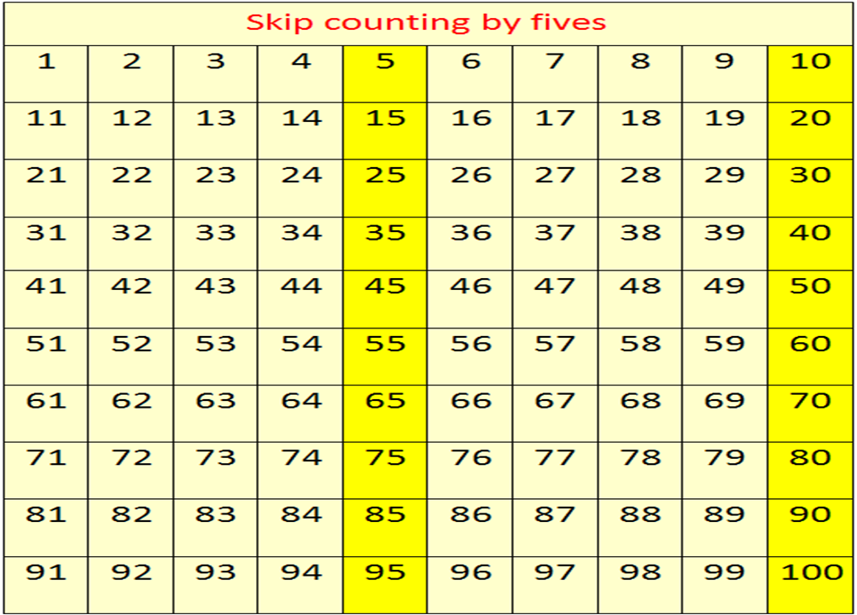
Counting in 5s
Now use the counting in 5s ppt to help you practice counting in 5s.

Slide 11
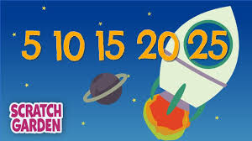
Number Songs
https://www.youtube.com/watch?v=EemjeA2Djjw

Slide 12
Let’s Go Live
This episode is packed full of interesting information. Once you have watched it, ‘think, pair and share with someone in your family and let them know what you found out.
https://www.youtube.com/watch?v=X64hNw0ZAFc

