Slide 1
Year 1 – Summer Block 1 – Multiplication and Division – Add Equal Groups
About This Resource:
This PowerPoint has been designed to support your teaching of this small step. It includes a starter activity and an example of each question from the Varied Fluency and Reasoning and Problem Solving resources also provided in this pack. You can choose to work through all examples provided or a selection of them depending on the needs of your class.
National Curriculum Objectives:
Mathematics Year 1: (1N1b) Count in multiples of twos, fives and tens
Mathematics Year 1: (1C8) Solve one-step problems involving multiplication and division, by calculating the answer using concrete objects, pictorial representations and arrays with the support of the teacher
More Year 1 Multiplication and Division resources.
Did you like this resource? Don’t forget to review it on our website.
© Classroom Secrets Limited 2018

Slide 2
Year 1 – Summer Block 1 – Multiplication and Division
Step 3: Add Equal Groups
© Classroom Secrets Limited 2018

Slide 3
Introduction
There are _______ groups of _______ shells.
There are _______ groups of _______ jewels.
There are _______ groups of _______ ducks.

Slide 4
Introduction
There are _______ groups of _______ shells.
There are _______ groups of _______ jewels.
There are _______ groups of _______ ducks.
3
3
4
5
2
2

Slide 5
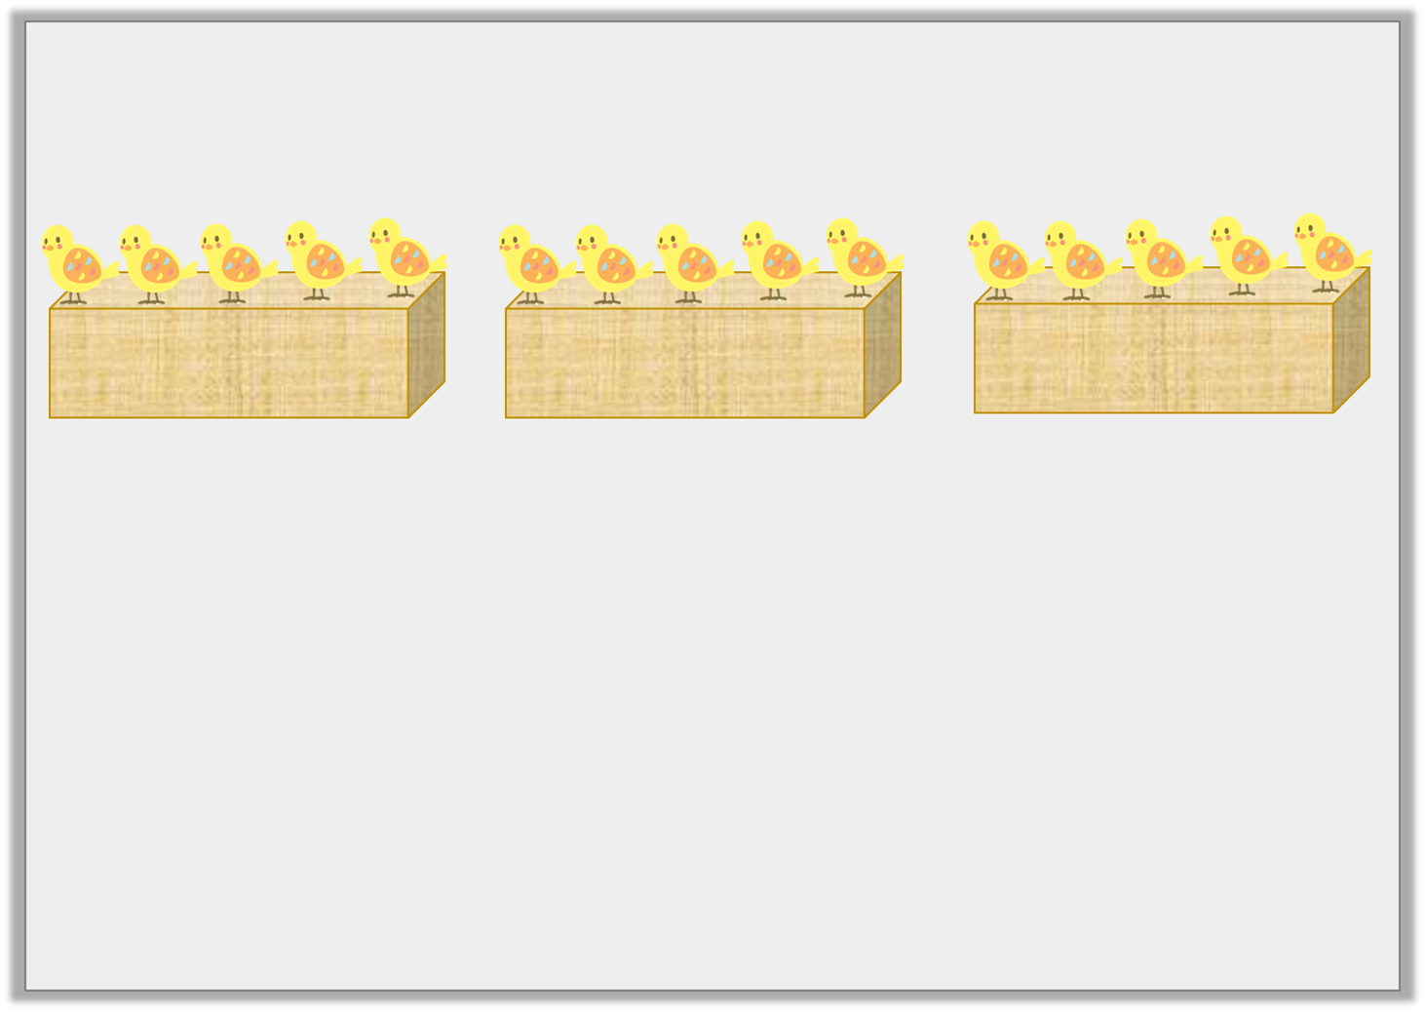
Varied Fluency 1
Which number line matches the chicks?
A
0 | 1 | 2 | 3 | 4 | 5 | 6 | 7 | 8 | 9 | 10 | 11 | 12 | 13 | 14 | 15
B
0 | 1 | 2 | 3 | 4 | 5 | 6 | 7 | 8 | 9 | 10 | 11 | 12 | 13 | 14 | 15
© Classroom Secrets Limited 2018

Slide 6
Varied Fluency 1
Which number line matches the chicks?
A
A
0 | 1 | 2 | 3 | 4 | 5 | 6 | 7 | 8 | 9 | 10 | 11 | 12 | 13 | 14 | 15
B
0 | 1 | 2 | 3 | 4 | 5 | 6 | 7 | 8 | 9 | 10 | 11 | 12 | 13 | 14 | 15
© Classroom Secrets Limited 2018

Slide 7
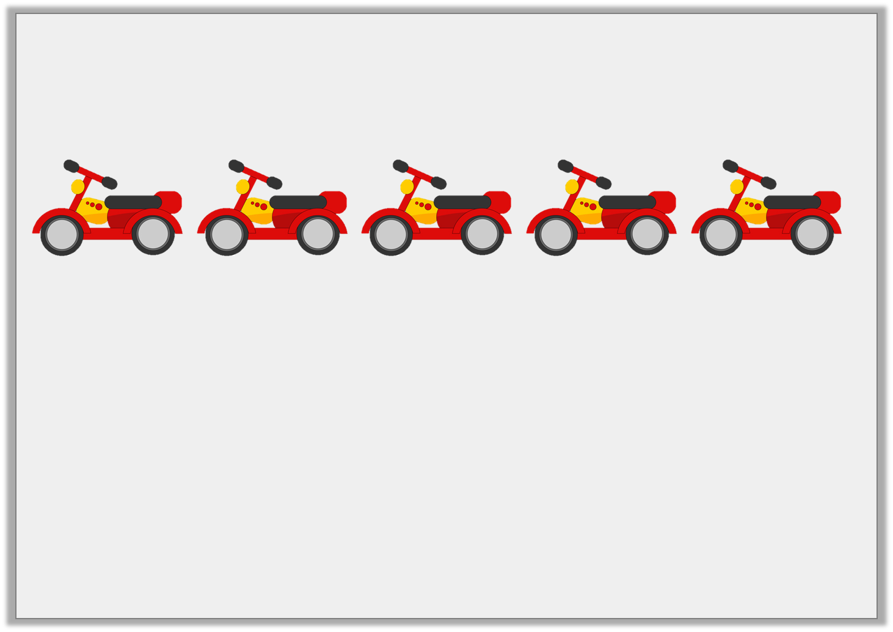
Varied Fluency 2
How many wheels on 5 scooters?
Which cubes match the calculation?
© Classroom Secrets Limited 2018

Slide 8
Varied Fluency 2
How many wheels on 5 scooters?
Which cubes match the calculation?
10 wheels
© Classroom Secrets Limited 2018

Slide 9
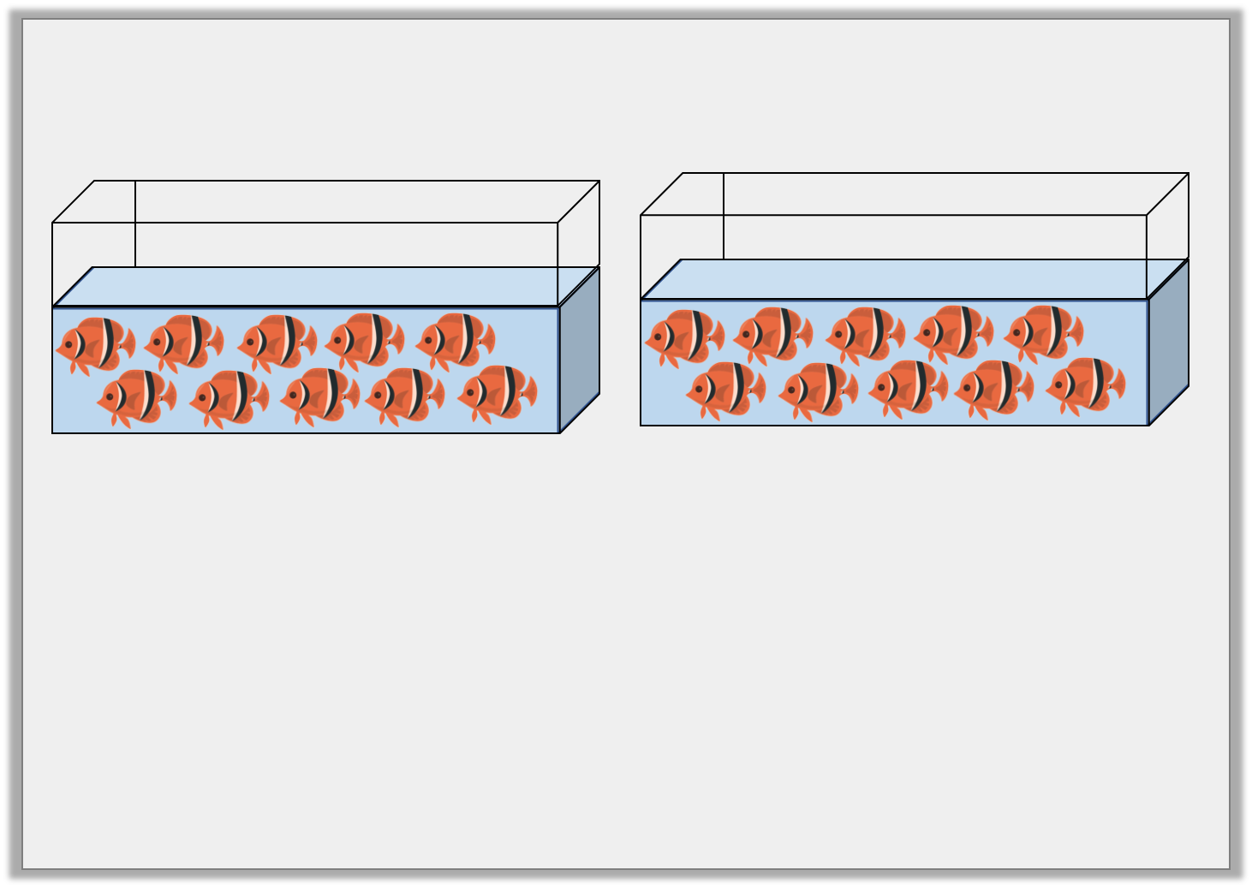
Varied Fluency 3
There are 10 fishes in each tank.
True or false?
There are 20 fishes altogether.
© Classroom Secrets Limited 2018

Slide 10
Varied Fluency 3
There are 10 fishes in each tank.
True or false?
There are 20 fishes altogether.
True
© Classroom Secrets Limited 2018

Slide 11
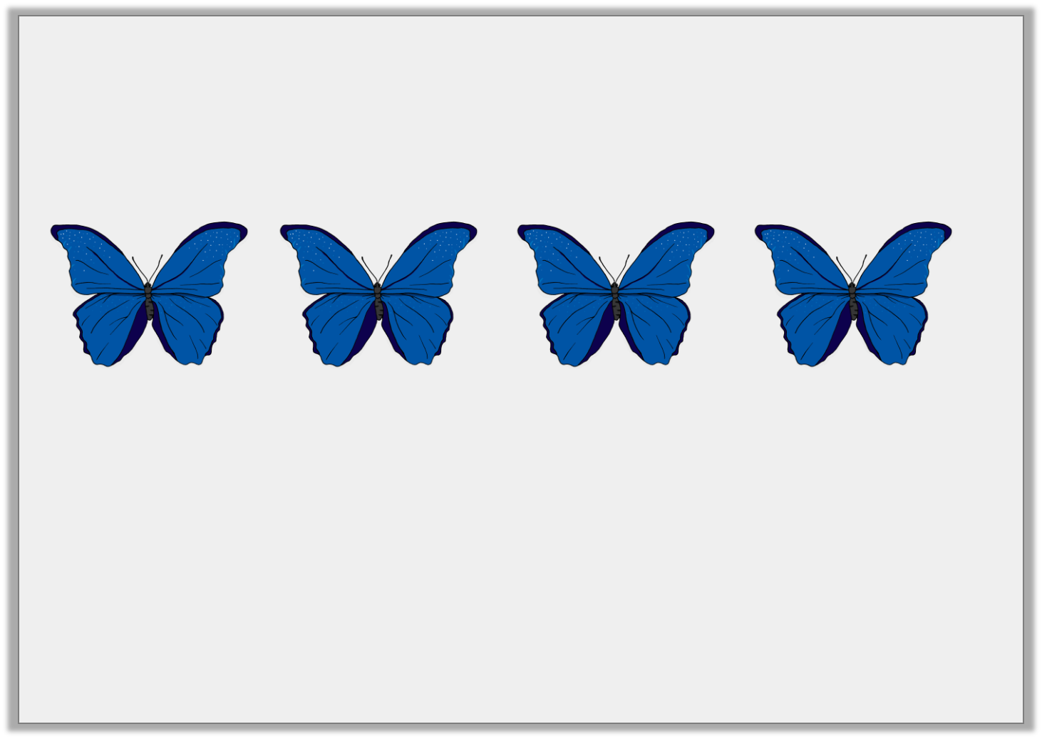
Varied Fluency 4
Draw spots on the butterflies to represent the calculation on the number line.
Complete the number sentence to match.
0 | 1 | 2 | 3 | 4 | 5 | 6 | 7 | 8 | 9 | 10 | 11 | 12 | 13 | 14 | 15
 | + |  | + |  | + |  | = | 8
© Classroom Secrets Limited 2018

Slide 12
Varied Fluency 4
Draw spots on the butterflies to represent the calculation on the number line.
Complete the number sentence to match.
0 | 1 | 2 | 3 | 4 | 5 | 6 | 7 | 8 | 9 | 10 | 11 | 12 | 13 | 14 | 15
2 | + | 2 | + | 2 | + | 2 | = | 8
© Classroom Secrets Limited 2018

Slide 13
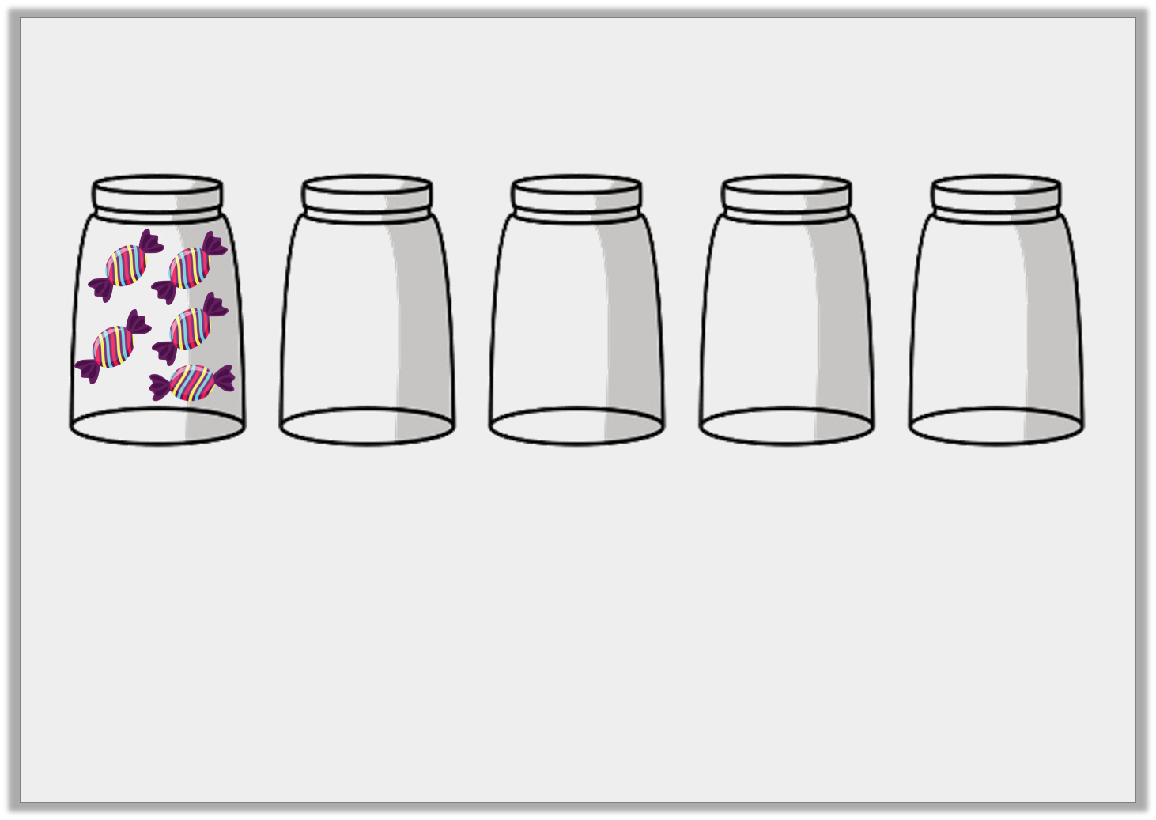
Problem Solving 1
Jamie has 5 jars. He puts 5 sweets in each jar.
How many sweets does he have altogether?
Show your working.
 | + |  | + |  | + |  | + |  | = | 25
© Classroom Secrets Limited 2018

Slide 14
Problem Solving 1
Jamie has 5 jars. He puts 5 sweets in each jar.
How many sweets does he have altogether?
Show your working.
25 sweets
5 | + | 5 | + | 5 | + | 5 | + | 5 | = | 25
© Classroom Secrets Limited 2018

Slide 15
Reasoning 1
Maggie and Kyle have been counting in 10s starting from 10.
Who is correct? Explain your answer.
Maggie
All of my numbers will be odd numbers.
Kyle
All of my numbers will end in a 0.
© Classroom Secrets Limited 2018

Slide 16
Reasoning 1
Maggie and Kyle have been counting in 10s starting from 10.
Who is correct? Explain your answer.
Kyle is correct because…
Maggie
All of my numbers will be odd numbers.
Kyle
All of my numbers will end in a 0.
© Classroom Secrets Limited 2018

Slide 17
Reasoning 1
Maggie and Kyle have been counting in 10s starting from 10.
Who is correct? Explain your answer.
Kyle is correct because when counting in 10s, all numbers end in 0. For example; 10, 20, 30
Maggie
All of my numbers will be odd numbers.
Kyle
All of my numbers will end in a 0.
© Classroom Secrets Limited 2018

Slide 18
Problem Solving 2
Look at the Numicon and the number sentences below.
10 + 10 + 10 = 20 5 + 5 + 5 = 20
Find and correct any mistakes.
© Classroom Secrets Limited 2018

Slide 19
Problem Solving 2
Look at the Numicon and the number sentences below.
10 + 10 + 10 = 20 5 + 5 + 5 = 20
Find and correct any mistakes.
10 + 10 + 10 = 30
5 + 5 + 5 + 5 = 20
© Classroom Secrets Limited 2018

