Slide 1
P5 WEEKLY DIARY WEEK COMMENCING Monday 18th May 2020

Slide 2
Could I please ask that no one edits (changes) anything on any page of this
PowerPoint. Thank you.

Slide 3
Dear Primary 5, parents and carers
This week our whole school Assembly is celebrating Reading. I thought I would start off our weekly diary by reading one of P5’s favourite poems.
Our Teams lessons start on Tuesday with literacy circle groups – each group will have a separate lesson. Please make sure you have completed your character analysis questions. On Wednesday we will have a subtraction and addition lesson for the whole class and on Thursday we will have a whole class lesson on how to write an ‘informal letter’ to our new nursery buddies.
Please let us know if you are having any difficulties with accessing elements of the weekly tasks. I am sure we can resolve any issues for you. Do not hesitate to get in touch.
Thank you for all your support. I know it is not always easy to upload the tasks and I really appreciate all your efforts.
Take care and I look forward to hearing you all soon.
Kind regards
Mrs Peters

Slide 4
Online Lessons this week.
Tuesday 9.30 am - 10 am Demon Dentist
Tuesday 10 am –10.30 am Firework-Maker’s Daughter
Tuesday 1.30 pm – 2 pm Gangsta Granny
Tuesday 2 pm – 2.30 pm Millions: The Not-So-Great-Train Robbery
Please have your completed character analysis answers to hand.
Wednesday 10.30 am SUBTRACTION – standard written message
Please have squared paper, a pencil and a ruler to hand.
Thursday - 11.00 am WRITING A LETTER TO OUR NURSERY BUDDIES
Spelling Test on Animal Plurals
Please have some paper and a pencil ready for taking notes.

Slide 5
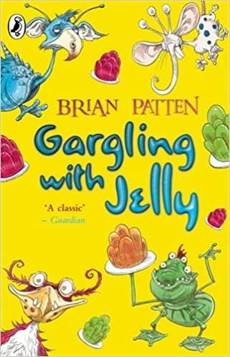
Celebrating Reading
The Trouble with My Brother

Slide 6
LITERACY
Spelling
This week we are focussing on Animal Plurals – this is revision, however, there will be
a few new words in the worksheet. Please check the correct spellings using a dictionary –
you can use on online dictionary if you wish. Fill in the missing words on the worksheet.
The missing words are the words you will be tested on at the end of our Writing Lesson on
Thursday. Remember to practise your spelling before Thursday using the strategy that works
for you. You could even get someone in your family to test you.
Please find the spelling worksheet on our website under P5 Class Blogs.

Slide 7
LITERACY
Grammar
This week you have to correct the punctuation in sentences. You have to re-write the unpunctuated sentences and insert the correct punctuation. You can write these in your jotters or type them out in a word document (whatever is easier for you).
The different types of punctuation you will have to insert are:
capital letters
full stops
question marks
inverted commas
To remind you of inverted commas (speech marks) please look at the following example:
can i take the dog for a walk asked Amy
“Can I take the dog for a walk?” asked Amy.
Please find the worksheet on our website under P5 Class Blogs.

Slide 8
LITERACY
Writing Task
Lesson on Thursday 11 am
LI – I can write an informal letter.
Writing to our new nursery buddies!

Slide 9
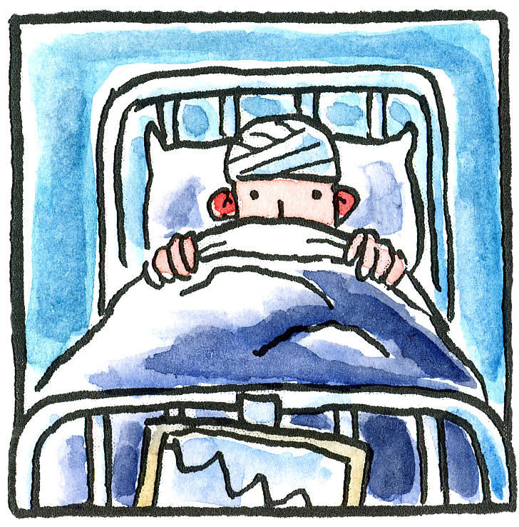
EXPRESSIVE ARTS - MUSIC
OPERA – BE PART OF A BRAND NEW OPERA CALLED ‘FEVER’
Week 2 – Don’t worry if you did not manage to visit the website last week – it is easy to catch up.
Go to www.scottishopera.org.uk/fever every Monday to find all you need to get started.

Slide 10
NUMERACY
Beetles and Butterflies
Please look at the guidance PP – Subtracting 3 digit numbers.
Complete the Subtraction Worksheets 1 and 2 (subtracting using the standard written method).
Complete the first three pages from the Addition and
Subtraction Workbook, the Large Numbers Addition
Worksheet, the Missing Number 3 digit Addition
Worksheet and the Addition Pyramids Worksheet 1.

Slide 11
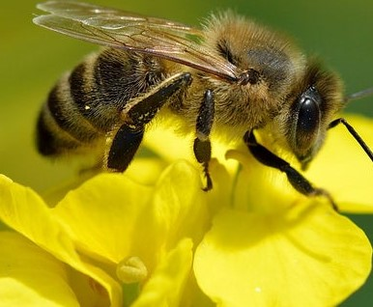
NUMERACY
H5 page 13 and 14
BEES
LI – I can add 3 digit plus 2 digit
2 8 4
+ 2 9
3 1 3
1 1
2 8 4
+ 0 2 9
3 1 3
1 1

Slide 12
BEES
LI – I can add 3 digit plus 2 digit
4 8 5
+ 3 9
5 2 4
1 1
4 8 5
+ 0 3 9
5 2 4
1 1

Slide 13
BEES
Now that you listened to me and read the two
previous slides, I would like you to complete:
Page 13 questions: 4, 1 and 3 (in this order)
Page 14 question 3 only
Page 14 question 1 (optional)

Slide 14
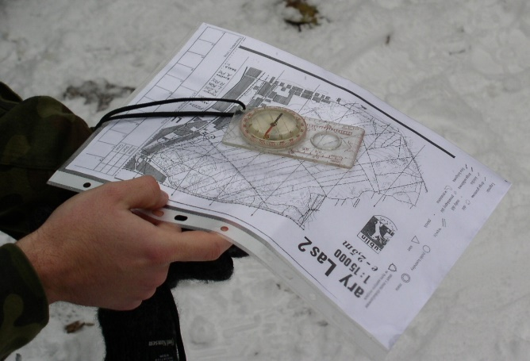
ORIENTEERING – part 2
Last week we learned about how to draw maps. This week we are learning about how to find the controls on a course (how to find our way around a course).
To find all the worksheets go to the school website and find P5 Class Blog or Teams/Files/P5 Resources/Orienteering.
Part 2: Courses and Controls
https://www.scottish-orienteering.org/lets-get-started-orienteering/

Slide 15
HEALTH AND WELLBEING
PHYSICAL EDUCATION
If you are still doing the Joe Wickes training sessions, great! If you want to try some new fitness routines, try the links below.
Cosmic Kids Yoga
https://www.youtube.com/user/CosmicKidsYoga
Oti Mabuse & Marius Lepure Online Dance Class
https://www.youtube.com/user/mosetsanagape/videos
Zumba Kids on Go Noodle
https://app.gonoodle.com/channels/zumba-kids

Slide 16
MINDFULNESS
If you are feeling a little worried and anxious, this is a five-minute video teaching you how breathing can help you to relax. Try doing it every day (at any time), lying down or sitting crossed legged, the more you practise the more you will feel the benefits.
https://www.youtube.com/watch?v=CvF9AEe-ozc

Slide 17
Reminders..
Remember that you can use the booklets and worksheets you took home.
We understand that you may not always have access to a device so just do what you can.
If you don’t have squared paper – just use any paper you have around the house.
Remember to share links to any learning videos you think are useful.
We have boxes in Sainsbury’s full of jotters and school things – let your parents know – I believe there are squared paper jotters.

