Slide 2
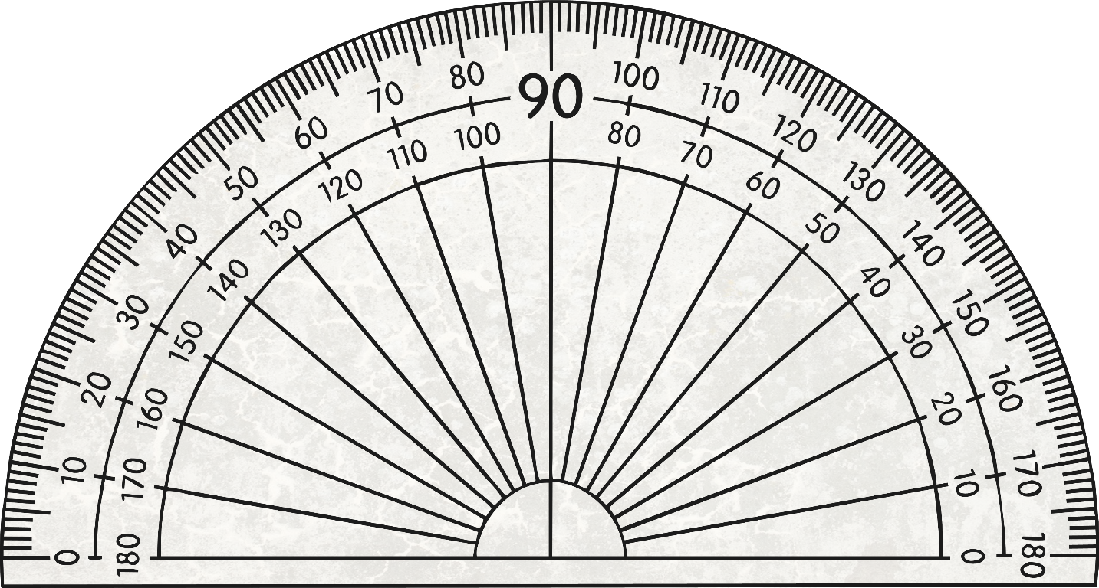
Right Angle
A right angle is 90⁰.

Slide 3
Acute Angle
An acute angle is less than 90⁰.

Slide 4
Obtuse Angle
An obtuse angle is more than 90⁰ and less than 180⁰.

Slide 5
Straight Angle
A straight angle is exactly 180⁰.

Slide 6
What kind of angle is this?
Right
Acute
Obtuse
Straight
Reflex

Slide 7
What kind of angle is this?
Right
Acute
Obtuse
Straight
Reflex

Slide 8
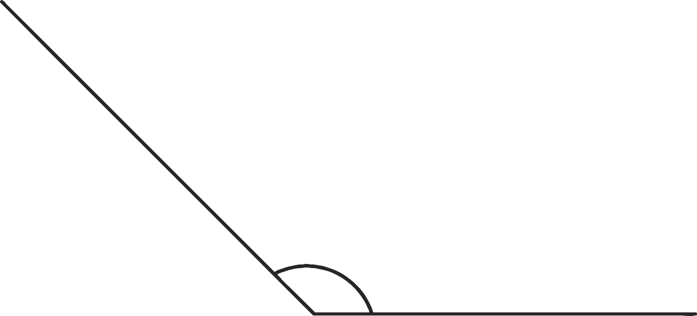
What kind of angle is this?
Right
Acute
Obtuse
Straight
Reflex

