Slide 1
Wednesday 13 May 2020
Bien? Regular? Mal?
https://www.bbc.co.uk/teach/supermovers/ks1--ks2-mfl-spanish-greetings-with-ben-shires/zfksqp3

Slide 2
Writing A Plan for Mrs Grinling
How can we stop the seagulls from eating Mr Grinling’s Lunch?’
Say- Can you think of sandwich filling ideas? Can you think of a way of protecting the sandwiches when they are in the basket? Share your ideas with your family.
Make – Draw detailed pictures/diagrams of your plan.
Write – Write a message to Mrs Grinling to let her know of your new ideas. Remember to use your core targets.
Do – Read your message to your mum or dad, does it make sense? Did you use your core targets?

Slide 3
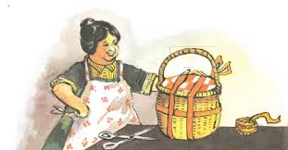
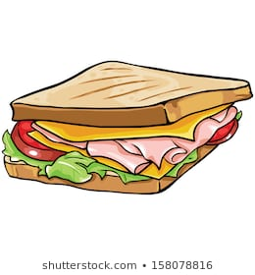
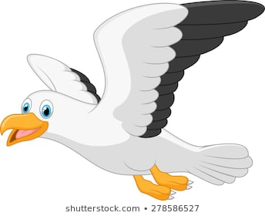
A Plan for Mrs Grinling
Please can you help me? I’ve run out of ideas!
Think, Pair and Share
What fillings could go in the sandwich?
How can we keep the sandwiches safe?
You’ll never stop me!
Now you have thought of some ideas, draw and write them down in your jotter or on the sheet. Thank you.

Slide 5
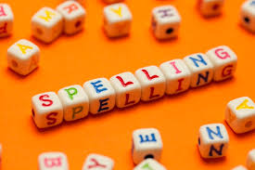
Spelling Words
important
body
music
sitting
running
shutting
wedding
splitting
winning
Here are your spelling words for the week. Choose 3 words each day to practise.
Remember to..
Read the word
Clap the syllables
Use your sound box to sound out the sounds.
Write out the words

Slide 6
Reading Detectives
I can read the sentences
I can find the vowel digraphs, tricky words, and words ending in ‘ing’.
I can up level the sentence to make it more interesting
Move these people over there because they are jamming the entrance to the hall.

Slide 7
Maths and Numeracy
I am learning to add and subtract to 20 and beyond
To explore numbers, understand quantities, use strategies to help me work with numbers I can
Say- count forwards and backwards to and from 50 in 5s, throw and catch a ball with someone as you do it.
Make – Play ‘Duck Shoot’ on www.ictgames.com to help you practice counting up to 100 in 2s, 5s and 10s from any given number.
Write and Do-Play the Equal Groups game (Instructions are on blog page) draw your groups.

Slide 8
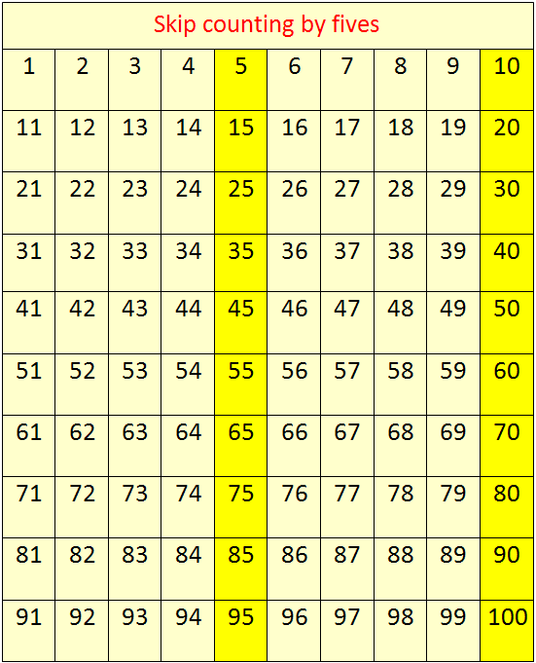
Counting in 5s
Now use the counting in 5s ppt to help you practice counting in 5s

Slide 9
Number Songs
https://www.youtube.com/watch?v=A1Mazc-SsG0

Slide 10
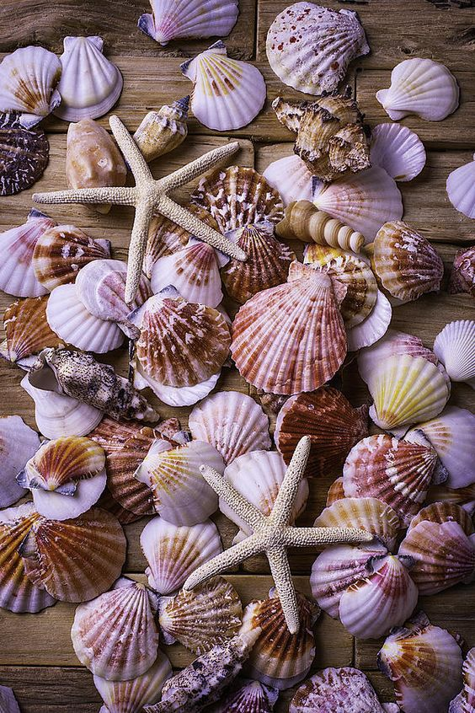
Number Talks
Can you estimate how many shells there are?
How was your estimation? Count them to check. How did you count them? Share your strategies.

Slide 11
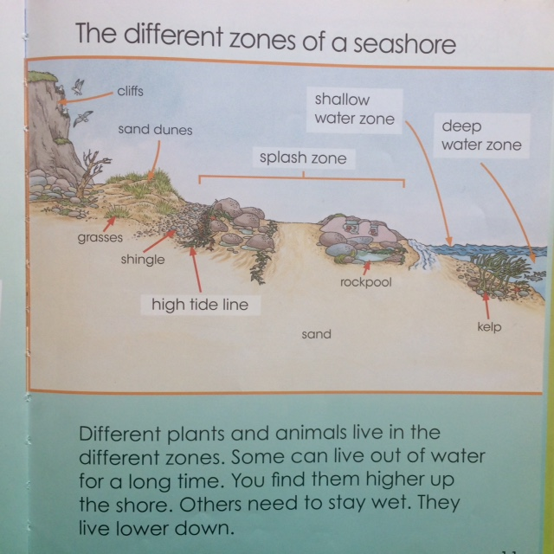
Seashore Zones

Slide 12
Story Time- Under the Sand
Can you name the shells and describe their properties? Which ones are bivalves? Which zone are these creatures in ?
https://www.youtube.com/watch?v=vHdgI1Ep4Dg&feature=youtu.be

Slide 13
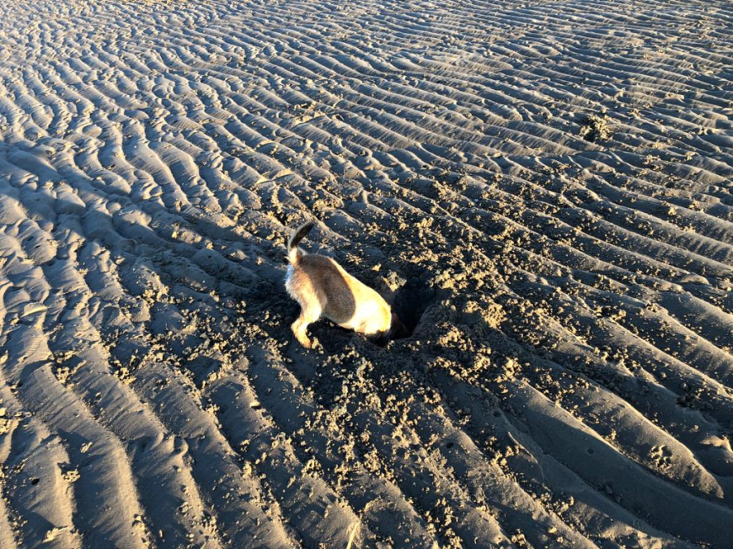
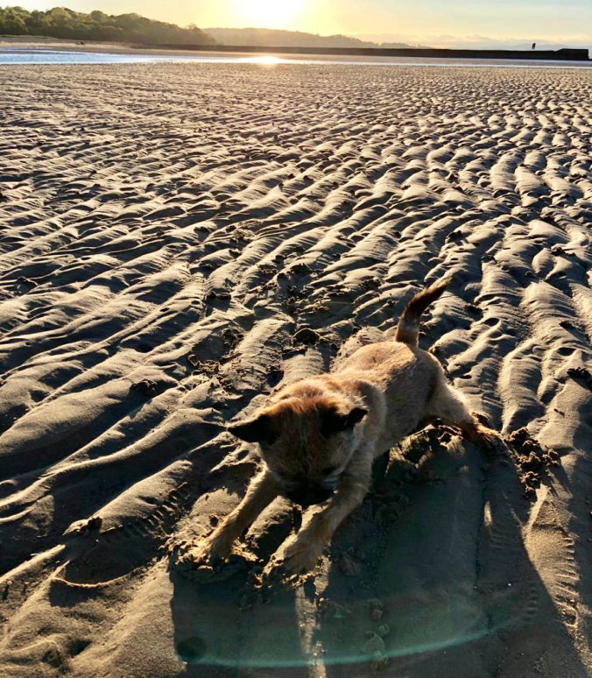
Digging for Molluscs
This is the shallow water zone. The tide is way out. Emma and I continued to look for clues on top of the sand and for molluscs under the sand, but sadly, despite a lot of digging we couldn’t find any molluscs. They must be really well hidden!

