Slide 1
P5 WEEKLY DIARY WEEK COMMENCING Monday 11th April 2020

Slide 2
Dear Primary 5, parents and carers,
Once again thank you for all your efforts and support.
I hope that the lessons last week were useful and as you will see, I have more planned for this week.
As usual, I have divided your tasks into curricular areas.
In literacy, this week you have a character analysis task, this should be completed for next Tuesday 19 May, when we will meet together in our literacy circles. Our comprehension and writing tasks will be based on a poem.
In numeracy, I have included some revision work based on what we did last week. We will be learning and revising how to add using the standard written method. We will also learn about acute and obtuse angles in a triangle.
We have a Spanish sway for you to watch and listen to, a great new Scottish Opera course – starting this Monday 11th. We will also be embarking upon an orienteering course- part 1 beginning this week.
So, lots of exciting activities and I am looking forward to speaking with you very soon.
Kind Regards
Mrs Peters

Slide 3
Online Lessons this week.
Tuesday 12th May 11 am – Mrs Bell
Wednesday 13th May 11.30 am – Acute and Obtuse angles.
Thursday 14th May 11.30 am
Times Tables Quiz
Discussing solutions to the numeracy assignments for last week.

Slide 4
GROUP READING NOVELS
I hope you have been remembering to read aloud. Reading aloud to yourself, family members or even your teddies, really does help you to understand and make sense, of what you are reading.

Slide 5
Literature Circle Task
Character Analysis
You will know the main character in your novel very well by now. This week we are going to learn how to write a character analysis.
A character analysis is when you describe:
When your character appears in the novel
What your character looks like
What your character’s behaviour is like
What happens to your character in the story
What is the main relationship with another character
What does your character learn

Slide 6
I answered the questions below about the main character in Charlotte’s Web – Wilbur.
An example of this is in the Class Blog.
I recommend that you read mine first and then answer the questions below about your own character.
How is the character first introduced by the author?
What happens to this character in the story?
What is his/her relation to the other characters?
How would you describe the physical description of your character.
How does your character speak?
What is your character’s behaviour like?
Find a quote from the novel which backs up your character analysis.
Please come to the Literacy Circle Team Lesson next Tuesday with your Character Analysis questions answered.

Slide 7
Comprehension - Poetry
‘Mrs Mather’, by Colin McNaughton
This is a poem by a well known children’s poet called Colin McNaughton.
In the poem there is a lovely rhyming pattern, but the peom’s real strength lies
In its use of short, powerful lines e.g., Cold sweat.
Read over the poem (twice) - you must read it twice and you must READ ALOUD!
On the worksheet is the poem and the questions – please answer A and B.
Remember to write your answers in sentences where possible.

Slide 8
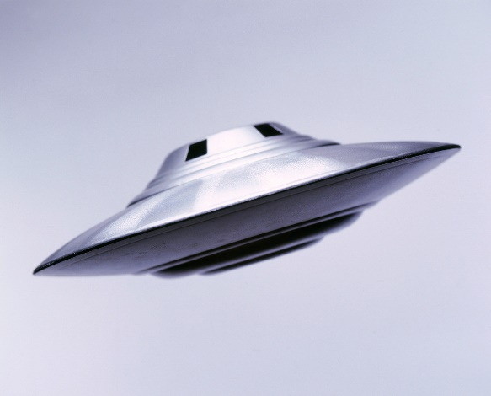
Writing Task
Your task this week is to write your own poem. In the poem ‘Mrs Mather’ the author has used short adjective phrases to describe how scared the boy is feeling, scared stiff, thumping heart. He has used adjectives in every phrase. In your poem you must use adjectives in every line.
Imagine you wake up in the middle of the night and see an alien spacecraft hovering outside
your bedroom window. The door of the spacecraft is opening slowly….
Write a poem about how you feel, using short phrases as in the ‘Mrs Mather’ poem.
Aim to have at lease 3 verses and at least 4 lines in each verse.

Slide 9
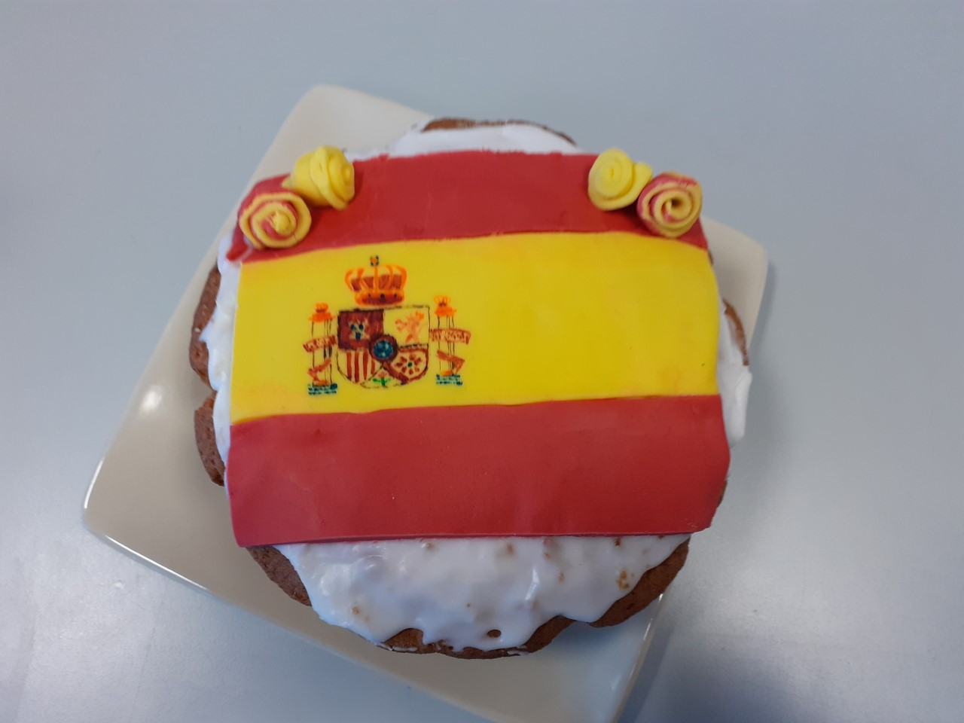
LANGUAGES –SPANISH
Below is the link to a sway about all things Spanish. You will really enjoy this
because you will recognise some of the Spanish words and there are lots of interesting
facts about Spain. At the end of the sway there is a bedtime story –The Three Little Pigs-
read to you in Spanish.
https://sway.office.com/xlsRkYYWwouqDTAr?ref=email

Slide 10
EXPRESSIVE ARTS - MUSIC
OPERA – BE PART OF A BRAND NEW OPERA CALLED ‘FEVER’
This is a new online course run by Scottish Opera – they want you to help to bring this opera to life!
Some people think opera is only about things that happened a long time ago. Well, this opera is all about a young boy who is struck down by a mystery illness and rushed to hospital. Sound familiar? Outside, the paparazzi demand answers. What is this disease? How is it transmitted and how can it be cured? But the busy medics have no time to talk; they need to get on with finding a vaccine.
Meanwhile, an epic battle is taking place inside the boy’s body as the opposing forces of Good and Bad Bacteria fight to gain control of his immune system… Will he find the strength to overcome his internal enemy? Will the medics find a cure? And will the media folks make it all up anyway, just to get a good headline?
You can join us in making this funny and fast moving story come to life. You'll find out all about infections and viruses and how your body fights them. You'll also find out about Fake News and why it’s so important to understand that not everything you read on the internet is true…
Short videos that tell the story of Fever! • Lyrics and teaching guides for pupils to practise each of 5 songs • Videos that help teach the accompanying choreography • A Curriculum for Excellence-based creative writing and science activities • Tips to make simple props and costumes
All this preparation will culminate in a nationwide virtual performance at the end of June - look out for more details coming soon!
To get stuck in, go to www.scottishopera.org.uk/fever from Monday 11 May to find all you need to get started. Further resources for Song 1 will be posted on Monday 18 May.

Slide 11
NUMERACY
Check out Assignments in Teams for Numeracy Challenges!
Everyone please remember to practise your multiplication tables. We will do a wee quiz on Thursday of this week.

Slide 12
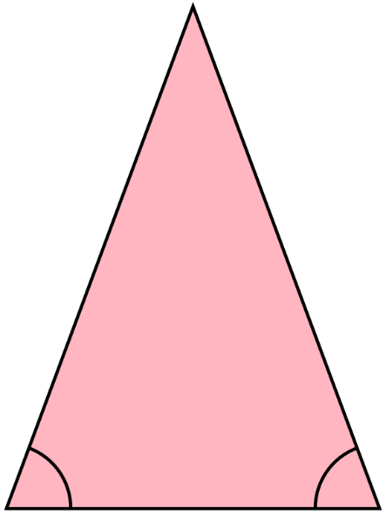
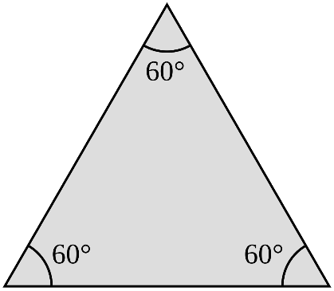
H5 page 104 - Revision A triangle is a 2D shape and it has 3 sides. An isosceles triangle has only 2 equal sides, an equilateral triangle has 3 equal sides and a scalene triangle’s sides are all different lengths. LI – I can identify an equilateral triangle and an isosceles triangle by the length of their sides. I am learning about the properties of a triangle.

Slide 13
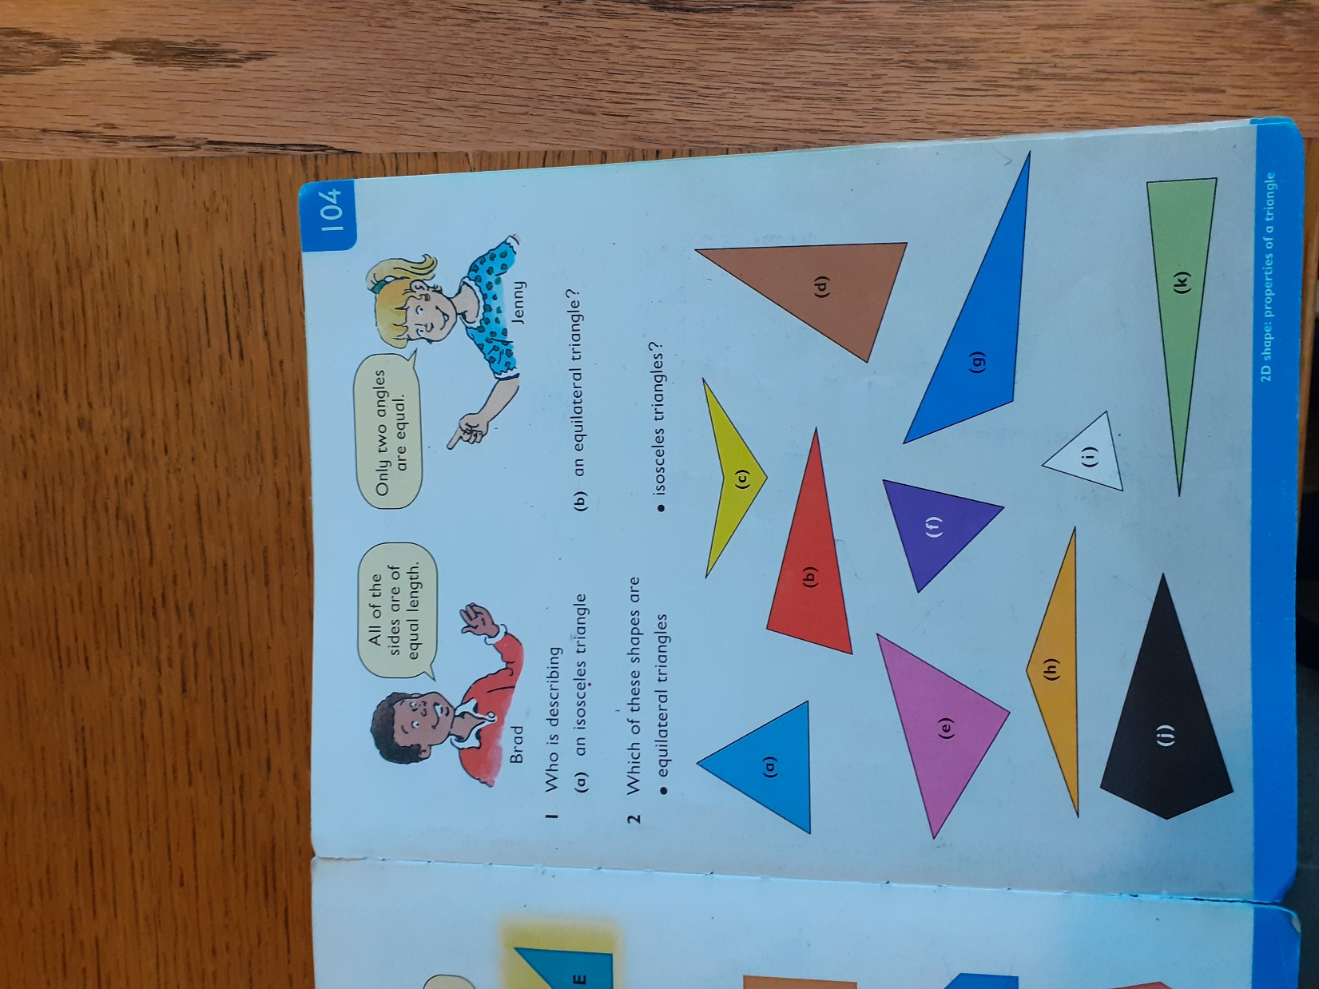

Slide 14
NUMERACY ASSIGNMENT
There are 100 centimetres in 1 metre.
100 cm = 1m
Can you explain how to change:
a. 8 metres into centimetres b. 200 centimetres into metres
2. Can you find out how many of each of these there are?
years in a decade decades in a century centuries in a millennium
Can you find a pattern of rule that connects these?
3. Pablo has to multiply 15 x 100. He believes that this is the same as
15 x 10 x 10. Is he correct? Can you explain?

Slide 15
Since you have been in P5 you have learned many new addition strategies. The one strategy we have not spent time on, is what we call the standard written method. Some people call this method – chimney sums or up and down sums too!
Some of you use this strategy already and if that is the case then you can jump straight to the H5 pages for your group. Still do the worksheets as this is good practice!
I can add 3 digit numbers using the standard written method.

Slide 16
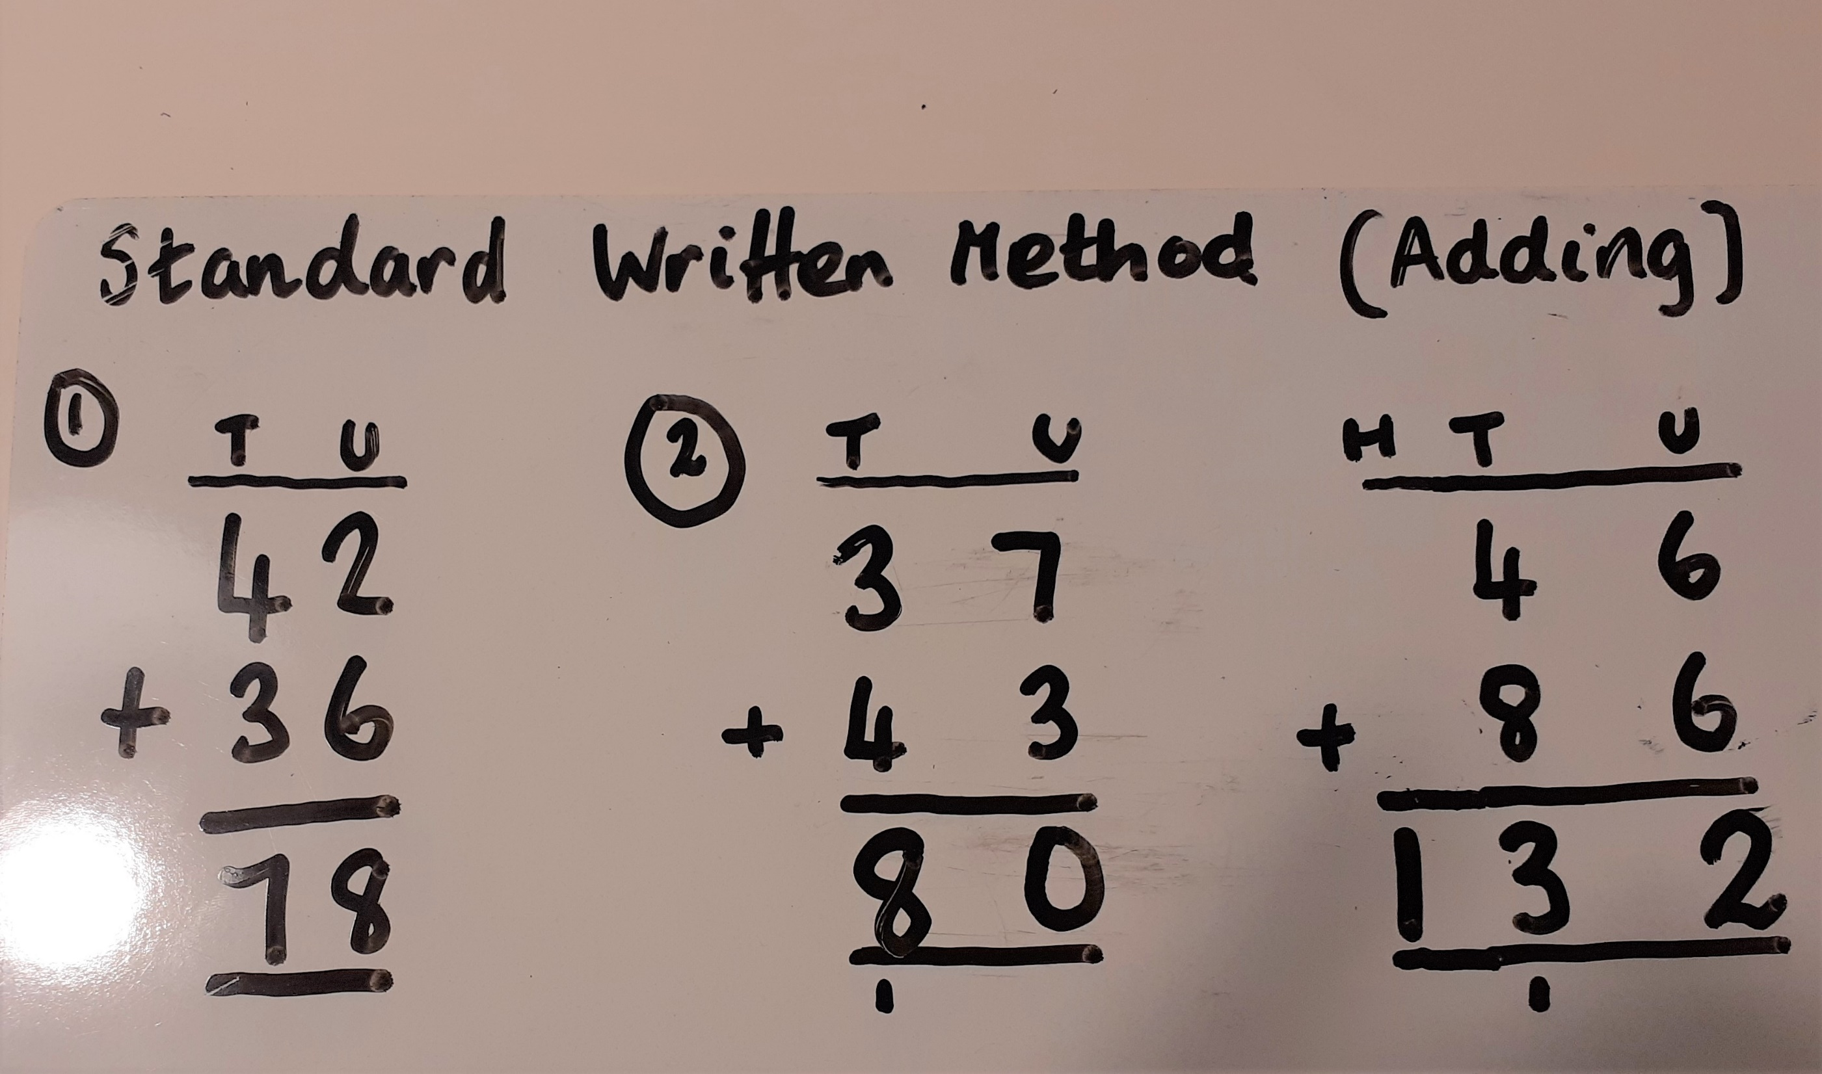

Slide 17
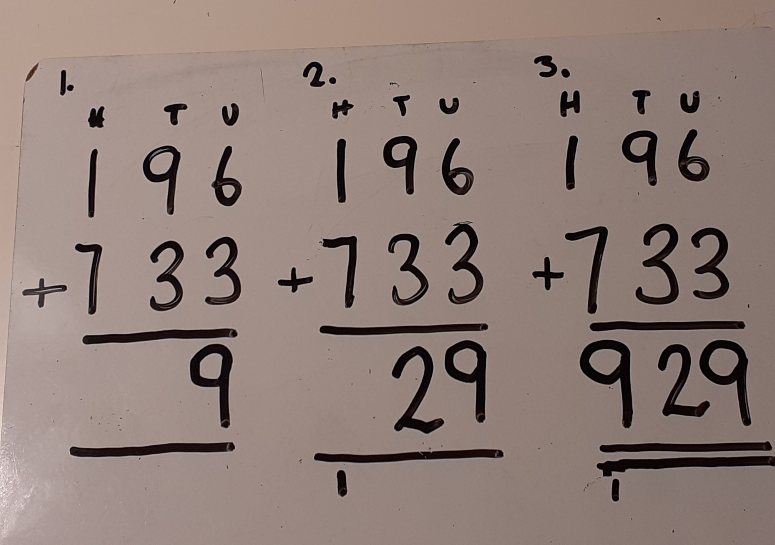

Slide 18
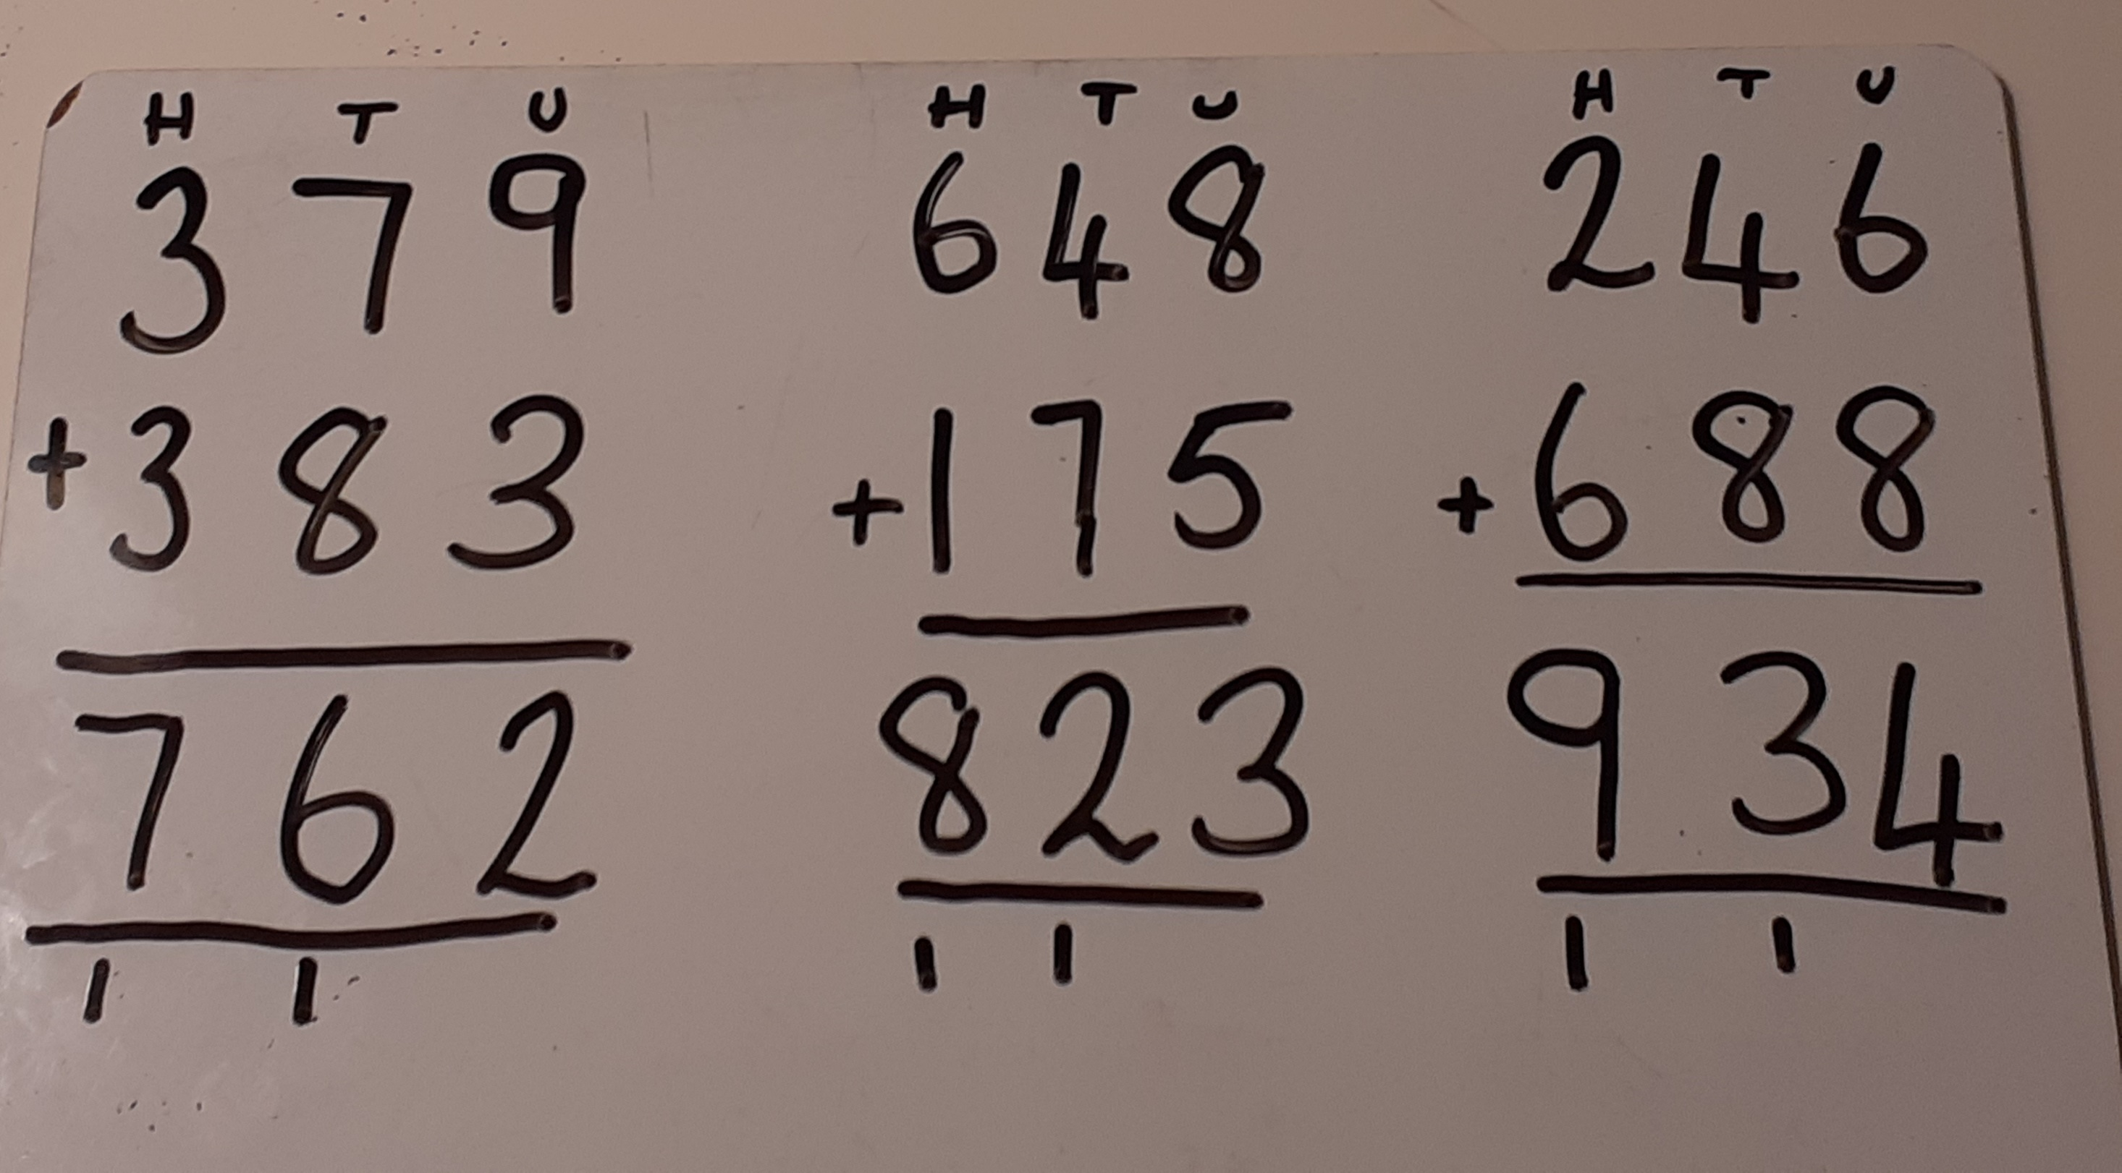

Slide 19
Bees –pages 10, 11 and 12
Optional – 3 digit by 3 digit worksheets in Class Blog
Butterflies and Beetles
Pages 19, 20
3 digit by 3 digit worksheets on Class Blog
If you can, please use squared paper and give each digit its own box.
All answer pages will be in next week’s slides.

Slide 20
The next 3 slides are for the BEES only. Please skip these slides if you are a Beetle or a Butterfly.

Slide 21
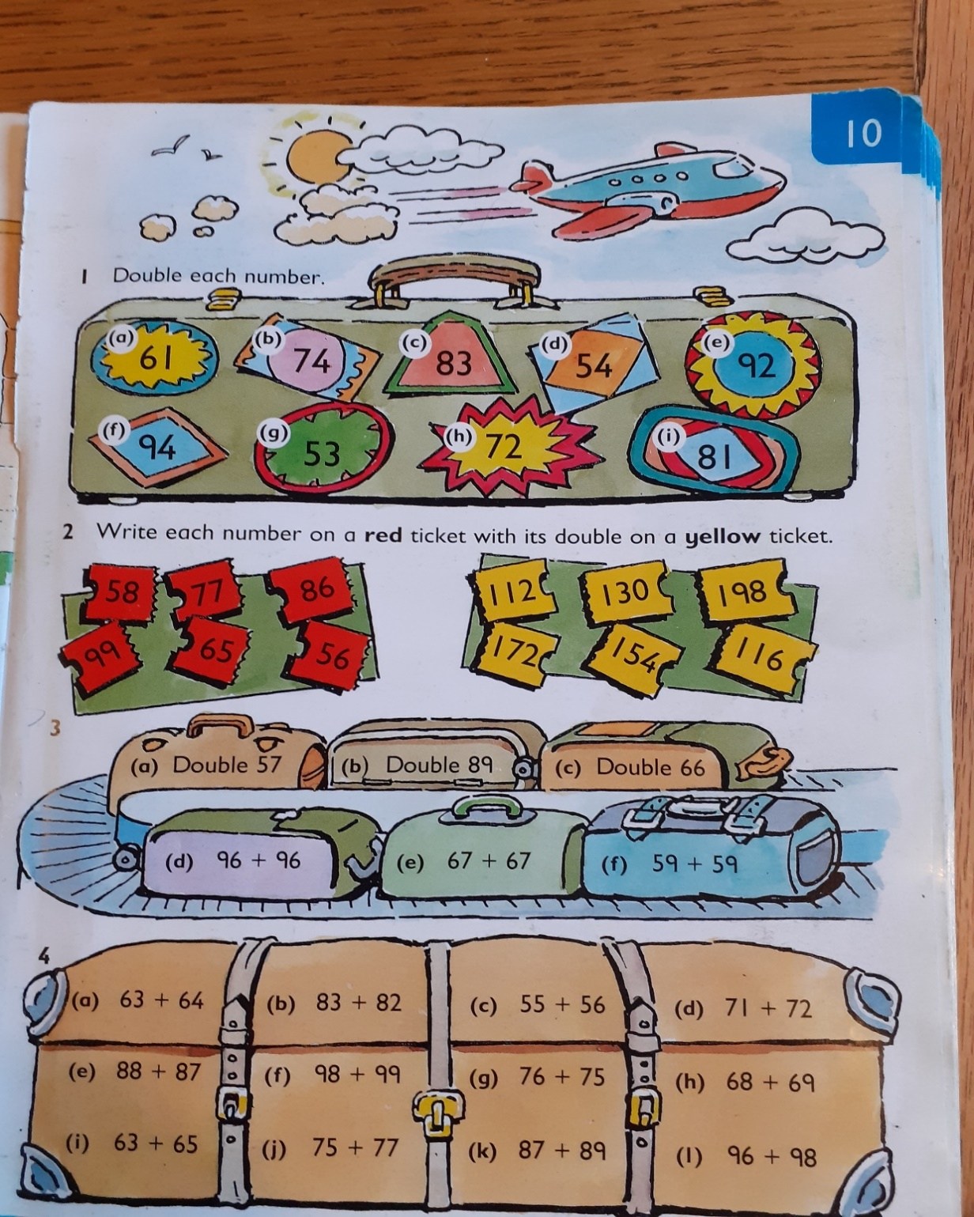
Bees
1a. 61 + 61 =
61
+61

Slide 22
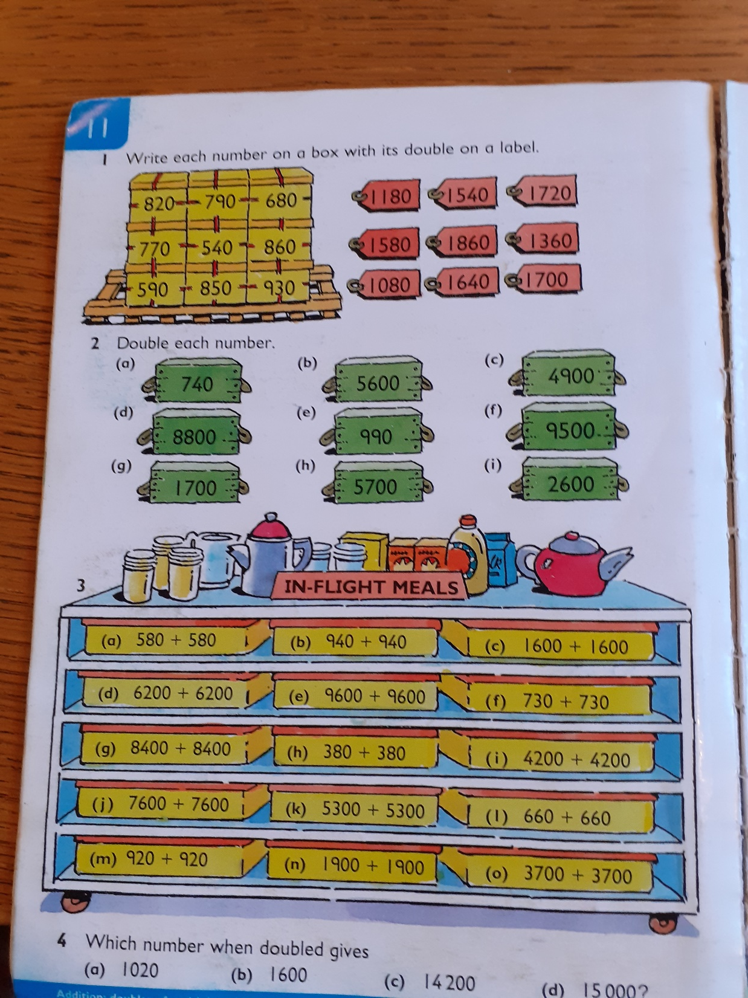
Bees

Slide 23
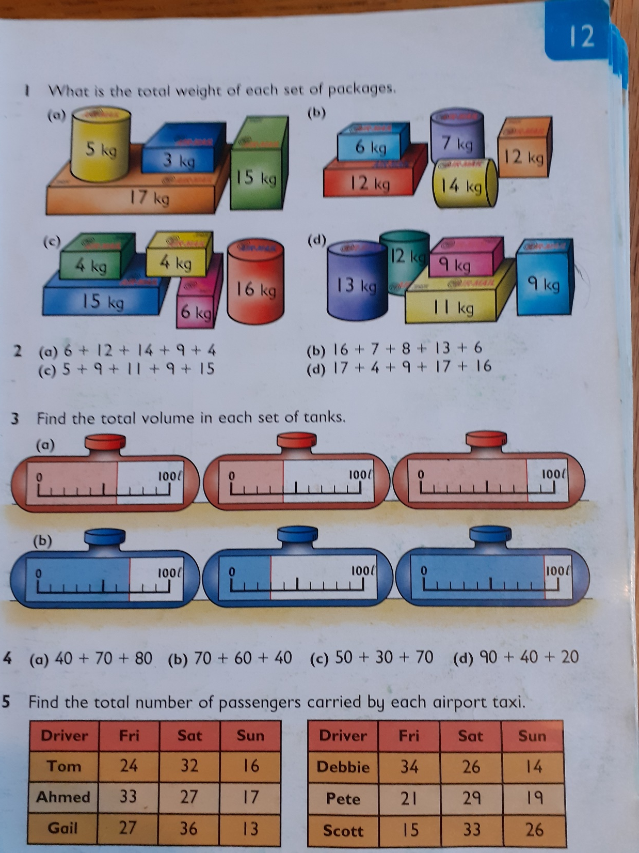
Bees
6 +12 + 14 + 9 +4 =
6 + 4 = 10
12 + 14 = 26
26 + 10 = 36
36 + 9 = 45

Slide 24
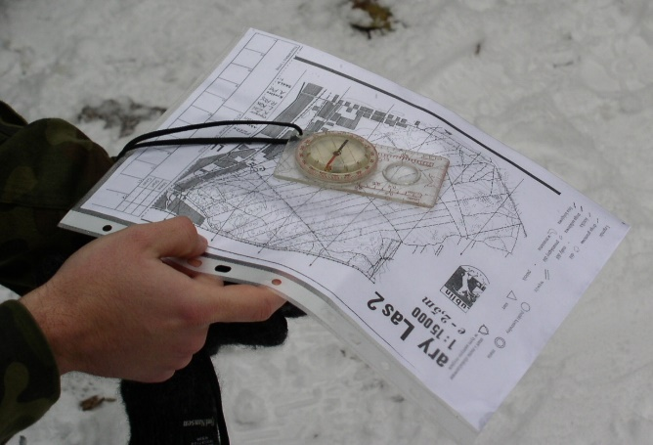
ORIENTEERING
Part 1: The Map
The 1st topic introduces the concepts of maps and challenges you to create your own maps of your home or garden.
https://www.scottish-orienteering.org/lets-get-started-orienteering/
Watch part 1 of the Orienteering video. Remember you made a plan of your ideal garden last week,
This week you will draw a plan of your actual garden or a floor of your house.
There are two worksheets to help you with this task – they are both in the P5 Blog.

Slide 25
HEALTH AND WELLBEING
PHYSICAL EDUCATION
If you are still doing the Joe Wickes training sessions, great! If you want to try some new fitness routines, try the links below.
Cosmic Kids Yoga
https://www.youtube.com/user/CosmicKidsYoga
Oti Mabuse & Marius Lepure Online Dance Class
https://www.youtube.com/user/mosetsanagape/videos
Zumba Kids on Go Noodle
https://app.gonoodle.com/channels/zumba-kids

Slide 26
MINDFULNESS
If you are feeling a little worried and anxious, this is a five-minute video teaching you how breathing can help you to relax. Try doing it every day (at any time), lying down or sitting crossed legged, the more you practise the more you will feel the benefits.
https://www.youtube.com/watch?v=CvF9AEe-ozc

Slide 27
Reminders..
Remember that you can use the booklets and worksheets you took home.
We understand that you may not always have access to a device so just do what you can.
If you don’t have squared paper – just use any paper you have around the house.
Remember to share links to any learning videos you think are useful.
We have boxes in Sainsburys full of jotters and school things – let your parents know – I believe there squared paper jotters.

Slide 28
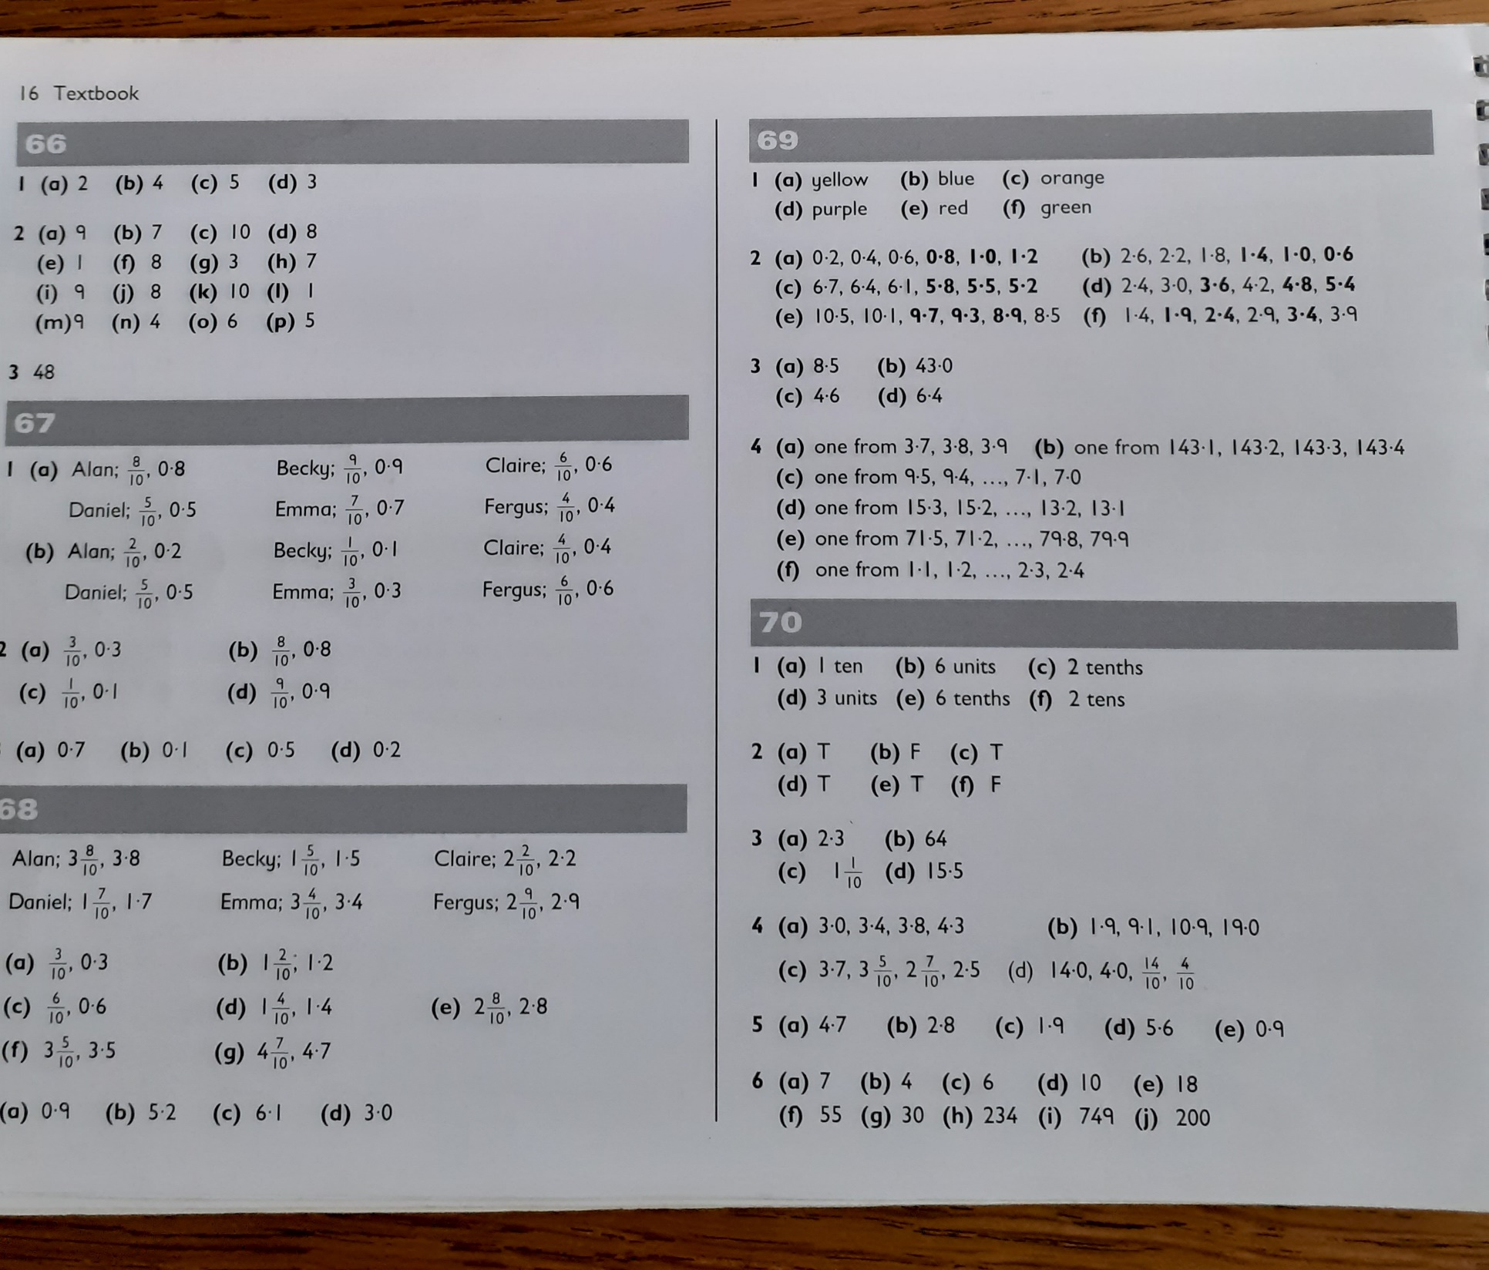
ANSWERS FOR H5 PAGES
YOU HAVE COMPLETED.

