Slide 1
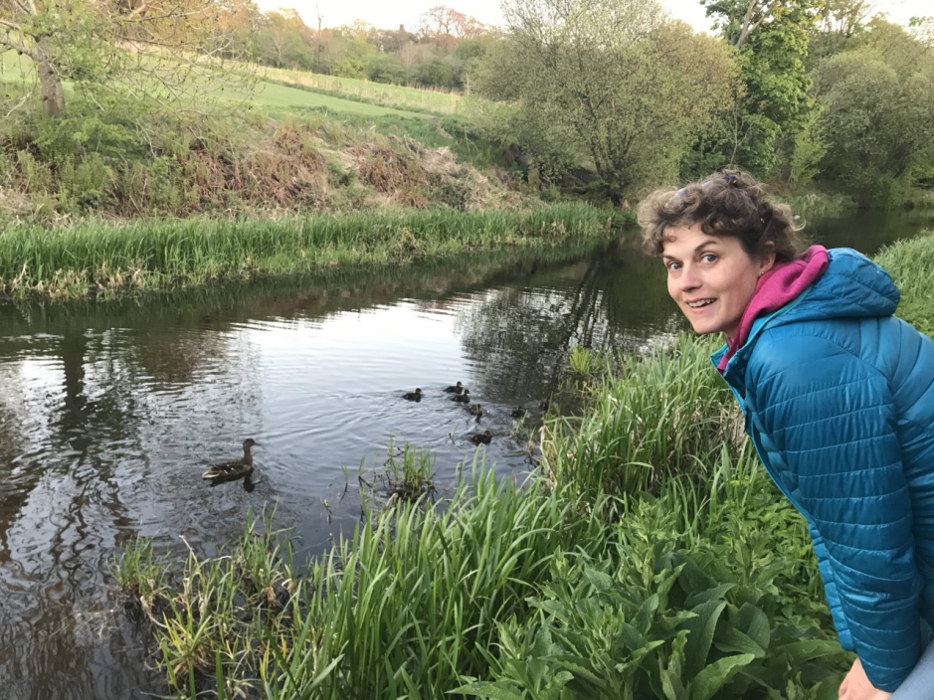
HWB at home – 6 May Spring Hunt
Good Morning!
Have you been seeing ‘spring’ things when your are outside?

Slide 2
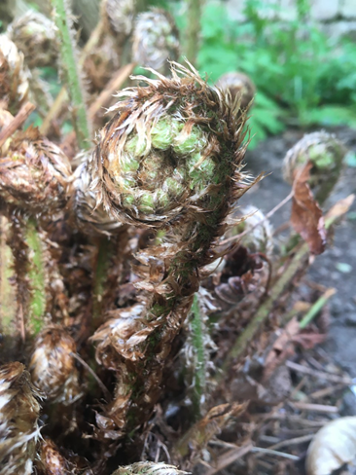
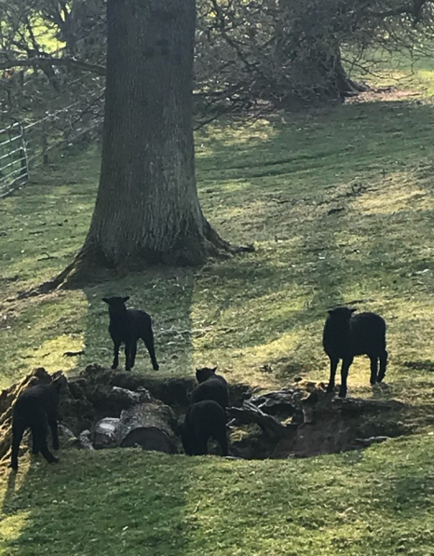
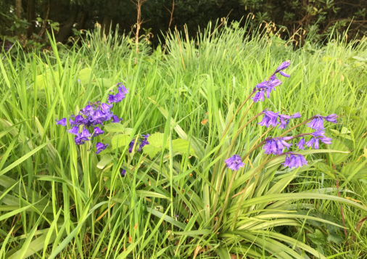
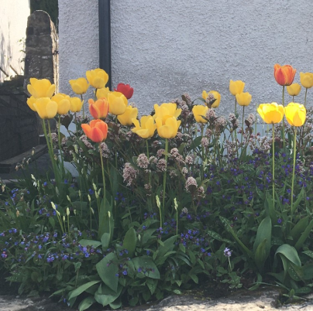
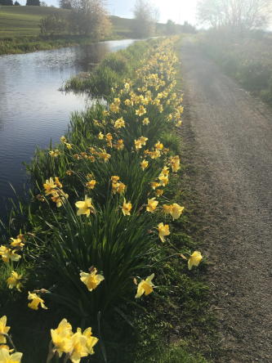
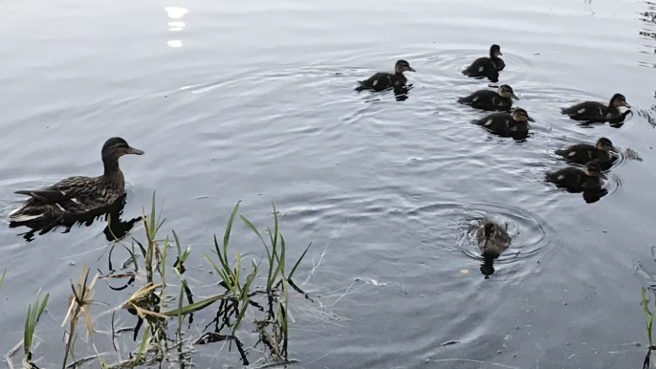
Mrs Bell’s Spring Hunt Look at these pictures from my walks. What would you not see in autumn or winter?

Slide 3
Did you spot :
Tree blossom
Lambs
Bluebells
Ducklings
Tulips
Daffodils
Tadpoles – Did you see them wriggling!
A curled up fern leaf from my garden.

Slide 4
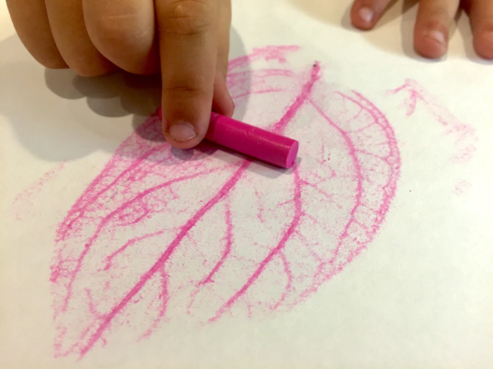
Leaf Rubbing
There are so many beautiful leaf shapes.
You will need:
Place your leaf on one side of the paper
Fold the paper over the leaf
Use the crayon to rub across the top of the paper.
Can you see the leaf shape?
Use your other leaf and make a picture of leaves.
2 leaves,
2 wax crayons,
a sheet of paper

