Slide 1
Friday 1 May 2020 Bonjour P2! Ca va bien? Comme ci comme ca? Ca va mal? https://www.bbc.co.uk/teach/supermovers/ks1--ks2-mfl-french-greetings-with-ben-shires/zdpdvk7

Slide 2
Assembly
Goodbye April, hello May!
Please enjoy this week’s assembly. It’s all about staying fit and healthy.
https://sway.office.com/iJDg1T8VBccG9rVg?ref=Link
Have a lovely long holiday weekend. I look forward to speaking to you again on Wednesday.

Slide 3
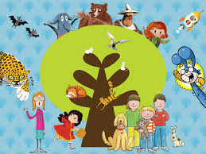
Reading Books
To make it easier to select books from oxford owl, I have set up a class password. Click on the link and enter the login details then choose a book that is suitable for the age and stage of your child.
https://www.oxfordowl.co.uk/
Username: p2 lbps Password: Marshall

Slide 4
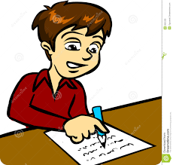
Dictation
Most of the house plants are looking very good but these tall ones are drooping.
The boat was rocking from side to side in the storm but the captain and the mate got it safely to shore.
My cat has been clawing at the couch but he has done it little harm.
Remember to –
Choose one sentence
Read the sentence aloud
Ask your child to repeat the sentence
Ask some questions to ensure understanding
Ask them to write the sentence 3 words at a time

Slide 5
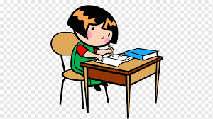
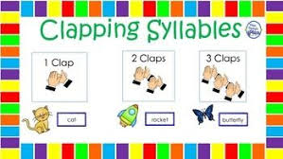
Spelling Words
Time for your spelling test.
I can use my spelling strategies to help me spell my words.
paper
these
together
cooking
chewing
boiling
drawing
joining
crawling

Slide 6
Number Talks
How many ways can you make the number 16?
Can you add, subtract and group objects?
Target Number
16

Slide 7
Friday Super Movers https://www.bbc.co.uk/teach/supermovers/ks2-pshe-teamwork-with-the-super-movers-crew/zkpdvk7

Slide 8
Big Talk
The saying goes, if the children can’t say it, the children can’t write it.
Every Friday (in place of ‘show and tell’) there will be a topic to talk about as a family. Please encourage your child to use interesting vocabulary, to speak in full sentences, to use eye contact. Thank you.
‘If you had one wish, what would it be? Why?

