Slide 1



Wednesday 29 April 2020
Bien?
Regular?
Mal?
https://www.bbc.co.uk/teach/supermovers/ks1--ks2-mfl-spanish-greetings-with-ben-shires/zfksqp3

Slide 2
The Lighthouse Keeper’s Lunch
To help me communicate effectively in and out of school, I will-
Say- listen carefully to the story of the Lighthouse Keeper’s Lunch. Discuss where the story took place, describe Mr Grinling and explain what happened at the beginning middle and end of the story.
Make – Use your the planning sheet or jotter to draw detailed pictures of the setting, Mr Grinling and something that happened at the beginning, middle and end.
Write – a description about Mr Grinling, remember to include what he looks like, where he lives, what his job is and anything else you can think of. (Don’t forget to use your core targets)
Do – Read your description to your mum or dad, does it make sense? Did you use your core targets?

Slide 3
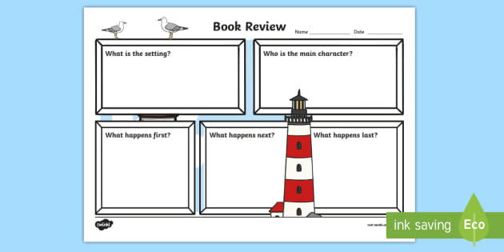
The Lighthouse Keeper’s Lunch
I can draw detailed pictures to describe what happens in the story.

Slide 4

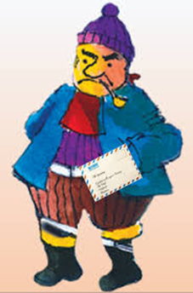
Mr Grinling
I can think of words to describe Mr Grinling?

Slide 5
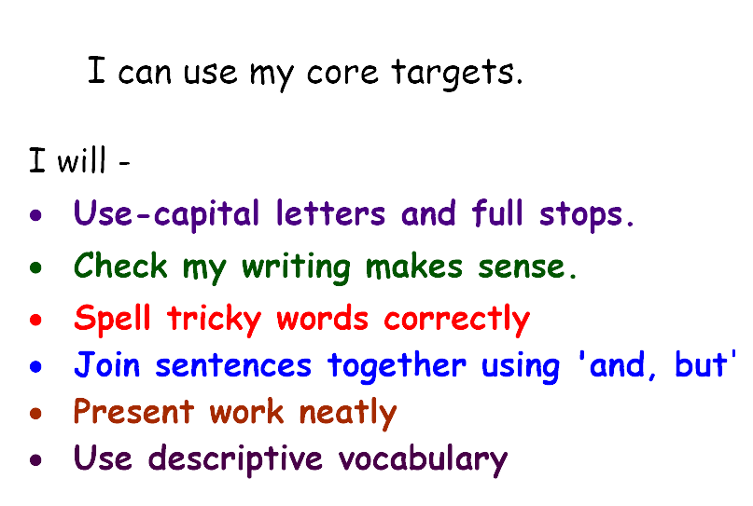

Slide 6
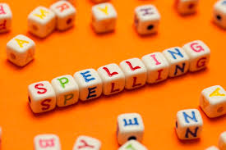
Spelling Words
Here are your spelling words for the week. Choose 3 words each day to practise.
Remember to..
Read the word
Clap the syllables
Use your sound box to sound out the sounds.
Write out the words
paper
these
together
cooking
chewing
boiling
drawing
joining
crawling
I have added the spelling activity sheet to the blog page

Slide 7
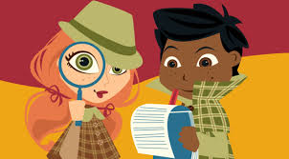
Reading Detectives
I can read the sentences
I can find the vowel digraphs, tricky words, and words ending in ‘ing’.
I can up level the sentence to make it more interesting
These are paintings of the countryside but there are some of the town over there.

Slide 8
Maths and Numeracy
I am learning to add and subtract to 20 and beyond
To explore numbers, understand quantities, use strategies to help me work with numbers I can
Say- count forwards and backwards to and from 100 in 2s, throw and catch a ball with someone as you do it.
Make – Play ‘Duck Shoot’ on www.ictgames.com to help you practice counting up to 100 in 2s, 5s and 10s from any given number.
Write-Complete the ‘grouping’ number sheet’.
Do-Can you make groups of 5 objects, (could be shells/stones/sticks). How many groups? How many altogether?

Slide 9
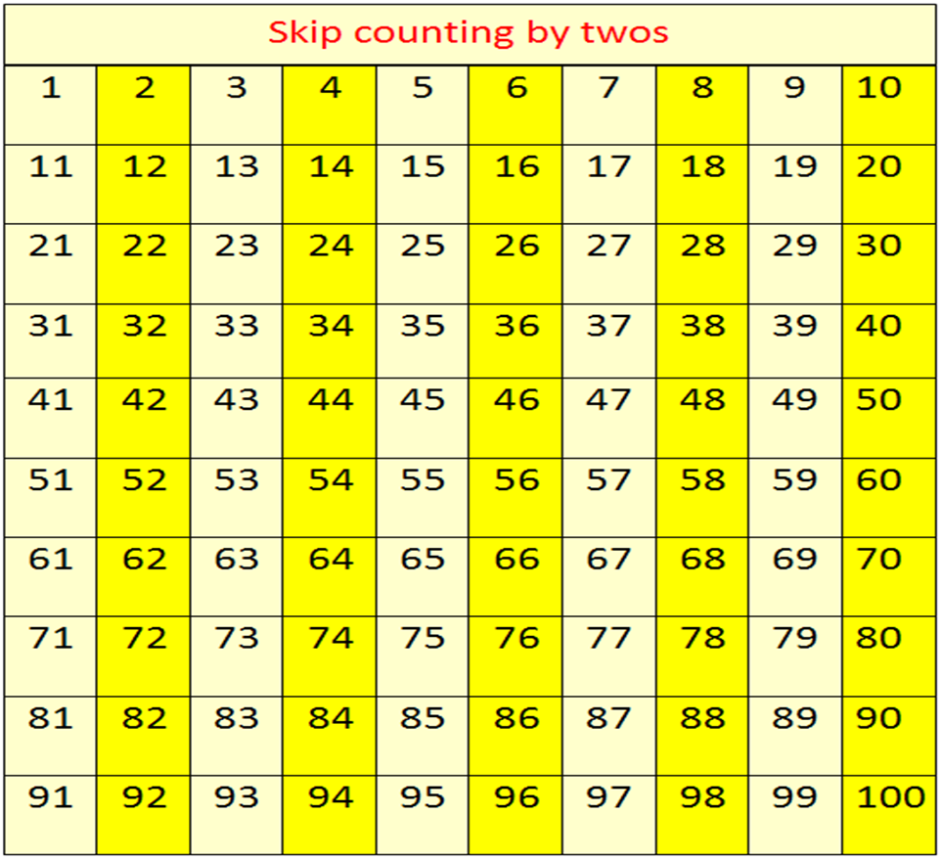
Counting in 2s

Slide 10

Making Equal Groups
I can make 3 groups of ten.
How many birds are there altogether?
There are _____ birds in each tree.
There are _____ trees.
There are _____ birds altogether.
How can we use the 100 square to help us?
10 + 10 + 10

Slide 11
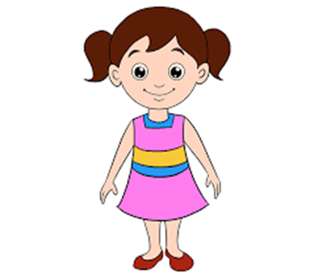
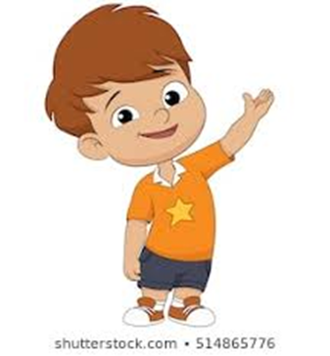
Making Equal Groups
I have made equal groups.
Rosie and Timmy are making hay bundles.
I have made equal groups.
Who has made equal groups? Explain how you know?

Slide 12

Number Talks
https://www.youtube.com/watch?v=A1Mazc-SsG0

Slide 13
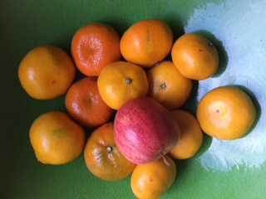
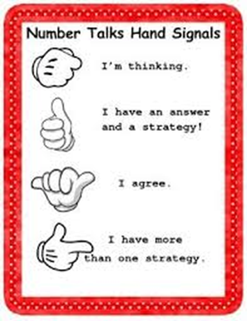
Number talks
Have a look at this bowl of oranges. Can you estimate how many are in the bowl?

Slide 14
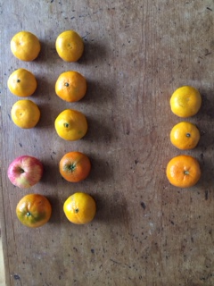
Number Talks
How was your estimation? Count them to check. How did you count them? Share your strategies.

Slide 15
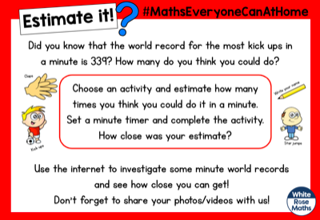
Estimate It!

Slide 16
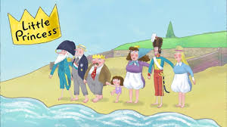
Story Time
I can listen to the story, make predictions and learn new vocabulary.
https://www.youtube.com/watch?v=URU_xUt5_HY

