Slide 1
Tuesday 28th of April Mardi 28 Avril
Good Morning Primary 1!
Bonjour la class!
https://www.youtube.com/watch?v=Lpwf5N0rfVE
Listen to the days of the week in French.
Click on the rainbow to listen to our Tuesday song.

Slide 2
P.E with Johnny
https://youtu.be/IDuWSTyM8RA
Click on the photo below to try out some challenges with Jump start Jonny.

Slide 3
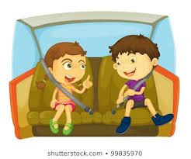
Sounds
I can use knowledge of sounds, letters and patterns to read words.
read
meal
teach
seat
Jolly Phonics songs - https://vimeo.com/106231366
sound out out words containing the ‘ea’ sound
using our ‘sound-box’

Slide 4
Revison Tricky Words Block 2
go we be
she are they
all some come
said one you

Slide 5
Sentence of the day
I can use knowledge of sounds, letters and patterns to read words.
It is a hot day we can all play in the sun.
Can you spot the tricky words?
How many did you find?

Slide 6
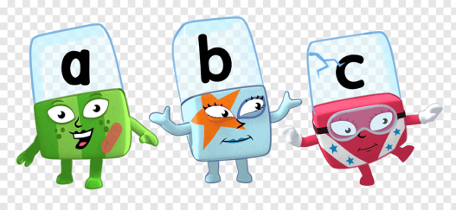
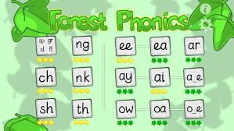
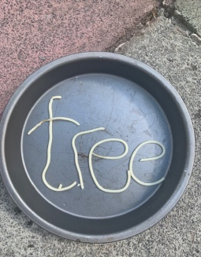
Phonics Activities
Click on the picture to watch an episode of alphablocks.
Activity
Spelling – choose an active spelling task to complete from the grid on the blog/website to spell 4 ee/ea words.
ICT – Forest Phonics ‘ea’ word building.
Letter formation – practise making the ‘ee/ea’ sound
Choose one of the following ways or choose your own way:
playdough
paint brush and water,
spaghetti
sensory bag (ziplock bag) with shaving foam

Slide 7
Story Time
Click on the picture below to listen to the story.
https://youtu.be/7bzey7HMWTk

Slide 8
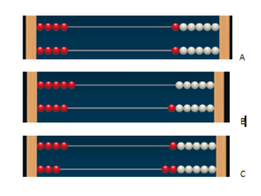
Maths Number Talks
Once you have an answer, draw and/or write down the way you worked it out take a picture and send it back so that we can see how you solved it.
Example -
How many beads do you see?
How do you see them?
Draw the rekenrek pattern and show
your thinking.

Slide 9
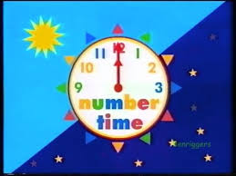
Number Rhyme Time

Slide 10
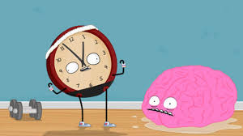
Time
I can tell the time in o clock and half past .
Click on the picture to help brain to tell the time in o clock and half past the hour.
I can tell the time in o clock on an analogue clock.

Slide 11
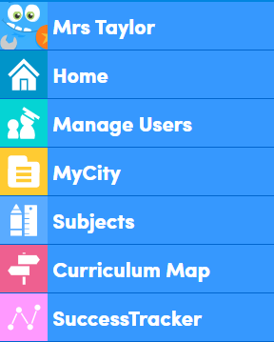
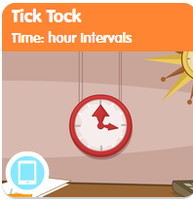
Education City
https://go.educationcity.com/subjects
Login to the above website and sign in using the username and password issued.
Click on Subjects on the left hand side then numeracy.
Click on early *** and activities
Scroll down to ‘Tick Tock, Time hour intervals’
Complete the Tick Tock activity sheet, download from the blog or website.

Slide 12
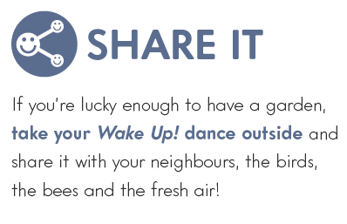
‘Wake Up’
Music Time
I enjoy singing along to music of different styles.
‘
Click on the ‘Out of the Ark Music’ link to hear today’s song ‘Wake Up’ (week 5)
I can partcipate activiely and use my voice to join in with the song.

