Slide 1
Thursday 2^{3rd} April
Good Morning Primary 1!
Hola mi clase!
https://www.bbc.co.uk/cbeebies/watch/presenters-daysoftheweekthursday

Slide 2
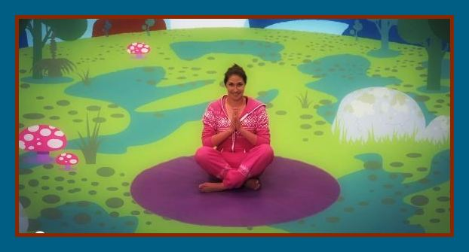
P.E with Jamie
P.E. with Cosmic Kids Yoga – Enzo the Bee
https://youtu.be/uyj5LooYWyg

Slide 3
Revision Tricky Words Block 2
go we be
she are they
all some come
said one you

Slide 4
Tricky Word Dictation
I can make an attempt to spell familiar words correctly.
her
of
one
said
all
Are my letters formed correctly?
Are my letters in the correct order?
CHALLENGE - Write a sentence using one of the Tricky Words above.
Ask an adult to read out these tricky words.
Can you spell them correctly?

Slide 5
Super Sentence
I can write a super sentence for a word containing the ai/ay sound.
Look out for this sound in books you have at home.
Visit the links below for ideas of ai/ay words.
https://youtu.be/K-vehzhMSEg
https://youtu.be/MTCP8i4Nwgc
finger spaces
full stop
Capital letter
Use a connective * challenge
Write your super sentence in your jotter. Draw a picture first to help you plan your sentence.

Slide 6
Story Time
https://youtu.be/UmrUV8v-KQg

Slide 7
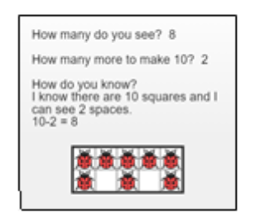
Maths Number Talks
Once you have an answer, draw and/or write down the way you worked it out take a picture and send it back so that we can see how you solved it.
Example -
How many do you see?
How many more to make 10?
How do you know?

Slide 8
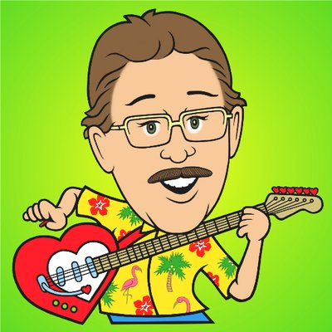
Number Rhyme Time
I can participate actively in songs, rhymes and stories.
https://youtu.be/omkuE6Wa5kQ

Slide 9
Months of the Year
I can name the months of the year and talk about the four seasons.
I can name the months of the year in order.

Slide 10
Months of the Year
I can name the months of the year and talk about the four seasons.
I can use a calendar to find information.

Slide 11
Months of the Year
I can name the months of the year and talk about the four seasons.
I can use a calendar to find information.

Slide 12
Maths Activities
Please download the activity below from the P1 section of the school website or blog.

Slide 13
HWB
I can share ideas in pictures and print.
Please listen to the story, on the following slides and then write in your jotter what you are looking forward to doing most, when lockdown is finished.
finger spaces
full stop
Capital letter
Use a connective * challenge

Slide 14
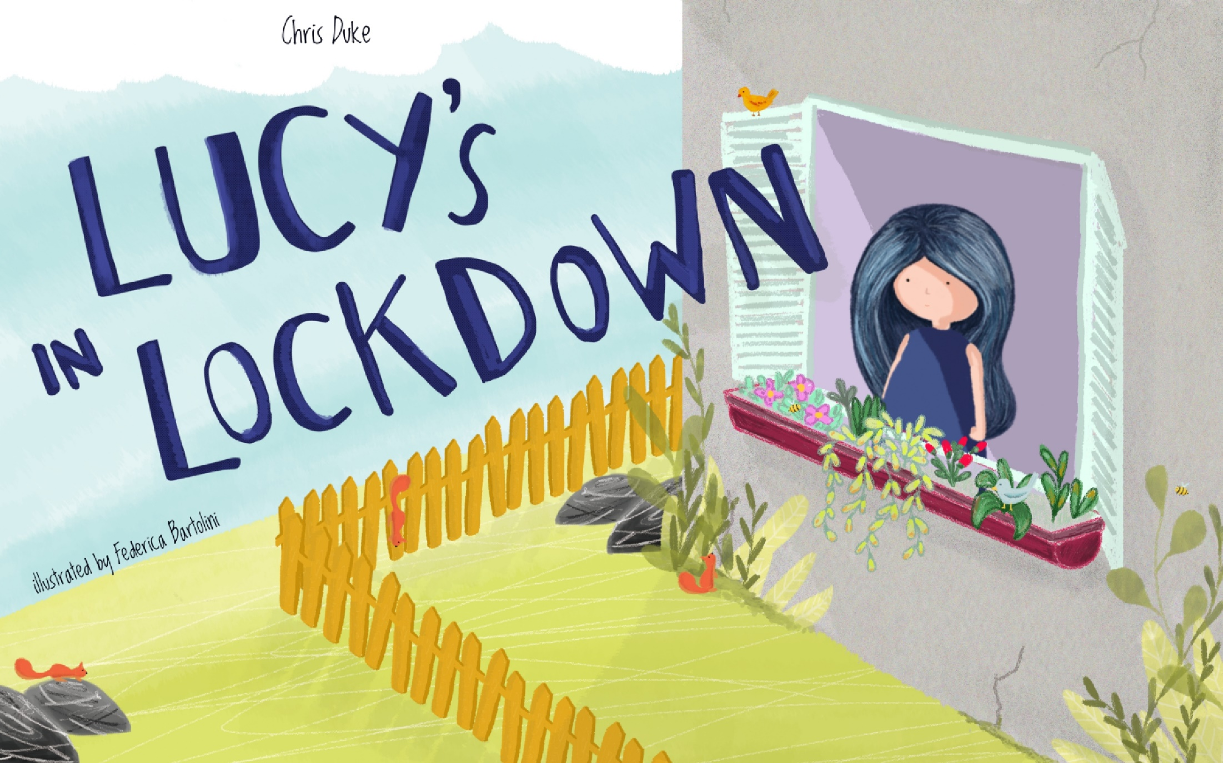

Slide 15
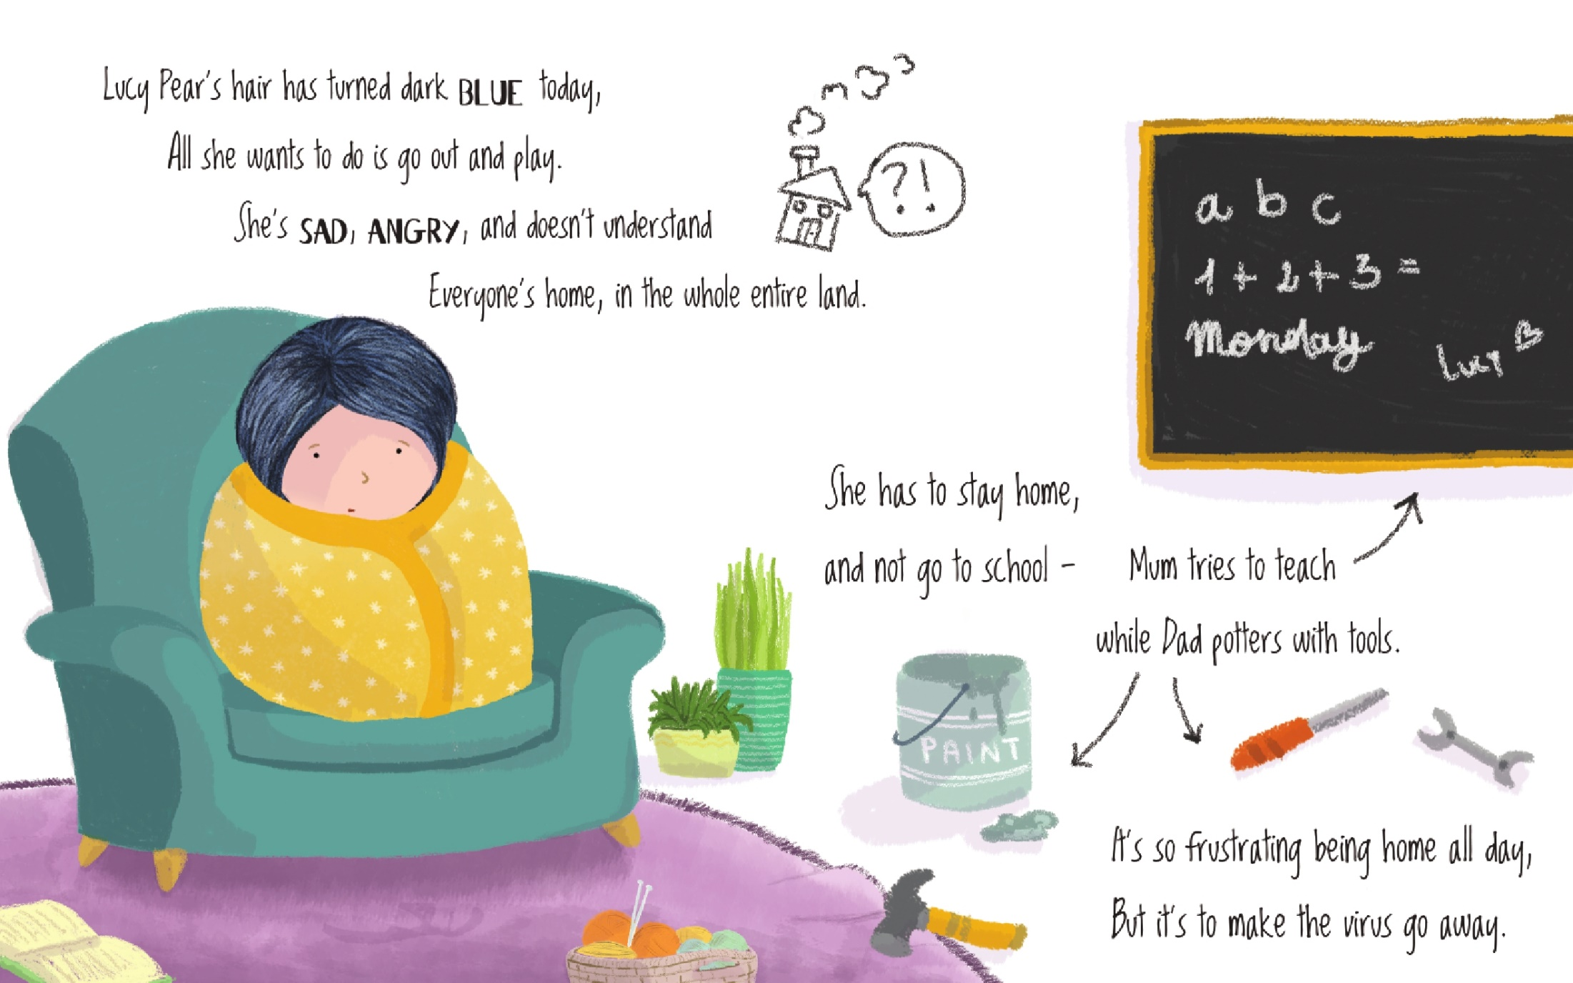

Slide 16
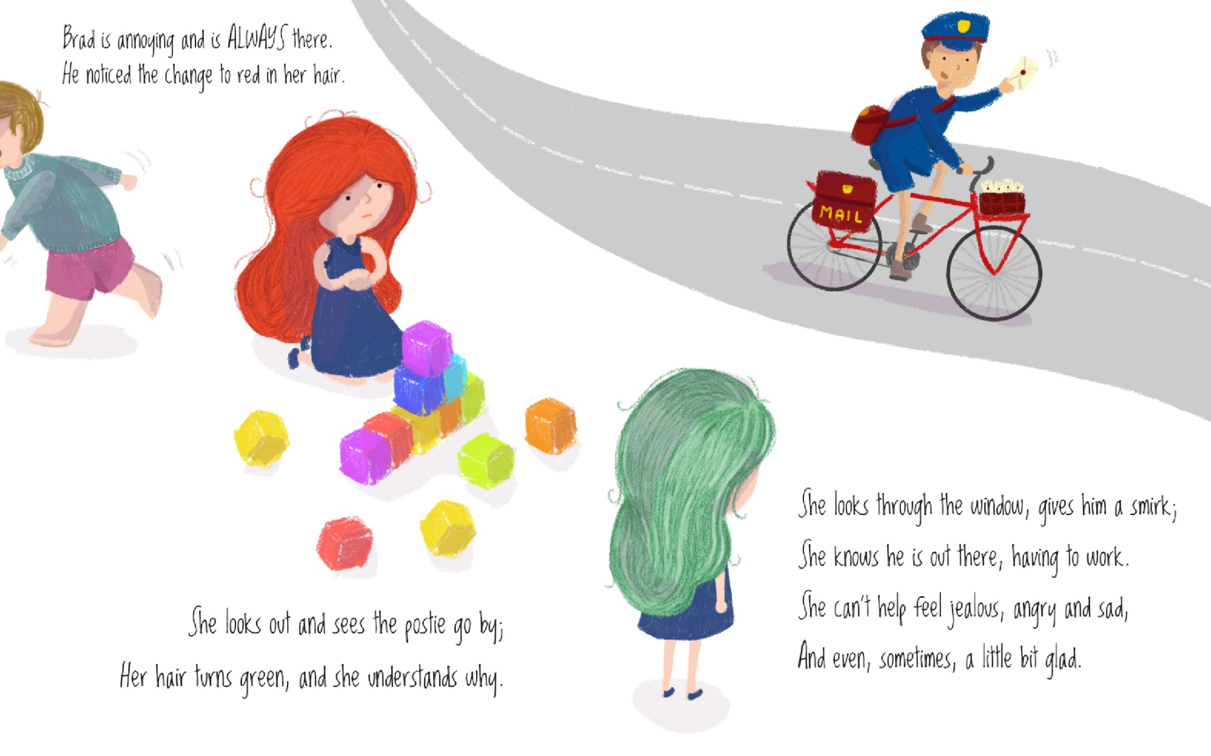

Slide 17
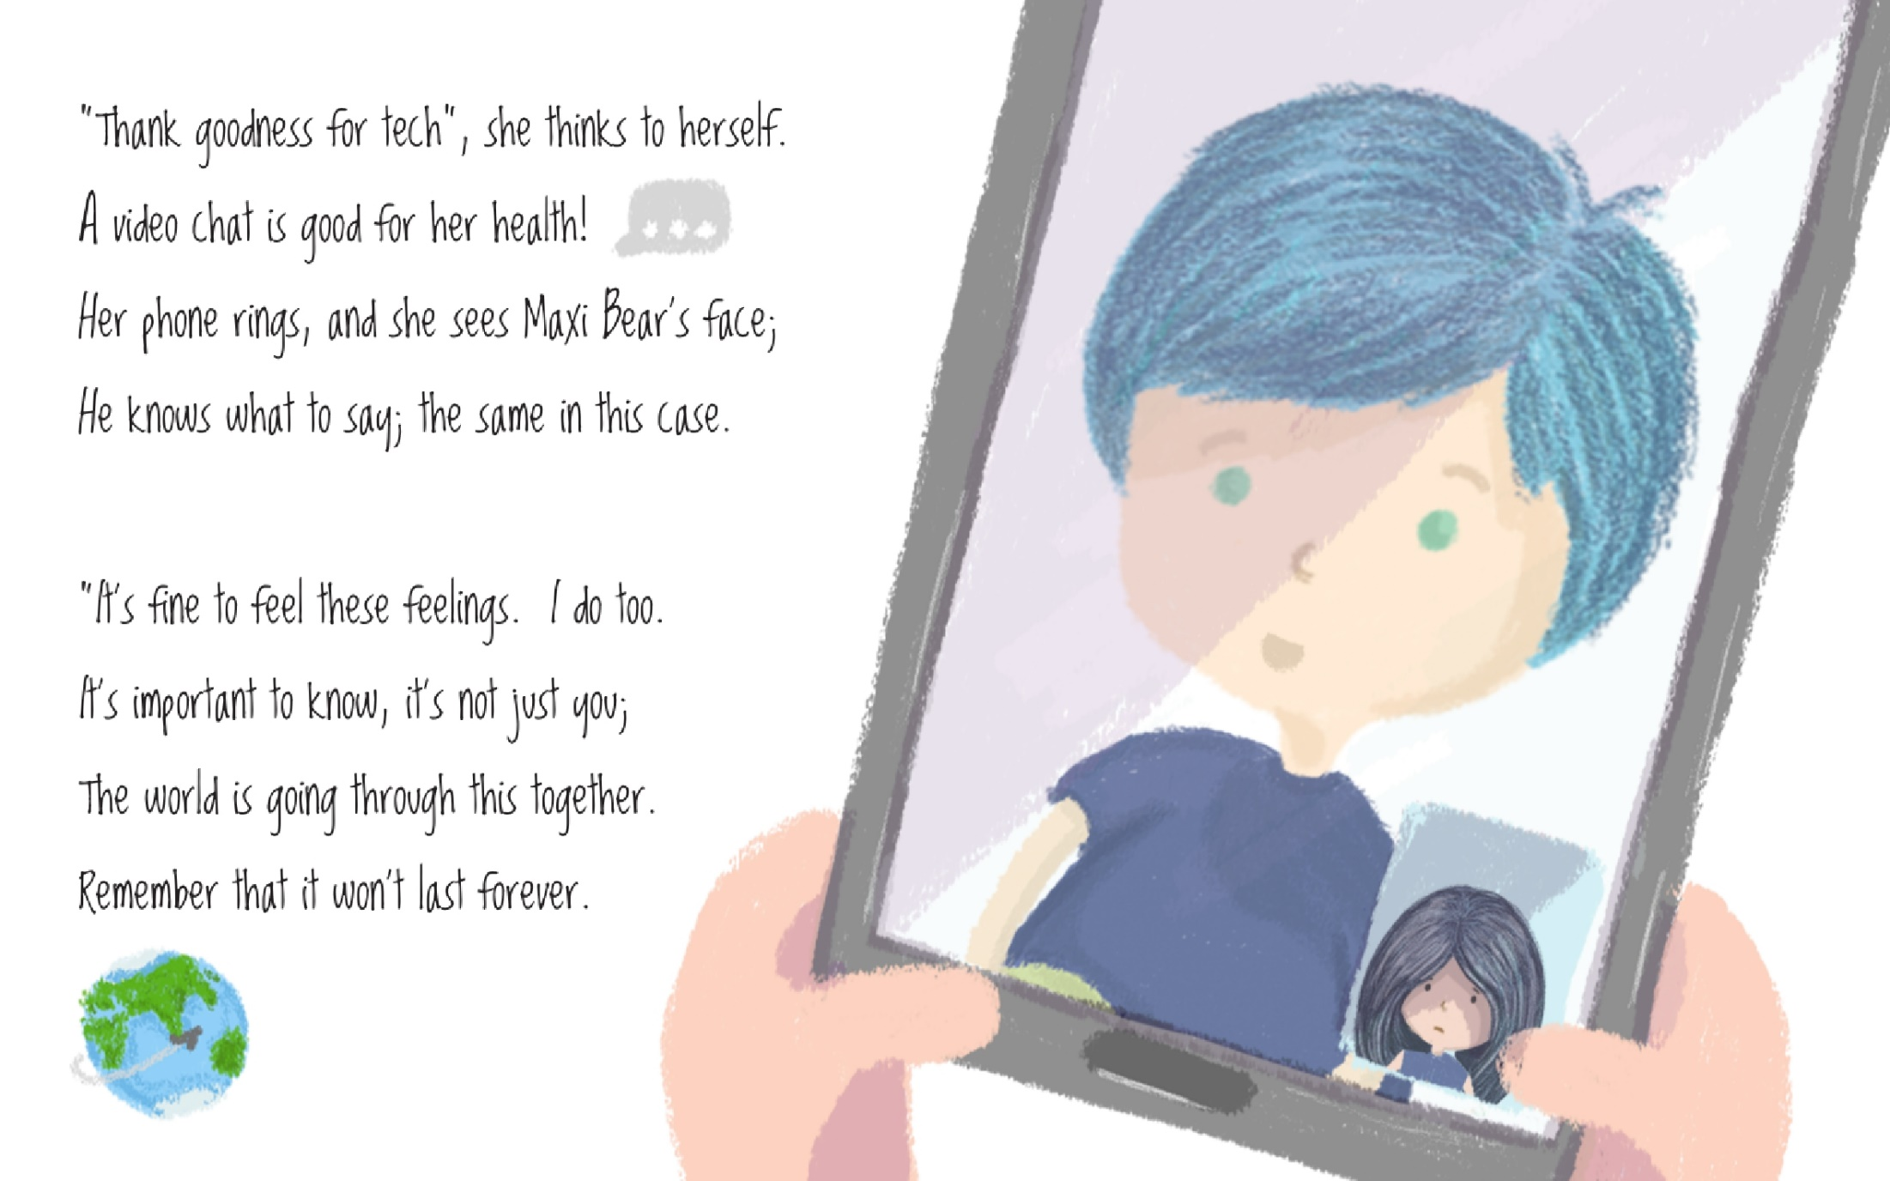

Slide 18
