Slide 1
Linlithgow Bridge Primary School P5 Home Learning Friday 24 April
TREASURE YESTERDAY
LIVE FOR TODAY
DREAM OF TOMORROW

Slide 2
Read through this powerpoint to see what your tasks are for today. Joe Wicks 9am. Remember our school values below. Some of your tasks today will be on resilience as we all have to be resilient to continue our education at home.

Slide 3
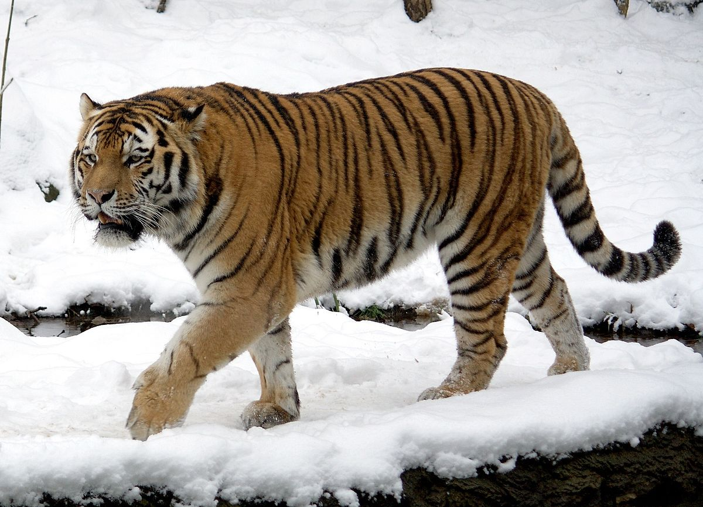
Learn the following:
1000grams – 1Kilogram
500grams – ½ Kilogram
250grams – ¼ Kilogram
750grams – ¾ Kilogram
WRITE THESE IN YOUR JOTTER
Grams can be written as g and kilograms as kg
A feather weighs much less than one gram
A tiger weighs approximately 240 kilograms

Slide 4
Maths for Today Weight
Recently, in school we learned about measuring length
Today we are learning about weighing objects in grams and kilograms
Tasks:
Use the following link to learn more about weight
https://www.ictgames.com/mobilePage/mostlyPostie/
INSTRUCTIONS FOR MOSTLY POSTIE Read the Scales
Choose your own level of difficulty
Drag object to scales
Read scales
Type number of grams on scales
Click to check
Back to menu to change difficulty

Slide 5
Page 83 of the Textbook is below in case you can’t find yours. Write your answers in the best way for you. If you can add to your CLASS NOTEBOOK, please do. Otherwise, write the answers in your jotter.

Slide 6
Estimating and Measuring
Ask an adult if you can look in the food cupboard/fridge.
Select an item and estimate the weight.
Write down the name of the item and its estimated weight but don’t be tempted to look on the package.
Finally, check the actual weight and put the answer on the estimation sheet or in your jotter.
Only by holding items in your hand will you become better at estimation.
We did this for measuring length in school. There is a sheet for you to print if you would like to, CALLED ESTIMATION
Item | Estimate | Actual

Slide 7
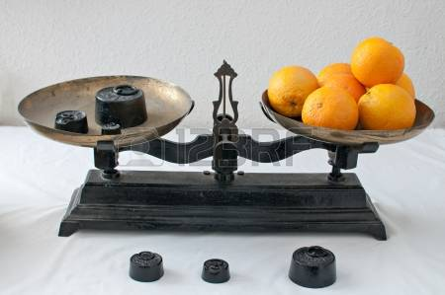
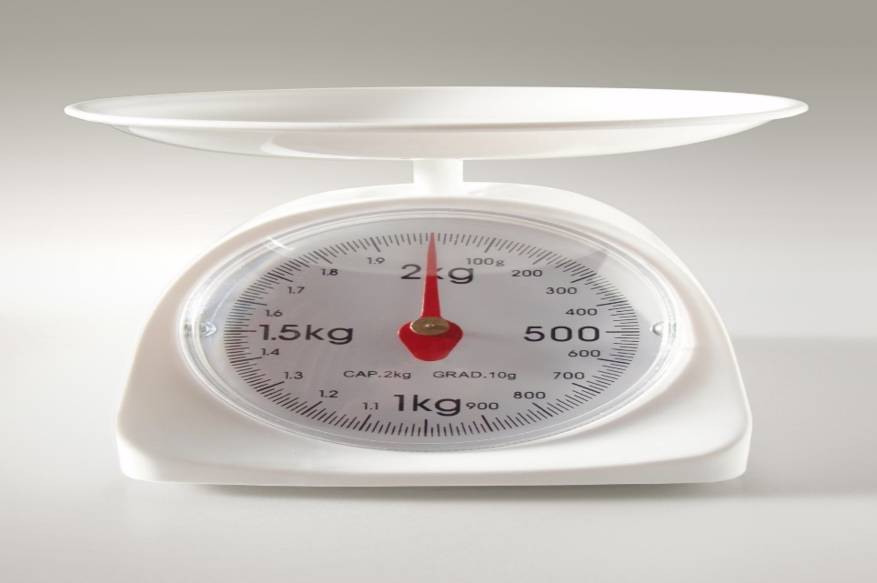
Reading Scales – only do this if you would like extra tasks.
Choose the READING SCALES worksheets, there are three levels of difficulty. Choose the one which best suits you or maybe begin with the easiest and then level 2 or 3. Upload answers if possible.

Slide 8
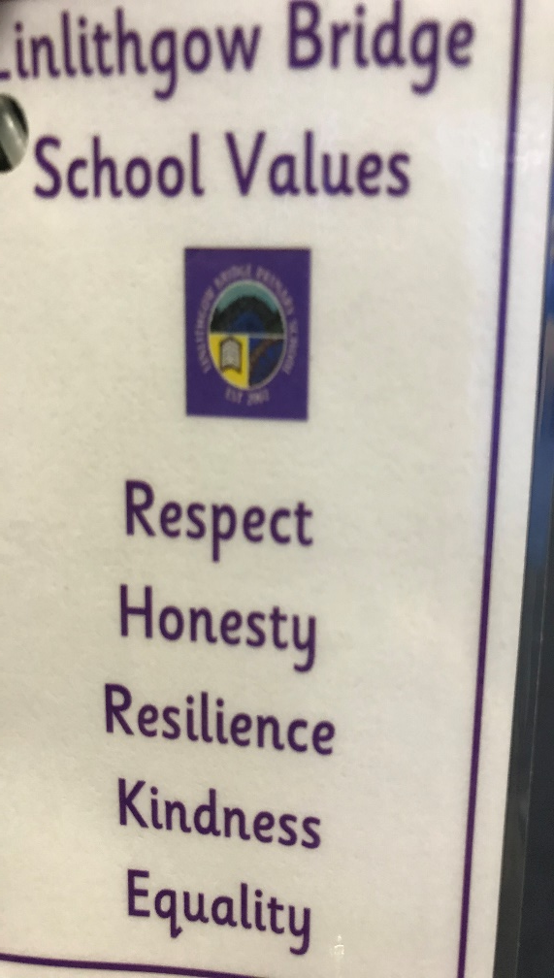
Remember our School Vision and Values
Values – Respect, Honesty, Resilience, Kindness and Equality
LBPS – Learn, Belong, Progress, Succeed
Treasure yesterday, Live for today, Dream of Tomorrow - motto
Ready, Respectful, Safe RRS

Slide 9
Resilience
One of our School Values is Resilience
WATCH THE RESILIENCE POWERPOINT and try to answer the questions as you go
Really think about what you could do to become more resilient

