Slide 1
Wednesday 22 April 2020 Bonjour P2! Ca va bien? Comme ci comme ca? Ca va mal? https://www.bbc.co.uk/teach/supermovers/ks1--ks2-mfl-french-greetings-with-ben-shires/zdpdvk7

Slide 3
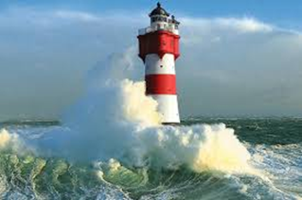
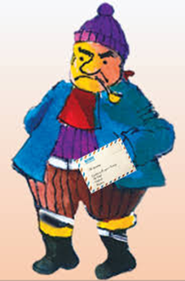
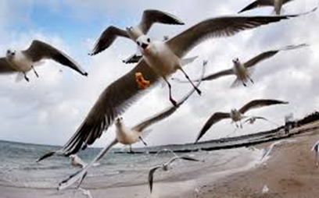

Slide 4
WAGOLL
Linlithgow Bridge Primary School
East Mill Road
Linlithgow
EH49 7PB
Dear Mr Grinling
Thank you for your letter. I would love to help you find out more about the seashore. I will read and listen to information on the internet and in books so that I can find out about sand, shells and rockpools.
I would also like to learn more about lighthouses, perhaps you could help us with this?
We look forward to hearing from you again.
Best Wishes
Mrs Marshall

Slide 6
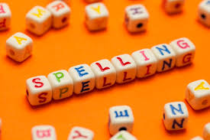
Spelling Words
country
young
example
floating
throwing
toasting
counting
coaching
shouting
Here are your spelling words for the week. Choose 3 words each day to practise.
Remember to..
Read the word
Clap the syllables
Use your sound box to sound out the sounds.
Write out the words

Slide 7
Reading Detectives
I can read the sentences
I can find the vowel digraphs, tricky words, and words ending in ‘ing’.
I can up level the sentence to make it more interesting
The king began pounding on the large palace gate but no one came.

Slide 8
Maths and Numeracy
I am learning to add and subtract to 20 and beyond
To explore numbers, understand quantities, use strategies to help me work with numbers I can
Say- count forwards and backwards to and from 100 in 10s, throw and catch a ball with someone as you do it.
Make – Make double numbers by playing, ‘Archery Doubles’ on www.ict.games.com
Write- Practise your double numbers up to 20 and beyond if you can. Complete the ‘Make Doubles’ sheet.
Do- Ask someone to help you practise your ‘near doubles’.

Slide 9
Number Talks
https://www.youtube.com/watch?v=A1Mazc-SsG0

Slide 11
Story Time I can listen to the story, make predictions and learn new vocabulary.
https://www.youtube.com/watch?v=3gzIH5e6db0

