Slide 1
P5 RME – 21- 24 April New Topic – Family Celebrations & Events
Our family celebrated my middle son’s 21st Birthday in February so we had family and friends over for a party He has certainly changed and grown!
Have you had a family celebration this year?
Look at photographs of the event, notice all the different ages and stages in life of people.

Slide 2
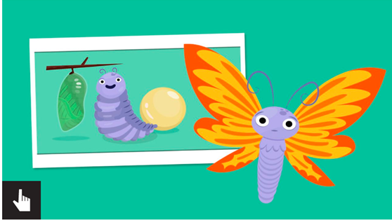
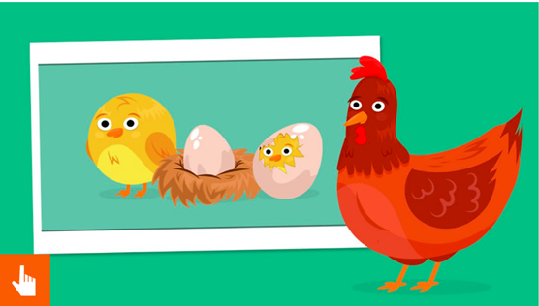
Life - cycles
Can you give an example of a plant or animal life cycle?
View BBC Bitesize ‘What is a Life cycle?’ https://www.bbc.co.uk/bitesize/topics/zgssgk7/articles/zwn6mnb
Scroll down and sort the stages of life for a frog and chicken.

Slide 3
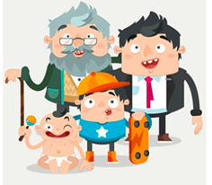
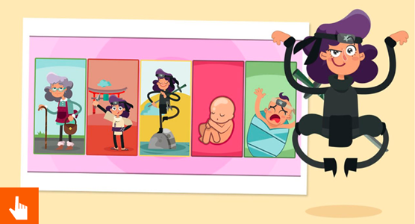
The Human Life -cycle
View BBC Bitesize ‘How do humans change during their life time?’
https://www.bbc.co.uk/bitesize/topics/zgssgk7/articles/z2msv4j
Questions
1.What stage do children become teenagers?
2.When do you learn to walk and talk?
3.What is a baby called as it grows inside it Mum’s womb?
Scroll down to order the human life cycle!

