Slide 1
Monday 20th April
Good Morning Primary 1!
Bonjour la class!
https://www.bbc.co.uk/cbeebies/watch/presenters-daysoftheweekmonday

Slide 2
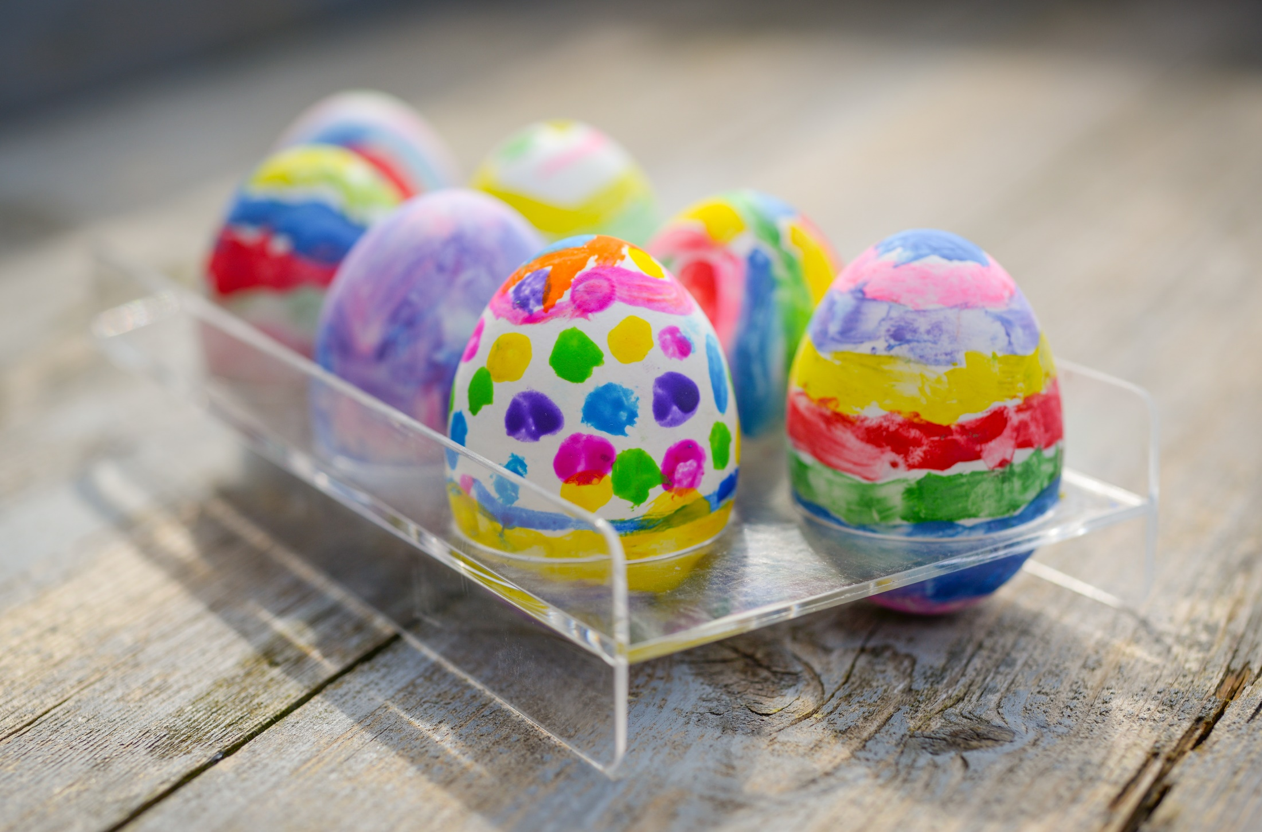
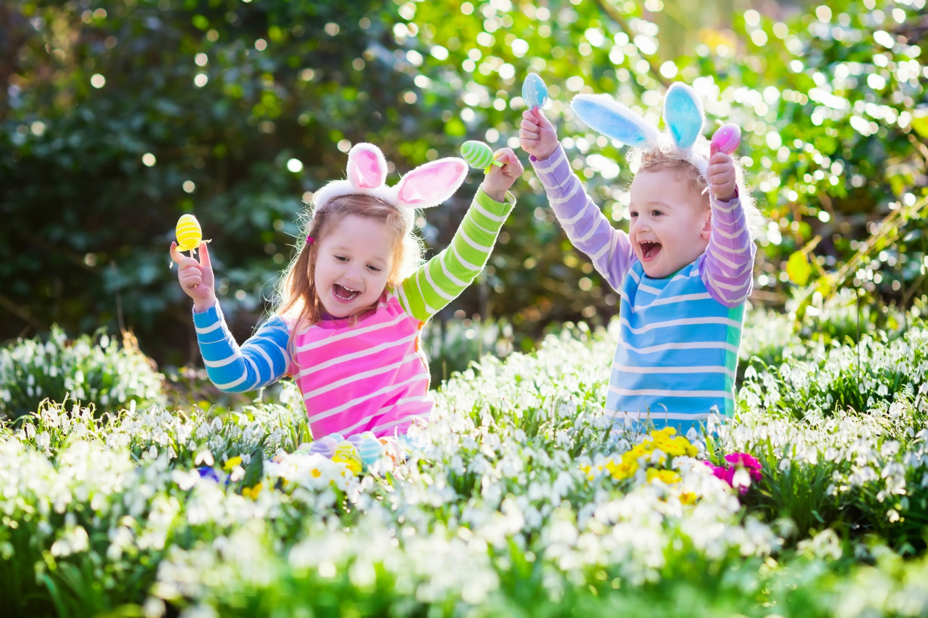
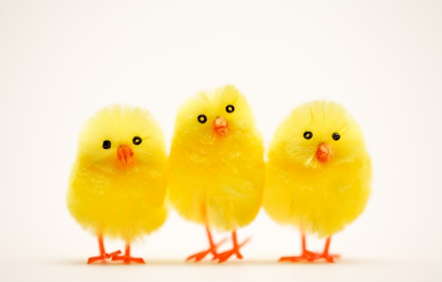
Easter Weekend Diary
I can share ideas in pictures and print.
On Easter Sunday I…
finger spaces
full stop
Capital letter
Use a connective * challenge
Write you diary entry in the jotter in your Home Learning Pack.

Slide 3
Fischy Music Assembly
https://youtu.be/20KHyvVYwVY
Log for some fun and singing!

Slide 4
Story Time
https://youtu.be/icw9oEWDm4E

Slide 5
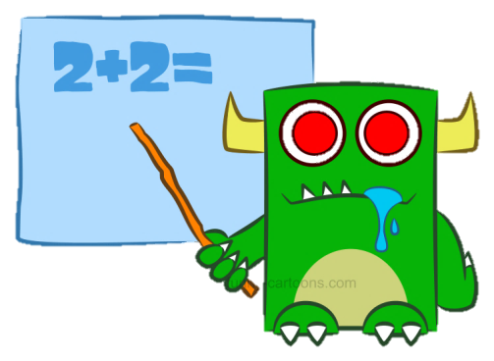
Maths Warm-up
Practise counting forwards/backwards within the 0 to 20/30 range, starting and stopping at different numbers to develop fluency. Try different actions when counting such as, stamping feet, nodding head, clicking fingers for e.g.
Play fastest fingers – hand behind your back to start. Race your family to see who can show the number quickest. Can you count on from 5 and not start from 1?
Find out when everyone in your family’s birthday is. If you can, mark the dates on a calendar or in a diary.
Make a paper chain of the months of the year. Decorate each month with key events (e.g. December – Santa for Christmas, February – hearts for Valentine’s Day).

Slide 6
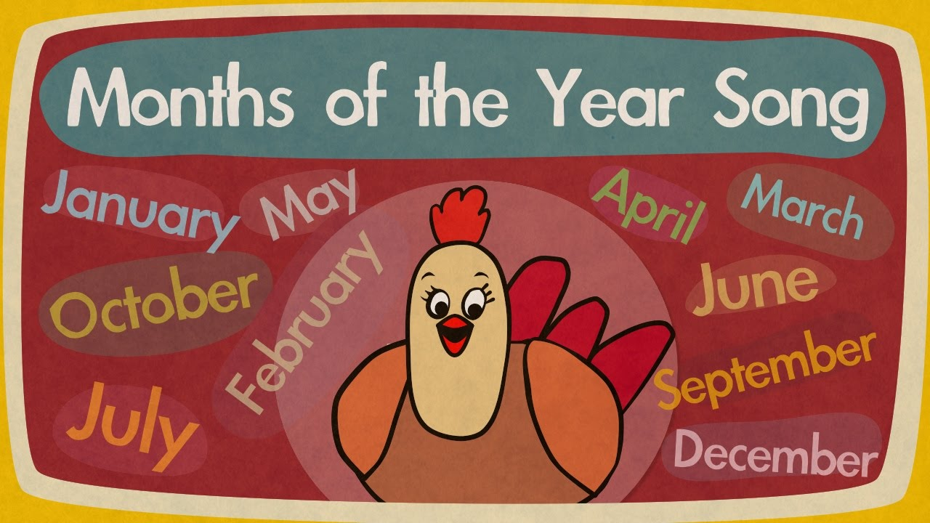
Maths Rhyme Time
I can participate actively in songs, rhymes and stories.
https://youtu.be/Fe9bnYRzFvk
https://youtu.be/Fe9bnYRzFvk

Slide 7
Maths Activities
I know the months of the year and can talk about the four seasons.
Please visit educationcity.com and access the free 21 day trial by creating a parent account. Once you have registered online, log on and select - subjects – numeracy – early(3rd box) – Learn Screens – Number, Money & Measurement - 12 months.

Slide 8
Maths Activities
I know the months of the year and can talk about the four seasons.
Please select - subjects – numeracy – early(3rd box) – activities – Number, Money & Measurement – Sten of the Month

Slide 9
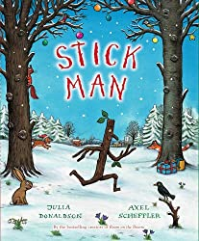
IDL
I can create my own Stickman character using different materials.
I can create my own adventure story for my Stick Man and share it with my family.
Listen to the story Stick Man, read aloud by Axel Scheffler.
https://youtu.be/OFhJrLVu3T0
Collect a stick or twig when you go on a walk or from your garden, when you get home decorate your Stick Man with wool, ribbon, buttons or string to make him come alive.
Ask a grown up to take a photo/video of your Stick Man and you sharing the adventure story he goes on and upload it to your Online Journal.

