Slide 1
Thursday 2nd April
Good Morning Primary 1!
Hola mi clase!
https://www.bbc.co.uk/cbeebies/watch/presenters-daysoftheweekthursday

Slide 2
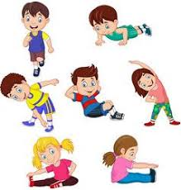
P.E with Joe
P.E with Joe – you tube channel ‘The Body Coach’ 9am

Slide 3
Revison Tricky Words Block 2
go we be
she are they
all some come
said one you

Slide 4
Tricky Word Dictation
I can make an attempt to spell familiar words correctly.
some
were
they
you
there
Are my letters formed correctly?
Are my letters in the correct order?
CHALLENGE - Write a sentence using one of the Tricky Words above.
Write your tricky words and sentence in the jotter from your Home Learning Pack.

Slide 5
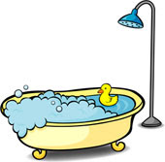
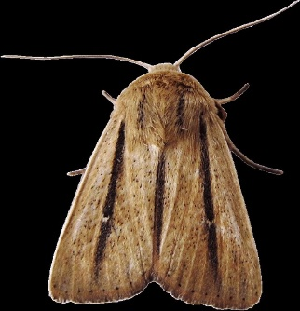
Super Sentence
I can write a super sentence for a word containing the th sound.
Look out for this sound in books you have at home.
Visit the link below for ideas of th words.
https://youtu.be/6U354eD-hgQ
finger spaces
full stop
Capital letter
Use a connective * challenge
Write your super sentence in your jotter. Draw a picture first to help you plan your sentence.

Slide 6
Story Time
https://youtu.be/mj20MAmb1c4

Slide 7
Maths Number Talks Remember – Number Talks are all about how you solve a task mentally. For this activity don’t use anything to help you , just your brains!
Once you have an answer, draw and/or write down the way you worked it out take a picture and send it back so that we can see how you solved it.
How many dots?
How do you see them?
Draw the pattern and circle how you see the dots, to show your thinking.
Why not try and write down in numbers too!
For example –
5 + 5 = 10

Slide 8
Number Rhyme Time
I can participate actively in songs, rhymes and stories.
https://www.bbc.co.uk/teach/supermovers/ks1-maths-counting-with-john-farnworth/zbct8xs

Slide 9
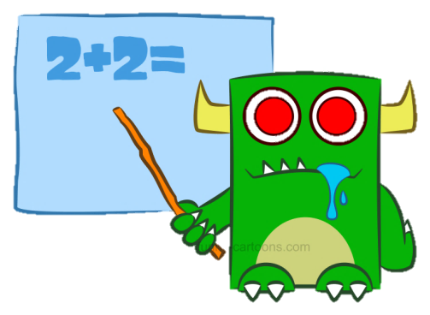
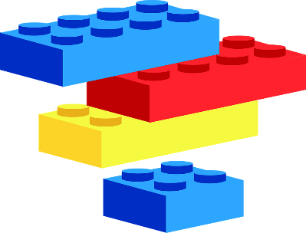
Maths Warm-up
Collect some random toys and objects from around the house. Estimate how many there are. Then count to check. Was your estimating close? What makes it easy to estimate, what makes it tricky?
Use Lego or other small toys/objects to practise sharing amounts into 2 equal groups. You could use 2 pieces of paper to keep the groups together. Count your objects to check you have the same on each side. Challenge* use larger amount of objects up to 30, can you share your objects into 3 or 4 equal groups?

Slide 10
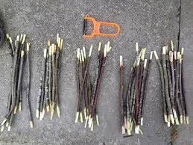
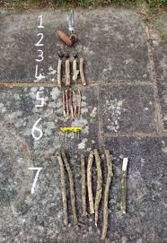
Maths Activites
Collect as many sticks as you can and arrange them in groups of ten. How many do you have altogether?
Can you make a counting in tens number line?
Ask a grown-up to cover up a number/number on your number line. What number is/are missing?
I can count in 10’s to 100

Slide 11
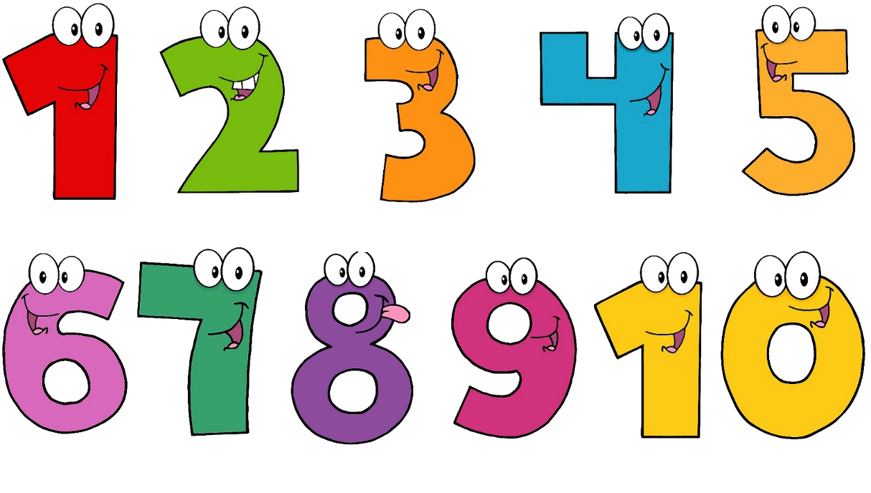
Maths Activities
Tee-Jay Numbers booklet page 3
ICT - https://www.studyzone.tv/game152-code7c4d9b219ae1d1eb339330f0d7e715c5

Slide 12
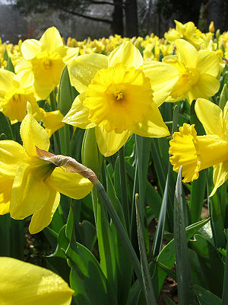
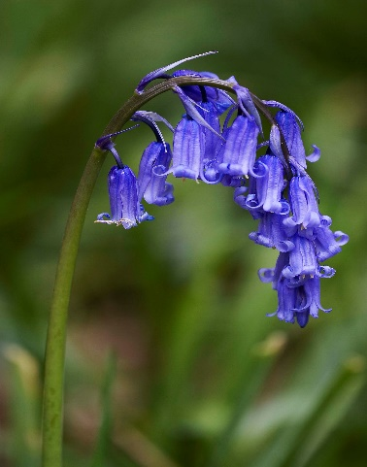
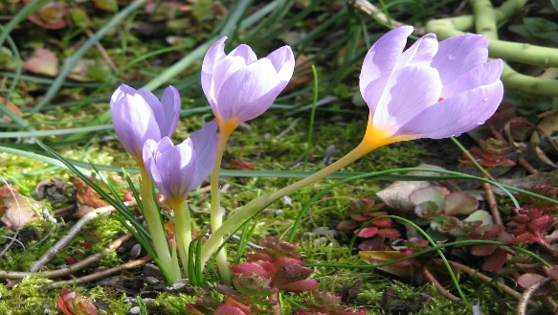
Art
I can express and communicate my ideas, thoughts and feelings through activities within art.
Can you paint/draw/make a picture of a spring flower/s that you saw when you went on your spring treasure hunt walk?

Slide 13
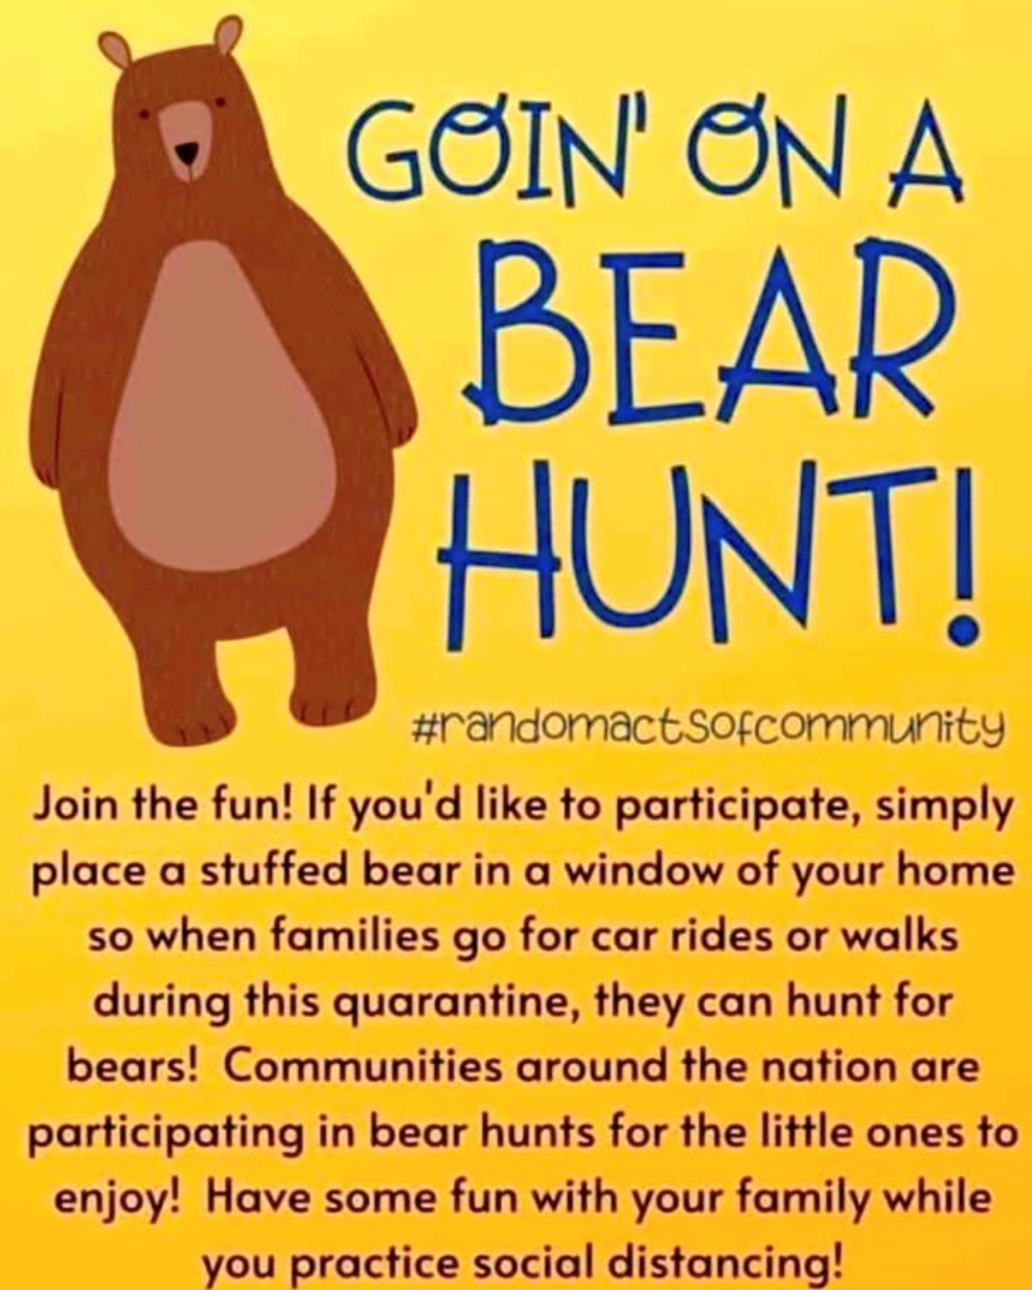
Bear Hunt
Can you choose a bear to put in your window. How many can you see when you go for a walk? I have taken a photo of mine and uploaded it to the Online Journals. Why don’t you do the same?

