Slide 1
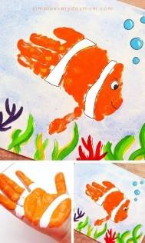
Literacy
Watch the story of Tiddler here: https://www.youtube.com/watch?v=pBRT5vsfE3U
Can you retell the story in your own words? You could draw some pictures to help you with the sequence.
Tell an adult at home what you like for tea.
Maths
Get messy and make some handprint fish. How many different patterns can you make? You could try stripes, swirls, spots or zigzags. Sort your fish using different criteria.
Music
Practise you singing and counting with ‘1, 2, 3, 4, 5, once I caught a fish alive’
w/c 15th June 2020
Under the Sea
Try some of these fun activities at
home. Let us know who you get on by uploading photos to the Learning Journals.
HWB
Here is the story of the Rainbow Fish. https://www.youtube.com/watch?v=r9mryuEKkKc It is all about Friendship. Can you make a list of what makes a good friend?
Science
Use the bath or sink to investigate floating and sinking. Can you predict what will float or sink?
Kirkhill Nursery
Art and Craft
Have a go at making your own octopus from a kitchen roll or toilet roll tube. See the separate sheet for instructions.
Literacy
Can you be a responsible citizen and make a poster about keeping our oceans clean?
PE
Have a go at some yoga with Squish the fish.
https://www.youtube.com/watch?v=LhYtcadR9nw

