Slide 1
Welcome to
Kirkhill Chatter 1

Slide 2

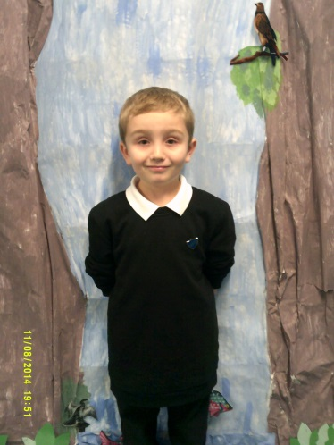
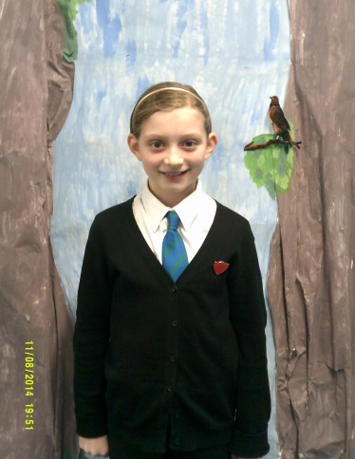
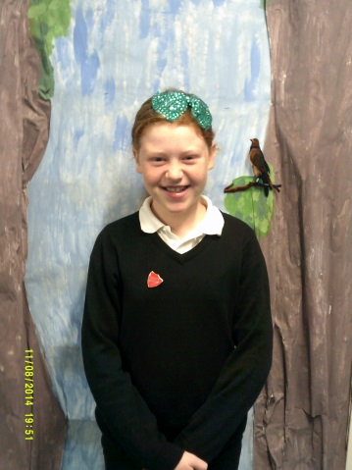
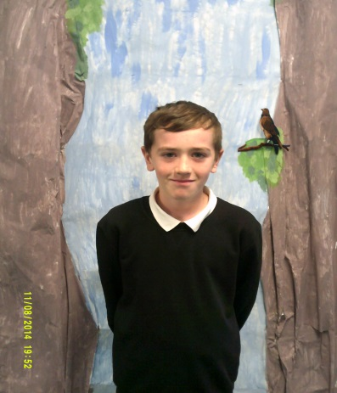
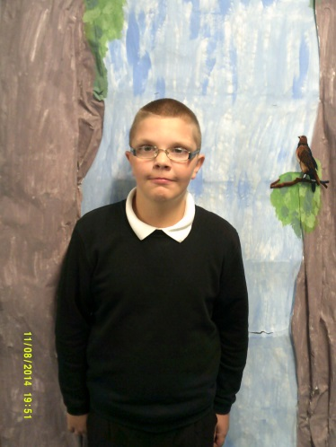
We are the House Team
Ewan
Head Boy
Evie
Head Girl
Emma
Depute Head Girl
Lauren
Head Girl
Callum
Depute Head Boy
Emma
Depute Head Girl
Calum
Depute Head Boy
Ryan
House Master

Slide 3
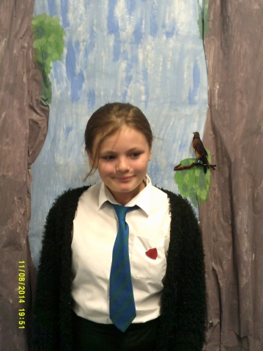
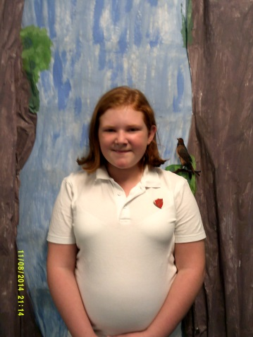
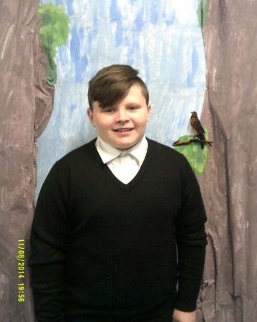
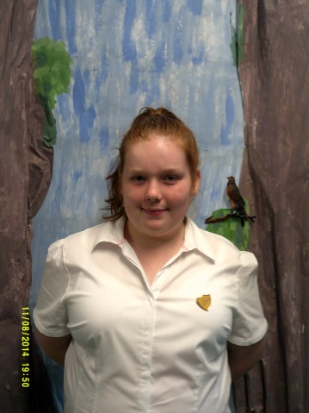
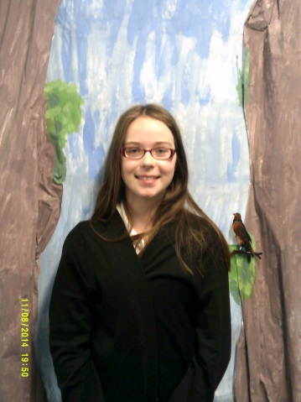
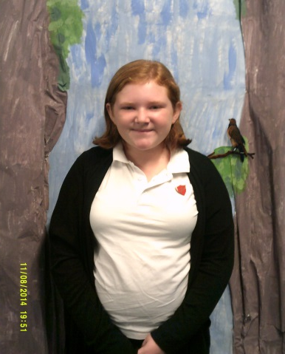
We are the House Team
Callum
Depute Head Boy
Declyn
Strathbrock House Captain
Kelsey
Buchan House Captain
Emma Buchan Vice Captain
Caitlin
Strathbrock Vice Captain
Holly
Cardross House Captain
Emily
Cardross Vice Captain

Slide 4
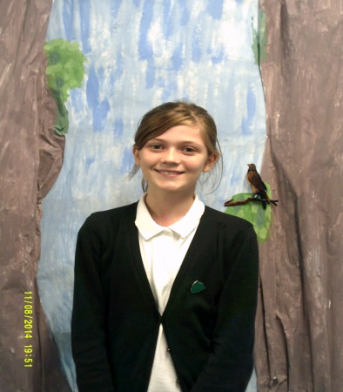
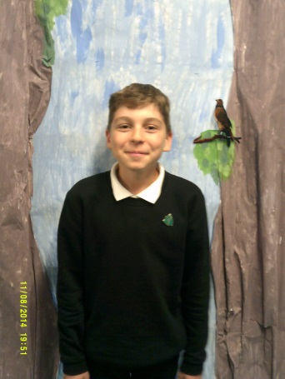
We are the House Team
Leah
Almondell House Captain
Lenny
Almondell
Vice Captain

Slide 5

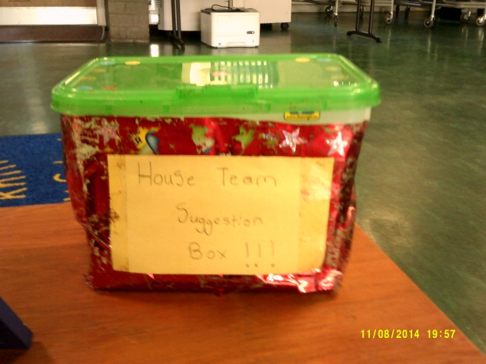
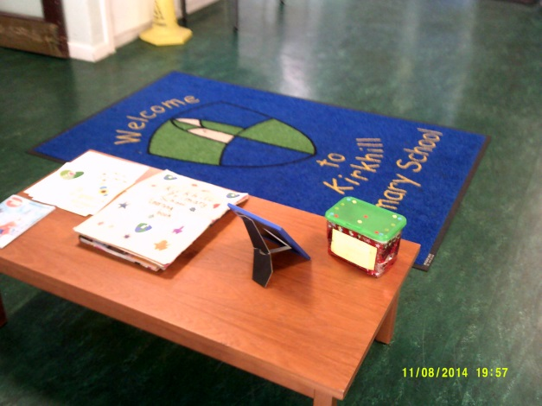
Remember that you can use the Suggestion Box if you have any suggestions, concerns or ideas. The House Team would be happy to hear from you. Thank you to those who have already been in touch with us.
Ewan
Head Boy

Slide 6

The aim of our first Kirkhill Chatter is to gather your views on the different ways of knowing how successful you have been in your learning.

Slide 7

Activity 1
Do you think it is important to know how well you have done in your learning?
How do we find out how we’ve done in our learning?

Slide 8

Activity 2
How helpful are these for letting us know how successful we have been and setting our next steps?
Success Criteria
Visual Signs (thumbs, traffic lights etc)
Stickers/Stamps
Peer Assessment
Create 3 areas in the classroom to represent ‘not very helpful’, ‘quite helpful’ and ‘very helpful’. Children to move to appropriate position for each of the four examples and teacher to complete the chart. Record a comment from at least one area.

Slide 9

Activity 3
It is important to know what you need to do to improve your learning. Do you know your
next steps?
Line up behind your answer!
Teacher to take a photo of each group.
I know some of my next steps.
I know most of my next steps.
I don’t know my next steps.

Slide 10
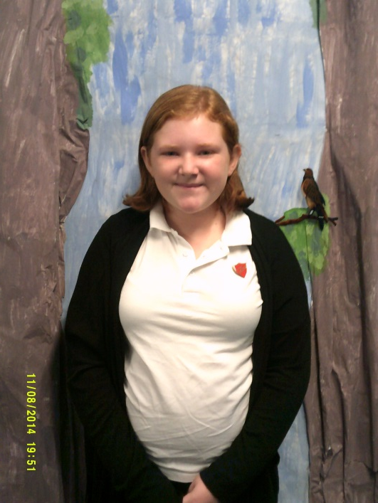
Thanks for taking part in KC1.
We will gather the information from KC1 and provide you with a brief summary of the findings on the feedback page (next slide).
The House Team will email your class to let you know when we have done this.

Slide 11
Feedback Page

