Slide 1
Welcome to
Kirkhill Chatter 4

Slide 2

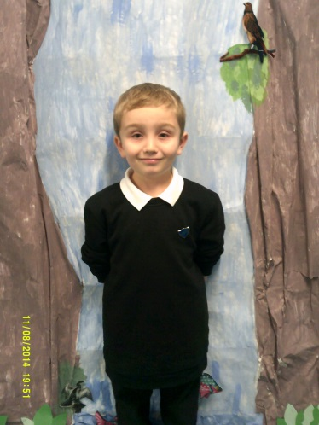
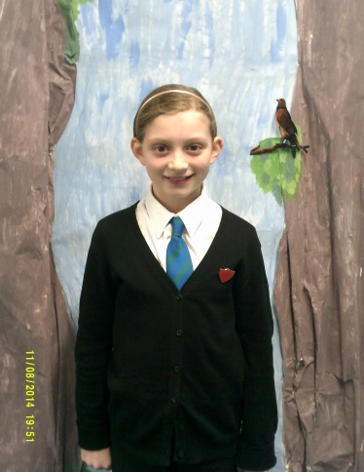
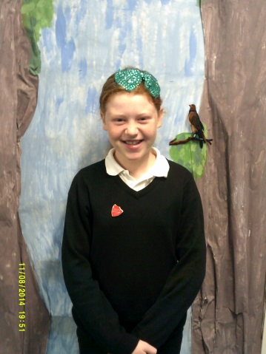
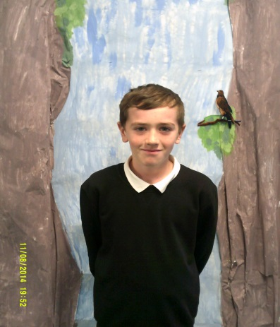
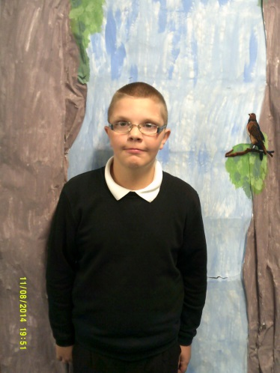
We are the House Team
Ewan
Head Boy
Evie
Head Girl
Emma
Depute Head Girl
Lauren
Head Girl
Callum
Depute Head Boy
Emma
Depute Head Girl
Calum
Depute Head Boy
Ryan
House Master

Slide 3
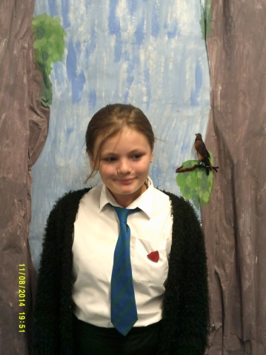
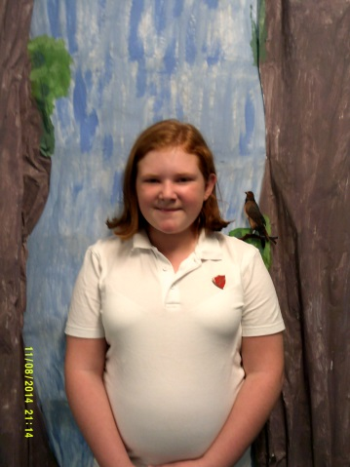
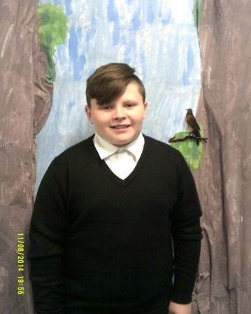
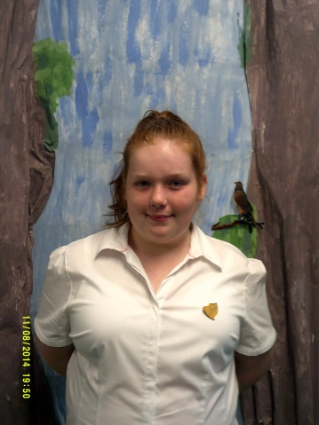
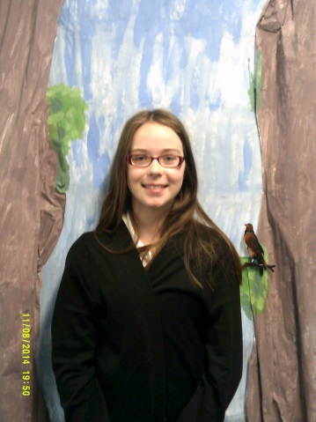
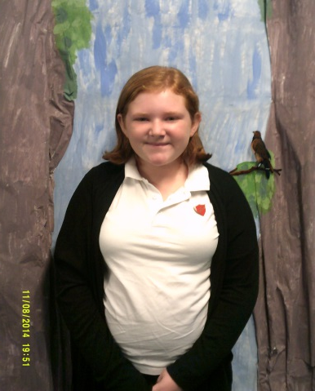
We are the House Team
Callum
Depute Head Boy
Declyn
Strathbrock House Captain
Kelsey
Buchan House Captain
Emma Buchan Vice Captain
Caitlin
Strathbrock Vice Captain
Holly
Cardross House Captain
Emily
Cardross Vice Captain

Slide 4
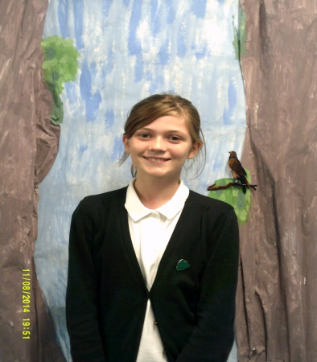
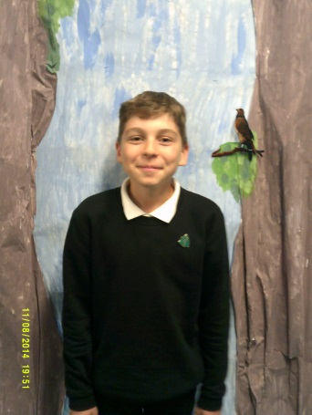
We are the House Team
Leah
Almondell House Captain
Lenny
Almondell
Vice Captain

Slide 5

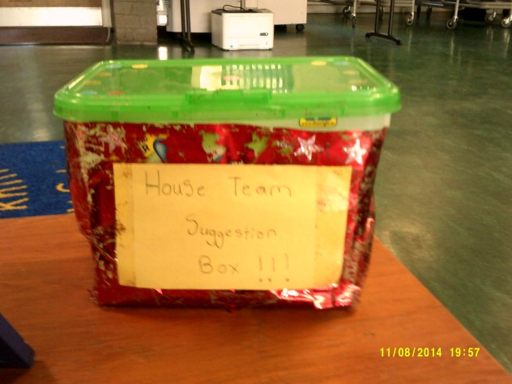
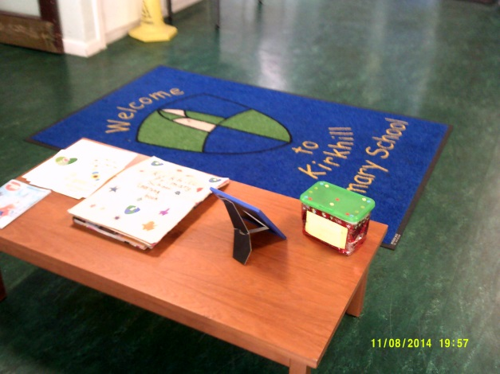
Remember that you can use the Suggestion Box if you have any suggestions, concerns or ideas. The House Team would be happy to hear from you. Thank you to those who have already been in touch with us.
Ewan
Head Boy

Slide 6

Thank you to everyone who took part in Kirkhill Chatter 3. We have enjoyed reading your graffiti walls and will be using these to look at next steps in learning in the Expressive Arts.

Slide 7
Please click on the link below to watch a movie of the various groups working on their expressive arts activities during Kirkhill Chatter 3.
Kirkhill Chatter 3

Slide 8

The focus for Kirkhill Chatter 4 is to develop our shared mission statement, vision, values and aims for our school.
It is important that we all have a shared understanding of what we want our school to be and to help us to achieve.

Slide 9

Our Vision
Our shared vision is all about what we want our school to help us to learn and achieve. It is important that we all know what our school vision is so that we can work together to help others to be the best that they can be and to develop skills that will help all of us in the future.

Slide 10

Activity 1 – Our Values
In your group make an acrostic poem for KIRKHILL – think about what we stand for as a school and what kind of school we want Kirkhill to be.
Your teacher will help with this.
.

Slide 11
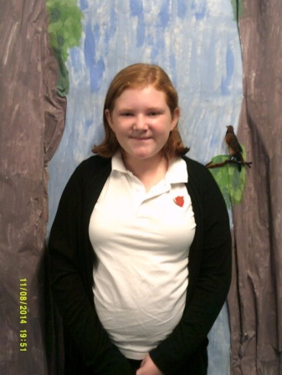
Activity 2 – Our Aims
These will help us to know what we aim to achieve as a whole
school for all of the children who come to Kirkhill to learn. As we have done some work on the wellbeing indicators at Get Together we would like you to write a short aim for each of the following:
Safe/Healthy/Achieving/Nurtured/Active/
Responsible/Respected/Included
Your teacher will help with this.
We will take all of the final pieces and put them together to form our schools aims along with what the staff team and parents say.
This means that our aims will be shared by the whole school community.

Slide 12

Activity 3 – Our Mission Statement
We need to think about a ‘catchy’ mission statement for our school and we need your help to decide this. Some examples from other schools are:

Slide 13
Striving for Excellence… with and for our communities – West Lothian Education
ABC – Achieve, Believe, Celebrate – Balbardie PS
Everyone is a learner and every experience is a learning opportunity
Everybody Matters, Everybody Succeeds
Working Together to Build a Future
Learning Together, Achieving More
In our school we value and celebrate – Bankton PS
A great school to learn in. A great school to teach in. A great school to work in. A great school to be in. – Broxburn Academy

Slide 14
Once we have finished Kirkhill
Chatter 4 the House Team will get together to put our mission statement, vision, values and aims together. The staff team will work together on May Inservice Day to finalise these. After this we will share these with everyone.
Please hand the three activities into Miss Henderson or Mrs Shankland.
Thank you for taking part this morning.

