Slide 1
Kirkhill Chatter 3 Friday
Positive Behaviour in Kirkhill Nursery and Primary School

Slide 2
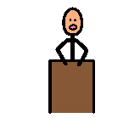
At our Kirkhill Chatter we were able to have our say about our school and what would help to make our learning better.
Well done!
Keep respecting everyone’s rights!
Article 12
You have the right to give your opinion, and for adults to listen and take it seriously.

Slide 3
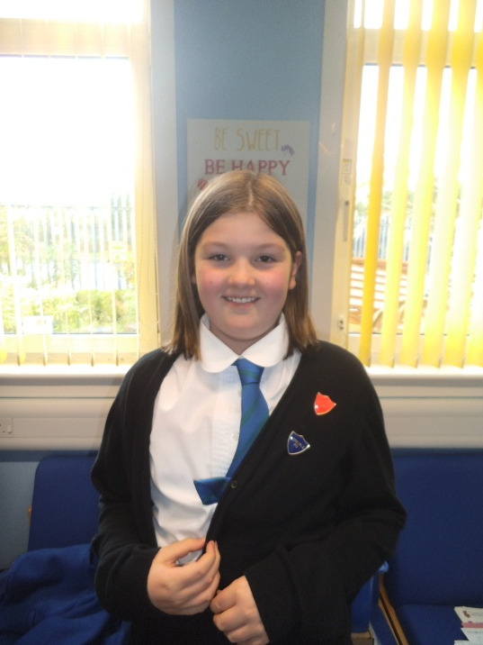
Good Behaviour
Head Girl – Cara Armstrong
We are working on developing the good behaviour systems in our school so that we can reward good behaviour and help those who find this difficult to change their behaviour.

Slide 4
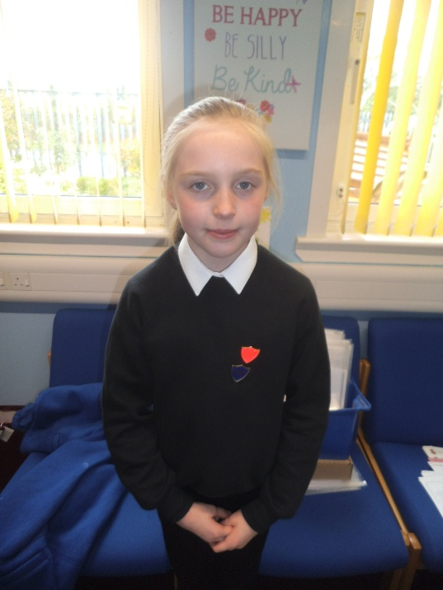
Good Behaviour
Buchan House Captain – Shannon Green
We need you to help us to develop the new system for this so that we can get it ready before the end of term. This means it will be ready to start at the beginning of next year.

Slide 5
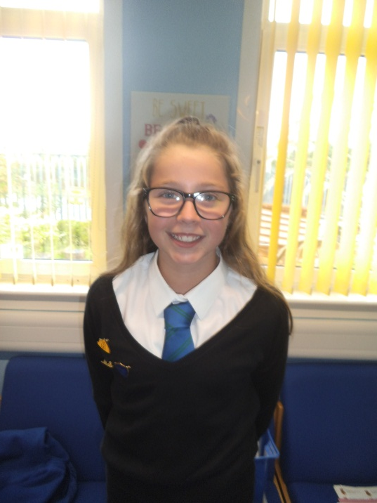
Good Behaviour
Strathbrock House Captain – Niamh Simpson
Question 1:
On the sheets we have given you please tell us what good behaviour looks, sounds and feels like. This will help us to make sure that we listen to all of your views.

Slide 6
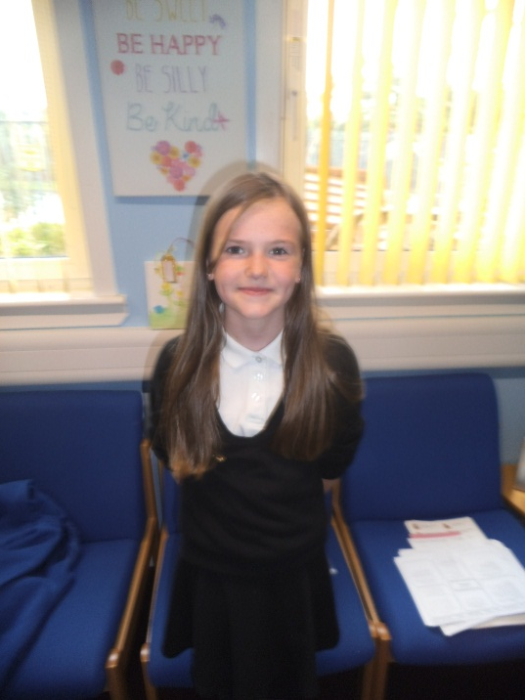
What we have now…..
Question 2:
We now would like you to help us to decide what we need to keep, what needs to change and what needs to go. Please complete the ‘stay, go or change ’ activities in your groups.

Slide 7
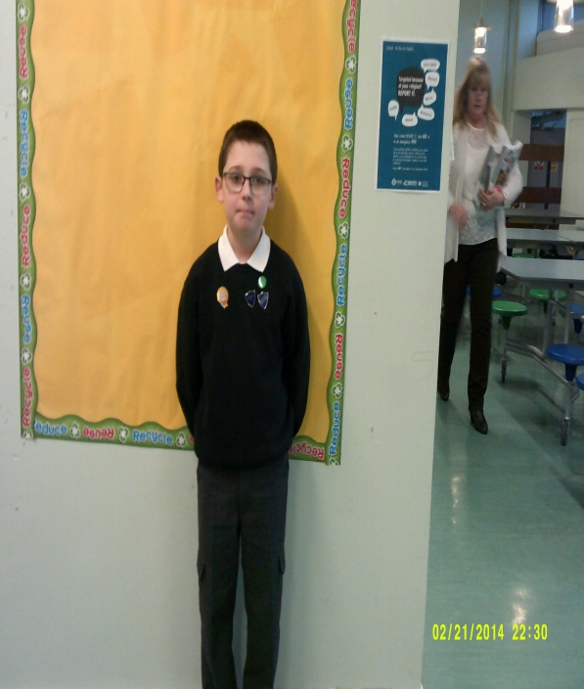
Our Ideas
Here are some of the ideas we have for our new Positive Behaviour system in school. Please write on the sheet provided any comments you have on this.

Slide 10
How you get up the steps and get into the Kirkhill Golden Club
You will gather stickers/dots/Dojo points at the end of each week in your class – we will have to look at how many stickers you will need to get to reach each of the steps.
Stickers will be awarded for following our rights and right actions
Teachers will decide what your class will use to record stickers and how you get up the steps.
There will be no more Good to be Green.
Teachers may still use yellow/red cards to help them decide Golden Time/stickers/Dojo/dots, but this will be your class teachers decision.
When you reach Step 5 you will be in the Kirkhill Golden Club and get entry into the special events – the quicker you get to Step 5 the more special events you will be able to attend.
Step 5 means you will visit Miss Henderson and receive a letter to take home praising you on entry into the Kirkhill Golden Club, a gold star badge and a wrist band.

Slide 11
Working Together
If we all work together on this then we can ensure that through better behaviour we can have behaviour learning for everyone in Kirkhill.

Slide 12
Thank You
Thank you for helping us to make sure that we have a Positive Behaviour system in place that helps to make our school the best place to learn in. We will let you know what the new system is as soon as we can.

