Slide 1
Kirkhill Chatter 1 Friday 25th September 2015
How Good is Our School?

Slide 2
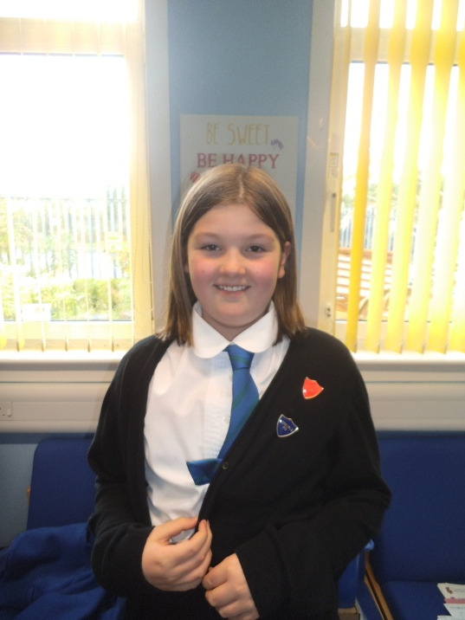
House Team
Head Girl – Cara Armstrong
Hi everyone, I’m Cara and I’m your Head Girl for this year. My job is to listen to your views and share them with the staff and parents. If you have anything you want to tell me about then please come and speak to me.

Slide 3
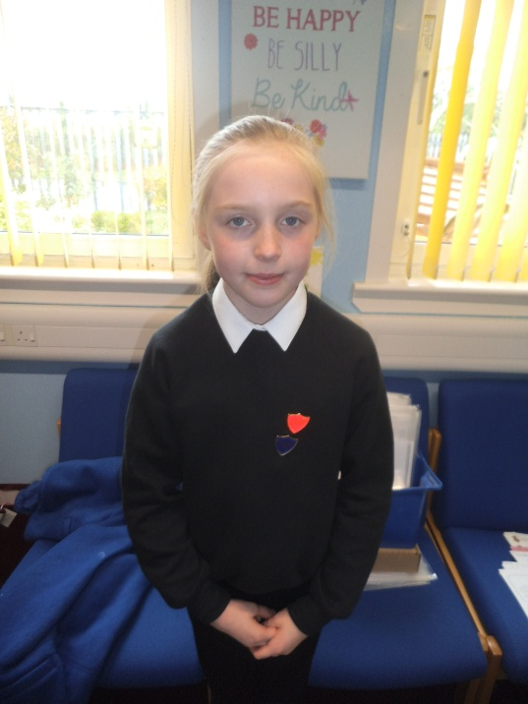
House Team
Buchan House Captain – Shannon Green
Hi everyone, I’m Shannon and I’m Buchan House Captain. My job is to listen to your views and share them with the staff and parents and to help Buchan to win the House Trophy. If you have anything you want to tell me about then please come and speak to me.

Slide 4
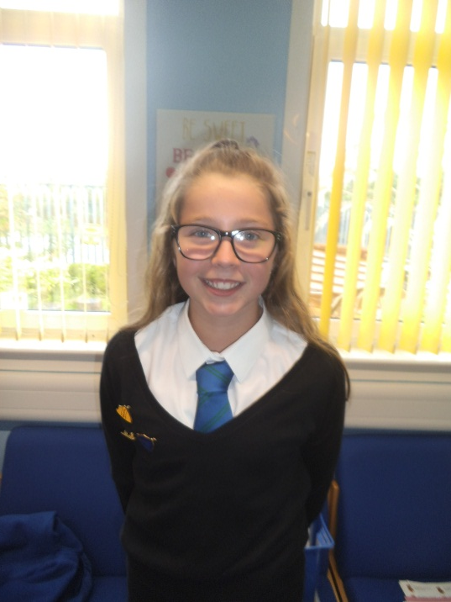
House Team
Strathbrock House Captain – Niamh Simpson
Hi everyone, I’m Niamh and I’m Strathbrock House Captain. My job is to listen to your views and share them with the staff and parents and to help Strathbrock to be House Champions. If you have anything you want to tell me about then please come and speak to me.

Slide 5
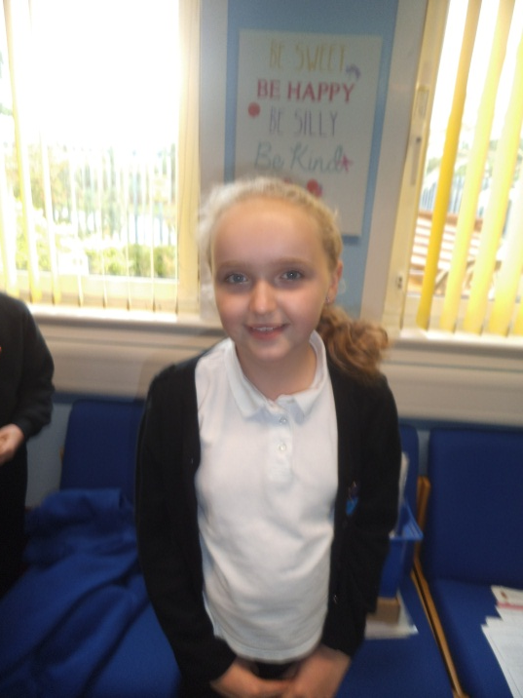
House Team
Cardross House Captain – Jessica Taylor
Hi everyone, I’m Jessica and I’m Cardross House Captain. My job is to listen to your views and share them with the staff and parents and to help Cardross triumph in the House competition. If you have anything you want to tell me about then please come and speak to me.

Slide 6
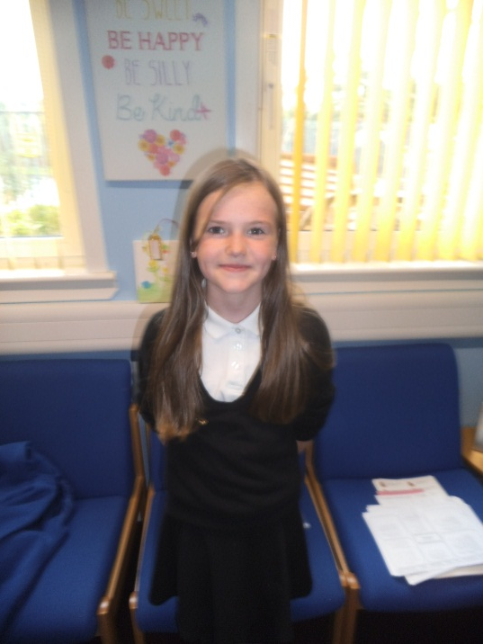
House Team
Almondell House Captain – Katie Scott
Hi everyone, I’m Katie and I’m Almondell House Captain. My job is to listen to your views and share them with the staff and parents and to help Almondell to be victorious in the House competition. If you have anything you want to tell me about then please come and speak to me.

Slide 7
How Good is Our School?
We want to find out what you think about our school. With your teacher leader and the others in your groups answer the following questions. Write what you think in the boxes on the A3 sheet.

Slide 8
Question 1
What is good about Kirkhill Primary School? Write your answers in the box on the A3 sheet.

Slide 9
Question 2
What isn’t so good about Kirkhill Primary School? Write your answers in the box on the A3 sheet.

Slide 10
Question 3
What would make Kirkhill Primary School the best place to learn in? Write your answers on the A3 sheet.

Slide 11
Thank You
Thank you for taking part in the first Kirkhill Chatter. Please hand your finished forms into Miss Henderson. Once we have put all the information together we will share the results with you at Get Together.

