Slide 1
P5/4 Transition With Mrs telfer

Slide 2
Task 1 – All About Me
Moving class can be exciting but also a little bit worrying.
This year we will have new faces in our class as we move together to become P4/5.
Your first task is to create 1 Powerpoint slide with the theme ‘All about Me’. I would like you to introduce yourself to your new classmates.
I have put an example on the next slide.
Please email your slide to jade.telfer@westlothian.org.uk

Slide 3
Mrs Telfer
My name is Mrs Telfer.
My favourite food is cake.
This will be my 11th year teaching.
My favourite colour is purple.
I like going to the cinema and shopping.

Slide 4
Task 2 – Your New Classroom
We will be moving into last years Primary 5 classroom.
Your classroom will look a little bit different on your return to school.
Have a look at the short video to see how it will look.
PS – It says 4/5 rather than 5/4 as I made it before class names were decided.

Slide 5
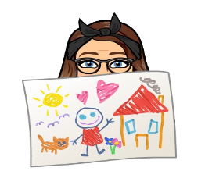
Task 2 – Your New Classroom
You will have noticed some changes. Current plans are:
You will each have your own desk
Each desk with have two seats, one for you to sit on and one for your bag and jacket, as we won’t be using the cloakroom.
Your tray will sit on your table and will have all your resources for the day, including your own stationery.
We have some blank wall space that is waiting to be filled with your lovely work.
This layout and these plans may change over the Summer depending on what our back to school plans turn out to be.

Slide 6
Task 3 – Filling our class with memories
In order to make our classroom feel more ‘homely’ and to recognise this time we have spent at home, I would like you to email me some photos of your lockdown activities. They can be work related or just simply photos of activities you have enjoyed during lockdown such as bike rides etc. I will use them to create a display in the classroom.

