Slide 1
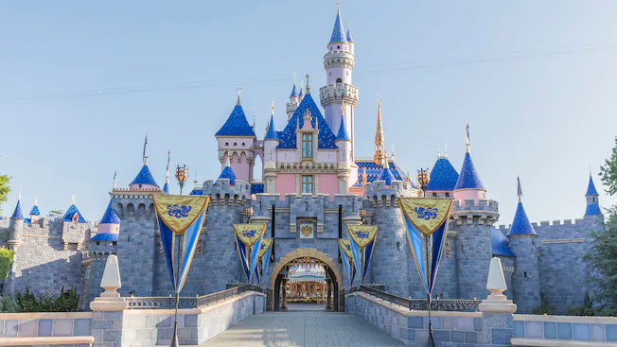
Disney Virtual Trip
Primary 1 and 2

Slide 2
Friday 26th June

Slide 3
IDL
Look at this picture from the movie ‘Moana’.
Only 1 in 1000 turtles live to be adults, they need our help!
Can you help the baby turtle to get to the sea by pointing out all of the obstacles.
What do humans need to do when they are on the beach to keep turtles safe?
Can you make a leaflet or poster to tell beach-goers how they can protect the environment?
LI - I am learning to care for the planet and its animals.
SC -
I can identify risks to the turtles.
I can explain what we can do to look after the turtles/planet.
I can present my ideas clearly through a recording or poster/leaflet.

Slide 4
Reading
Watch the clip from ‘Moana’ and answer the questions:https://www.youtube.com/watch?v=KGqBfyQFG_g
What did Moana find on the beach?
Where did the turtle go?
Why did Moana want to go back to the beach?
Make sure you write your answers in sentences. You could think of a question to ask somebody else, to check that they were watching carefully!
LI - I am learning to answer questions about what I have seen/heard.
SC –
I can watch and think carefully about what is happening in the clip.
I can answer questions about what I have seen.
I can create my own questions.

Slide 5
Writing
Enjoy the Toy Story ride. https://www.youtube.com/watch?v=_oqkZbkZ6gg
The Toy Story characters are all very good friends. Can you write a letter to one of your friends? You might want to tell them a piece of news, or what you enjoy doing with them.
LI - I am learning to write a letter.
SC –
I can use “to” and “from”. I can sound out words. I can draw a detailed picture.
I can write in sentences. I can use “to” and “from”.

Slide 6
Numeracy
Mickey Place Value
Draw yourself a Mickey place value board, like the example. Have an adult choose a number between 10 and 50. Put the number in the middle of the board and use the ears to show how many tens and units the number is made up of.
LI –
I am learning to build numbers using tens and ones.
SC -
I can split a number into its tens and ones.

Slide 7
HWB
Watch the video of the parade. Can you join in with any of the dancing?
https://www.youtube.com/watch?v=rR-KP8KH1Ng
Learning Intention: I am learning to follow movements that I see.
Success Criteria:
I can follow movements.
I can create my own dance.

Slide 8
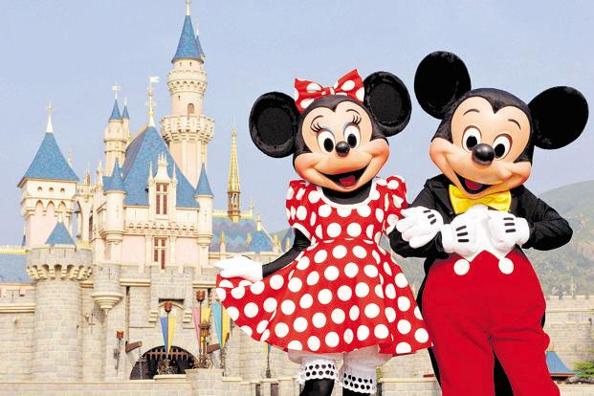
Create a souvenir photo! Take a close photo of your face and add it to the template as your souvenir!

Slide 10
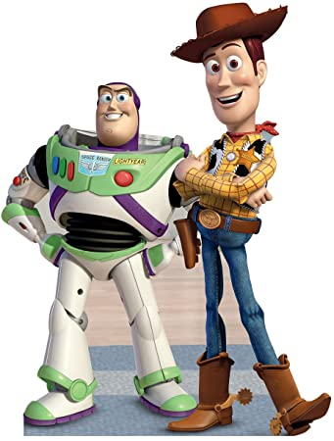

Slide 12
