Slide 1
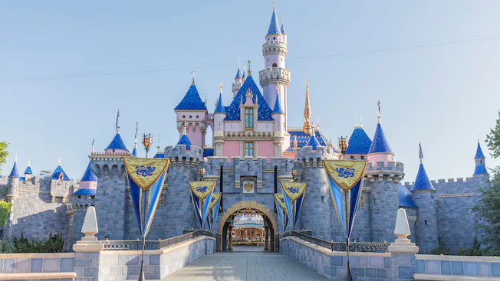
Disney Virtual Trip
Primary 1 and 2

Slide 2
Thursday 25th June

Slide 3
Reading
Can you read each character’s name? Can you match them to the correct pictures?
Challenge Match the phrases to the correct pictures.
LI - I am learning to blend sound in order to read words.
SC -
I can blend sounds together.
I can match the words to the pictures.

Slide 4
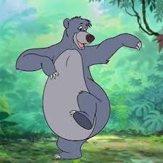
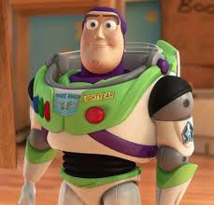
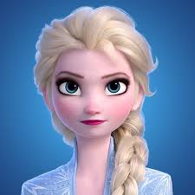
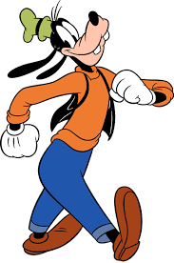
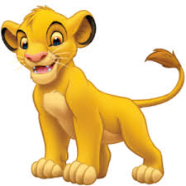
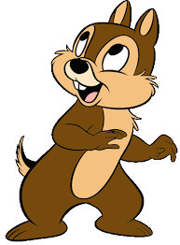
Elsa
Chip
Goofy
Simba
Baloo
Buzz

Slide 5
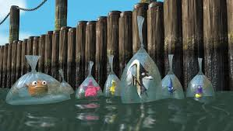
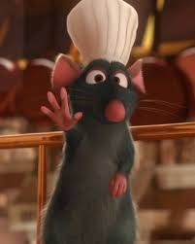
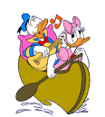
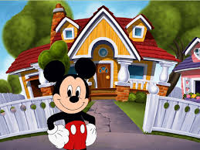
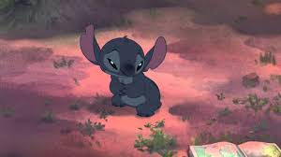
Match the phrases to the correct pictures.
Two ducks in a boat.
A mouse and his house.
There is a rat in a hat.
Stitch is sad.
The fish are in bags.

Slide 6
Writing
Task: We’re Flying Through the Air! Enjoy the Aladdin ride, where you fly through the sky on a magic carpet!
Where would you fly to on a magic carpet and why? Describe the setting using your most descriptive words! What would you see, hear, smell, touch and taste in the setting?
https://www.youtube.com/watch?v=fcbWb1FkSC0
LI –
I am learning to describe a setting.
SC -
I can use descriptive words. I can describe a setting to the reader.

Slide 7
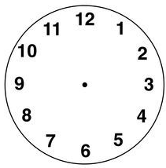
Numeracy: Primary 1
Draw the hour and minute hands to show the time.
The park opens at 9 o’clock.
You go on the log flumes at 11 o’clock.
You visit Mickey’s house at 4 o’clock.
Challenge: The park closes at half past 8.

Slide 8
Numeracy: Primary 2
Draw the hour and minute hands to show the time.
The park opens at quarter past 9.
You go on the log flumes at half past 11.
You visit Mickey’s house at quarter to 3.
Challenge: The park closes at 25 past 8.

Slide 9
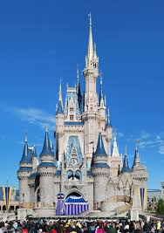
IDL
STEM
Look at the picture of Cinderella’s castle. Can you create your own castle using materials of your choice? You could use sticks, blocks, or anything else that you wish. Be as creative as you can!
LI - I am learning to build a design.
SC - I can select materials that will work for my design. I can create an interesting design. My design is stable and stays up.

Slide 10
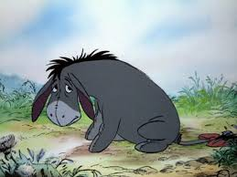
HWB
Eeyore is known for being sad sometimes. What could you do when you are feeling sad to make yourself feel a bit better?
Extension: How could you help a friend who was feeling sad?
LI - I am learning to identify and manage my emotions.
SC -
I can explain ways that I could try to cheer myself up when I am sad.
I can think about how to help others too.

