Slide 1
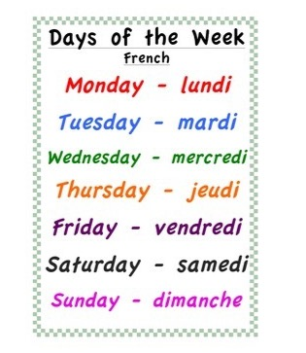
Wednesday 24th of June Mecredi 24 juin
Good Morning Primary 1!
Bonjour la class! Ca Va?
Click on the above picture to listen to the days of the week in French.

Slide 2
Moana Dance Class!
Click on the above picture to join in with Oti Mabuse’s Disney dance class.

Slide 3
Wednesday’s Disney Virtual Trip

Slide 4
I can use knowledge of sounds, letters and patterns to read words.
Activity –
Can you see the hidden ‘tricky words’ and words containing long vowel sounds in the next two pictures.
Draw your own Disney picture and hide some of our spelling words in it.

Slide 5
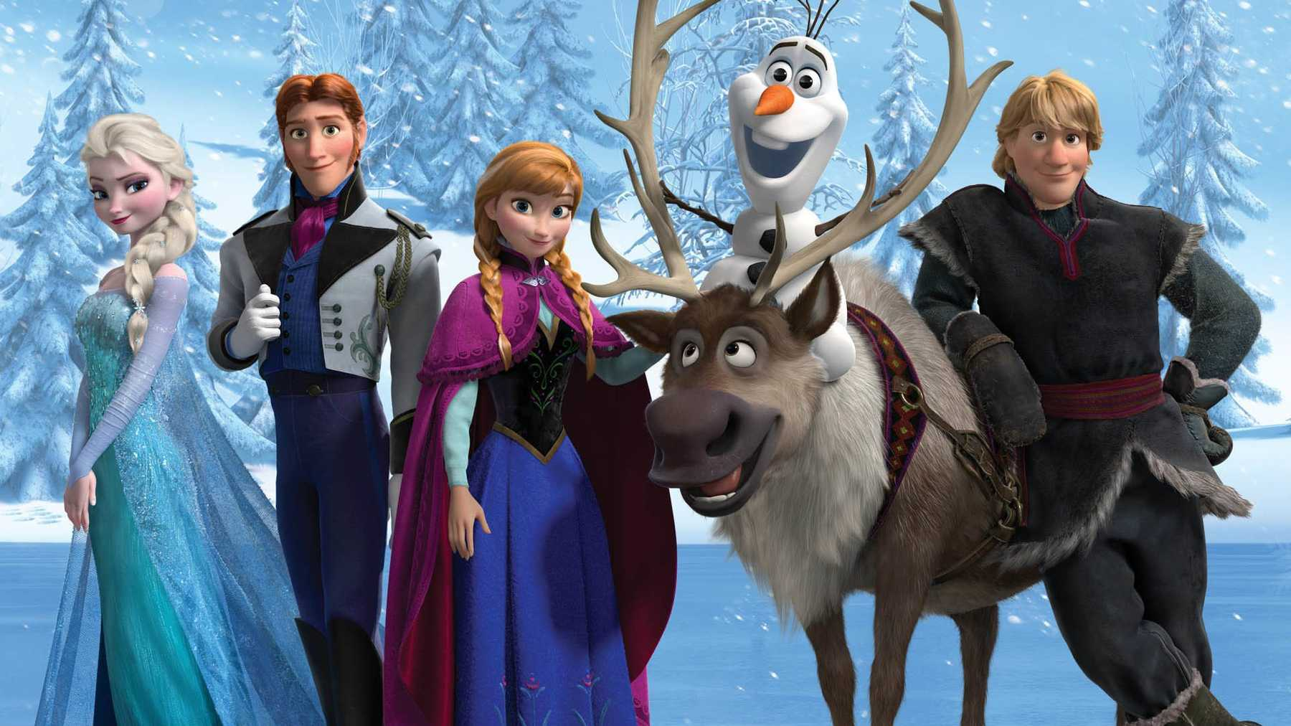
some
said
all
we
go
me
they
she
come
the
are
one

Slide 6
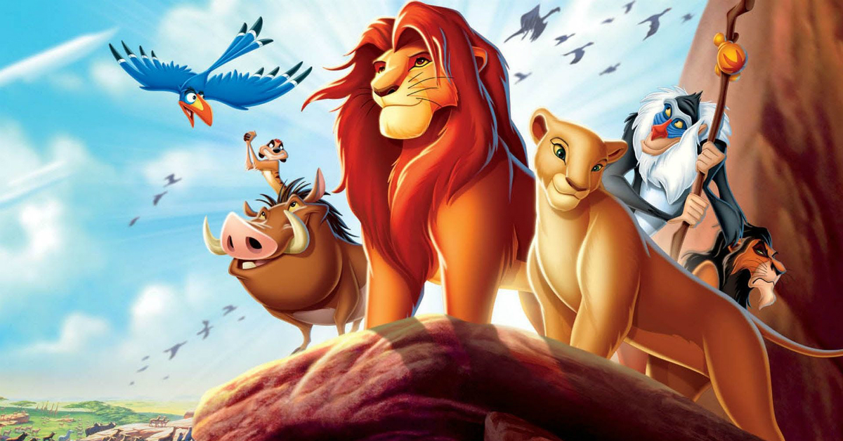
snail
whip
fly
light
soil
shed
read
thick
boat
chop
fly
green
book

Slide 7
Story Time
I enjoy engaging with and listening to a story.
Click on the picture to take you to the story.

Slide 8
I can write to reflect my own experiences and feelings.
Activity – Make a postcard to send to someone telling them all about your virtual trip to Disney. You will need to write a message on one side and detailed picture on the other.
Challenge – Can you write the person’s address?

Slide 9
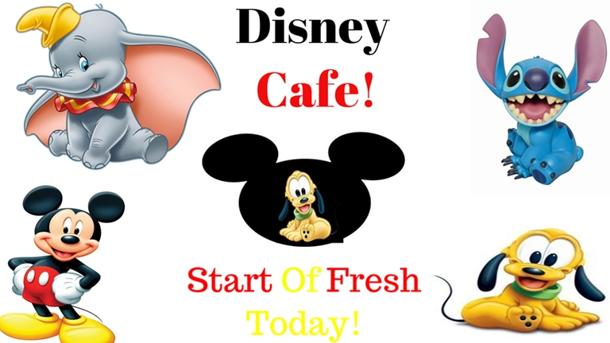
I can recognise and use a range of coins.
Have a look at the Disney snacks on the next few slides.
Circle the snack that you would like, and choose the correct coins to pay for it. There are 3 slides, so you could do this 3 times.
Challenge: How much change would you get if you paid with a 10p coin?
I can apply addition and subtraction skills and use 1p, 2p, 5p and 10p coins to pay the exact value to items to 10p

Slide 10
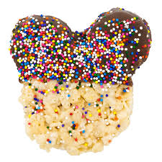
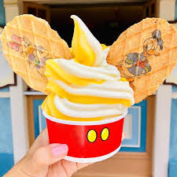
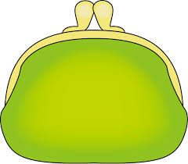
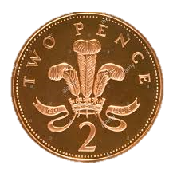
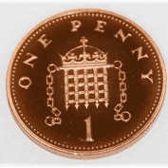
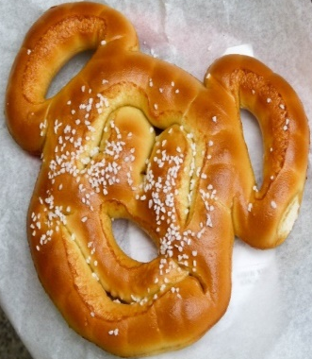
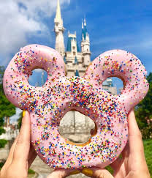
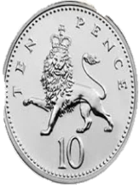
Mickey’s Snack Menu
Aladdin fruit skewers 5p | Pizza 7p
Ice cream 10p | Rice crispy treat 6p
Pretzel 4p | Doughnut 8p

Slide 11
Mickey’s Snack Menu
Aladdin fruit skewers 5p | Pizza 7p
Ice cream 10p | Rice crispy treat 6p
Pretzel 4p | Doughnut 8p

Slide 12
Mickey’s Snack Menu
Aladdin fruit skewers 5p | Pizza 7p
Ice cream 10p | Rice crispy treat 6p
Pretzel 4p | Doughnut 8p

Slide 13
I can demonstrate simple food preparation techniques.
Activity – listen to the Ratatouille clip (click on the above link) can you help to prepare a meal or snack today? You could look at a recipe with an adult.
With adult support I can demonstrate simple food preparation techniques e.g peeling, slicing, mixing, spreading.

Slide 14
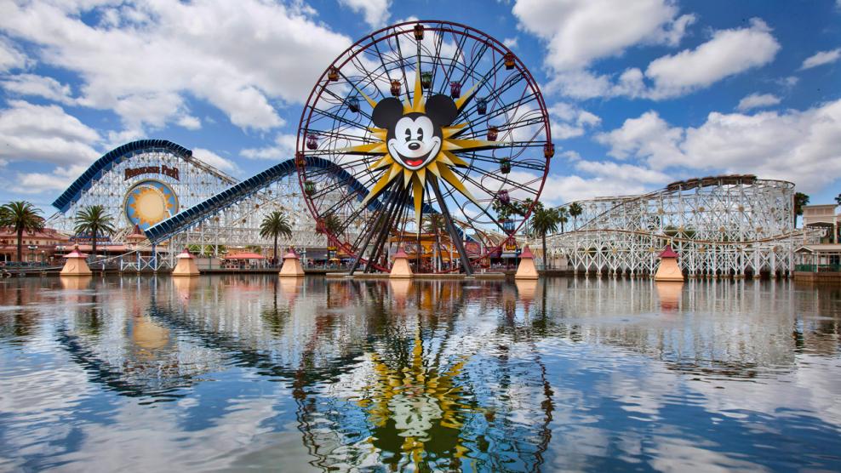
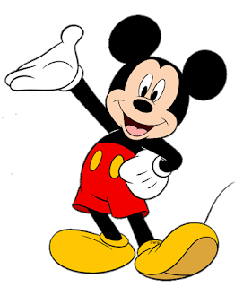
I can explore and discover different ways of representing ideas in imaginative ways.
Mickey has asked for your help to design a new ride for Disney Land! You could draw your ride, video yourself describing it, or build it out of blocks, recycling etc.
I can use a range of materials when designing a model of a Disney ride.

Slide 15
SHANARRI Activity
Choose one of the the SHANARRI activities.
Safe
Achieving
Healthy
Nurtured
Responsible
Active
Respected
Included

Slide 16
Smile Mile
Go for a Smile Mile around your garden or outside area.

