Slide 1
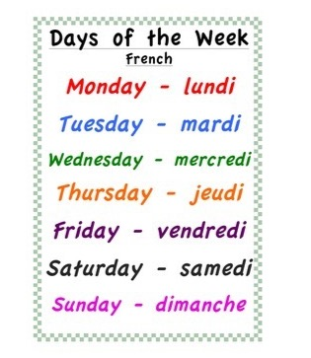
Tuesday 23rd of June Mardi 23 juin
Click on the above picture to listen to the days of the week in French.
Click on the rainbow to listen to our Tuesday song.

Slide 2
Disney Moana Cosmic Kids
I am learning how to move my body well exploring how to manage and control it.
Click on the picture to take you to Cosmic Kids.

Slide 3
Tuesday’s Disney Virtual Trip

Slide 4
I am learning to describe a character.
Click on the picture to take you to the 360º Ride on Monsters, Inc. Mike & Sulley to the Rescue!
Design your own monster and record yourself describing them. Are they kind, scary, fluffy, angry? Can you think of any other ways to describe them?
Write a sentence to describe your monster.

Slide 5
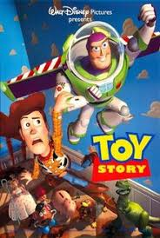
Story Time
I enjoy engaging with and listening to a story.
Click on the picture to take
you to the story.

Slide 6
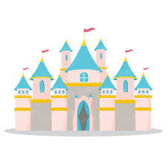
I can use simple directions and describe positions.
Look at the map of Disney World on the next slide. Can you find your way through the map?
1 Start at the Entrance and go to Donald’s house boat.
2 Start at the log flume and go to the rollercoaster.
3 Start at the pond and go to the Frozen ride.
Challenge: Can you give detailed directions on how to get from each place to the next. For example, “Turn left then go straight until you get to the pond”.

Slide 7
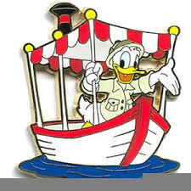
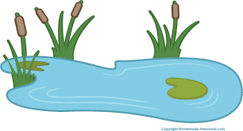
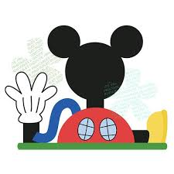
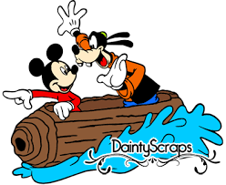

Slide 8
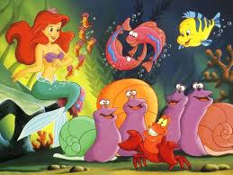
I listen or watch for useful or interesting information.
Why does Sebastian think it is better to live under the sea? Record yourself explaining 2 reasons from the song.
Draw and label a detailed picture of why Sebastian thinks it is better to live under the sea.

Slide 9
SHANARRI Activity
Choose one of the the SHANARRI activities.
Safe
Achieving
Healthy
Nurtured
Responsible
Active
Respected
Included

Slide 10
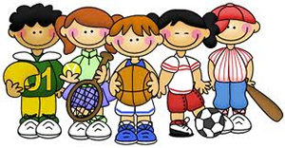
P.E
Take part in Mrs McMaster’s Tuesday activity.

