Slide 1
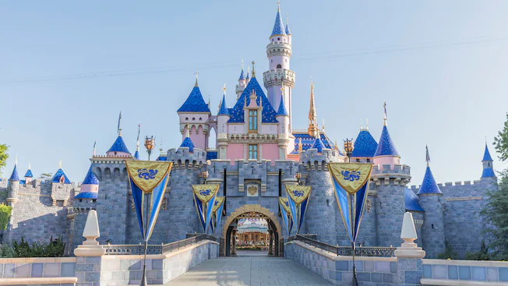
Disney Virtual Trip
Primary 1 and 2

Slide 2
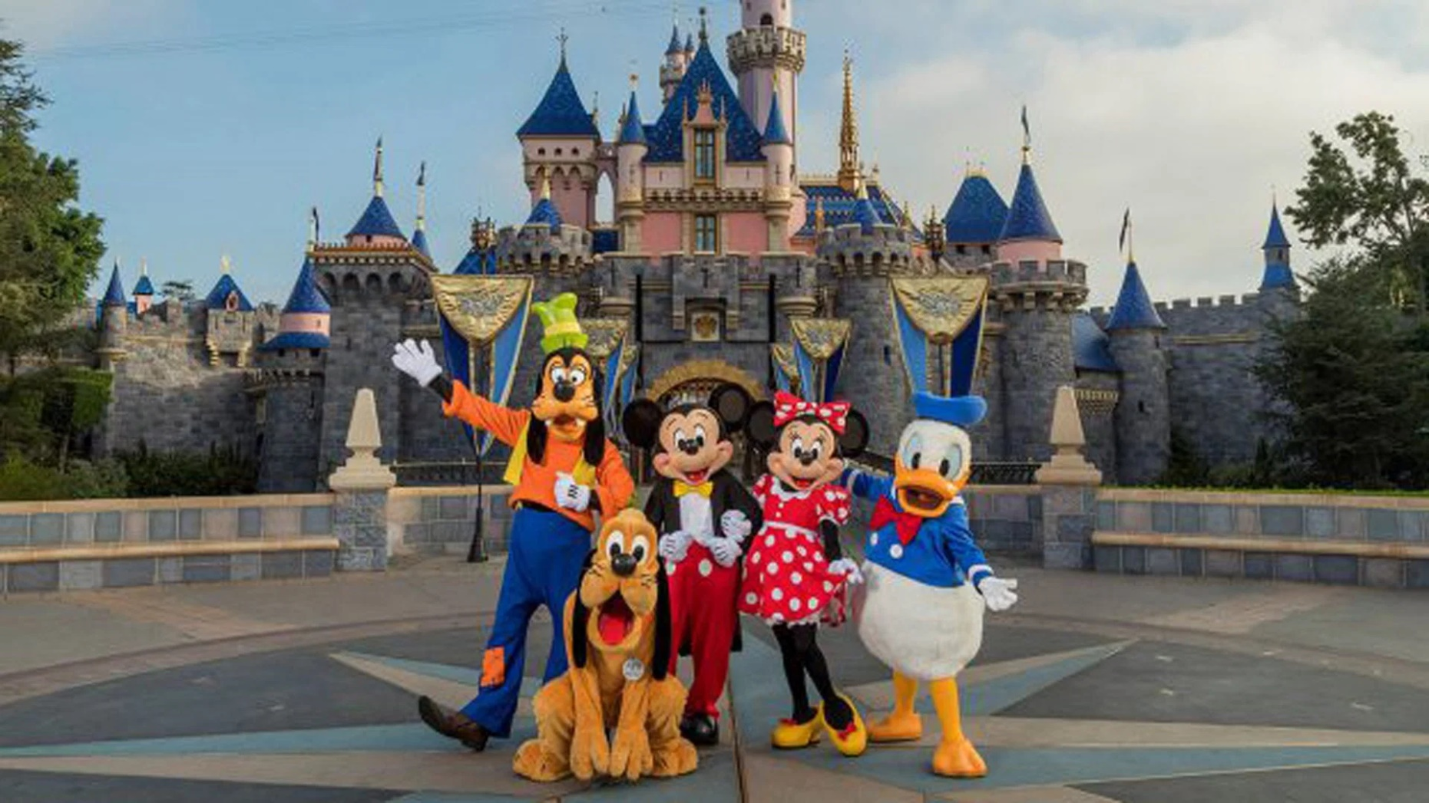
Monday 22nd June

Slide 3
Art
Create a passport that you can use during your trip! Remember to include a front cover, your name, a picture of yourself and lots of space for characters names! Each time you see a character this week in a ride, video or song, make sure to write their name in your passport! How many characters will you meet by the end of the week?
LI - I am learning to create an eye-catching design.
SC - I can create a front cover.
I can include: my name and age.

Slide 4
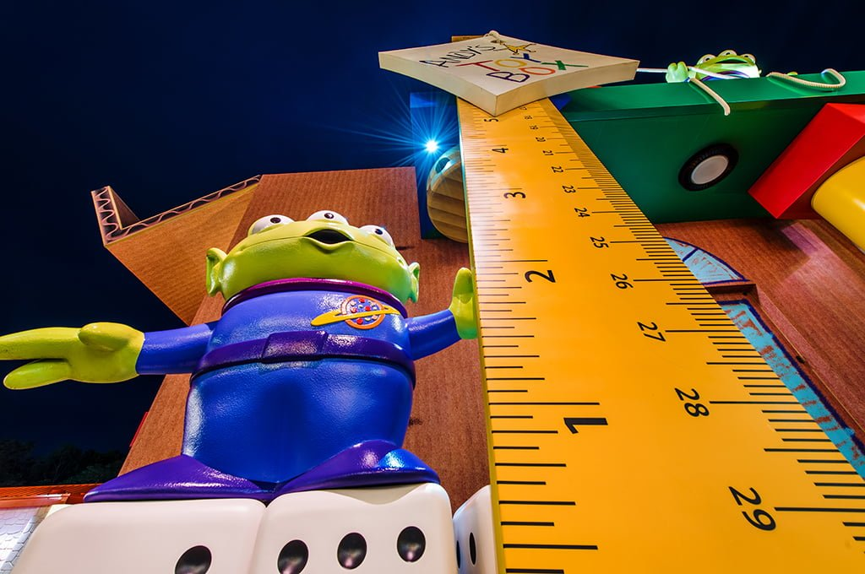
Numeracy
To go on today’s the rides you must be taller than:
6 pieces of cutlery
6 of your own shoes/socks
3 books
15 blades of grass
Estimate and then measure whether you are tall enough to ride!
If you have a measuring tape/ruler, you could measure how tall you are. Can you find 3 things that are taller and 3 things that are shorter than you. Measure the height of each thing.
LI - I am learning to measure and estimate height.
SC - I can use a tape measure/ruler accurately. I can compare heights.

Slide 5
Writing
Take a tour of Donald Duck’s house boat. What can you see? Draw and label 5 things that you can see inside his house.
Challenge: Can you think of a story using Donald Duck’s house as the setting?
Write about how Donald Duck’s house is different to yours, for example, my windows are not circles and I do not dry my washing on my roof!
https://www.youtube.com/watch?v=XERRGapwSVQ&t=17s
LI - I am learning to write about a setting.
SC - I can write in sentences. I can identify differences.

Slide 6
IDL
Task: Enjoy the ‘It’s a Small World’ ride. The ride shows many countries and places around the world.
Find out 2 facts about another country You could add photos/drawings/text to the template or record yourself saying what you have found out.
Compare Scotland with another country. You might think about: weather, food, attractions/scenery, events and celebrations, flags or anything else you are interested in. You could present your information in a poster or by speaking
https://www.youtube.com/watch?v=I2Do309e4YU
LI - I am learning about other countries and cultures.
SC -
I can find out 3 facts about another country.
I can find out information about a country. I can think about how this compares to Scotland.

Slide 7
Reading
Watch the Frozen ride – how many words can you think of that rhyme with snow. Record yourself saying all of the words that you can think of.
https://www.youtube.com/watch?v=J8OHP9OriMA&t=33s
Challenge: Make a silly sentence using as many of the words as you can.
Write down your list and create a silly story using lots of rhyming words.
LI - I am learning to produce rhymes.
SC -
I can produce a rhyme.
I can write a silly sentence or story using rhyming words.

