Slide 1



Welcome to …
Mrs McEwan’s Monday message
Notes:
Welcome to Mrs McEwan’s Monday message!
I hope you all had a lovely weekend. I hope you are all still safe, well and happy. I can’t quite believe that we are beginning our last week of term and that this is our last assembly of the school year.

Slide 2

Our school Values
Kindness Honesty
Respect Love
Notes:
Good morning everyone! We are now in the final week of the Summer term so I thought a really good way to end our year would be to sing our school hymn altogether – fingers crossed the music will work but if not I am sure that you all remember the tune! Let’s think of our school value of love this morning and the really happy memories of our friends at school while we sing the words ‘Joseph teach us how to live and show us how to love’

Slide 3

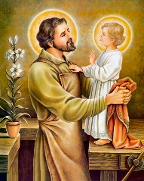
Let’s all sing our school hymn to St. Joseph!
Verse 2
Joseph was a man of God, a strong and gentle man,
Called to have a special part in God’s almighty plan.
Joseph had to trust that God knew what was best,
As Joseph’s faith and love for God were put to the test.
Chorus
Verse 3
Joseph was a man of faith, a kind and humble man,
He accepted what God planned tho’ he didn’t understand.
Joseph heard God’s call and his new life had begun,
As he and Mary love and cared for Jesus, God’s own son.
Chorus
Verse 1
Joseph was a carpenter, a man who worked with wood,
Working hard and honestly the only way he could.
He found a girl he loved, with whom he’d share his life,
And he would raise a family with Mary as his wife.
Chorus
Joseph, show us how to live, show us how to love,
Show us how to give our lives to God.
Joseph, show us how to trust, show us how to care,
Show us how to give our lives to God.

Slide 4
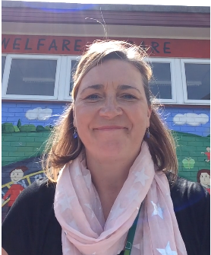
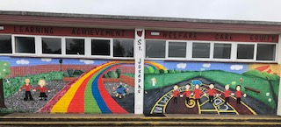
A message from Mrs McEwan
https://vimeo.com/430632751/467b9faa94
Notes:
Here is a message from me to tell you all about some of the changes we have been making in the school.

Slide 5
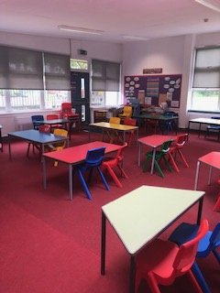
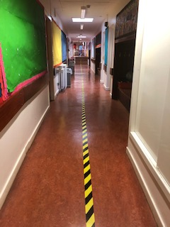
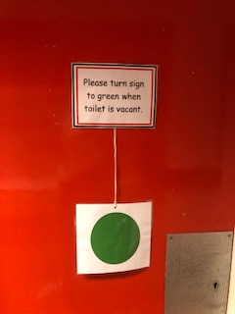
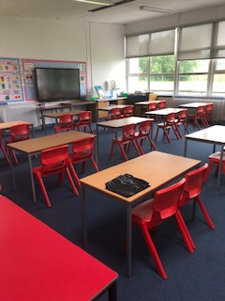
Some photos of changes inside the school
Notes:
Before I go on to tell you about the winning house for this year – here are a few photos that I took in school this week to give you a little peek at how the classrooms look a bit different. It is very likely that they will look like this in August.

Slide 6

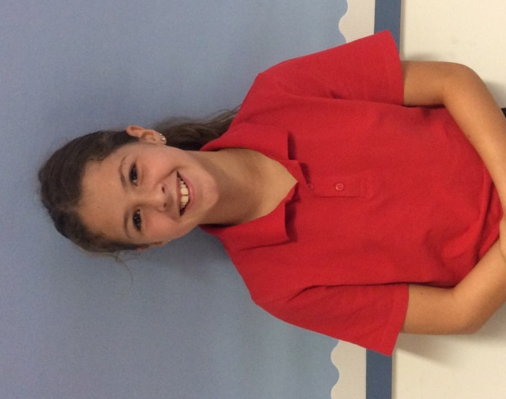
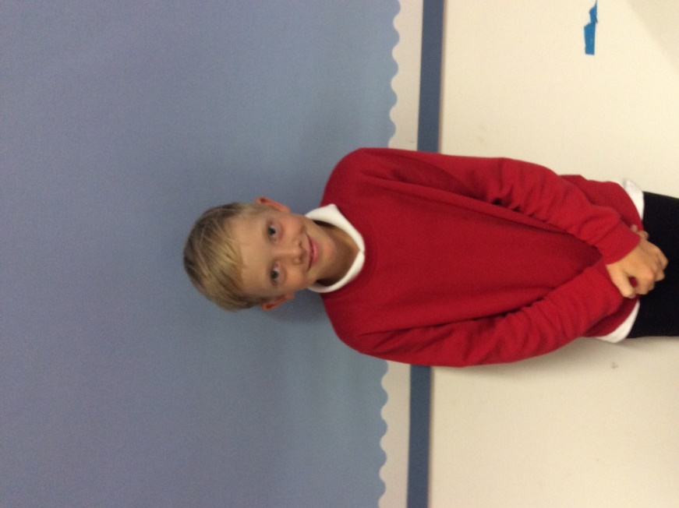
House Points
1541 + 960 (Sports Day)
= 2501

Slide 7

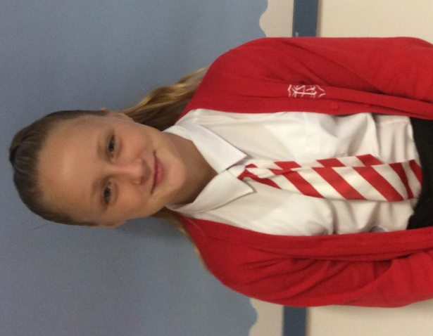
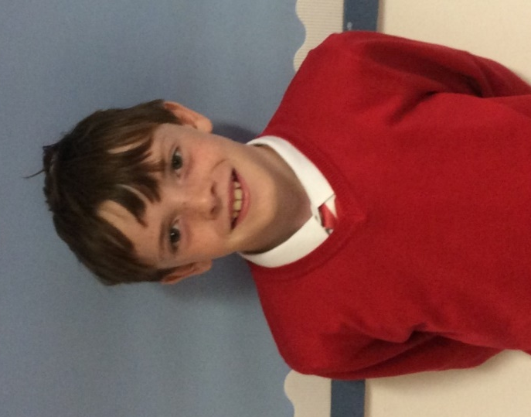
House Points
1731 + 900 (Sports Day)
= 2631

Slide 8

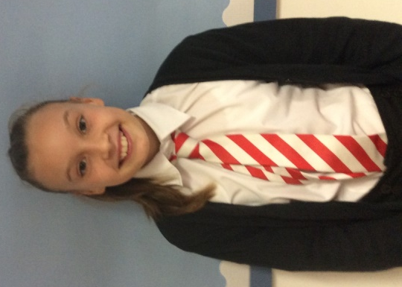
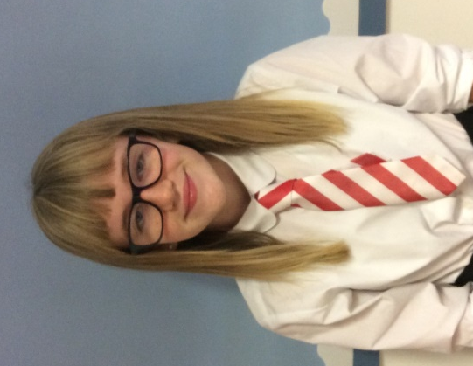
House Points
1593 + 840 (Sports Day)
= 2433

Slide 9

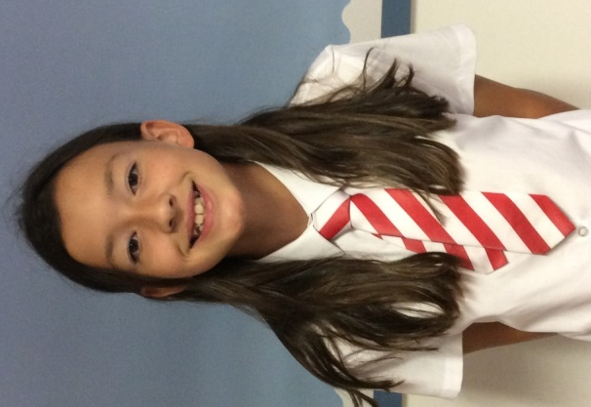
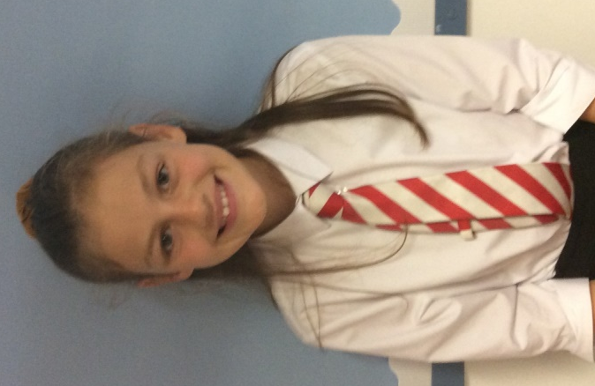
House Points
1835 + 730 (Sports Day)
= 2565

Slide 10

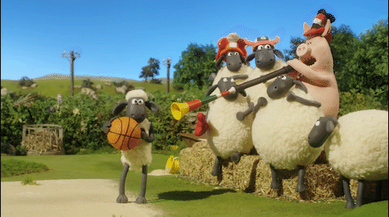

Sports Day
Winners

Slide 11


House Point
Winners

Slide 12



Birthdays
Emma P7
Kassidy P4
Connor P5
Freya P7
Sam P6
Cara P1
Leo P1
Hazel P7
Finlay P7
Amber P3
Click on the candles
Notes:
This weeks special June birthday is Kassidy in P4 – I hope you have a lovely Birthday Kassidy!!! A big shout out too to all of our Summer birthdays in July – Cara and Leo in P1, Connor in P5, Sam in P6, and 4 P7’s celebrating their birthdays in August – Emma Mc, Freya, Hazel and Finlay! Happy Birthday to all of you – I hope your celebrations are very special this Summer!

Slide 13

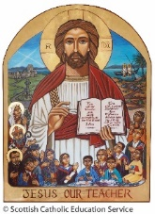

Prayer for the week
May God's blessings await us next year,
To embrace each new challenge without fear.
Fill this school with your love,
and guide our hearts from above.
Full of faith, full of hope,
full of joy, and full of love.
Amen.
May God's blessing go with us today,
At the end of this school year we pray.
That you keep us safe and give us rest
So we start again renewed and refreshed.
Full of health, full of fun
Ready to come and learn again.
May God's blessing go with us today,
As we begin our school holiday.
Give your peace and your joy,
To every girl and every boy.
Help the teachers to enjoy the break,
and prepare and plan for the new intake.
Notes:
As we say a special prayer this, the last week of term we think about how very special the community of St. Joseph’s is and give thanks that we are all safe and well. We remember this as we say … In the name of the Father and of the Son and of the Holy Spirit Amen…..

Slide 14


A message for all our leavers
The Summer Term at St. Joseph’s is nearly over now with holidays coming fast,
I have to tell that this year has simply been a blast.
Shortly you’ll be moving on to different schools – all fresh and new,
This school will be so different when we do not have you.
We’ve watched you grow and turn into the young people that you are,
Developing your skills and personalities – you simply are all stars.
We want you to remember, a message from us all,
Live your life and chase your dreams, whether big or small.
You are all unique and wonderful and of course you will be missed.
So grab life and forever hold it tightly in your fist.
Goodbye from everyone at St. Joseph’s, and thank you – it has been so much fun,
Remember you are special, stand tall and be proud – everyone!
Notes:
We also have a very special thought for all the pupils who are leaving us this year. We know that we will see all of you later in the year when it is safe to do so but we want to wish you all well so here is a lovely poem for all of our P7’s and for Ellie, Izzy and Anthony. We wish you all the very best in your new schools.

Slide 15
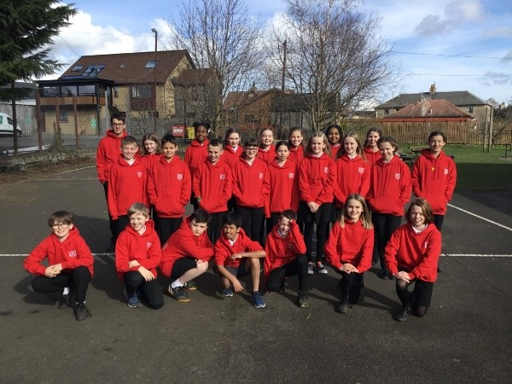
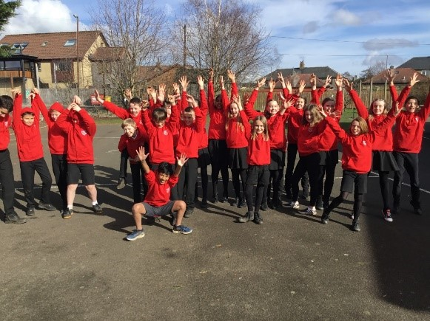
Good luck P7 from everyone at
St. Joseph’s
Notes:
A final thought for the week has to be for our P7 pupils not only leaving us but starting the next stage of the learning journey at high school. On behalf of the whole school community of St. Joseph’s I want to say what a pleasure and a privilege it has been to see you learn and grow into unique and fantastic individuals – I am lucky to have been part of your journey. I know you will all be successful in everything you do – I can’t wait to find out what you become! The very best of luck for your future with lots of best wishes from me and all the pupils and staff at St. Joseph’s.

