Slide 1
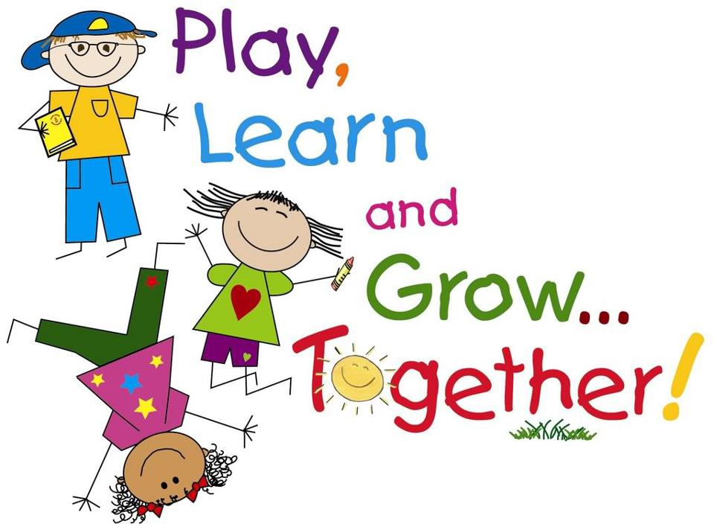
P2 – Thursday 26.3.20

Slide 2
Good Morning ☺
Have a great Friday everyone!

Slide 3
Friday 19th June 2020
19.6.20
Prayers
Mindfulness
Wonder Wall
Freewriting
Break
Milk and Story
Spelling Challenge
BMBT
Reward Time

Slide 4
Morning Prayer
Father in Heaven you love me,
you are with me night and day
I want to love you always in all I do and say
I’ll try to please you father
bless me through this day.
Amen

Slide 5
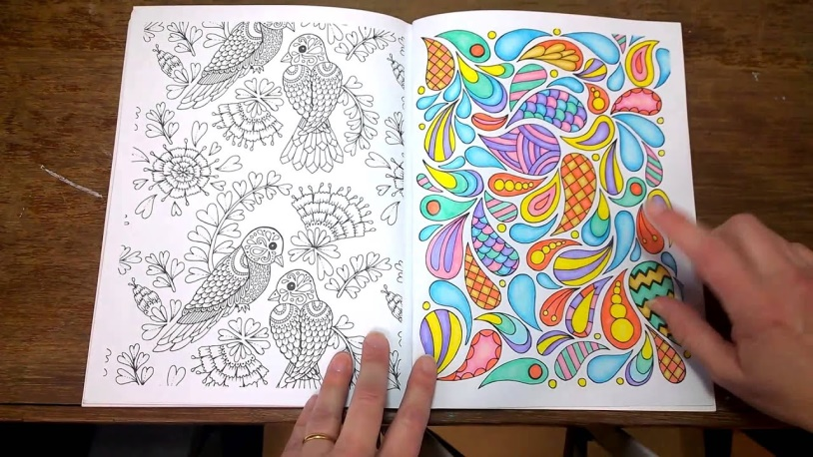
Mindfulness - 19.6.20
LI – I am learning to use mindfulness skills to reduce stress and support my wellbeing.
Activity
I have added a mindfulness colouring page to our blog for you. Try to make it as colourful as possible. You can send a picture to my email address if you like! The link below will give you some relaxing music to listen to while you are colouring.
https://www.youtube.com/watch?v=rBF35invXZc

Slide 6
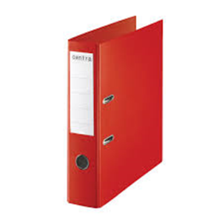
Profiles - 19.6.20
LI – I am learning to keep a record of my learning.
Task
Lets see if we can complete our Wonder Wall.
What have we been learning this week?
On your Wonder Wall from last week you can do our usual activity where we fill in 2 bricks in our Wonder Wall to record something we have enjoyed learning about this week. If you had any problem printing it just use a page at the back of your jotter and create your own wall.
Remember it can be a picture or words.
SC – record 2 learning activities
- discuss what you enjoyed about them

Slide 7
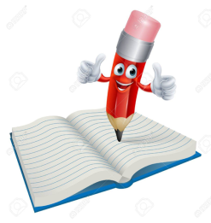
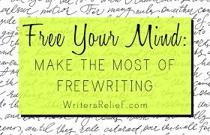
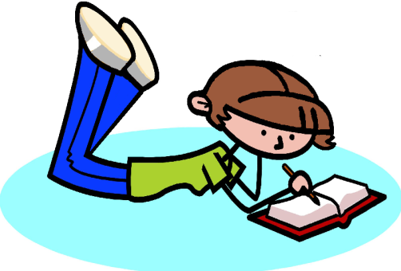
Free Writing - 19.6.20
LI – I am learning to select my own purpose for writing.
Task
Either in your jotter or another notebook at home, use 1 page to write about anything you like, just like we do at school ☺
SC – enjoy writing !

Slide 8
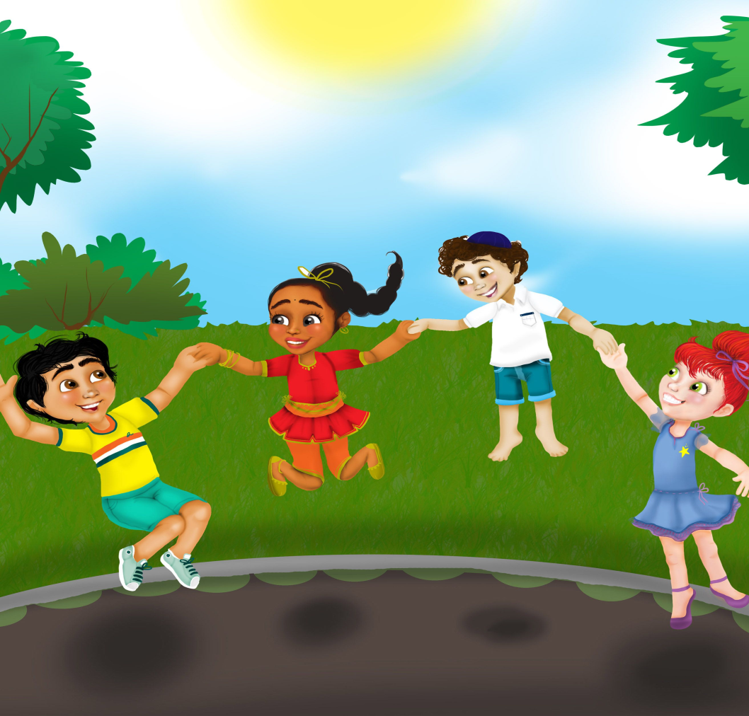
Have a Break - 19.6.20

Slide 9
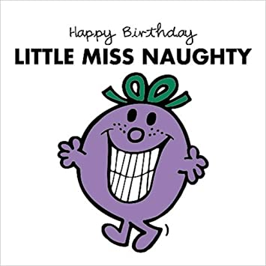
Milk and Story - 19.6.20
Here’s a Little Miss Naughty cartoon for you!☺
https://www.youtube.com/watch?v=ZkDJpiPwDH4

Slide 10
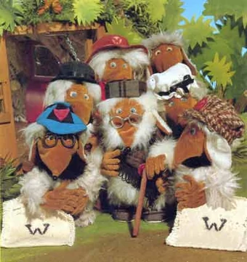
Milk and Story - 19.6.20
Here is a link to our Friday treat! ☺
https://www.youtube.com/watch?v=O_tlI-m8MXI

Slide 11
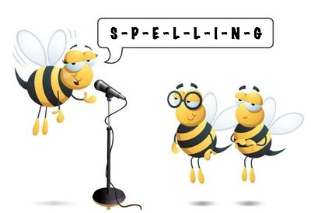
Spelling Challenge- 19.6.20
LI – I am learning to identify and use spelling patterns.
Ask an adult to give you a spelling challenge on this weeks words. They could even select a couple of words from previous weeks if you have your Home Learning Journal with you!
How did you get on?
SC – I can spell words accurately.
I can blend sound into words.

Slide 12
Big Maths Beat That - 19.6.20
LI – I am learning to recall addition facts quickly and accurately.
Task
You can print a BMBT sheet from our blog page. The link below will take you to the music, you’ll need to set a 30 second timer and start the timer when the music finishes. Are you ready……?
Remember not to start until it’s time, begin with the calculation you find easiest and check it over if you have time before the time is up! You could ask others at home to join you, just print them a copy too!
https://www.youtube.com/watch?v=VHB9Fm04URQ
SC – correct answers
- you gave it a go!

Slide 13
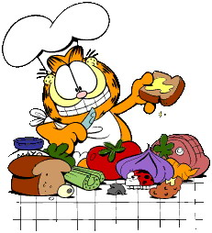
Lunchtime
Bless us O Lord
as we sit together.
Bless the hands that
made the food.
Bless us O Lord
Amen

Slide 14
I hope you have all had a good morning. Enjoy your lunch and do something fun for Reward Time.
Enjoy the rest of your day and have a great weekend . I will ‘see’ you all again on Monday!
Mrs Grant ☺

