Slide 1
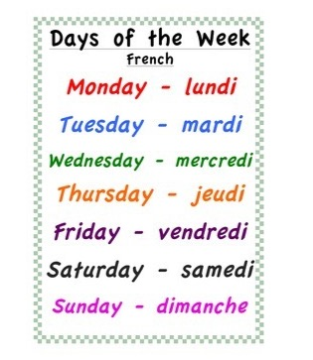
Friday 19th of June Vendredi 19 Juin
Good Morning Primary 1!
Bonjour la class! Ca Va?
Listen to the days of the week in French
Click on the above picture to listen to the days of the week in French.

Slide 2
Oti’s Boogie Beebies
I can move my body well, exploring how to manage and control it.
Click on the above link to take you to the song.

Slide 3
Story time
I can participate actively in songs, rhymes and stories.
Click on the above link to listen to the story ‘Alien Loves Underpants’.
Activity – design an amazing pair of underpants that the Aliens would love.
.

Slide 4
Sounds
OLI - I can use knowledge of sounds, letters and patterns to read words.
Revision of sounds
Click on the sound button, say the sound and the word.
sh
th
wh
ai
ay
ch
ee
ea
igh
y
oa
ow
oo
ew
oi
oy
ou
ow
au
aw
sound out words containing consonant digraphs sh, ch, th, wh and long vowels ai/ay, ee/ea , igh/y, oa/ow ,oo/ew , oi/oy, ou/ow and au/aw using our 'Fred Fingers’

Slide 5
Mrs Taylor’s Active Spelling Challenge
Choose one of the activities to sound out 4 of our revision words.
Or choose your own way to learn your spelling words.

Slide 6
Father’s Day
I know that there are people in our lives who care and look after us.
Click on the picture to take you to the video clip.
Activity – download the Father’s day card from the blog to decorate or create your own.

Slide 7
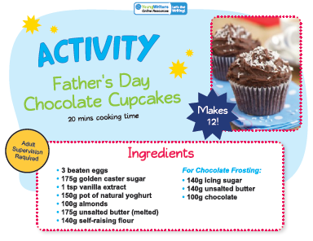
Recipe
3 beaten eggs For Chocolate Frosting:
175g golden caster sugar * 140g icing sugar
1 tsp vanilla extract * 140g unsalted butter
150g pot of natural yoghurt * 100g chocolate
175g unsalted butter (melted)
140 g self-raising flour

Slide 8
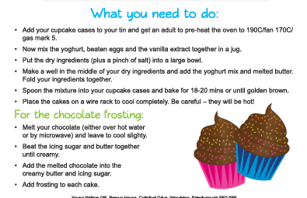
Father’s Day Krispie Cakes

Slide 9
Number Time
I can double numbers to a total of 20.
I can use practical materials to ‘count on and back’ to help me to understand subtraction.
To subitise and then double a number within 20.

Slide 13
Activity – Can you make your own Princess Mirror-Belle reflection?

Slide 14
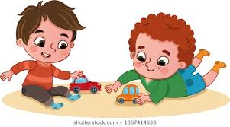
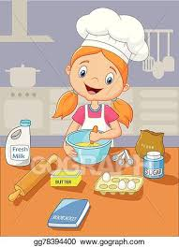
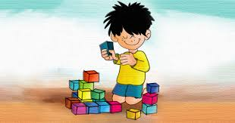
Fun Friday Activities
Article 31 – I have the right to play and relax.

Slide 15
Well Done Primary 1!
Primary 1 you are all amazing! Well done for another week of super learning. Have a fantastic weekend!

