Slide 1
Thursday
18.6.20
Daily Plan

Slide 2
Morning
This Photo by Unknown Author is licensed under CC BY-SA

Slide 3
Spelling Starter
low
grow
throw
follow
shallow
show
LI – I am learning the ‘ow’ sound
Complete one of the activities
to practise your spelling words.

Slide 4
Matilda Chapter
Listen to or read Chapter 19 of Matilda
See the next slide for your activity.
Click on the picture to listen

Slide 5
Matilda Activity
In chapter 19 Matilda shows a great deal of perseverance and determination. Read the next few slides to find out what this means.
Ask an adult to tell you about a time they had to do this.
Complete the activity on the blog.

Slide 6
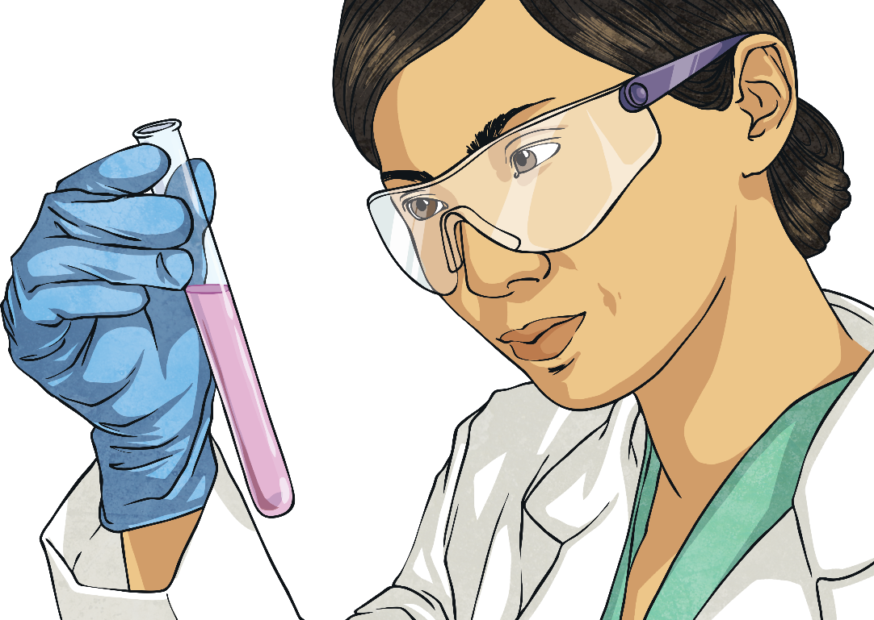
What Is Perseverance?
Perseverance is when someone keeps trying, no matter how hard something is.
It can help someone achieve their goals.

Slide 7
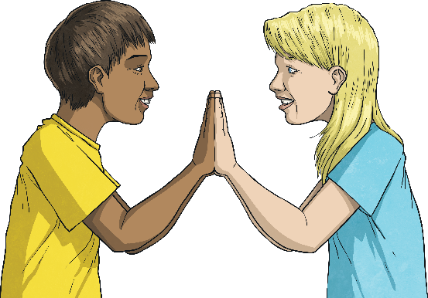
How Can We Show Perseverance in School?
We can show perseverance in school by:
not giving up;
following school rules;
trying your best;
setting some goals for yourself;
asking for help if you need it.

Slide 8
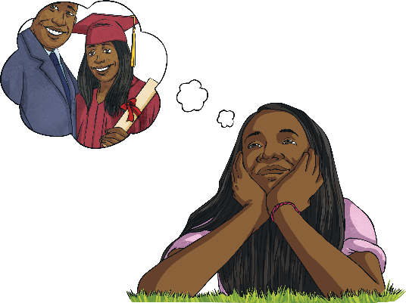
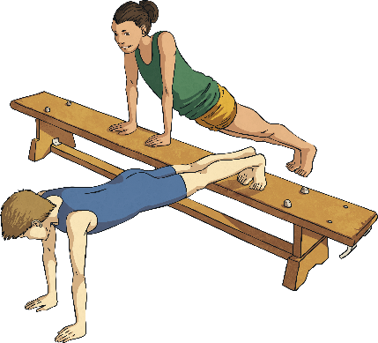
Examples of Perseverance
Never giving up on your dreams!
Training for the team you would like to join, no matter how tiring it is.
Finding new ways of learning something that you need to know to make sure you achieve your goal!

Slide 9
Break Time
This Photo by Unknown Author is licensed under CC BY-SA

Slide 10
Mid Morning
This Photo by Unknown Author is licensed under CC BY-SA

Slide 11
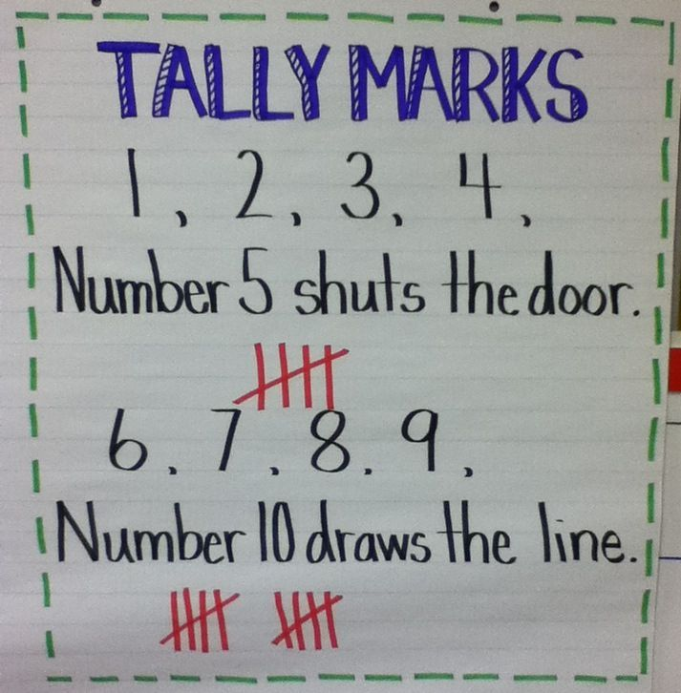
Maths
LI – I am learning to
use tally marks

Slide 12
Tally Chart
A tally chart is a quick and easy way to record lots of information.
If you want to know what eye colour every child in the school has you could go around the classes doing a survey. This would be a lot of people to record data for at one time, if you tried putting 1 for each child by the time you finished it would take you a long time to count up the information.
Instead you could record the information you get using tally marks.

Slide 13
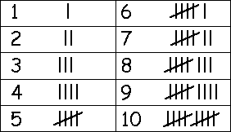
Tally Marks
When using tally marks you begin by using a single line for the number 1, you keep going this until you get to the number 5 then you create your first group.
This means that when you have finished collecting your data you can count in groups of 5 to find out how many you have.
Much quicker than trying to keep track of lots of 1s.

Slide 14
Tally Chart Tasks
Watch the video below:
https://www.bbc.co.uk/bitesize/clips/zw3r87h
2. Complete the activity on the blog
3. Optional extension:
Tally mark domino game on the blog

Slide 15
Lunch Time
This Photo by Unknown Author is licensed under CC BY-SA

Slide 16
Afternoon
This Photo by Unknown Author is licensed under CC BY-SA

Slide 17
RE
LI – I am learning that Palestine was part of the Roman Empire.
The country where Jesus was born was called Palestine.
Palestine, at that time in history, was part of the Roman Empire. Have a look at the map of the Roman Empire (on the blog) and helps the children to locate Palestine on the map.
Have a look at the Map of Palestine (on the blog) and locate the places associated with the Bible and the life of Jesus by circling them on the map.

Slide 18
PE with Mrs McMaster
See the blog for you PE activities from Mrs McMaster, have fun!

