Slide 1
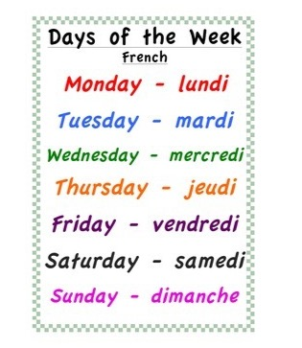
Thursday 18th of June Jeudi 18 Juin
Good Morning Primary 1!
Bonjour la class! Ca Va?
Click on the above picture to listen to the days of the week in French.

Slide 2
I am learning how to move my body well exploring how to manage and control it.
Yoga Time
Click on the above link to take you to the yoga video.

Slide 3
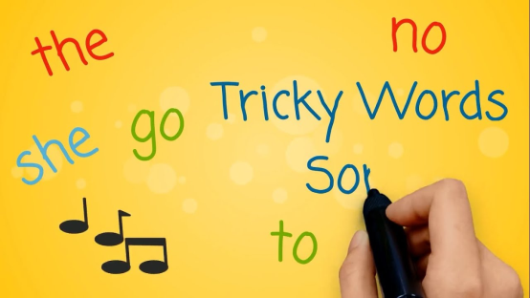
Revison Tricky Words Block 2
go we be
she are they
all some come
said one you
her of were

Slide 4
Tricky Word/sounds Dictation
I can make an attempt to spell familiar words correctly.
law
jaw
maul
haul
there
into
Are my letters formed correctly?
Are my letters in the correct order?
CHALLENGE - Write a sentence using one of the tricky Words above.
Ask an adult to read out these tricky words.
Can you spell them correctly?

Slide 5
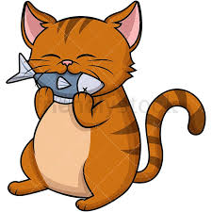
Sentence Dictation
I can make an attempt to spell familiar words correctly and use my ‘sound-box’ to spell other words.
Mum has fish for tea. The cat ran into the room. Do not let the cat eat the fish.
Are my letters formed correctly?
Are my letters in the correct order?
Did you remember finger spaces?
Did you remember to include a capital letter and a full stop in your sentences.
CHALLENGE – Circle all the tricky Words in the sentences. Underline the capital letters and full stops. How many sentences can you spot?
Ask an adult to read the sentences aloud.
Can you write it independently?
Can you spell the words correctly?

Slide 6
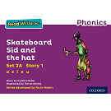
Reading Book
I can use my knowledge of sounds, letters and patterns to read words.
Read the e-book which has been set for you and self-assess using the targets below?
Activity – Reading Task mat. Choose one of the Reading Task Mat activities from the blog to do with your reading book.

Slide 7
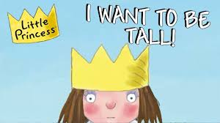
Story Time
I enjoy engaging with and listening to a story.
Click on the picture to take you to the story.

Slide 8
Number Story Time
I can participate actively in songs, rhymes and stories.
Today’s maths is linked to the above story. Click on the picture to listen to the story.

Slide 15
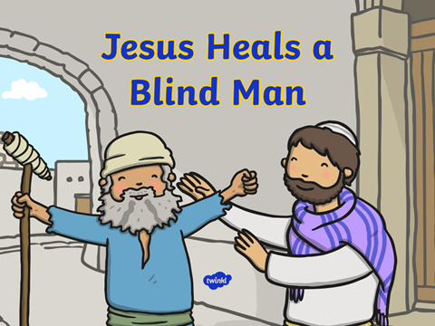
R.E
I am aware of some bible stories.
Download the PowerPoint from the Blog to read about the miracle of Jesus healing a Blind Man.
Write a sentence and draw a picture of the miracle.
(download the worksheet from the blog or write/draw in your jotter.
I can give an example of a miracle Jesus performed.

Slide 16
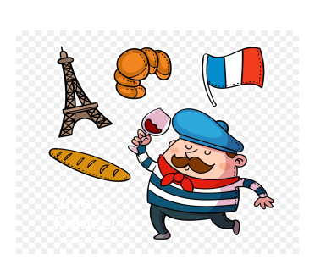
French
I can listen to the sounds of the target language.
.
Click on the
picture to take you
to the French
Greetings song.
I can repeat numbers up to 20.

Slide 17
I can listen to the sounds of the target language.
French
Click on the above picture and scroll down to lesson 5 ‘Counting in French’
I can repeat numbers up to 20.

Slide 18
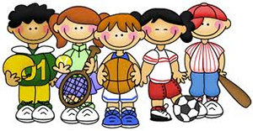
P.E
Take part in Mrs McMaster’s Thursday activity.

