Slide 1
Wednesday 17th of June Mecredi 17 Juin
Good Morning Primary 1!
Bonjour la class! Ca Va?
Click on the above picture to listen to the days of the week in French.

Slide 2
Wake up Song!
Click on the above picture to join in with the ‘Wake Up’ song.

Slide 3
Writing
I can explore events and characters in stories and use what I learn to invent my own.
To write a narrative.
Understand the purpose and audience
Write an opening that will interest others (who, what, where, when, why)
Include characters and what part they play (who, what, why)
Include thoughts and feelings
Write a logical sequence of events.
Include a simple ending.

Slide 4
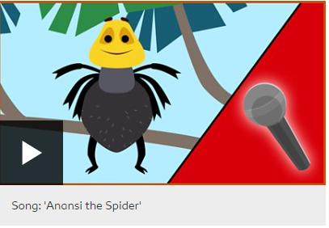
Anansi The Spider
Say I can talk about the story and predict what could happen next.
Write I can write 2 to 3 sentences using capital letters, full stops and finger
spaces. * challenge - use a connective.
Make I can draw a detailed picture of Anansi.
Do I can join in with the song ‘Anansi the Spider’ by clicking on the above
picture and scrolling down to the song.

Slide 5
IDL
I can explore events and characters in stories and use what I learn to invent my own.
.

Slide 6
Story Time
I enjoy engaging with and listening to a story.

Slide 7
Number Rhyme Time
Click on the above picture to take you to the song.

Slide 8
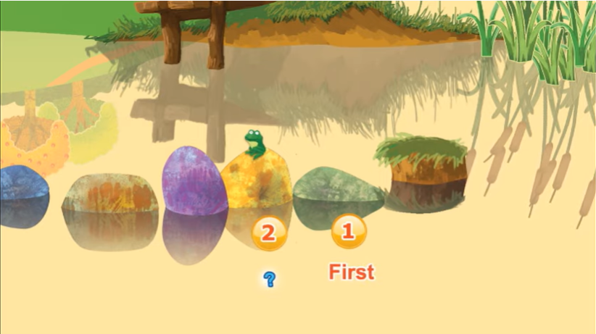
Ordinal Number Story
Click on the picture above to help JoJo get to meet his friend Ducky.

Slide 9
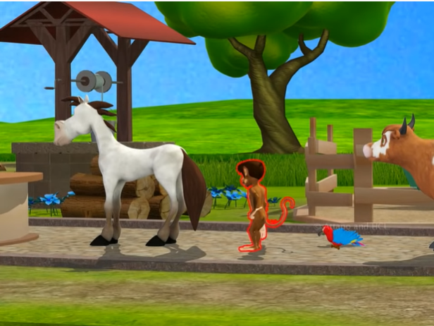
Ordinal Numbers
I can use and understand ordinal numbers in everyday activities.

Slide 10
Ordinal Numbers
Click on the picture to play the Ordinal Number game.
Activity – Complete the Ordinal numbers worksheet from the blog or draw it in your jotter.

Slide 11
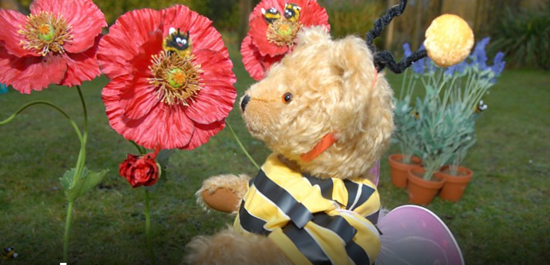
IDL
I have observed living things over time and am becoming aware of how they depend on each other.
Click on the above picture to listen to the radio programme all about bees.

Slide 12
IDL
I have observed living things over time and am becoming aware of how they depend on each other.
.
Activity – Can you create your own flower filled garden to attract the bees?
Use finger painting technique to make the bee.
Download the activities from the blog or design your own picture.

Slide 13
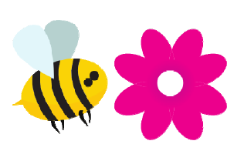
Smile Mile
Go for a Smile Mile around your garden or outside area.
On your Smile Mile today see if you can spot any bees buzzing around in your garden or local area.

