Slide 1
Wednesday
17.6.20
Daily Plan

Slide 2
Morning
This Photo by Unknown Author is licensed under CC BY-SA

Slide 3
Spelling Starter
low
grow
throw
follow
shallow
show

Slide 4
Grammar
LI – I am learning to use apostrophes for belonging.
Important note before you begin.
It can be tempting to begin to put apostrophes everywhere after this lesson. If in doubt, leave it out, we can always chat about it and correct it once we understand why it should be there.
Don’t get into the habit of going apostrophe crazy.

Slide 5
Grammar
LI – I am learning to use apostrophes for belonging.
Complete the activities on the BBC Bitesize page.
Complete the activity on the next slide.
Optional Extension – board game on the blog.
Click the apostrophe to take you to BBC Bitzesize then complete the task list.

Slide 6
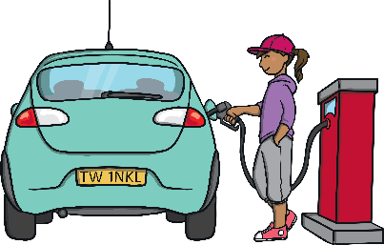
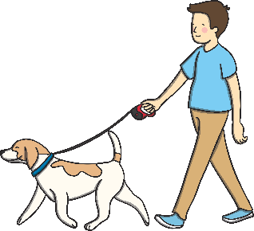
Can you write a sentence to describe each picture using an apostrophe to show possession? Click on the picture to see the answer.
Nadia
Rachel
Clara
This is Nadia’s radio.
This is Rachel’s car.
This is
This is
This is Clara’s train.
Owen
Kaylee
Malik
This is
This is Owen’s dog.
This is Kaylee’s book.
This is Malik’s rocket.
This is
This is

Slide 7
Break Time
This Photo by Unknown Author is licensed under CC BY-SA

Slide 8
Mid Morning
This Photo by Unknown Author is licensed under CC BY-SA

Slide 9
Morning Story
Listen to or read the next chapter of Matilda today.
(No activity to follow.)
Click on the picture to listen

Slide 10
Maths
LI – I am learning to interpret information from a bar graph.
On Monday you began to learn about Bar Graphs.
It is important for bar graphs to have the following things to help you interpret the information:
A title
Both axis labelled
A scale to show how many – today we are going to explore this further.

Slide 11
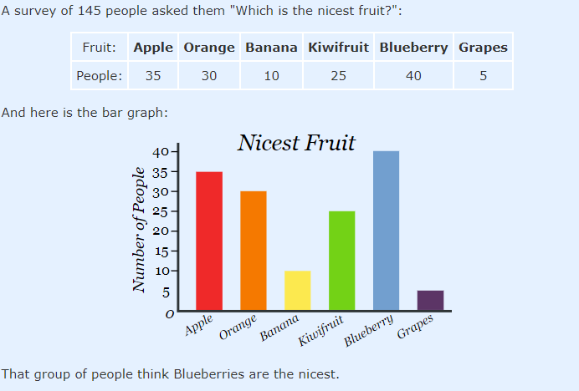
Example
The example above shows how important the scale is. You should always read the scale before you begin to interpret the information.
Why do you think this person has chosen to count up in 5s?

Slide 12
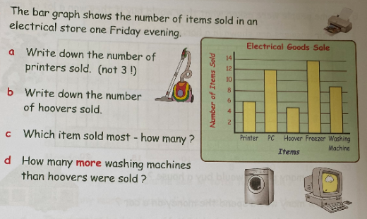
Question 1

Slide 13
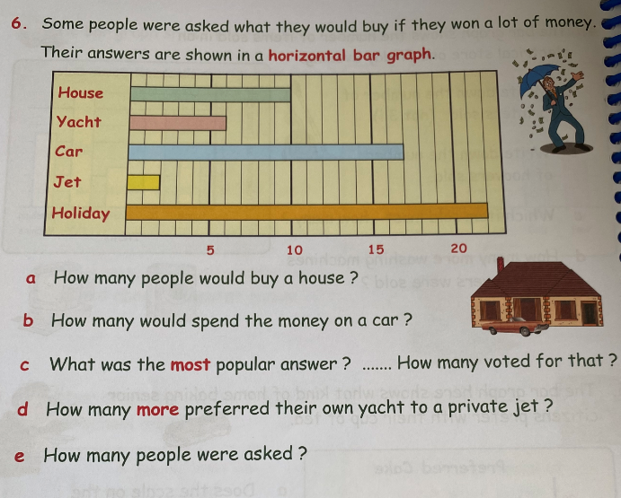
Question 2
Sometimes bar graphs are displayed horizontally, don’t let that confuse you. You just work out the information in the exact same way.
This example has much trickier questions, try your best.

Slide 14
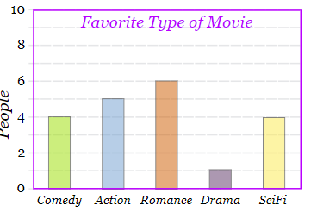
Extension
https://mathsframe.co.uk/en/resources/resource/51/bar_charts
Some of the examples get quite tricky.
Do what you can, I suggest sticking to level 1.

Slide 15
Lunch Time
This Photo by Unknown Author is licensed under CC BY-SA

Slide 16
Afternoon
This Photo by Unknown Author is licensed under CC BY-SA

Slide 17
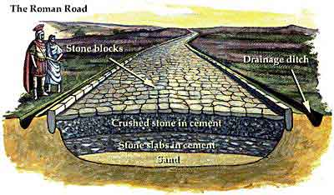
Roman Roads
LI – I am about Roman roads.
Click the picture below to play the video

Slide 18
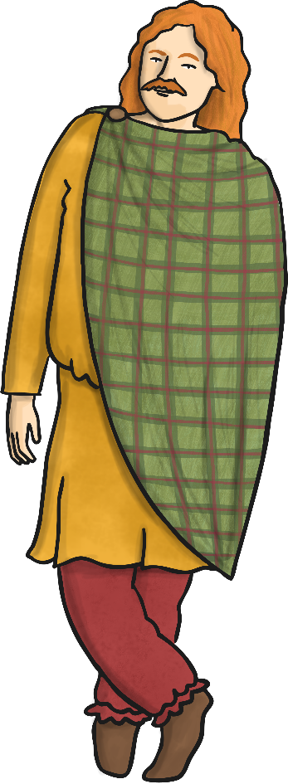
Before Roads
The Celts rode horses, walked, or travelled in carts pulled by oxen. Before the Romans arrived, Britain had no proper roads. There were paths and tracks to connect local farms and hamlets, and there were some longer routes for trade. These tracks were often in very poor condition.

Slide 19
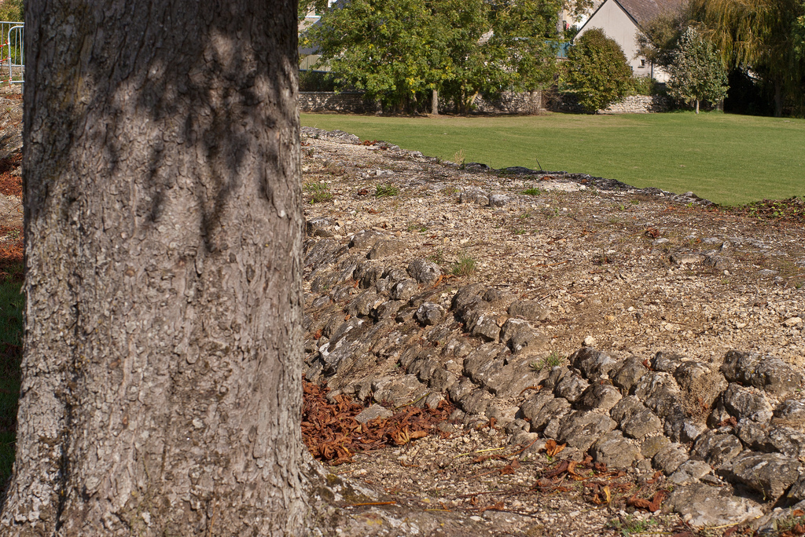
The Romans were famous for their roads. You can still see some Roman roads today, two thousand years after they were built.

Slide 20
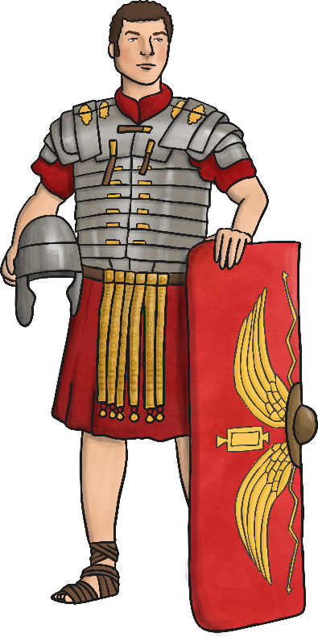
Why Did the Romans Want
Better Roads?
Getting supplies to different areas of the country
Movement of troops quickly
Trading goods
The Emperor had more control if messages could be sent quickly

Slide 21
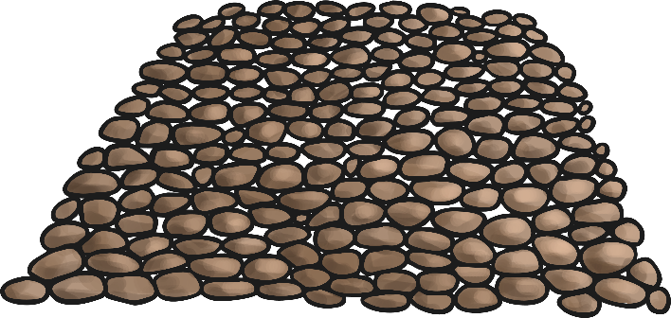
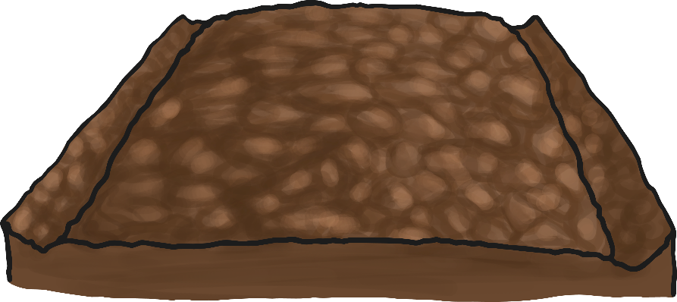
How Did They Build The Roads?
To build a Roman road, we would need to:

Slide 22
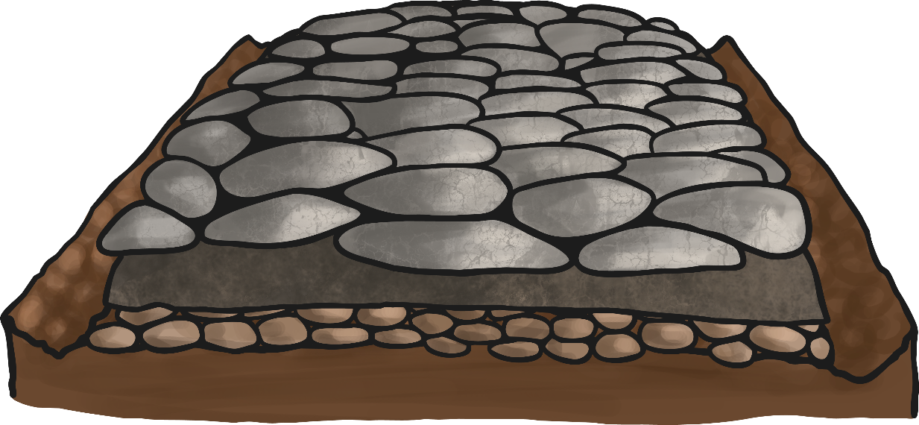
Cross Section of a Roman Road
Can you name the parts of this Roman road?

Slide 23
Roman Roads Task
Read the sheet on the blog with an adult and either answer the questions aloud or write the answers down.
Optional Extension:
Edible Roman Road Recipe on the blog.

