Slide 1
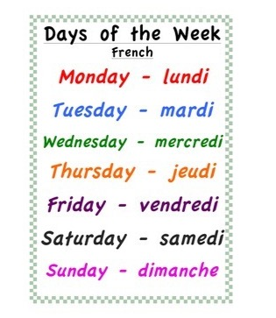


Monday 15th of June
Lundi 15 Juin
Good Morning Primary 1!
Bonjour la class!
Click on the picture below to sing our Monday song.

Slide 2

It’s the month of …
Mrs McEwan’s Monday Message
Click on the link in the blog to join in with Mrs McEwan’s Assembly.
Notes:
Welcome to today’s assembly which I am now calling Mrs McEwan’s Monday message! It’s the month of May – a time when we really see the world beginning to burst through with colourful flowers and the trees now full of their Spring Blossom!

Slide 3

Fischy Music Assembly
Fischy music are looking for photos of children taking part in their Assembly on lockdown. If you are happy to share your child’s photo can you e-mail me a picture to forward on to the Fischy people.
Click on the picture below at 11am for some fun and singing!

Slide 4


New Sounds
au/aw
I use my knowledge of sounds, letters and patterns to read words.
Can you think of any words that contain the au/aw sound ?
Can you find this sound in any of your books at home?
Can you spot this sound on any signs when you are out on a walk?
Air Writing
Write the sound in the air, say it quietly.
Write the sound in the air, say it loudly.

Slide 5
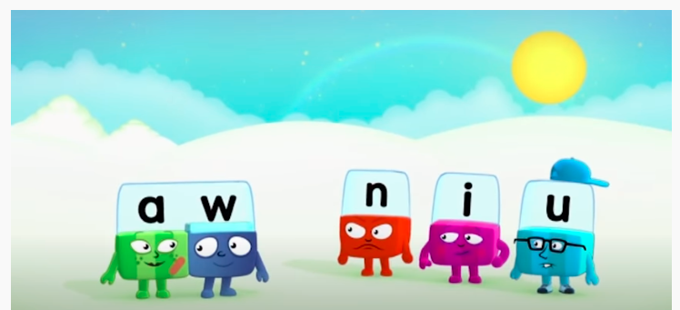
New Sound
I use my knowledge of sounds, letters and patterns to read words.
Click on the picture to watch The Alphablocks episode on
au/aw.

Slide 6


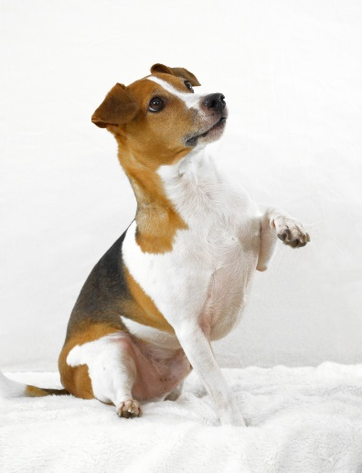
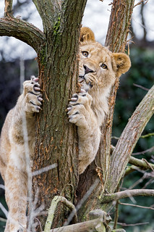
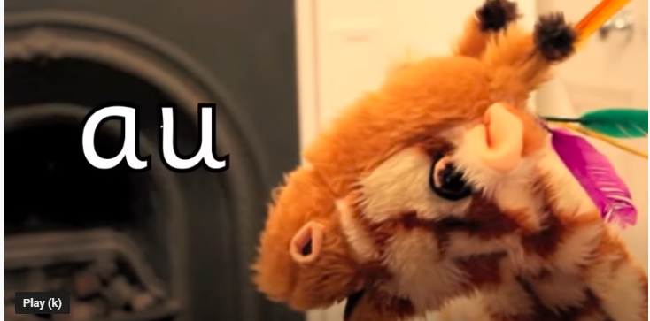

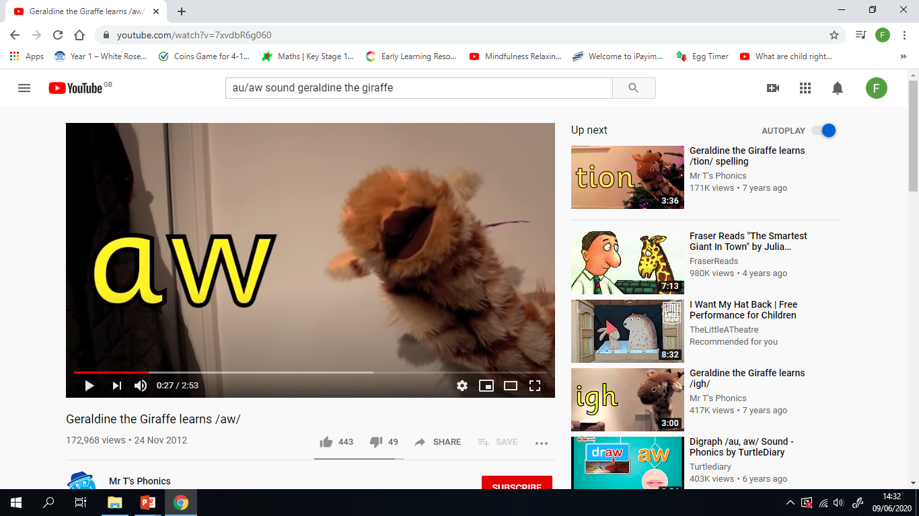
New Sound
I can use knowledge of sounds, letters and patterns to read words.
maul
Paul
lawn
paw
Click on the pictures to learn about the au/aw sounds.
I can sound out words containing the au/aw sounds
using my ‘sound-box’

Slide 7


Sentences of the day
I can use knowledge of sounds, letters and patterns to read words.
We went to town on the bus. We saw
a show. It was good fun.
Can you spot the tricky words?
How many did you find?

Slide 8
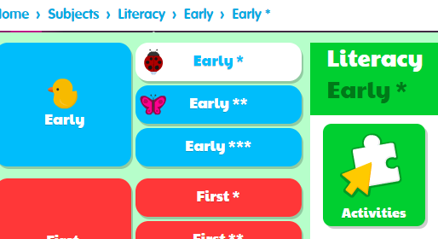
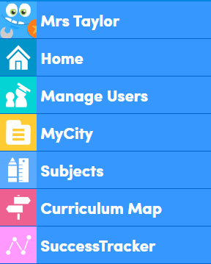
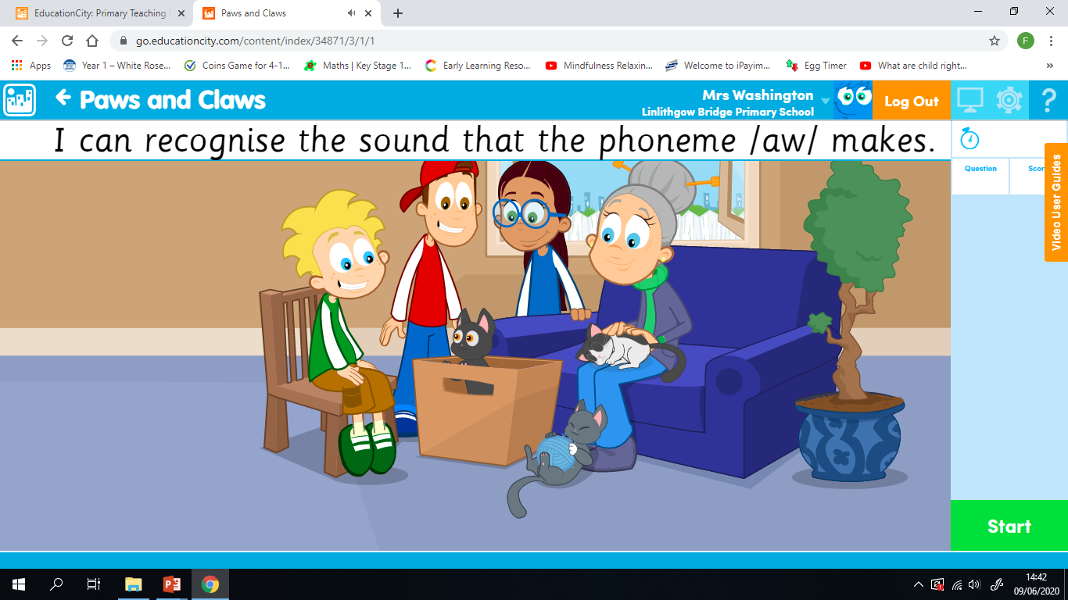
Education City
https://go.educationcity.com/subjects
Login to the above website and sign in using the username and password provided.
Click on Subjects on the left hand side then Literacy.
Click on early ***and activities
Scroll down to ‘Paws & Claws’

Slide 9
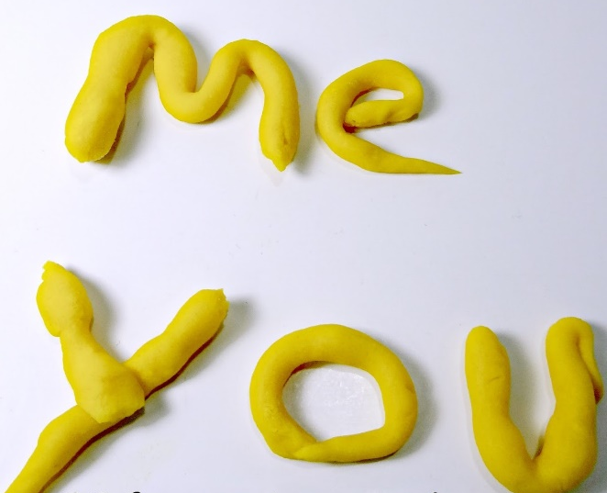
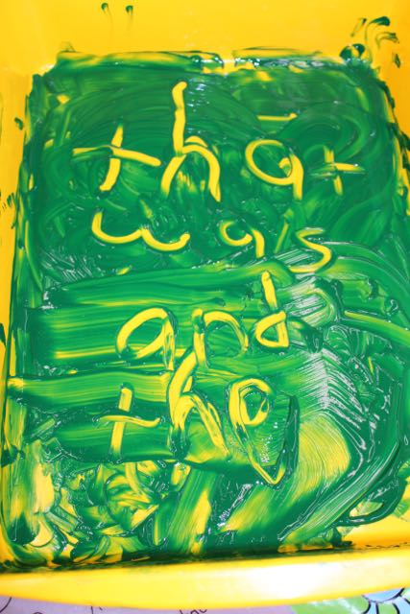
Phonics Activities
Activity
Spelling – Can you use playdough or finger-paints to create 2 ‘au’ and 2 ‘aw’ words?

Slide 10

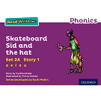
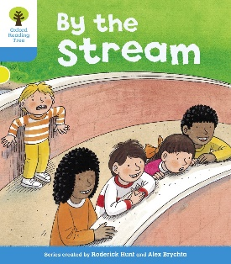



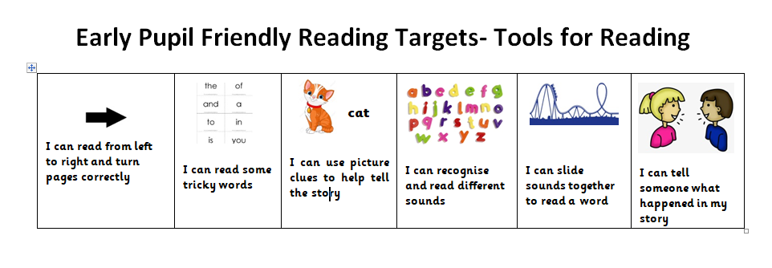
Reading Book
I can use my knowledge of sounds, letters and patterns to read words.
Read the e-book which has been set for you and self-assess using the targets below?

Slide 11
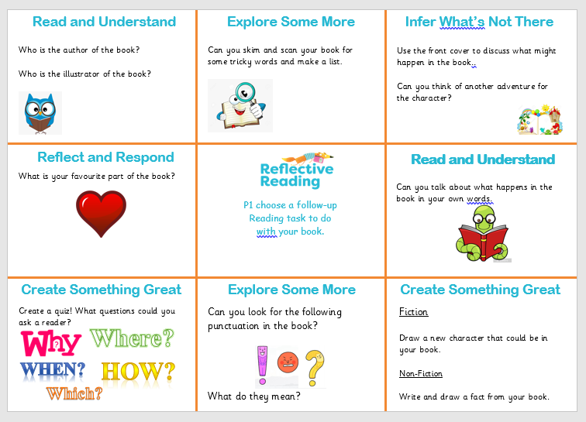
Reading Activities
Activities
Have a look at the Reading Mat on the blog or download it. Choose one of the follow-up reading tasks to do with your book.

Slide 12
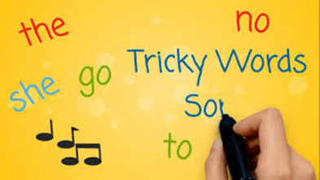
Revision Tricky Words Block 2
Click on the picture to take you to the song.
go we be her
she are they of
all some come were
said one you

Slide 13

Block 2 Tricky Word Activities
Activity
Spelling – Look at the tricky words below, they are missing some letters. Can you work out what letters are missing and write them down correctly? Use the previous slide or the tricky words in your box to help.
s_e y_u s_id th_y
_re o_e c_me
w_re a_l h_r o_

Slide 14

Story Time
I can actively engage in a story.

Slide 15
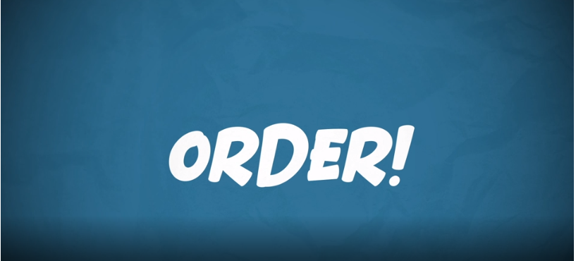
Number Rhyme Time
I can participate actively in songs, rhymes and stories.
Click on the picture below to sing along to a song all about ordinal numbers.

Slide 16
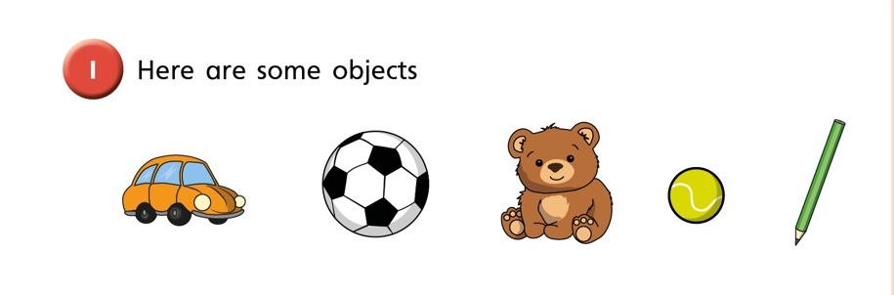
Ordinal Numbers
I can use and understand ordinal numbers in everyday activities.
What is the fifth object?
What comes after the third object?
What comes before the second object?

Slide 17
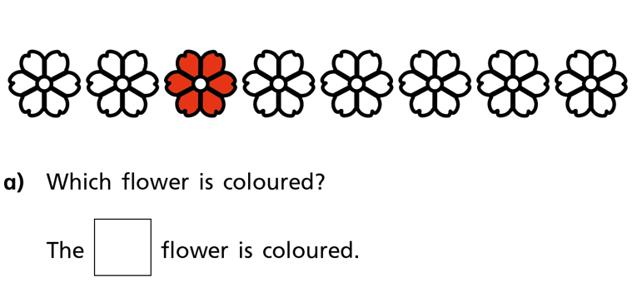
Ordinal Numbers
I can use and understand ordinal numbers in everyday activities.
Draw the flowers in your jotter. Colour the 5th flower blue and the 7th flower green.

Slide 18
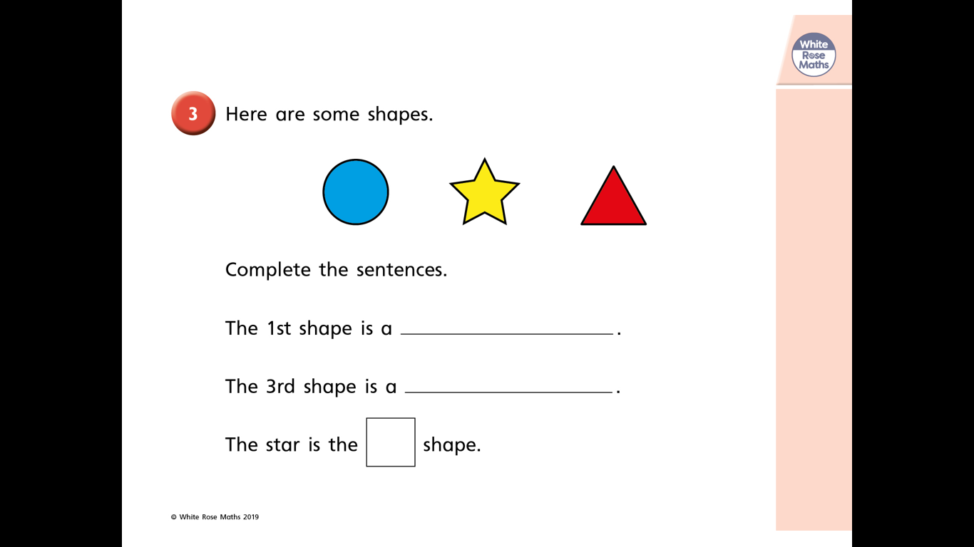
Ordinal Numbers
I can use and understand ordinal numbers in everyday activities.

Slide 19
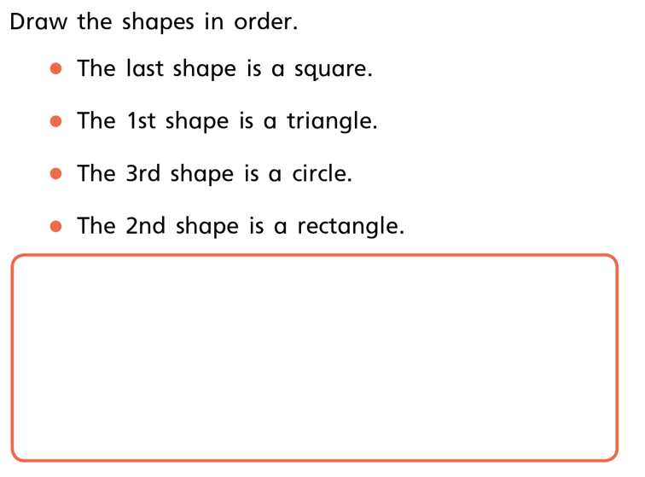
Ordinal Numbers
I can use and understand ordinal numbers in everyday activities.

Slide 20
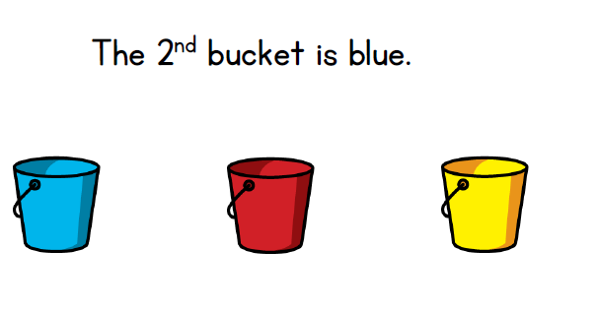
Ordinal Numbers
I can use and understand ordinal numbers in everyday activities.
True or False?

Slide 21
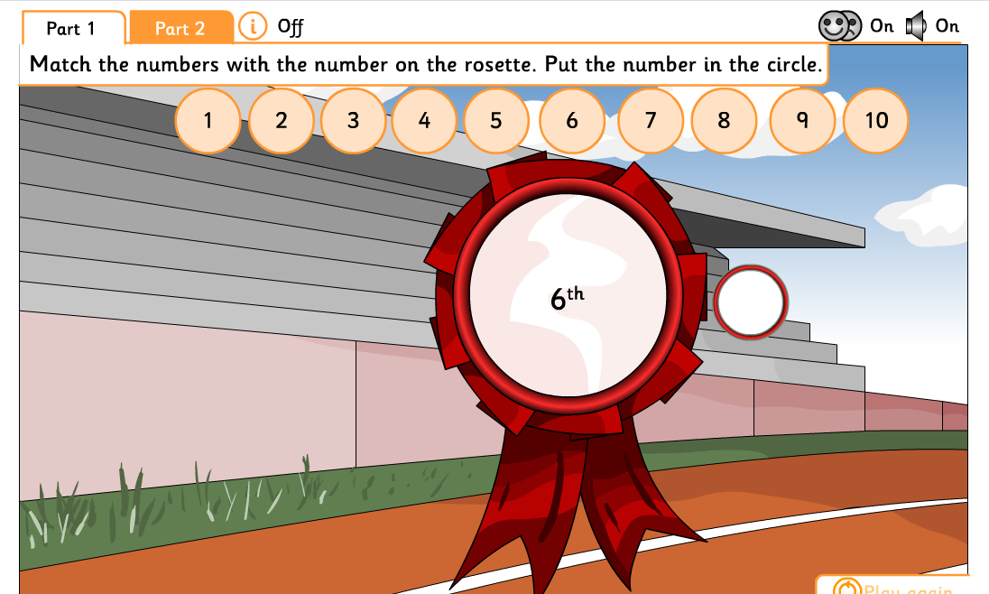
Ordinal Numbers
I can use and understand ordinal numbers in everyday activities.
Click on the link below to access the activities linked to ordinal numbers.

Slide 22
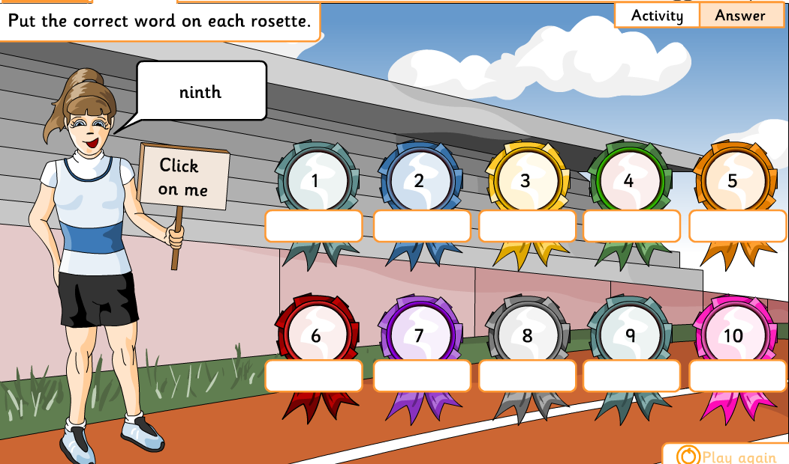
Ordinal Numbers
I can use and understand ordinal numbers in everyday activities.
Click on the link below to access the activities linked to ordinal numbers. Please select Part 2 to get to this activity.

Slide 23
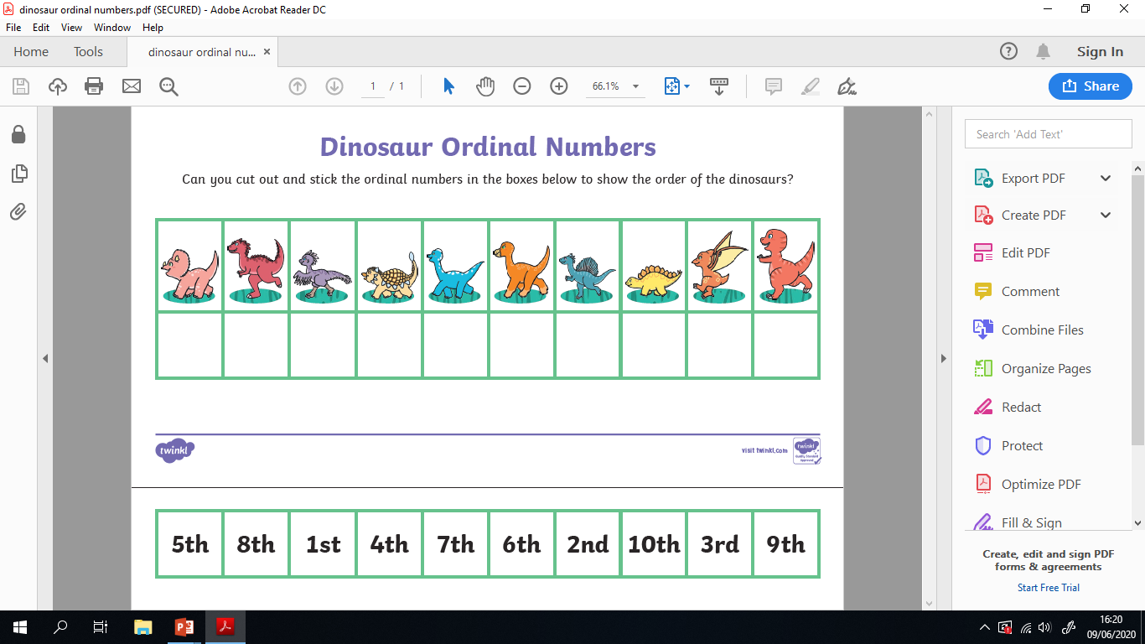
Ordinal Numbers
I can use and understand ordinal numbers in everyday activities.
Please download the Dinosaur Ordinal Number Sheet from the blog or website.

Slide 24

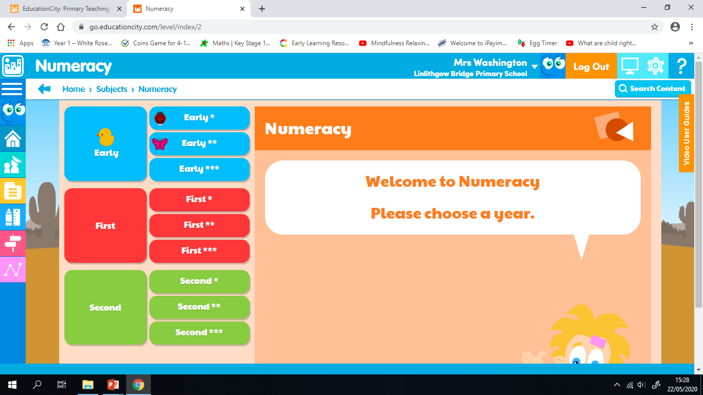
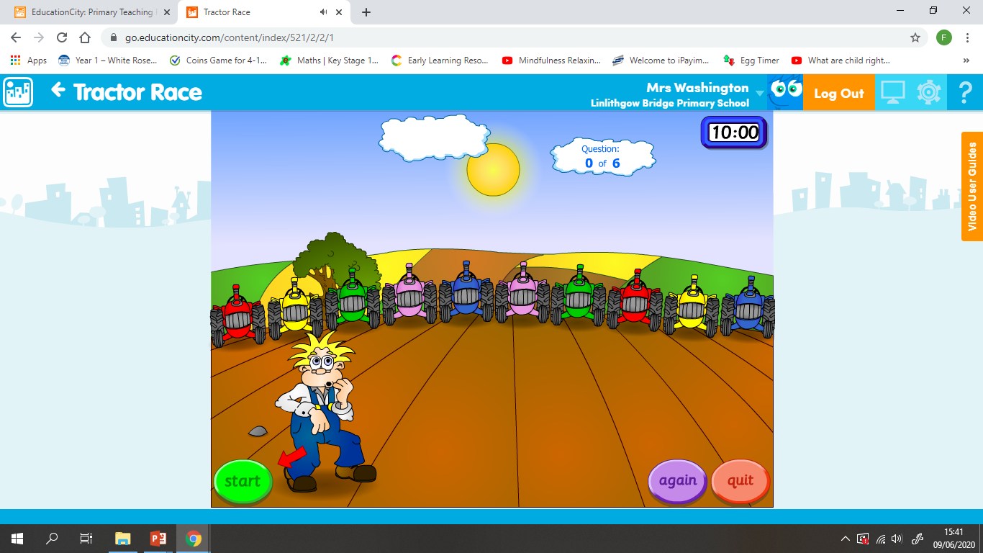
Ordinal Numbers
I can use and understand ordinal numbers in everyday activities.
Click on ‘Education City’ to log in.
Click on Subjects – Numeracy – Early ** - Activities, and scroll down to ‘Tractor Race’ there are two games that can be played. One focuses on ordinal numbers the other focuses on ordinal number vocabulary.

Slide 25


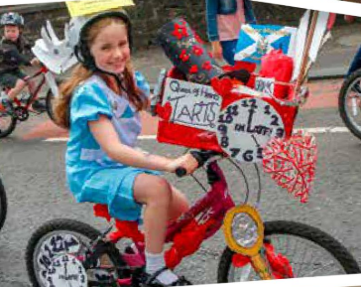
Marches Day
I explore and discover different ways of representing ideas in imaginative ways
Decorate a Marches bicycle.
Use your imagination to decorate the bike. How creative can you be?
Download the bicycle template from the blog or draw one in your jotter.

Slide 26

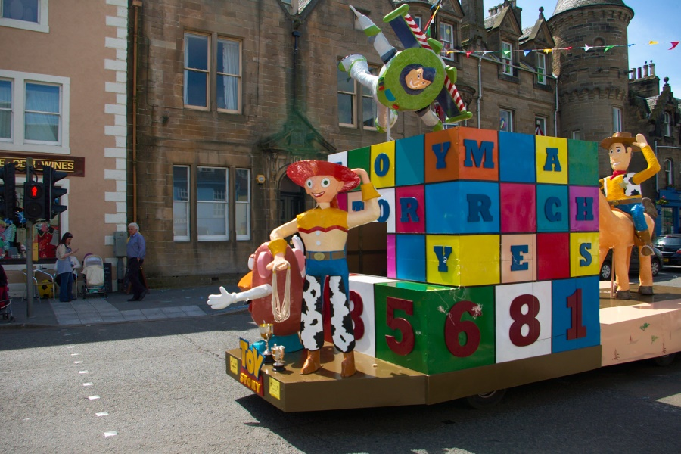
Marches Challenge
Tomorrow would have been Marches day. Today we will continue with our Marches STEM focus. There are 3 activities, which can be completed at your leisure. You can download the activities from the blog or have a look at the following slides.

Slide 27
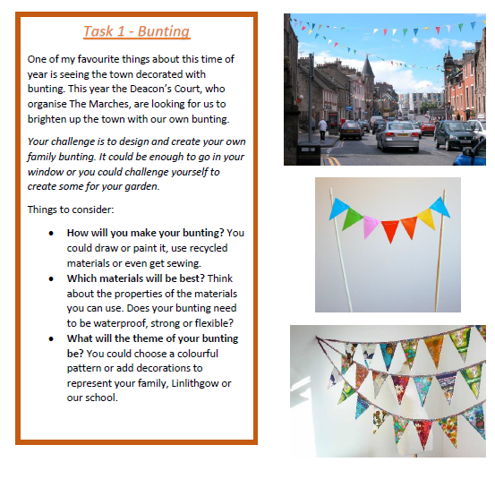
The Marches

Slide 28
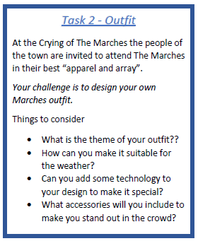
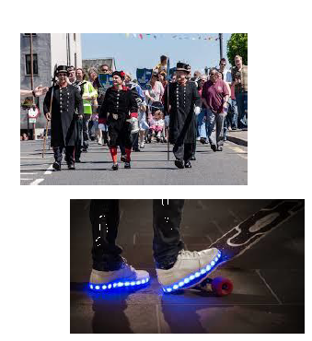
The Marches

Slide 29
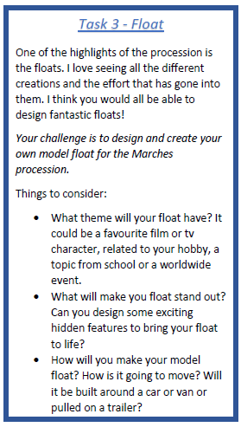
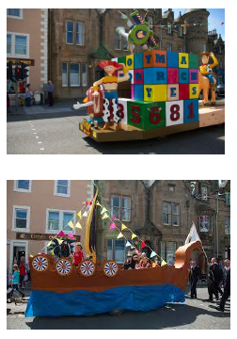
The Marches

Slide 30

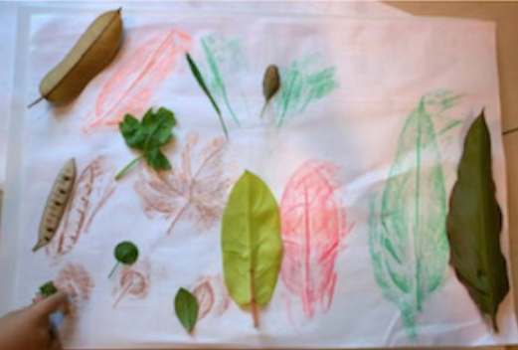
Smile Mile
Go for a Smile Mile around your garden or outside area.
Optional Activity – Take some crayons and paper on your walk today. Can you create
Your very own rubbings? What different patterns and textures can you find to
rub? Tree bark, a street sign, the floor, some leaves. Try different sorts of
places and see what you can find.

