Slide 1
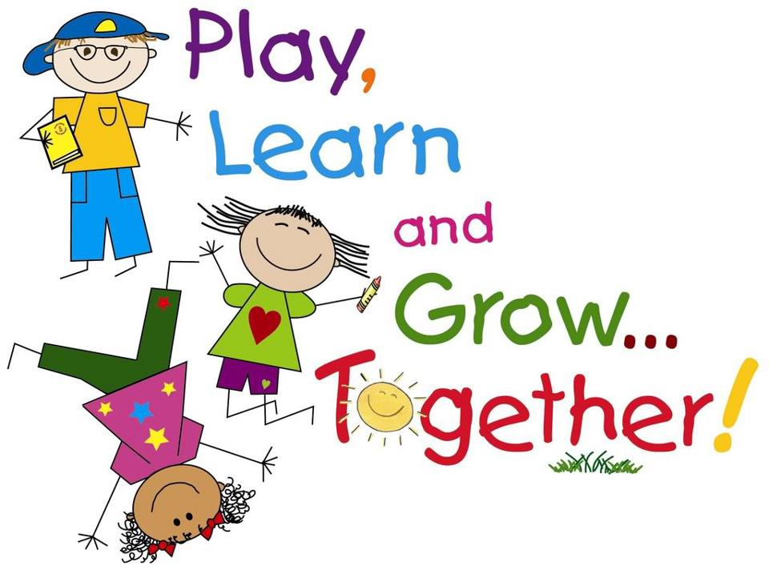
P2 – Monday 15.6.20

Slide 2
Monday 15th June 2020
15.6.20
Prayers
Spelling
Assembly
Writing
Break
Milk and Story
Reading
Maths
Lunch
Mindfulness
IDL (Topic)

Slide 3
Morning Prayer
Father in Heaven you love me,
you are with me night and day
I want to love you always in all I do and say
I’ll try to please you father
bless me through this day.
Amen

Slide 4
I hope you all had a lovely weekend and are ready to continue our blog school adventure!
Let’s get started!

Slide 5
Spelling - 15.6.20
LI – I am learning to identify and use spelling patterns.
Use your spelling grid to select a spelling activity.
SC – I can spell words accurately.
I can blend sound into words.
Red | Blue | Yellow
sifted | shouted | number
hugged | landed | normal
caged | pointed | afternoon
punched | painted | talk
hurried | country | flock
family | young
question
complete

Slide 6
Assembly - 15.6.20
Mrs McEwan’s Monday Message is on the blog for you.

Slide 7
Writing - 15.6.20
LI – I am learning to create a story plan for an imaginative story.
Task
Watch the video on how to create a story plan.
https://www.bbc.co.uk/bitesize/topics/zfxtyrd/articles/zhh992p
There are instructions below the clip to help you create a story plan for the character and setting we have been working on.
SC – I can use imaginative and descriptive language.
I can include the correct information.

Slide 8
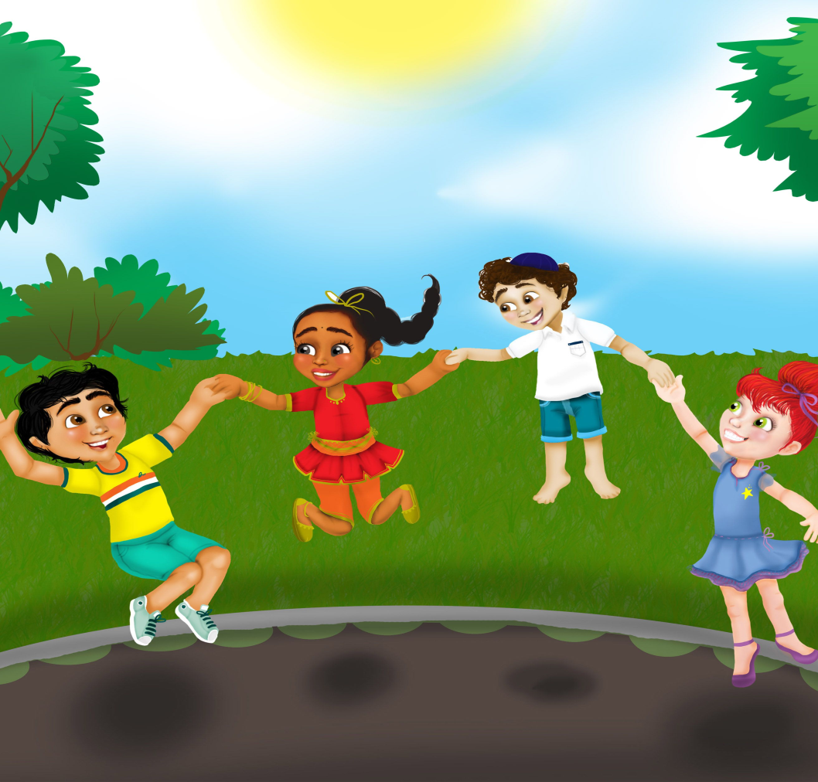
Have a Break - 15.6.20

Slide 9
Milk and Story - 15.6.20
Have a drink and I’ve included a link to Brave Irene for you. The Newsround link are still here for you if you prefer that.
https://www.bbc.co.uk/newsround/news/watch_newsround
https://www.storylineonline.net/books/brave-irene/

Slide 10
Reading - 15.6.20
LI – I am learning to use spelling strategies, my knowledge of tricky words and punctuation to read fluently.
Task
Read a few pages from your favourite book to an adult.
Use the Reading Challenge grid and select an activity, we can use the same grid for the week!
SC – I can read with fluency and show understanding of the text.

Slide 11
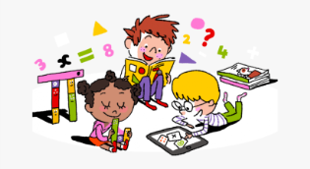
Starter - 15.6.20
On the next page you have a maths starter
challenge.

Slide 13
Maths - 15.6.20
Amazing Arrays
LI – I am learning to develop strategies to multiply using arrays.
Today we are going to explore multiplication arrays.
Watch the power point called Amazing Arrays, it is on the blog. It’s where you put things in rows to help you count them and it really helps with multiplication.
There is an activity sheet for you to try too!
SC- I can use my knowledge of grouping to help me explore multiplication.

Slide 14
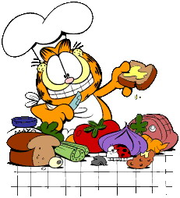
Lunchtime
Bless us O Lord
as we sit together.
Bless the hands that
made the food.
Bless us O Lord
Amen

Slide 15
I hope you enjoyed your lunch
Thank you God for
the food we have eaten.
Thank you God for
all our friends.
Thank you God for
everything.
Thank you God.
Amen

Slide 16
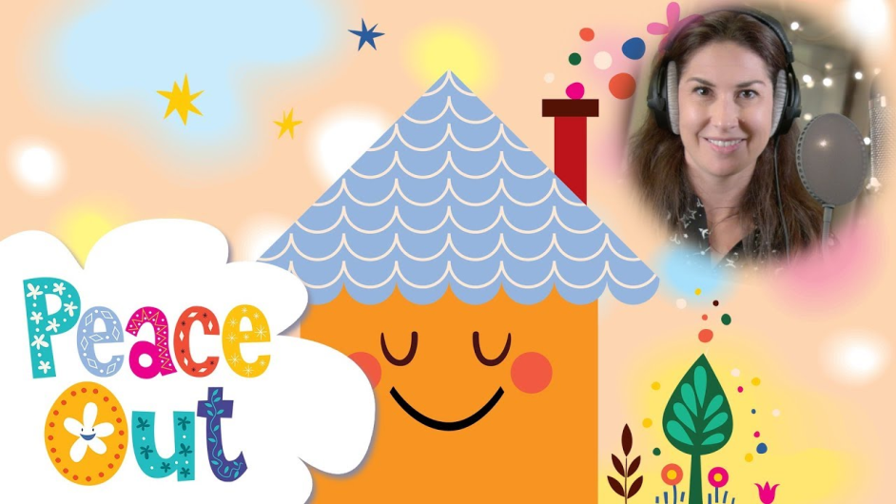
Mindfulness - 15.6.20
LI – I am learning to use mindfulness skills to reduce stress and support my wellbeing.
Activity
I am hoping we can all do this at the same time!
If we all use this link or google ‘Refresh Your Senses’ at 1.15pm we will know we are all together. https://www.youtube.com/watch?v=qRoN8xdsVX0

Slide 17
IDL – Touch - 15.6.20
LI – I am learning to explore my senses and discuss how they help me in the world around me.
Task
Use the link to find out about our sense of touch
https://www.bbc.co.uk/bitesize/topics/z39qhyc/articles/zkk7bdm
Use the activity sheet to explain how our sense of touch keeps us safe.
SC – I can begin to describe how my sense of
touch works.

Slide 18
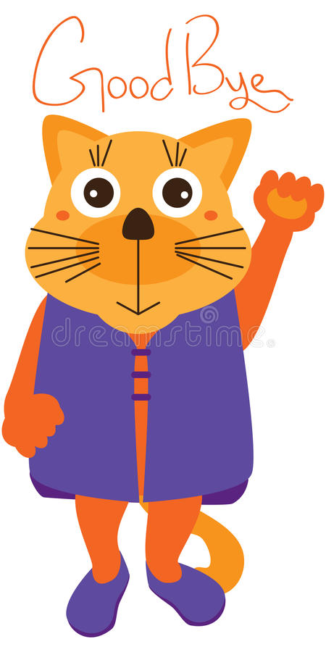
Well done Team Primary 2! Thank you for all your lovely emails I really appreciate them! Enjoy the rest of your day. I will ‘see’ you all on Wednesday!
Mrs Grant ☺

Slide 19
Evening Prayer
God our Father, I come to say thank you for your love today. Thank you for my family and all the friends you give to me. Guard me in the dark of night and in the morning send your light. Amen

