Slide 1
Friday
12.6.20
Daily Plan

Slide 2
Morning
This Photo by Unknown Author is licensed under CC BY-SA

Slide 3
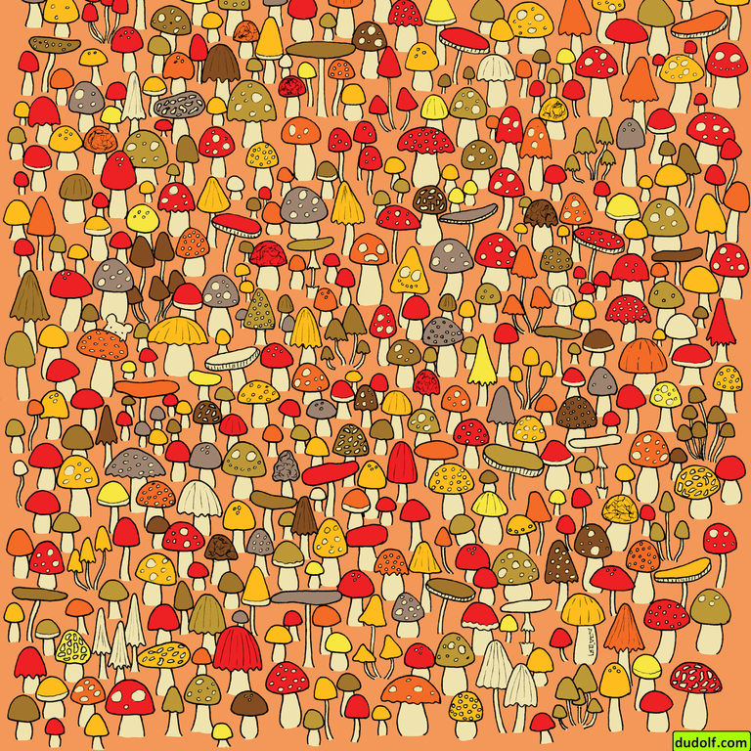
Morning Brain Teaser
Can you find the mouse in the picture?

Slide 4
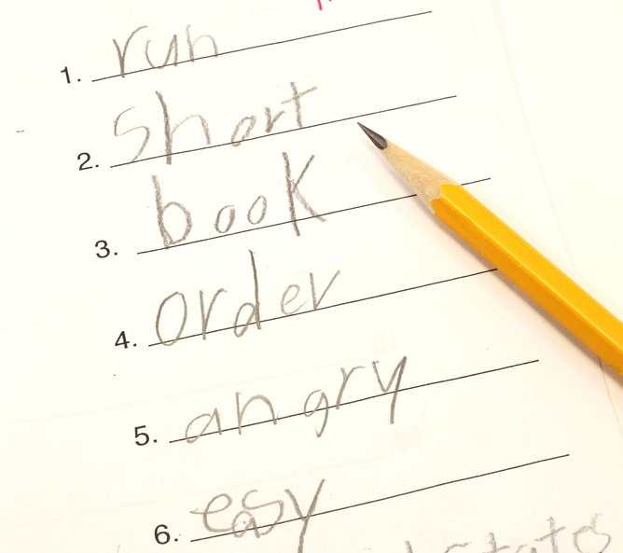
Spell Check
L.I. I am able to identify patterns in my spell words
Ask an adult to test you on your ‘ea’ words.
You can either spell them aloud or write them down.

Slide 5
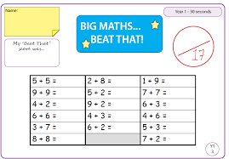
Maths
Do your next Big Maths Beat That for Y1- remember you are trying to beat your last score.
Here is the warm-up song
https://www.youtube.com/watch?v=MijqHIpmb5E

Slide 6
Break Time
This Photo by Unknown Author is licensed under CC BY-SA

Slide 7
Free Writing
This is time for free writing. Use the time to write anything you would like. I loved your stories last week using the pictures on the power point.
I have added some new pictures. I know a lot of you enjoy Book Creator online so you could use both…

Slide 8
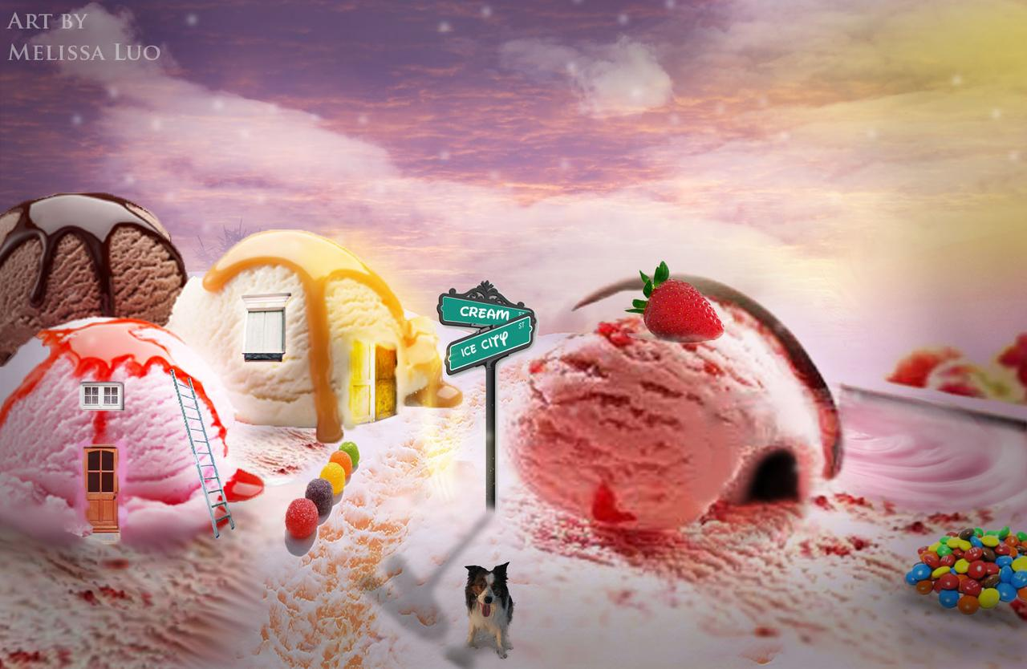

Slide 10
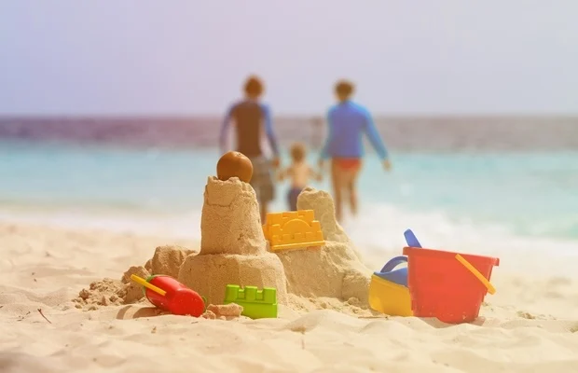

Slide 11
Quiz Time
I have attached a quiz ppt on the blog for you to take part in. Ask someone else to ask you the questions or you could be the quiz master.

Slide 12
Free Play
Have fun and enjoy your weekend!

