Slide 1
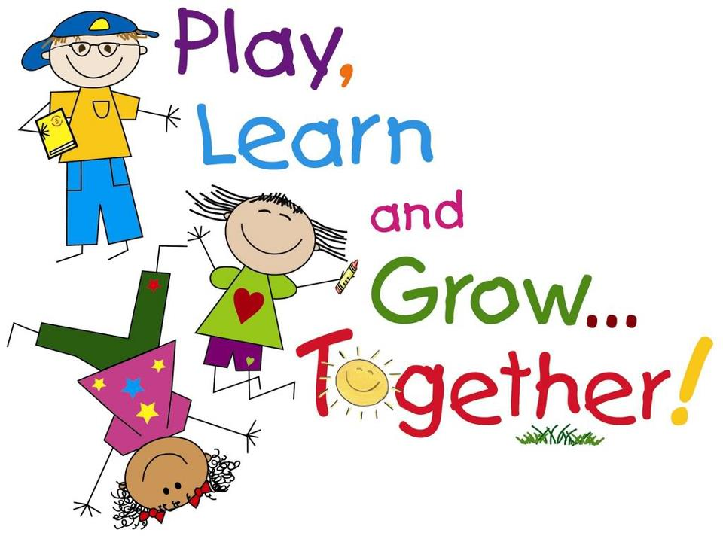
P2 – Thursday 11.6.20

Slide 2


Good Morning ☺
It’s Thursday!
Here we go!

Slide 3
Thursday 11th June 2020
11.6.20
Prayers
Spelling
Handwriting
Reading
Break
Milk and Story
Maths
Lunch
Mindfulness
PE
IDL

Slide 4

Morning Prayer
Father in Heaven you love me,
you are with me night and day
I want to love you always in all I do and say
I’ll try to please you father
bless me through this day.
Amen

Slide 5


Spelling - 11.6.20
LI – I am learning to identify and use spelling patterns.
Use the spelling words to complete these challenges.
Spelling Activities
Select 1 or 2 challenges from the grid to complete using your spelling words.
SC – I can spell words accurately.
I can blend sound into words.

Slide 6

Handwriting - 11.6.20
LI – I am learning to form my letters correctly.
Task
In your Handwriting Booklet we are looking at
Level 1 – 40.
You can use pen, any ballpoint pen is fine.
Remember to keep comparing your writing to the line above and include joining flicks.
SC – I can form my letters neatly and include joining flicks.

Slide 7

Reading - 11.6.20
LI – I am learning to use spelling strategies, my knowledge of tricky words and punctuation to read fluently.
Task
Read a few pages from your favourite book to an adult.
Use the Reading Challenge grid and select an activity, we can use the same grid for the week!
SC – I can read with fluency and show understanding of the text.

Slide 8
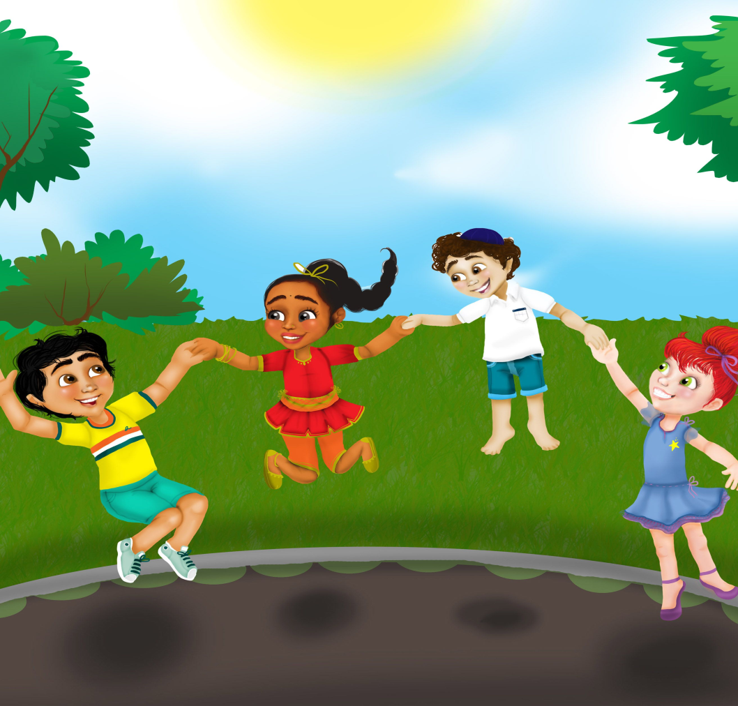
Have a Break - 11.6.20

Slide 9



Milk and Story - 11.6.20
Have a drink and use the link the listen to The Coal Thief. The Newsround link are still here for you if you prefer that.
https://www.storylineonline.net/books/the-coal-thief/
https://www.bbc.co.uk/newsround/news/watch_newsround

Slide 10
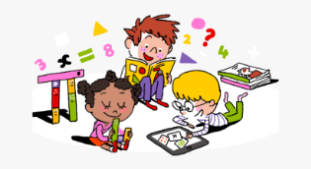
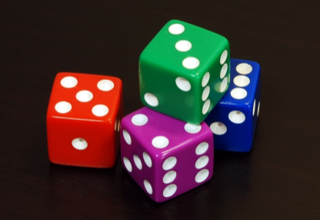
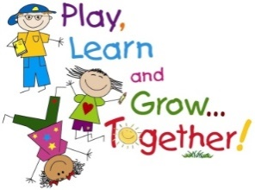
Number Talks - 11.6.20
On the next slide you will see the dots, remember to look, think and say how you see them. Remember to use the hand signs.
Challenge yourself to come up with different ways of calculating the dots.

Slide 11
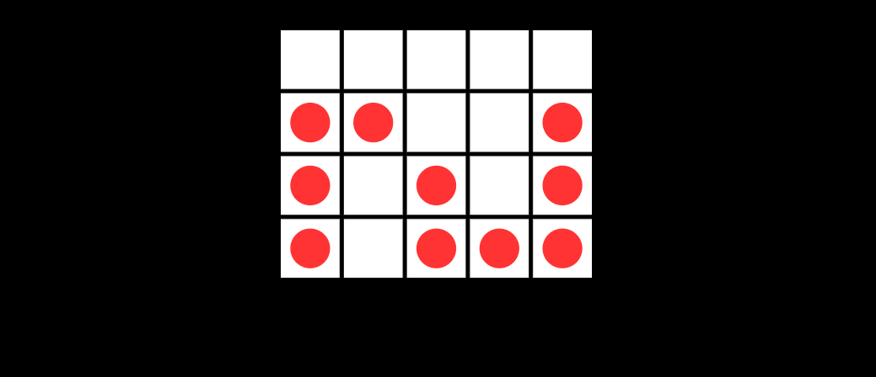

Slide 12



Maths - 26.5.20
Dividing by Grouping
LI – I am learning to develop strategies to multiply items.
Task
Today we have a 2 times table worksheet on the blog. Remember repeated addition can help you. I have also created a Multiplication Chilli Challenge with a Lava level!
SC- I can use my knowledge of multiplication to help me solve maths problems.

Slide 13
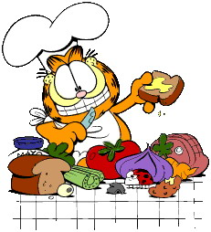
Lunchtime
Bless us O Lord
as we sit together.
Bless the hands that
made the food.
Bless us O Lord
Amen

Slide 14
I hope you enjoyed your lunch
Thank you God for
the food we have eaten.
Thank you God for
all our friends.
Thank you God for
everything.
Thank you God.
Amen

Slide 15


Mindfulness - 11.6.20
LI – I am learning to use mindfulness skills to reduce stress and support my wellbeing.
Activity
I am hoping we can all do this at the same time!
If we all use this link or google ‘Peace Out’ it’s called Treasure Box at 1.15pm we will know we are all together. https://www.youtube.com/watch?v=Id6PeFfAmeM

Slide 16
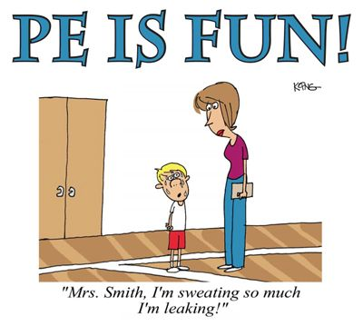
PE
Have a look a the PE Home Learning Challenges from Mrs McMaster and select a couple to try.
You could also have at look at PE with Joe using the link below or search on Google.
https://www.youtube.com/watch?v=6v-a_dpwhro

Slide 17
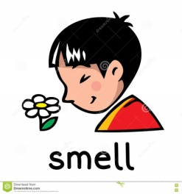
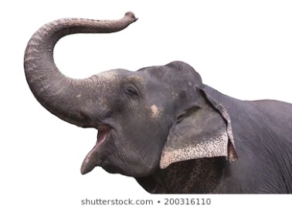
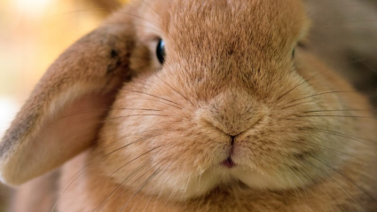
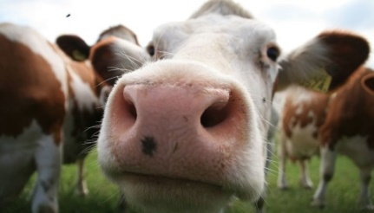

IDL – Smell - 10.6.20
LI – I am learning to explore my senses and discuss how they help me in the world around me.
Task
How many different kinds of noses can you list? For example your nose, an elephant, rabbit….
Try to draw all the different noses on your list.
SC – I can begin to describe how my nose works.

Slide 18
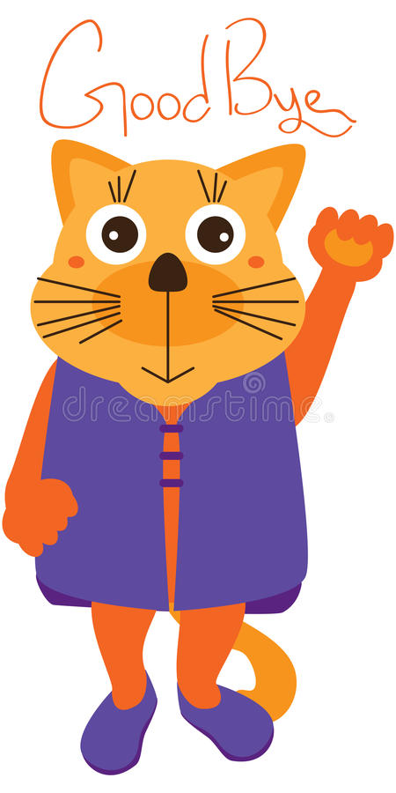
Well done everyone! Enjoy the rest of your day.
I will ‘see’ you all tomorrow!
Mrs Grant ☺

Slide 19
Evening Prayer
God our Father, I come to say
thank you for your love today.
Thank you for my family
and all the friends you give to me.
Guard me in the dark of night
and in the morning send your light.
Amen

