Slide 1
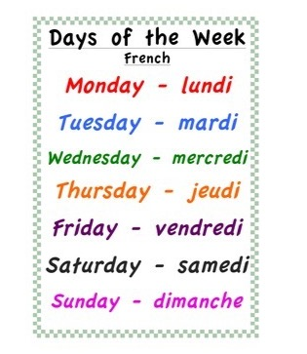


Thursday 11th of June jeudi 11 juin
Good Morning Primary 1!
Bonjour la class! Ca Va?
Click on the above picture to listen to the days of the week in French.

Slide 2

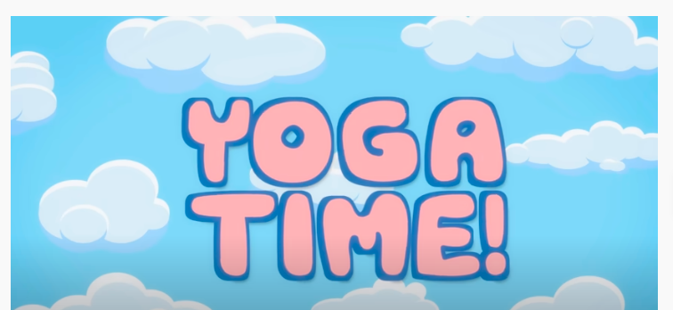
I am learning how to move my body well exploring how to manage and control it.
Yoga Time
Click on the above link to take you to the yoga video.

Slide 3
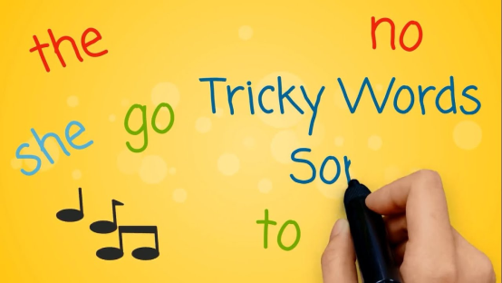
Revison Tricky Words Block 2
go we be
she are they
all some come
said one you
her of were

Slide 4

Tricky Word/sounds Dictation
I can make an attempt to spell familiar words correctly.
owl
row
out
mouth
were
her
Are my letters formed correctly?
Are my letters in the correct order?
CHALLENGE - Write a sentence using one of the tricky Words above.
Ask an adult to read out these tricky words.
Can you spell them correctly?

Slide 5
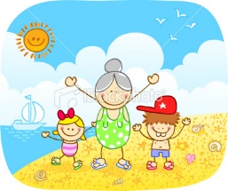
Sentence Dictation
I can make an attempt to spell familiar words correctly and use my ‘sound-box’ to spell other words.
It is a hot day. Joy and I are at the beach. We look for fish in the sea.
Are my letters formed correctly?
Are my letters in the correct order?
Did you remember finger spaces?
Did you remember to include a capital letter and a full stop in your sentences.
CHALLENGE – Circle all the tricky Words in the sentences. Underline the capital letters and full stops. How many sentences can you spot?
Ask an adult to read the sentences aloud.
Can you write it independently?
Can you spell the words correctly?

Slide 6

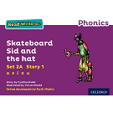



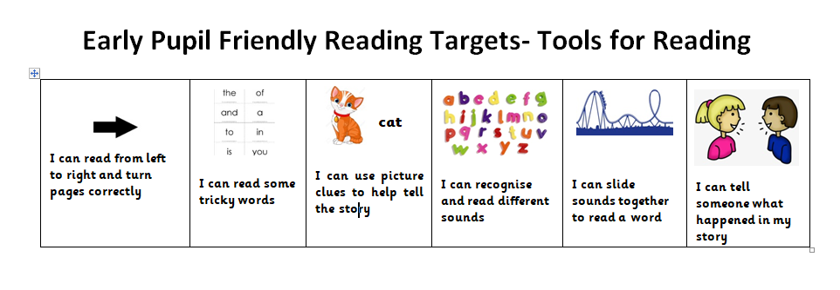
Reading Book
I can use my knowledge of sounds, letters and patterns to read words.
Read the e-book which has been set for you and self-assess using the targets below?
Activity – Reading Task mat. Choose one of the Reading Task Mat activities from the blog to do with your reading book.

Slide 7

Story Time
I enjoy engaging with and listening to a story.

Slide 8
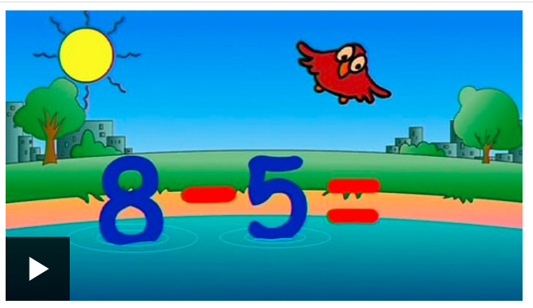
Number Rhyme Time
I can participate actively in songs, rhymes and stories.
Click on the picture below to sing along to a song all about the minus sign.

Slide 9
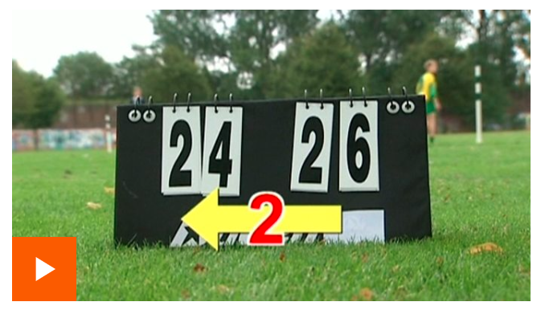
Subtraction
Click on the image below to learn about finding the difference between two numbers.

Slide 10
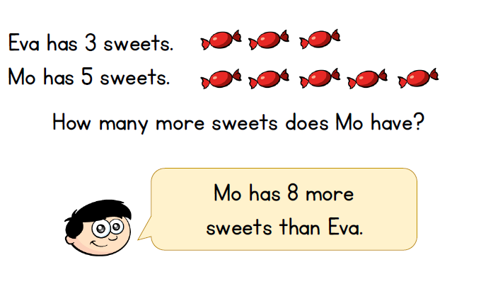
Subtraction
Finding the Difference
I can count on and back in ones to add and subtract.
True or False?

Slide 11
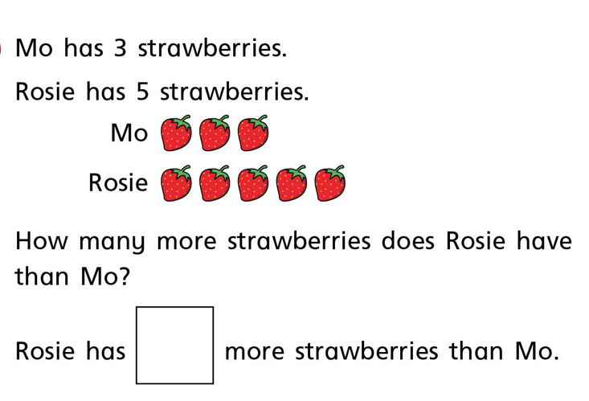
Subtraction
Finding the Difference
I can count on and back in ones to add and subtract.

Slide 12
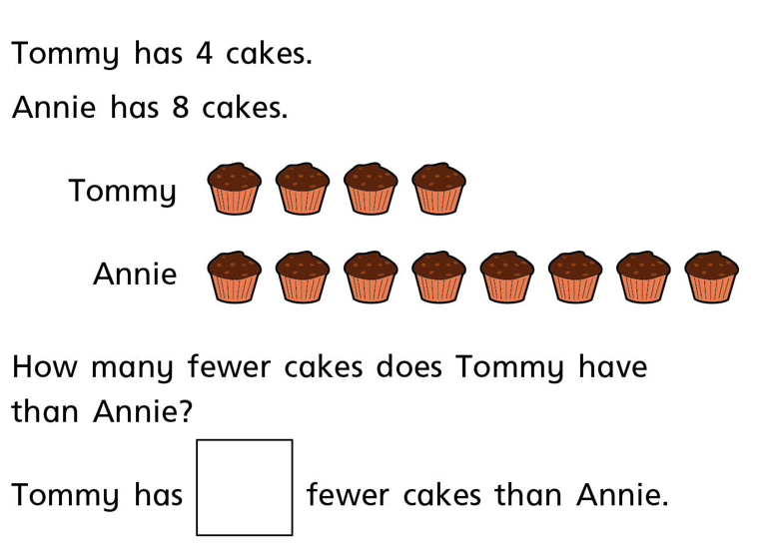
Subtraction
Finding the Difference
I can count on and back in ones to add and subtract.

Slide 13
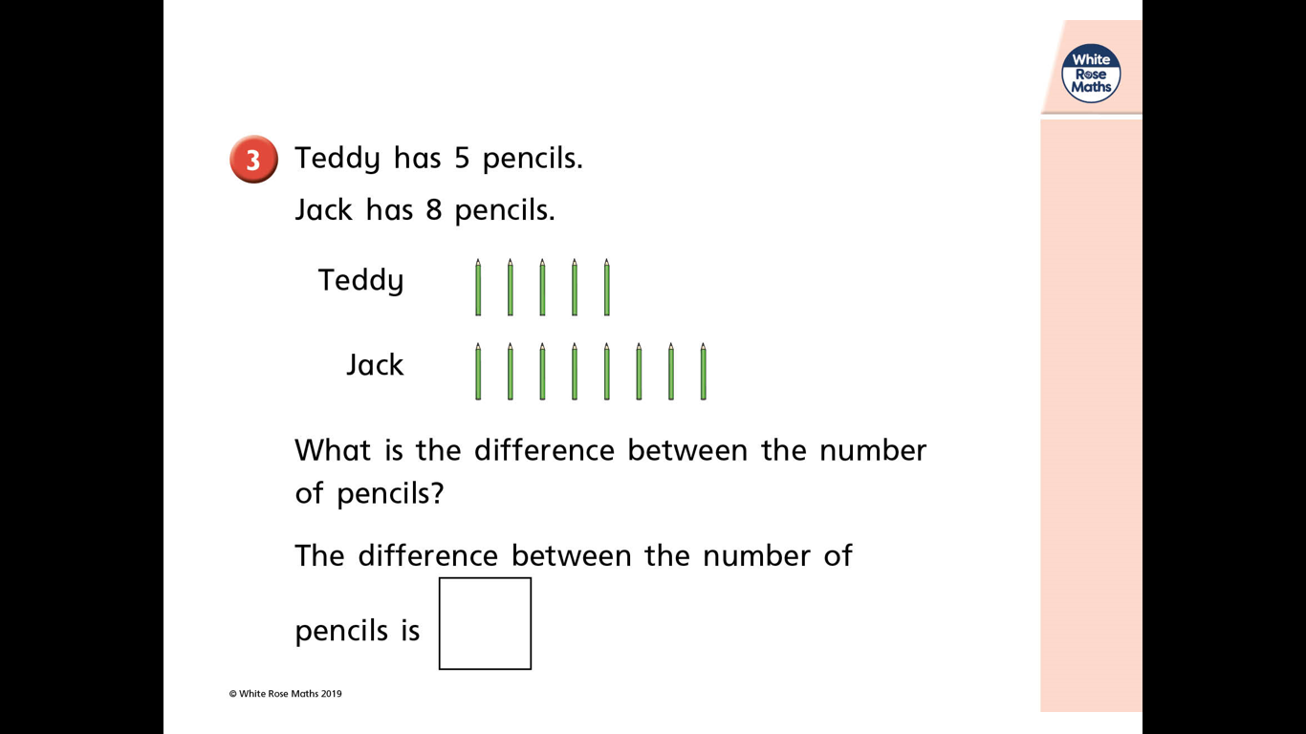
Subtraction
Finding the Difference
I can count on and back in ones to add and subtract.

Slide 14
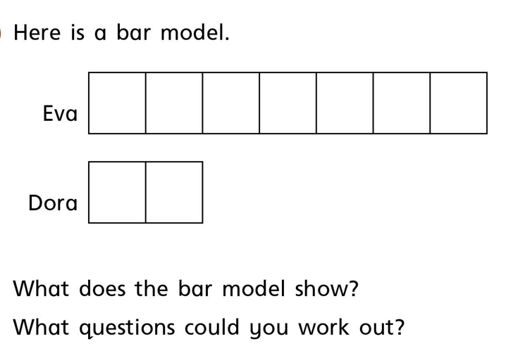
Subtraction
Finding the Difference
I can count on and back in ones to add and subtract.

Slide 15
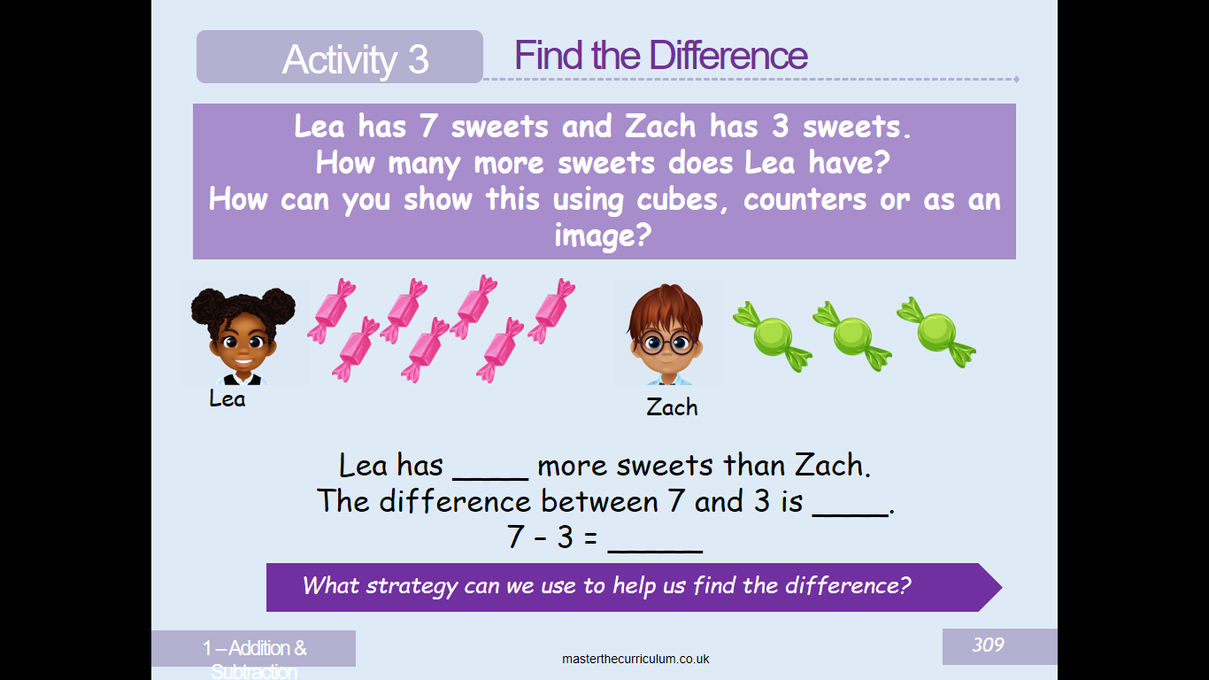
Subtraction
Finding the Difference
I can count on and back in ones to add and subtract.

Slide 16
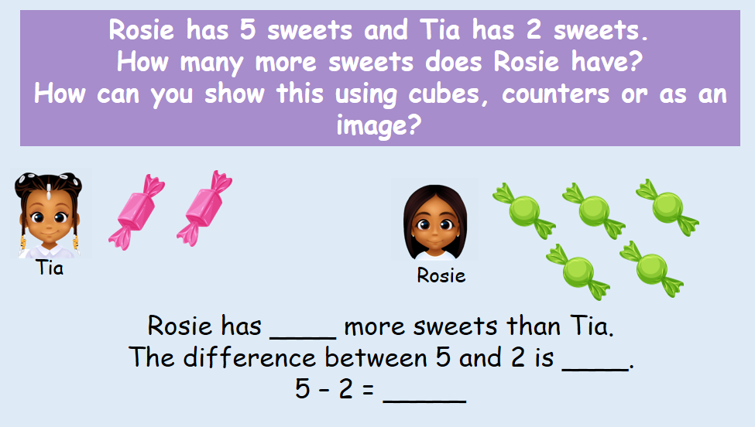
Subtraction
Finding the Difference
I can count on and back in ones to add and subtract.

Slide 17
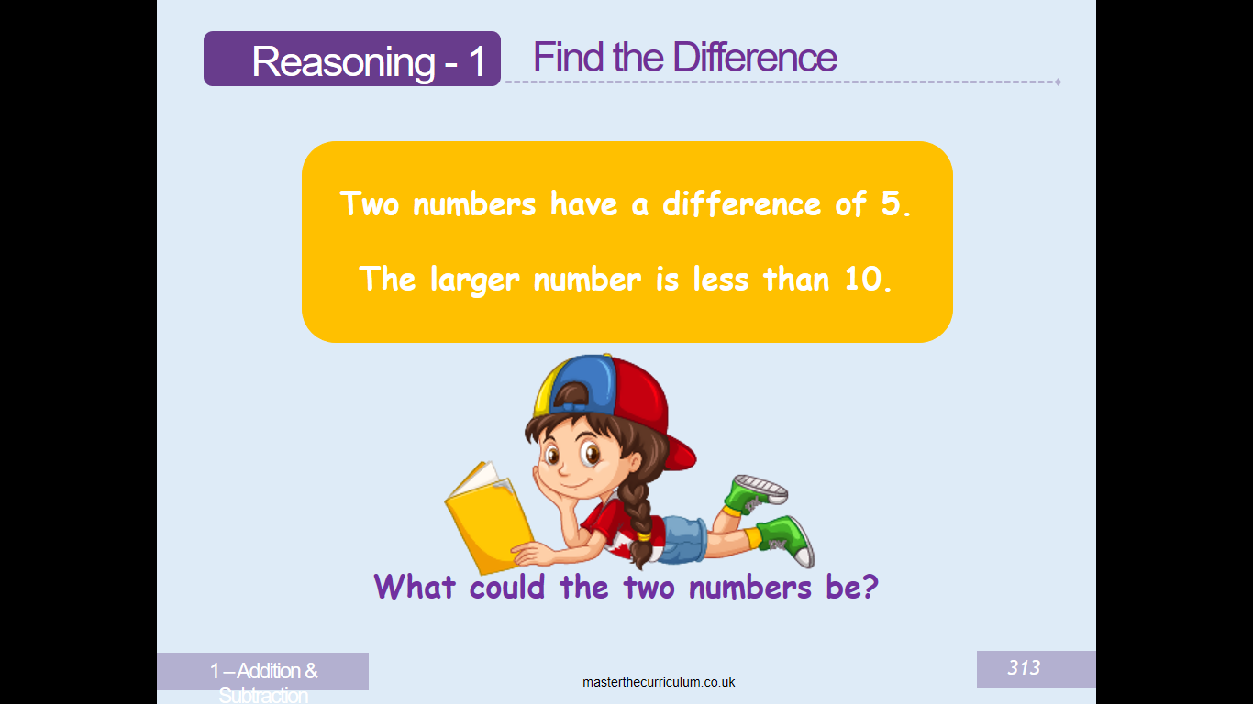
Subtraction
Finding the Difference
I can count on and back in ones to add and subtract.

Slide 18
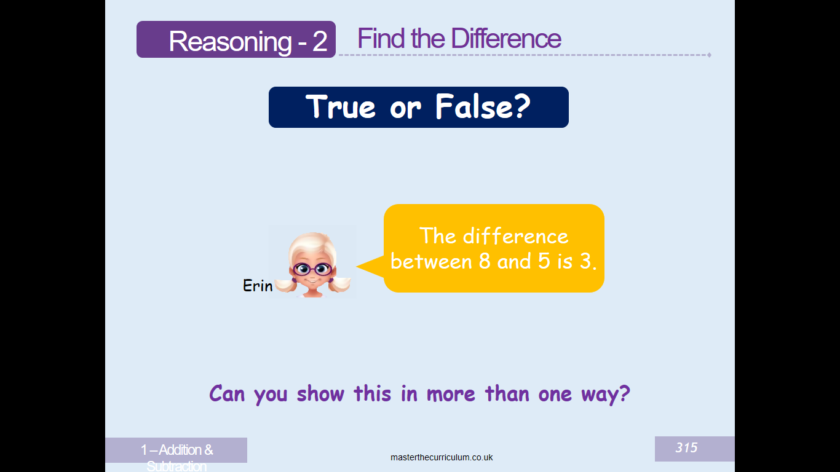
Subtraction
Finding the Difference
I can count on and back in ones to add and subtract.

Slide 19
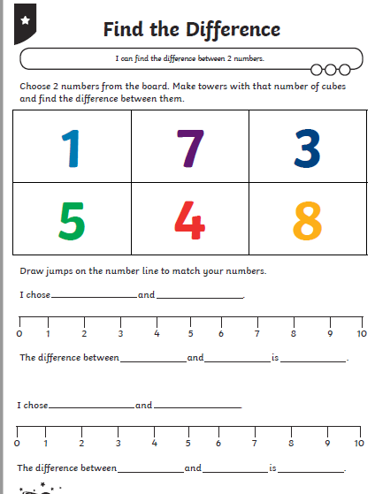
Subtraction
Finding the Difference
I can count on and back in ones to add and subtract.
Please download the ‘Find the Difference Sheet’ from the blog. Alternatively, please help your child draw some number lines in their jotter and solve the problems.

Slide 20
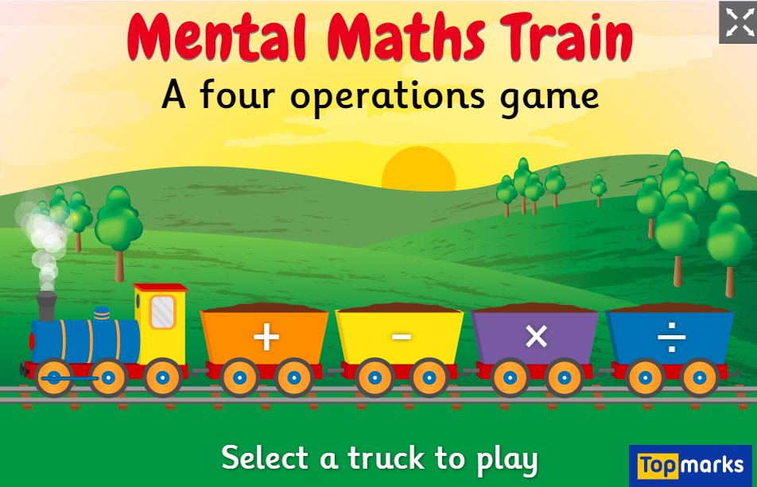
Subtraction
Click on the link and select the subtraction sign to play the game.

Slide 21
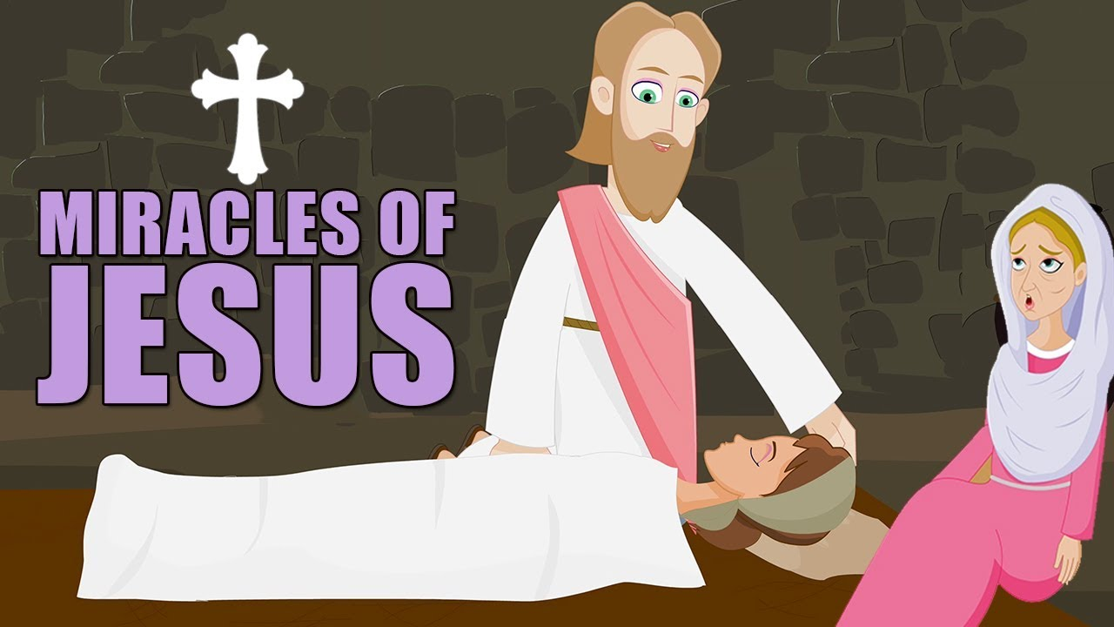

R.E
I am aware of some bible stories.
Activity – Click on the above picture and listen to the miracles of Jesus.
I can give an example of a miracle Jesus performed.

Slide 22
Linlithgow Deacon’s Court and Marches
Marches Challenge
Tuesday would have been Marches day. The Linlithgow Marches and Deacons Court are having a virtual Marches. You can send a Marches message – either as a video or a written message and picture.
You can design a float, decorate a bicycle or you could get dressed up!
The deadline is Friday 12th of June and you can send in messages, videos and pictures via the Deacons Court messanger or emailing decaonscourt.events@gmail.com
There are some STEM Marches activities on the following slides or you can download from the Blog.

Slide 23


Slide 24

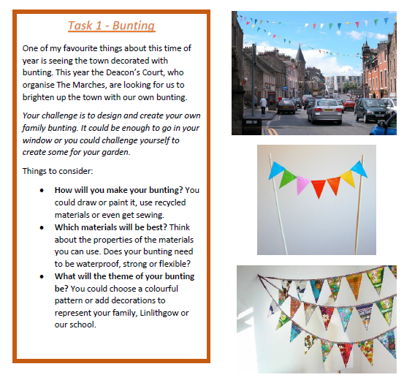

Slide 25
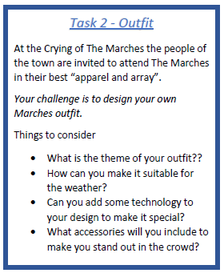
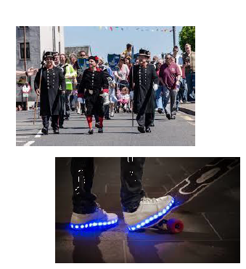

Slide 26
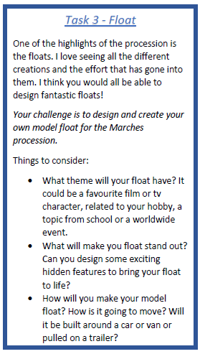
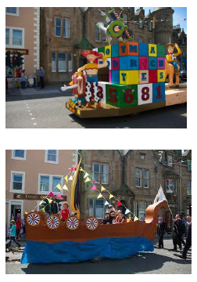

Slide 27
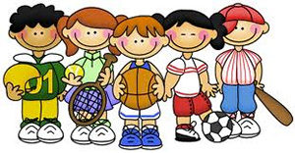

P.E
Take part in Mrs McMaster’s Thursday activity.

