Slide 1
Tuesday
9.6.20
Daily Plan

Slide 2
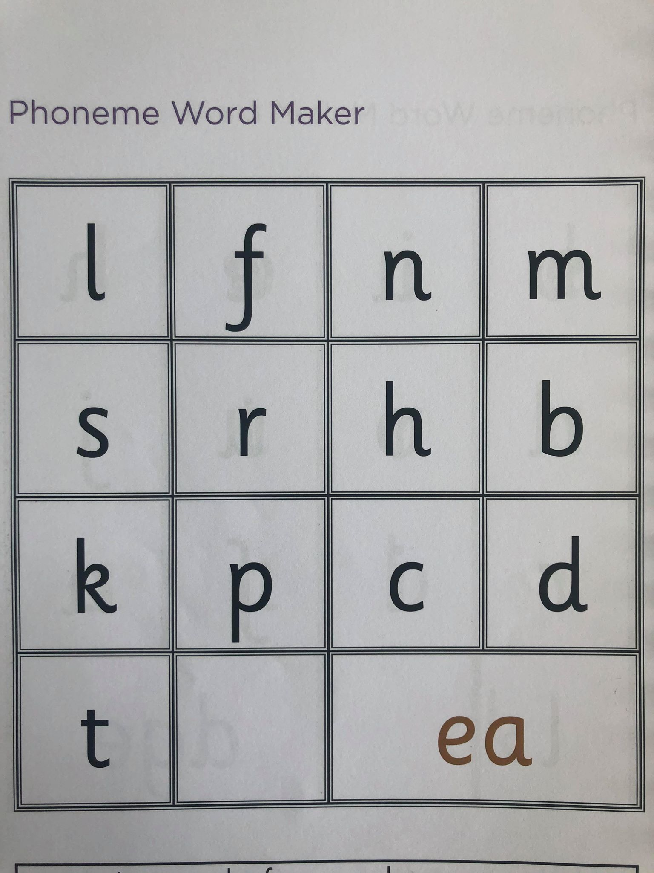
‘ea’ word maker
L.I. I can identify and use spelling patterns.
Tasks
1. Use the grid on this slide to see how many ‘ea’ words you can make.
2. Play ‘ea anagram’ gram where you need to put the letters in order to spell the correct word.
https://games.galacticphonics.com/longvowels/ea/interactive/game/index.html

Slide 3
Handwriting
L.I. I am learning to form letters taking care over entry and exit flicks.
Complete page Level 2- Pg 41- Sentences- in your handwriting revision booklet.
Extension- Fine Motor Skill Challenge cards
Pick a challenge card from the activities on today’s blog. These activities are another way to help with your handwriting.

Slide 4
Snack Time
This Photo by Unknown Author is licensed under CC BY-SA

Slide 5
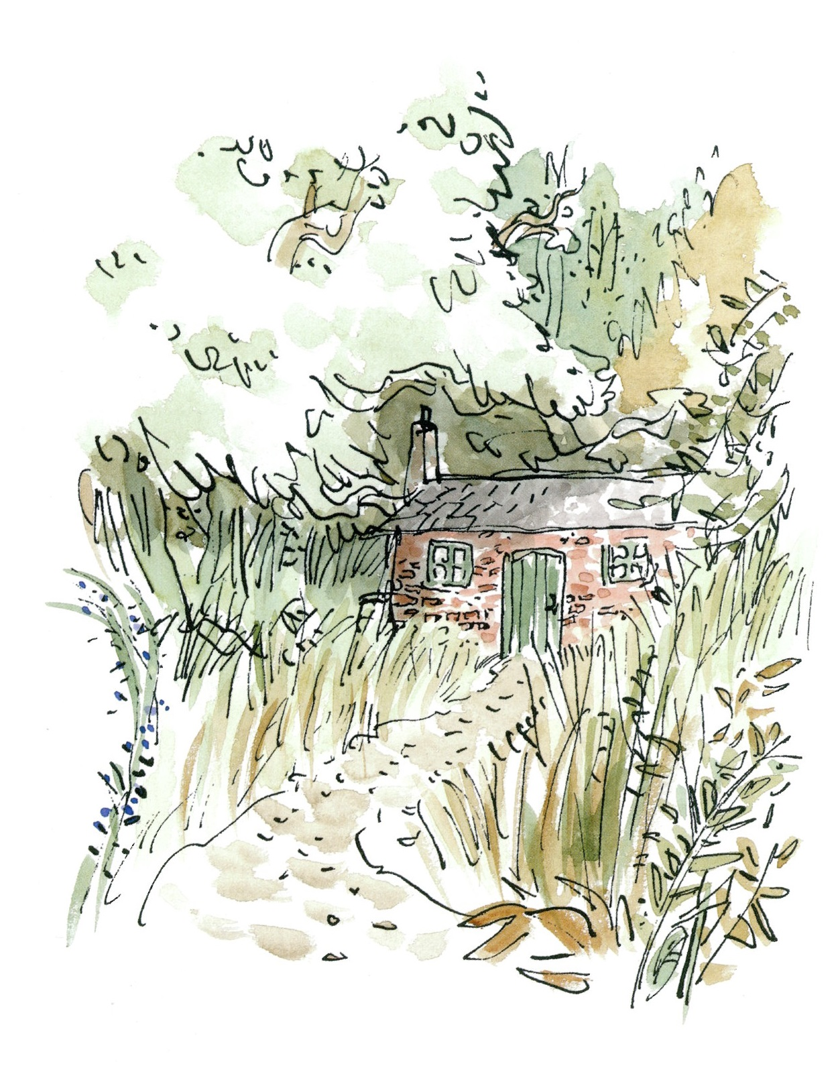
Mid Morning- Reading
Character Study- Matilda Ch16 Miss Honey’s Cottage
https://www.youtube.com/watch?v=qn88yBDGs20
L.I. I can take notes from a text.
Task- Make Miss Honey’s cottage-
On the blog, you will find a task sheet on this chapter. It does not need to be completed in one day! The first part of the task is to note down features of the cottage from the chapter.

Slide 6
Maths-Data handling
L.I. I can read information from a table.
Write down or discuss with an adult
Gerry and Tanya counted the number of goals they have scored over the past 3 seasons.
Gerry scored 16 in season 2.
Find out;
How many goals did Tanya score in season 2?
How many goals did Gerry score in season 1?
Who scored more goals altogether? How many was that?
one lines of
 | Season 1 | Season 2 | Season 3
Gerry | 21 | 16 | 25
Tanya | 17 | 19 | 25

Slide 7
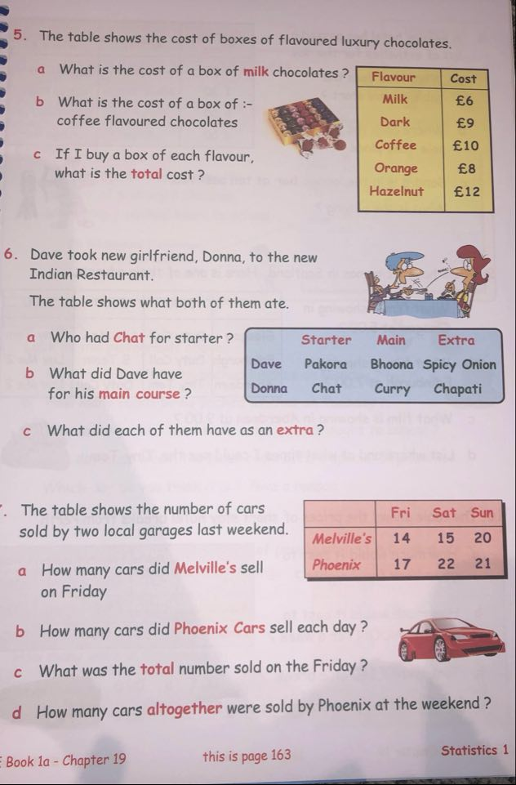
Maths- Data Handling
L.I. I can read information from a table.
.
Textbook Task

Slide 8
Lunch Time
This Photo by Unknown Author is licensed under CC BY-SA

Slide 9
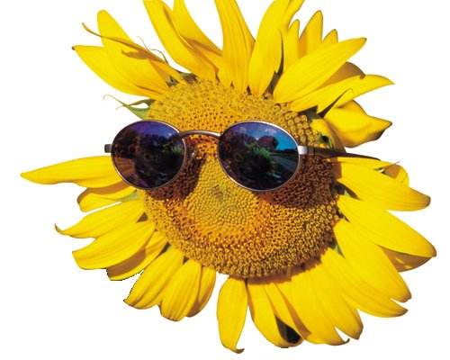
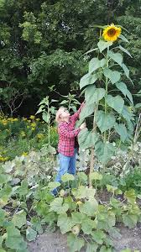
HWB- Living Things
L.I. I am learning what a plant needs to grow and develop.
The Sunflower challenge!
Please keep me updated on the progress of your sunflower over the coming weeks.

Slide 10
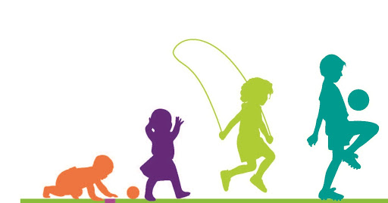
HWB-Growing up
L.I. I can list several things I can do now which I couldn’t do when I was born.
As we grow up, we naturally learn new skills. We then can develop these skills and talents through practice.
Task: Design a poster to show what you can do now which you couldn’t do as a baby.

Slide 11
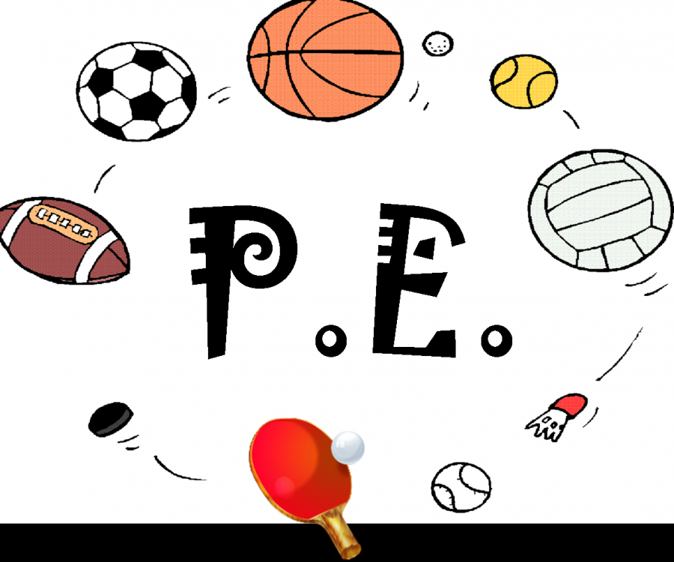
PE and Music
PE with Mrs McMaster
and
Music with Mrs Bain

Slide 12
Music with Mrs Bain
I am learning to follow performance directions.
CUP DANCE The Man in the Moon. A fantastic, progressive cup dance that helps you to keep a steady beat. You need two plastic cups. Even the presenter gets a bit muddled towards the end! Have a go. You can practise this as many times as you like. Go to Youtube and copy this link youtu.be/5Zutf-sPf8I for Cup patterns (The man in the moon). Enjoy!

Slide 13
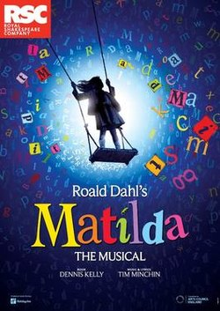
Music Matilda Alternative
Take some time to learn some of the songs Matilda the musical on Youtube.
Here is one of my favourites
https://www.youtube.com/watch?v=dExxFRTwBsw

