Slide 1
P2 – Monday 8.6.20

Slide 2
Monday 8th June 2020
8.6.20
Prayers
Spelling
Assembly
Writing
Break
Milk and Story
Reading
Maths
Lunch
Mindfulness
IDL (Topic)

Slide 3
Morning Prayer
Father in Heaven you love me,
you are with me night and day
I want to love you always in all I do and say
I’ll try to please you father
bless me through this day.
Amen

Slide 4
I hope you all had a lovely weekend and are ready to continue our blog school adventure!
Let’s get started!

Slide 5
Spelling - 8.6.20
LI – I am learning to identify and use spelling patterns.
Use your spelling grid to select a spelling activity.
SC – I can spell words accurately.
I can blend sound into words.
Red | Blue | Yellow
biting | taking | burden
flaming | hoping | advert
smiling | liking | hamster
cheated | started | know
melted | through | walk
enough | always
almost
important

Slide 6
Assembly - 8.6.20
Mrs McEwan’s Monday Message is on the blog for you.

Slide 7
Writing - 8.6.20
LI – I am learning to create a setting for an imaginative story.
Task
Watch the video on how to create a story setting.
https://www.bbc.co.uk/bitesize/topics/zfxtyrd/articles/zbgmmfr
There are instructions below the clip to help you create a setting. We will use this next week to begin to plan a story for the character and setting you come up with.
SC – I can use imaginative and descriptive language.
I can include the correct information.
I can make an interesting story setting.

Slide 8
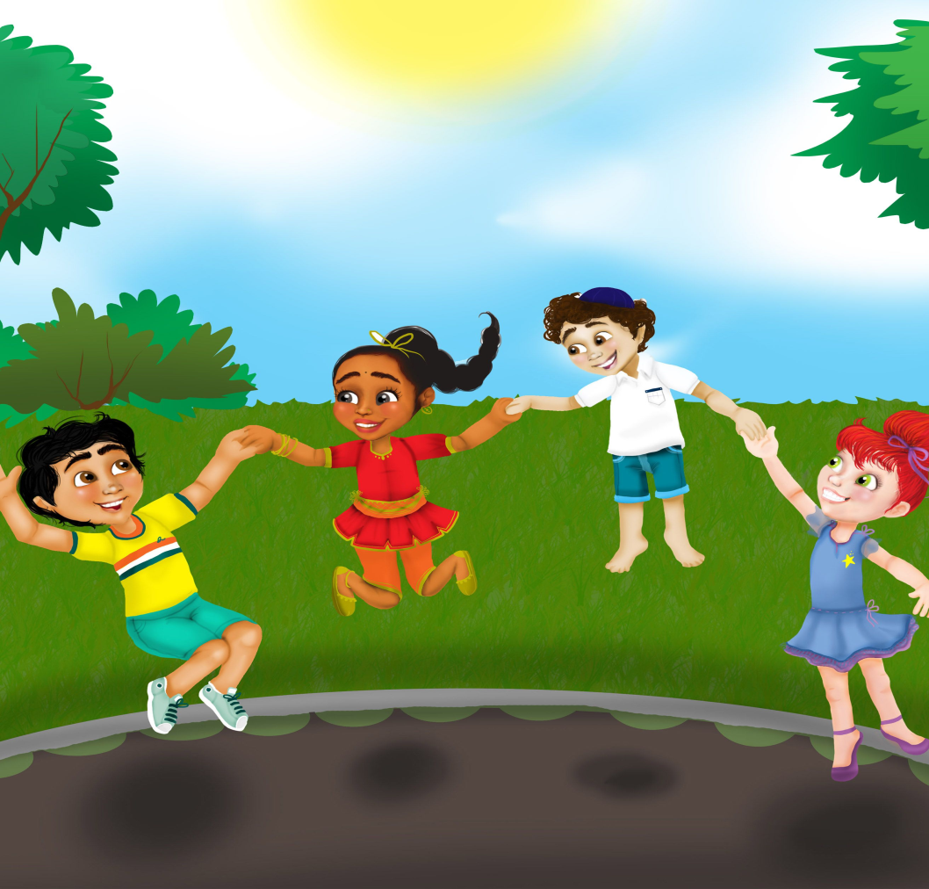
Have a Break - 8.6.20

Slide 9
Milk and Story - 8.6.20
Have a drink and I’ve included a link to Arnie the Doughnut for you. The Newsround link are still here for you if you prefer that.
https://www.bbc.co.uk/newsround/news/watch_newsround
https://www.storylineonline.net/books/arnie-the-doughnut/

Slide 10
Reading - 8.6.20
LI – I am learning to use spelling strategies, my knowledge of tricky words and punctuation to read fluently.
Task
Read a few pages from your favourite book to an adult.
Use the Reading Challenge grid and select an activity, we can use the same grid for the week!
SC – I can read with fluency and show understanding of the text.

Slide 11
Starter - 8.6.20
On the next page you have a maths starter
challenge.

Slide 12
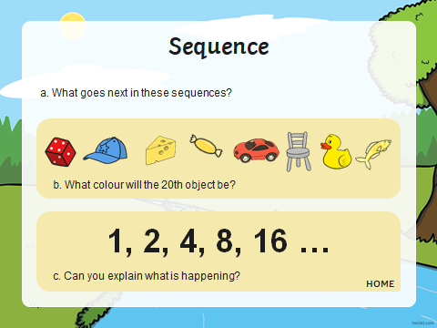

Slide 13
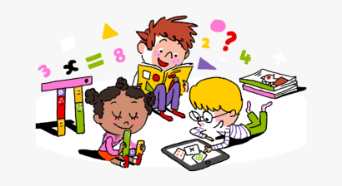
Maths - 8.6.20
Concept of Multiplication
LI – I am learning to develop strategies to multiply by repeated addition
Today we are going to explore multiplication by repeated addition. I think you will see links to division!
I have included a link to a really good clip that is very well done. Also there is a little task to do, it’s on the blog.
https://www.youtube.com/watch?v=2bjnhxFEwC0
Please don’t worry, this is just a first look, you can do it!
SC- I can use my knowledge of division to help me explore multiplication

Slide 14
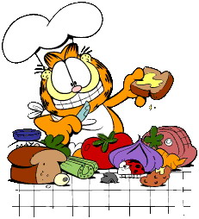
Lunchtime
Bless us O Lord
as we sit together.
Bless the hands that
made the food.
Bless us O Lord
Amen

Slide 15
I hope you enjoyed your lunch
Thank you God for
the food we have eaten.
Thank you God for
all our friends.
Thank you God for
everything.
Thank you God.
Amen

Slide 16
Mindfulness - 8.6.20
LI – I am learning to use mindfulness skills to reduce stress and support my wellbeing.
Activity
I am hoping we can all do this at the same time!
If we all use this link or google ‘Space Breathing’ at 1.15pm we will know we are all together. https://www.youtube.com/watch?v=KhXt7cpCPPs

Slide 17
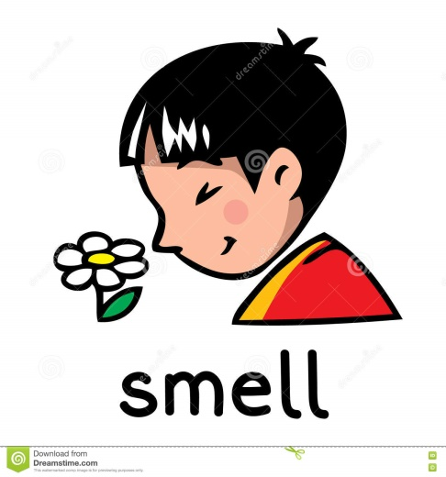
IDL – Smell - 8.6.20
LI – I am learning to explore my senses and discuss how they help me in the world around me.
Task
Use the link to watch Chloe and the Nurb!
https://www.youtube.com/watch?v=hzOSzX_HXE4
We are going to carry out a smell experiment.
Tip – Only parent/carer read the instructions or it won’t work!
See the next slide for instructions.
Have fun!
SC – I can begin to describe how my nose work.

Slide 18
Instructions
You will need -
plastic cups or tumblers
At least 3 clear liquids (water, vinegar, lemonade for example)
Put some of each liquid in a cup, ask your child to look at them and guess what they could be
Invite them to smell each one and guess what it could be (I wouldn’t give options for this, just see what they come up with)
As a challenge I would colour the liquids all the same colour or have the same liquid in each cup and make them different colours ( food colouring, paint, etc could be used)
Repeat the steps above, how did their answers change? Have fun!

Slide 19
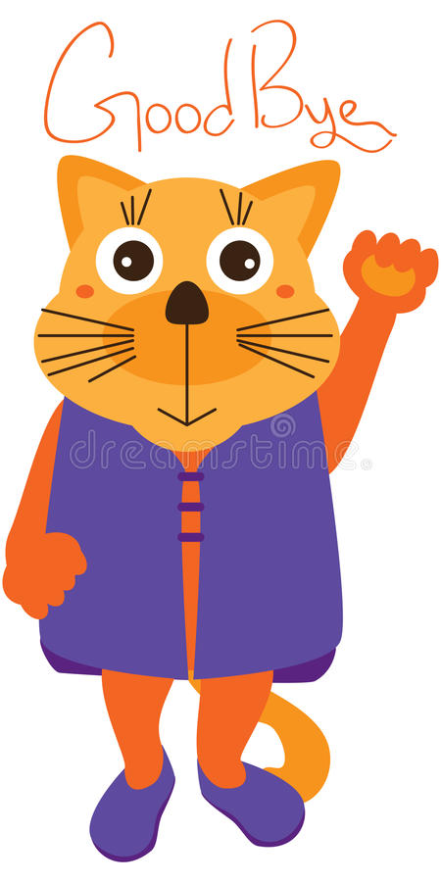
Well done Team Primary 2! Thank you for all your lovely emails I really appreciate them! Enjoy the rest of your day. I will ‘see’ you all tomorrow!
Mrs Grant ☺

Slide 20
Evening Prayer
God our Father, I come to say thank you for your love today. Thank you for my family and all the friends you give to me. Guard me in the dark of night and in the morning send your light. Amen

