Slide 1
Monday
8.6.20
Daily Plan

Slide 2
World Oceans Day
Today is ‘World Oceans Day.
If you click on this link, it gives you access to a range of fantastic video throughout the day on a range of ocean topics. It all starts at 9am and goes on all day. Please feel free to dip in and out as you wish.
I am looking forward to finding out how to breathe like a dolphin at 10.00am.
https://worldoceanday.school/

Slide 3
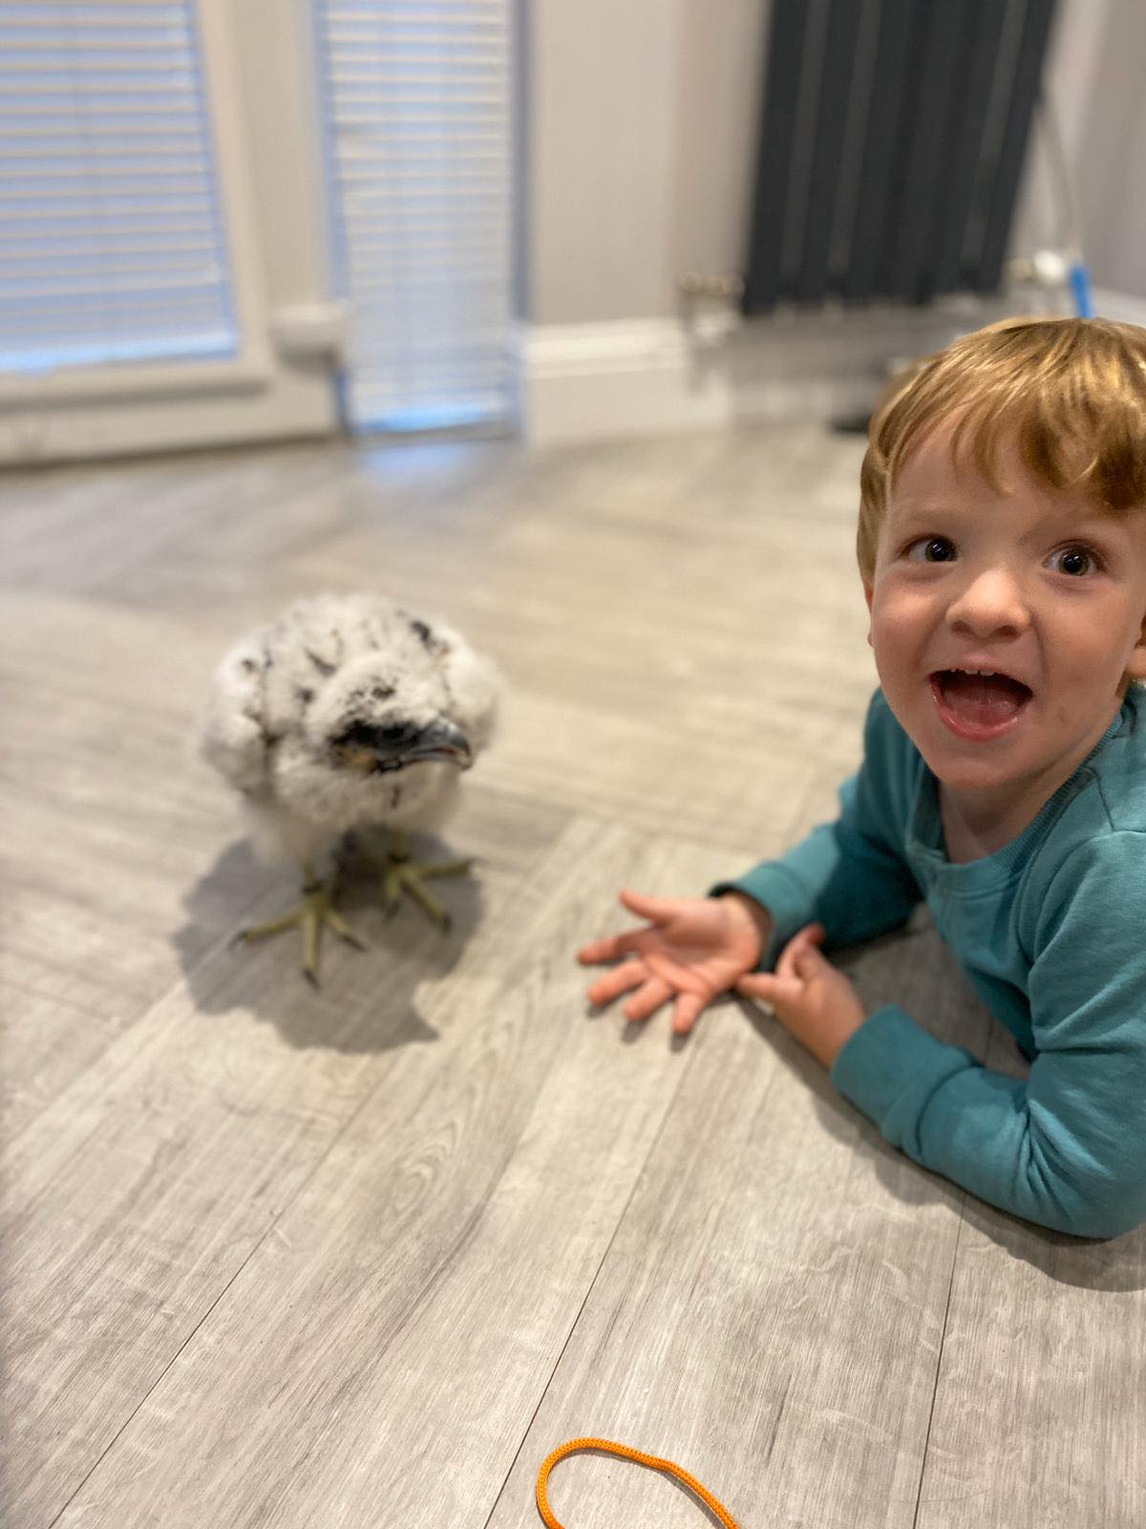
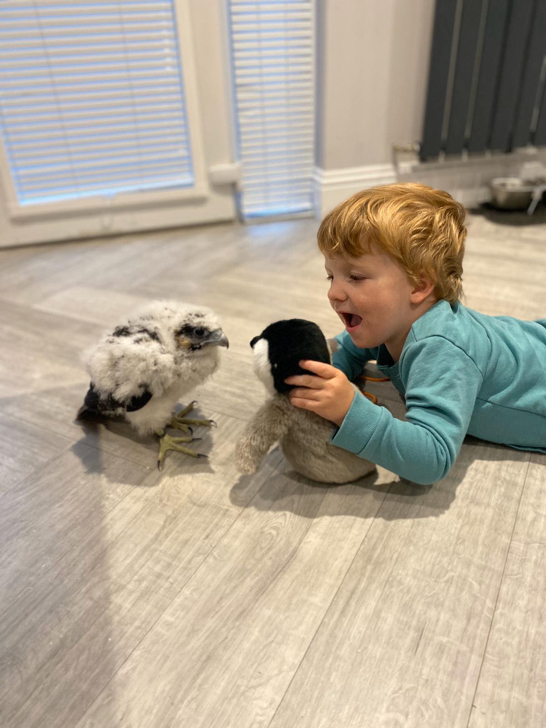
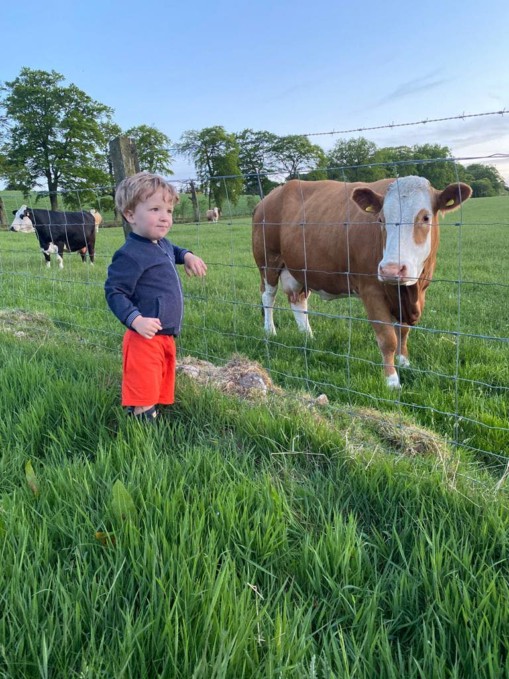
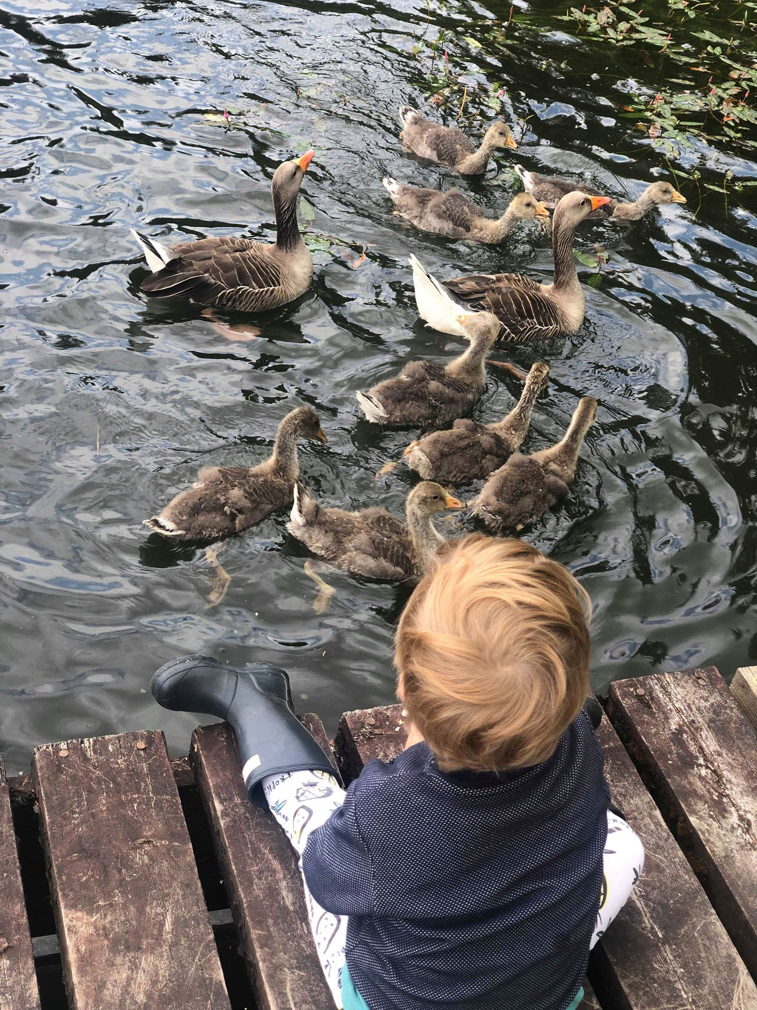
My weekend update
This weekend, Quinn has been having fun with Petra- she is getting so big and getting all her feathers through. We went to Beecraigs and feed the baby geese too and met a cow.

Slide 4
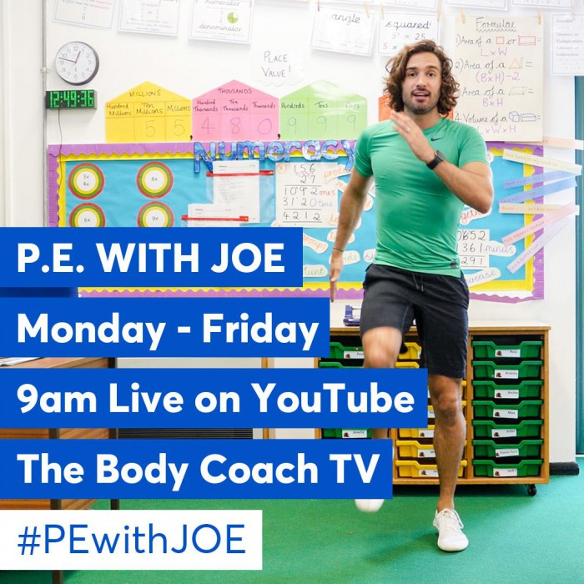
Our Morning
Morning Prayers
Morning Movement with Joe Wicks
https://www.youtube.com/channel/UCAxW1XT0iEJo0TYlRfn6rYQ

Slide 5
Spelling
On the blog, you will find your weekly spelling words. Please use these words for this mornings task.
This week we are looking at the sound ‘ea’.
L.I. I am learning to identify and use spelling patterns.
Before watching the video- think/write down as many words as you can that contain the ‘ea’ sound.
https://www.youtube.com/watch?v=xmesRaf3bCA
Think about ‘when two vowels go walking’ the first one does the talking.
https://www.youtube.com/watch?v=7fb3Pdt8kxg

Slide 6
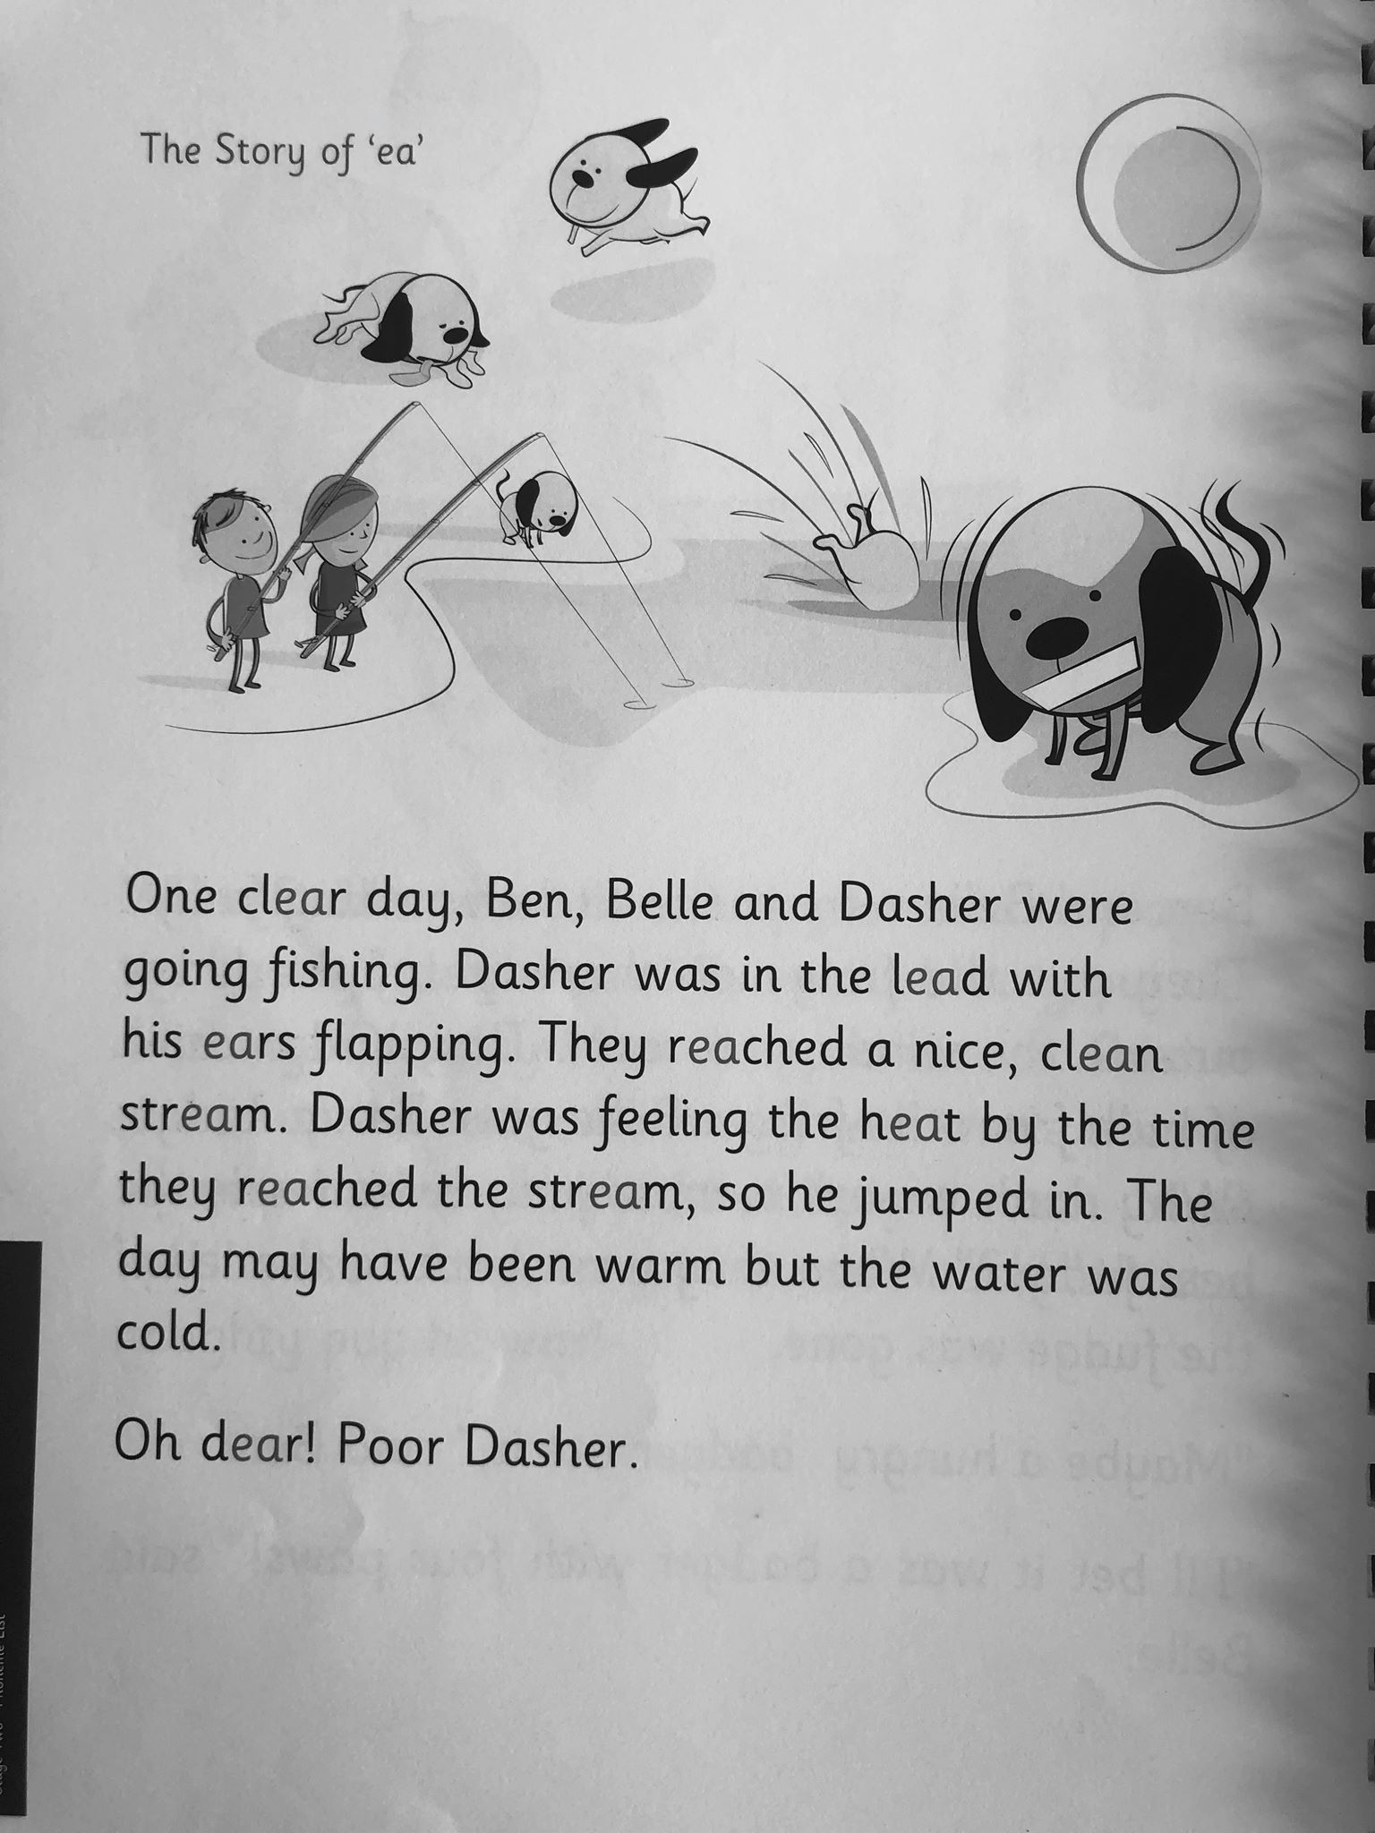
The story of ‘ea’
Tasks
Read the story of ‘ea’ and copy or highlight the words (if you can print) with the ‘ea’ sound.
Use you weekly spelling words to create your own interesting sentences.
Extension games- ea wordsearch https://www.spellzone.com/word_lists/games-2914.htm

Slide 7
Assembly
On the blog today, you will find Mrs McEwan’s assembly PowerPoint. Please use this time to look through it.

Slide 8
Snack Time
This Photo by Unknown Author is licensed under CC BY-SA

Slide 9
Mid Morning
Milk and Story (Choose a story from this link to listen to)
www.storylineonline.com

Slide 10
Maths- Data Handling
L.I. I can read information from a table.
Information which appears in a table or chart should be easy to read.
This table shows the number of pupils from a Primary 3 class who were absent with flu from school during one week last winter.
We know – there were 6 absent on Tuesday
- the longer the week went on, the more absences
Many more pieces of information can be taken from the table.
Day | Number Absent
Monday | 4
Tuesday | 6
Wednesday | 7
Thursday | 9
Friday | 10

Slide 11
Reading information from a table
Task 1- Use the table to answer these questions;
How many pupils were absent on Monday?
How many pupils were absent on Wednesday?
How many more were absent on Thursday than Monday?
How many less were absent on Tuesday than Wednesday?
How many absences were there altogether that week?
Day | Number Absent
Monday | 4
Tuesday | 6
Wednesday | 7
Thursday | 9
Friday | 10

Slide 12
Reading tables for information
Task 2
Nurse Perry has set her TV box to record her favourite programmes while she is at work.
What time is CSI Ayr on at?
When does Emmerdake start?
How long after Corrie Road starts does CSI Ayr come on?
Extension- Can you give two more pieces of information from the table.
Extension/optional task on the blog.
Start Times | Programme
7.00 | Emmerdake
7.30 | Corrie Road
8.00 | CSI Ayr
9.00 | Our Family

Slide 13
Lunch Time
This Photo by Unknown Author is licensed under CC BY-SA

Slide 14
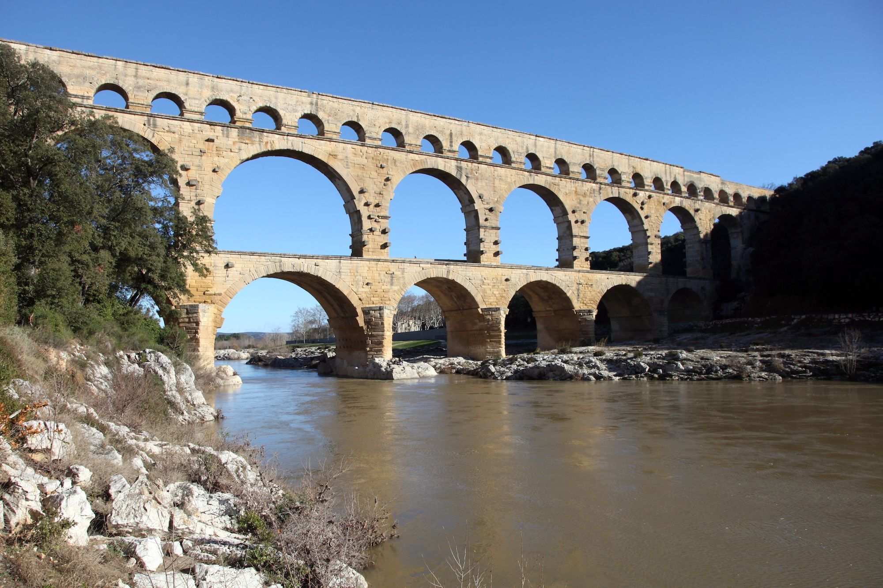
The Romans
Roman Legacy- Language and calendar
L.I. I am learning to understand how Roman ideas still impact our lives today.
Roman Poem
The Romans gave us aqueducts,
Fine buildings and straight roads,
Where all those Roman legionaries
Marched with heavy loads.
They gave us central heating,
Good laws, a peaceful home...
Then after just four centuries
They shuffled back to Rome.

Slide 15
Roman Calendar
I know the origins of our calendar and understand the origin of some of the names
Click on the picture for more information on Roman calendar.

Slide 16
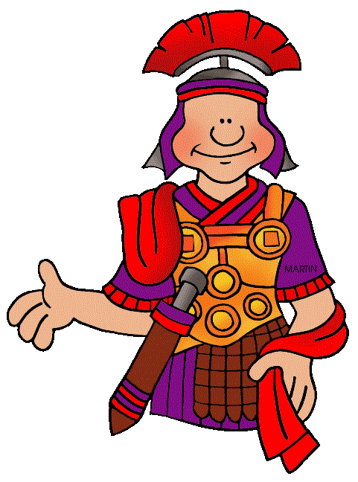
Calendar Tasks
Task 1. Watch this clip which helps explain the Roman calendar
https://www.youtube.com/watch?v=Wu51v0FlSdM
Task 2. Calendar task on the blog

Slide 17
Topic Afternoon
Remember Monday and Wednesday afternoon is also time for you to complete the activities you have chosen from the topic grid.
Have fun and remember to send in your pictures if you would like to share your learning!

