Slide 1
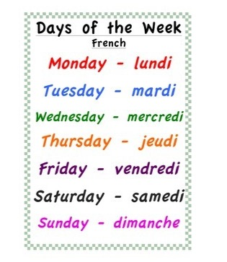
Wednesday 27th of May Mecredi 27 Mai
Good Morning Primary 1!
Bonjour la class! Ca Va?
Click on the above picture to listen to the days of the week in French.

Slide 2
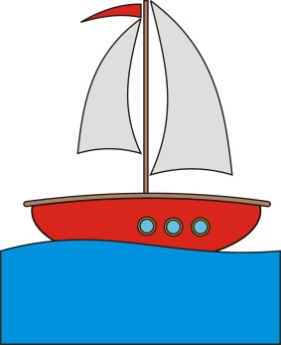
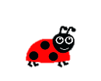
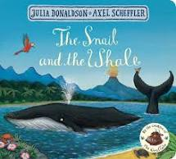
The Snail on the Whale
I can write to convey information in a real context.
Click on the picture to take you to the story.
To write a narrative of the story ‘The Snail and the Whale’.
Write an opening that will interest others (who, what, where, when, why)
Include characters and what part they play (who, what, why)
Include thoughts and feelings
Write a logical sequence of events
Include a simple ending

Slide 3
The Snail and the Whale
Click on the picture to take you to the Snail and the Whale song.
Say I can talk about the events in the story.
Write I can write 3 sentences to describe what happens at the beginning,
middle and end of the story.
Make I can make a story wheel of the events in the story.
Do I can join in with the song ‘The Snail and the Whale’
Download the sheet from the blog to write your sentences or write them in your jotter.

Slide 4
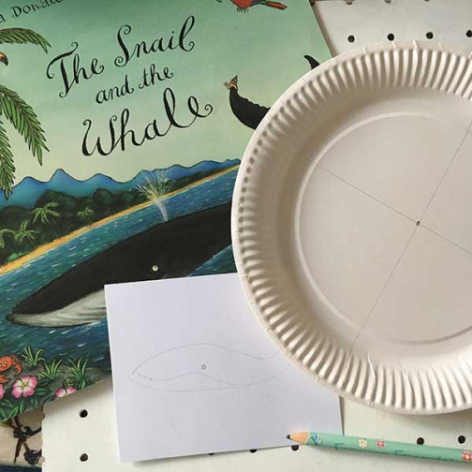
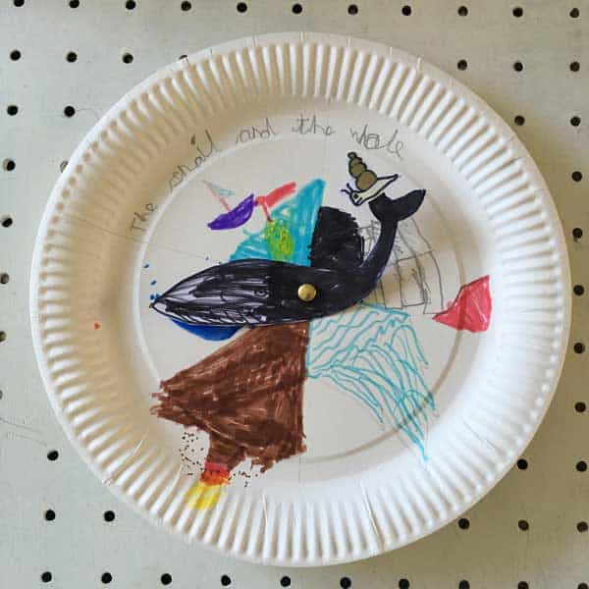
Snail and the Whale Story Wheel
Create a story wheel
What you will need:
Paper Plate
Coloured Pens
Scissors
White card
Section the plate into parts to show different settings in the story. E.g
The Snail meets the Whale
The icebergs
The volcano
The huge waves
Busy Beach
Draw the whale and the snail on a separate piece of paper/card to stick in the middle of the plate. The whale can then be moved into each section to tell the story.

Slide 5
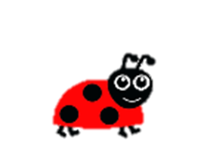
Story Time
I can actively engage in a story.
Click on the picture to take you to the story.

Slide 6
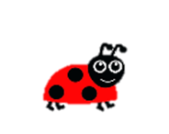
Number Song Time
Click on the picture to take you to the music clip.

Slide 7
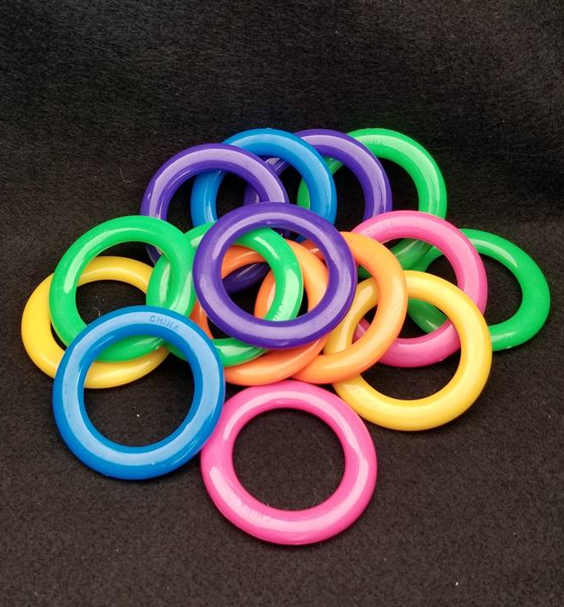
I can use my skills of subitising (recognise the amount in a group without counting) to help me estimate the number of objects in a larger group.
How many rings are there?
As the clues appear, use the information to narrow the possibilities to a smaller set. After each clue, use estimation again to determine which of the remaining answers is the most reasonable.
Write down your first estimate. After each clue, you’ll see if your estimate is still a possibility. After each clue, if it is no longer possible write down a new estimate – and be prepared to explain why you chose it.
Steve Wyborney
www.stevewyborney.com

Slide 8
Clue #1
Clue 1
The answer is between 1 and 20.
Clue 2
The answer is smaller than 20.
Clue #2
Clue 2
The answer is bigger than 14.
Clue #3
Clue 3
The answer is bigger than 14.
Clue 4
The answer is not 18 or 19.
Clue #4
1 | 2 | 3 | 4 | 5 | 6 | 7 | 8 | 9 | 10 | 11 | 12 | 13 | 14 | 15 | 16 | 17 | 18 | 19 | 20
Steve Wyborney
www.stevewyborney.com

Slide 9
After seeing the clues, you have narrowed the possibilities to a small set of numbers. Before you see the answer, select your final estimate. Write it down, and explain to someone why you chose that number.
Steve Wyborney
www.stevewyborney.com

Slide 10
The Reveal
Click to see the answer.
15 rings
Steve Wyborney
www.stevewyborney.com

Slide 11
Volume and Capacity Challenge
Which of the jugs is the smallest? Can you find some different jugs and bottles with measurements on?

Slide 12
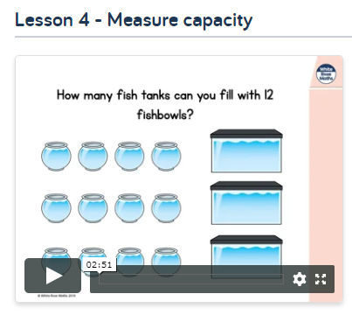
Volume and Capacity
I can estimate then measure the mass and capacity of familiar
objects using a range of non-standard units.
Click on the picture to take you to the lesson on ‘Measure Capacity’. Click on
Wk 1st June, scroll down to Lesson 4.
Activity
Listen to the Whiterose maths video.
Complete the worksheet from the blog or in jotter.
..
I can compare and describe volume and capacity using appropriate vocabulary.

Slide 13
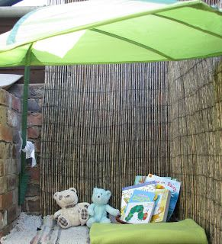
Reading Garden
I can choose a story to read for enjoyment.
Set up an area of your garden or house as a reading garden. Put some cushions and bring out some toys and your favourite books to read.

Slide 14
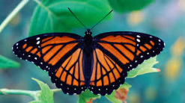
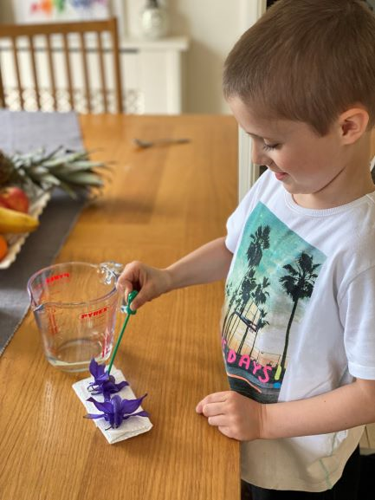
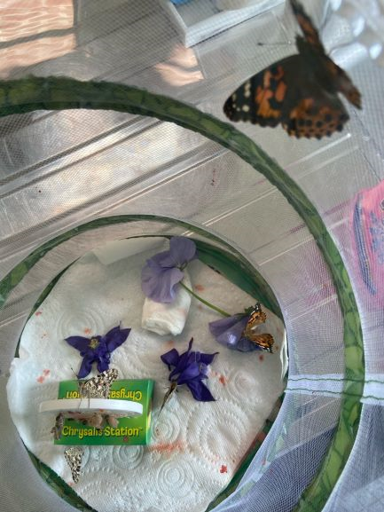
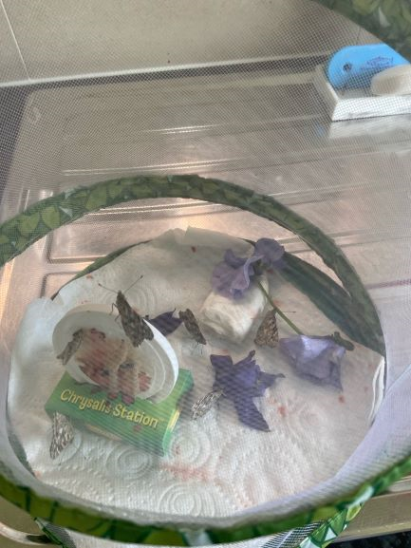
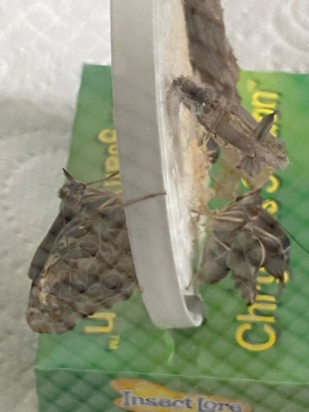
Butterfly Garden Update
Our butterflies came out of their cocoons over the weekend. We have 5 beautiful butterflies. We have dissolved water and sugar together and have soaked some flower petals in it for the butterflies to feed off.
It looks like they are bleeding but this is red liquid that comes out of their cocoons and is normal.
We will keep feeding them over the next few days and hope to release them on Thursday.
From Leo

Slide 15
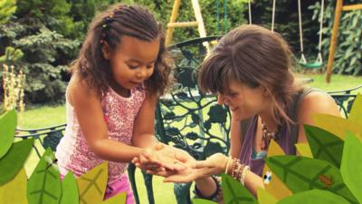
IDL
Click on the photo of Jess to learn all about snails.

Slide 16
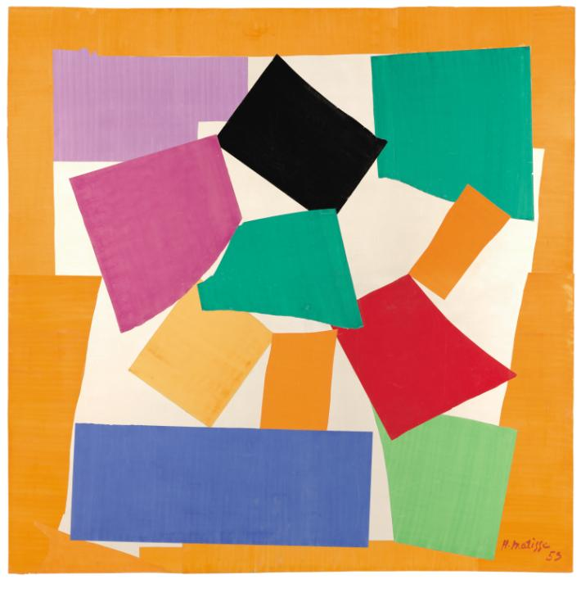
ART
I can use the ‘The Snail’ by Matisse to inspire me to create my own collage.
This artwork is called The Snail and it’s by a French artist called Henri Matisse. Does it look like a snail's spiralling shell to you?
(Pssst there is also a secret tiny snail hidden in the picture – can you see it? If you look very, very closely you might just spot a tiny snail shape on top of the purple square).
The Snail shows Matisse’s interest in bright colour. He has arranged complementary colours alongside each other to create a vibrant effect. For example the green touches the red, and the blue is next to the orange. This makes the picture extra zingy and really attracts your eye's attention!
The Snail is a collage made from pieces of brightly painted paper that have been cut out and stuck onto a canvas.

Slide 17
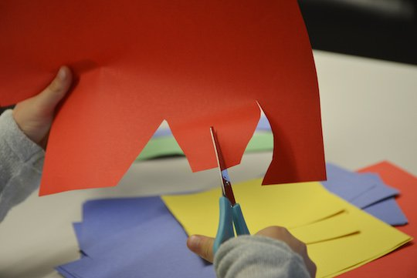
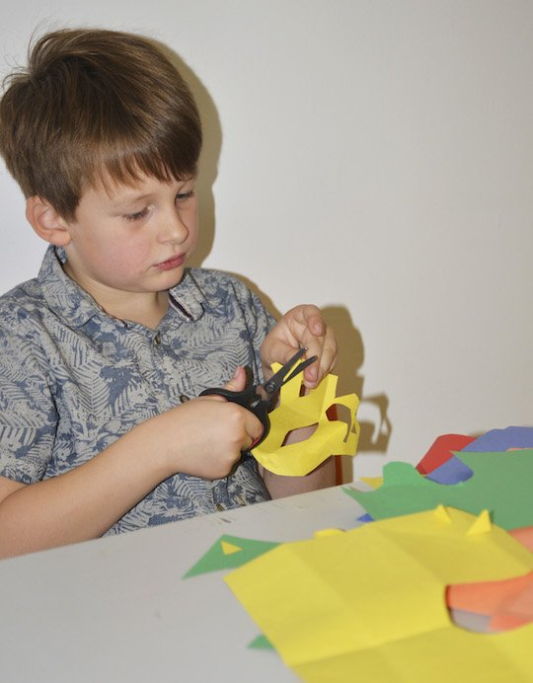
Art
I can use the ‘The Snail’ by Matisse to inspire me to create my own collage.
Click on the image to see ‘The Snail’ on display at The Tate Modern.

Slide 18
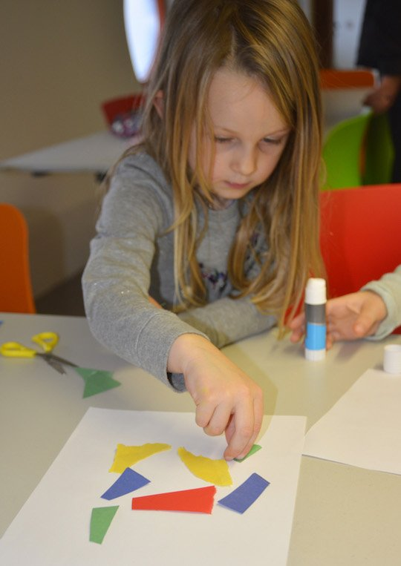
ART
I can use the ‘The Snail’ by Matisse to inspire me to create my own collage.
You are going to make your very own Matisse inspired collage. Use scissors and cut out shapes from brightly paper. They can be any shape you want; they can be wavy like the sea or sharp like a cactus.
When you have made a pile of brightly coloured shapes take a large sheet of coloured paper and start creating your picture. Arrange the shapes onto the page to make a picture that looks like a snail. Don't be afraid to experiment with your shapes, they can be apart or touching. You could even overlap them to make a new shape – just play around and see what happens.
Once you're happy with your picture you can stick your paper shapes down.

Slide 19
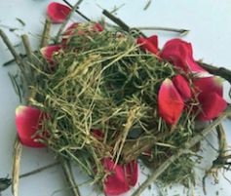
Smile Mile
Go for a Smile Mile around your garden or outside area.
Optional activity – on your walk can you make a nest for a bird/rabbit/mouse? Use things you find such as dried grass, fallen leaves, twigs or petals. Can you use your imagination to form a small structure for an animal to live in? Make it nice and cosy so they feel invited to live there.

