Slide 1
Wednesday
27.5.20
Daily Plan

Slide 2
Morning
This Photo by Unknown Author is licensed under CC BY-SA

Slide 3
Spelling Starter
day
tray
play
stay
prayer
way
Pick one of the spelling activities

Slide 4
Grammar-Commas
LI – I am learning to use commas when writing lists.
Using a comma for listing items saves having to write and lots of times.
https://www.bbc.co.uk/bitesize/topics/z8x6cj6/articles/zxvcrdm
Task 1 – Play the game
Task 2- Take the quiz
Task 3- Activity on the blog.

Slide 5
Break Time
This Photo by Unknown Author is licensed under CC BY-SA

Slide 6
Mid Morning
This Photo by Unknown Author is licensed under CC BY-SA

Slide 7
Morning Story
Choose a story from Storyline online.
https://www.storylineonline.net/

Slide 8
Maths- Symmetry
LI - I am learning to draw symmetry.
Remember that when drawing symmetry, both sides must be identical.
Have a little practice again using this online game.
https://pbskids.org/peg/games/symmetry-painter

Slide 9
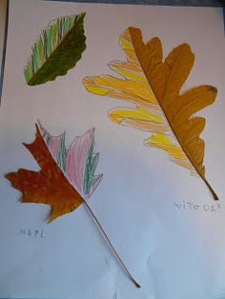
Drawing Symmetry
Drawing symmetry Task
Find a range of interesting leaves around your garden/local area.
Cut in half and Stick them down on a piece of paper
Use coloured pens/pencils to draw the other symmetrical side.
Extension (optional) task can be found on the blog.

Slide 10
Lunch Time
This Photo by Unknown Author is licensed under CC BY-SA

Slide 11
Afternoon
This Photo by Unknown Author is licensed under CC BY-SA

Slide 12
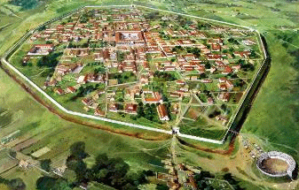
The Roman building and engineering.
LI – I am learning about Roman towns and features of Roman buildings.
Lets find out- What buildings did the Romans build and for what purposes? How did they solve engineering problems such as providing enough water for their towns and cities, and enabling the army to get from A to B.
http://www.primaryhomeworkhelp.co.uk/romans/towns.htm
https://www.bbc.co.uk/bitesize/topics/zqtf34j/articles/ztqg4wx

Slide 13
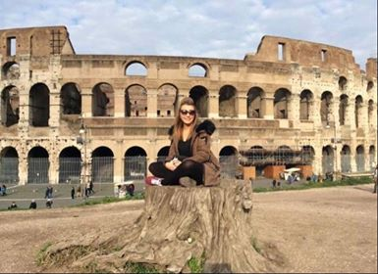
Build a Roman building Task
On the blog you will find out a power point showing famous Roman buildings.
There is instructions on how to build your own Roman building.
I went to Rome a few years ago and all the buildings were amazing. My favourite was the coliseum.

Slide 14
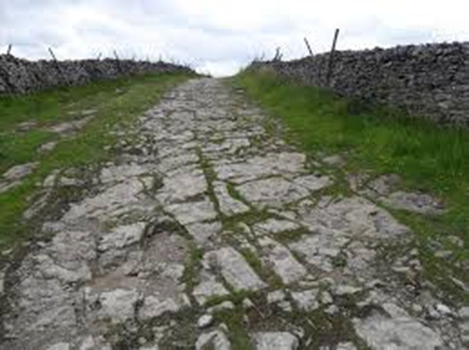
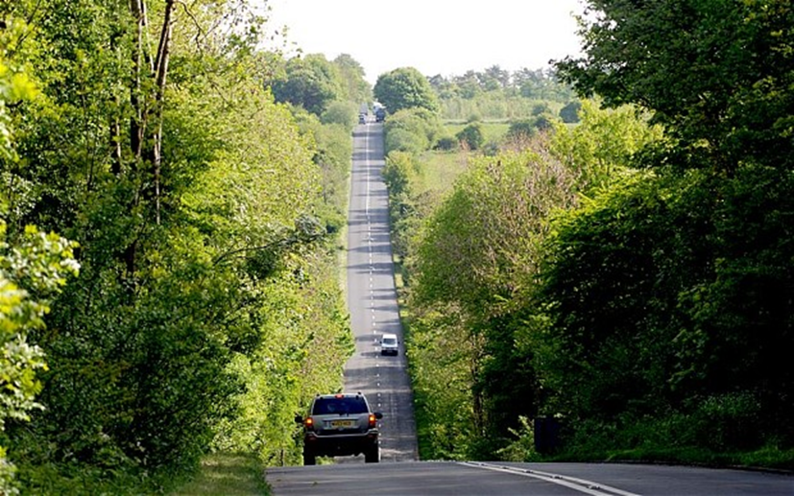
Roman Roads
L.I. I am learning how the Romans built roads and how many of these have survived over 2000 years.
Find out more about Roman roads here.
http://www.primaryhomeworkhelp.co.uk/romans/roads.htm
A modern road travelling along the same route as a Roman road
The remains of a Roman road today

Slide 15
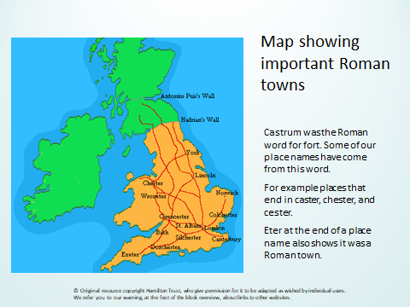

Slide 16
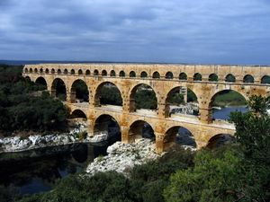
Aqueducts
L.I. I am become familiar with the construction and use of aqueducts to bring fresh water into the towns and cities.
Click the link to find out more
https://kids.britannica.com/kids/article/aqueduct/399914
On the blog you will find a power point with details on how to build your own aqueduct. This is one of your topic grid challenges. I know Amber has already carried out this challenge is happy for me to share some of her pictures on the next slide.

Slide 17
