Slide 1
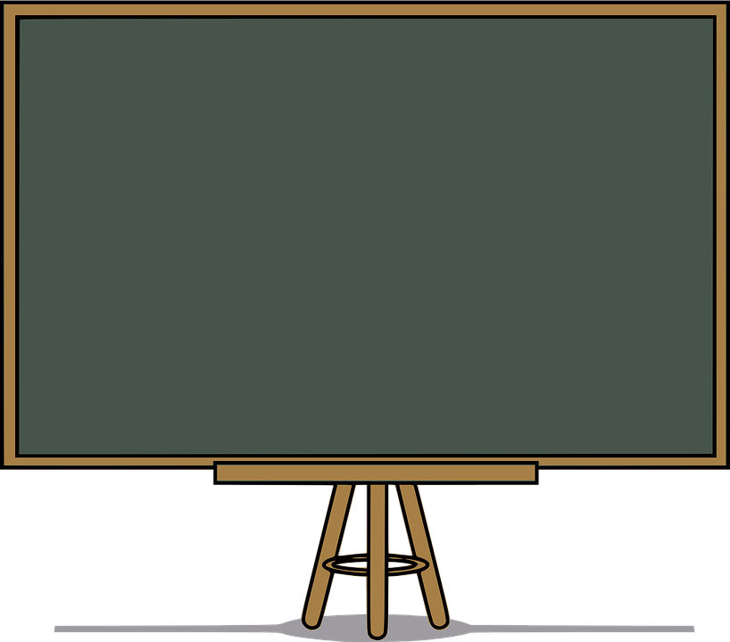
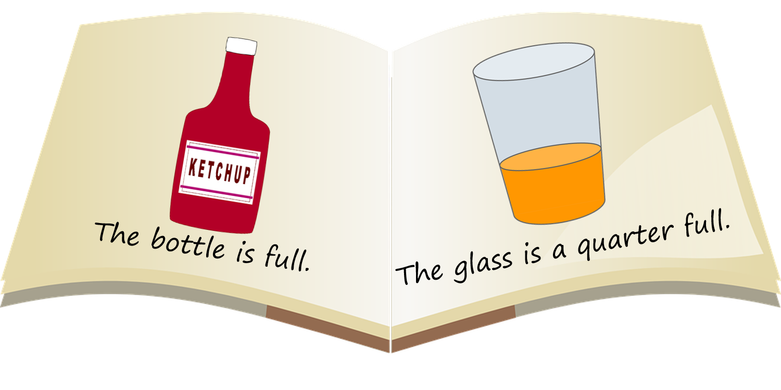

Slide 2
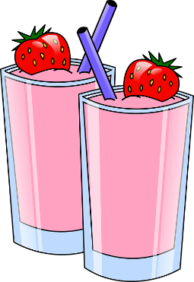
Volume is the amount of space something is taking up inside a container.

Slide 3
We can describe the volume of the contents in a container by using the words empty or full.
empty
full

Slide 4
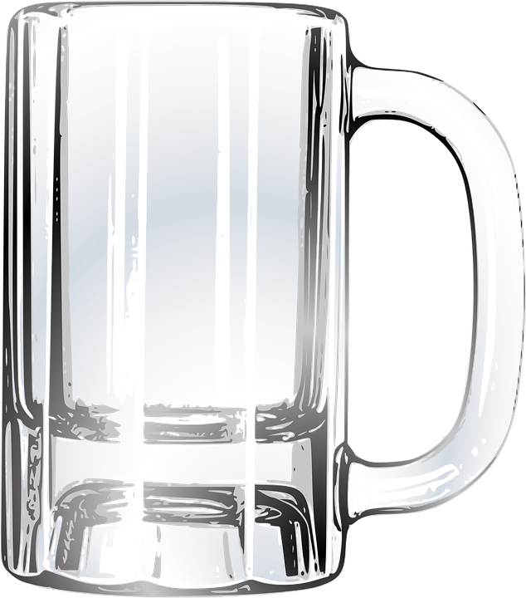
This glass is empty.
empty

Slide 5
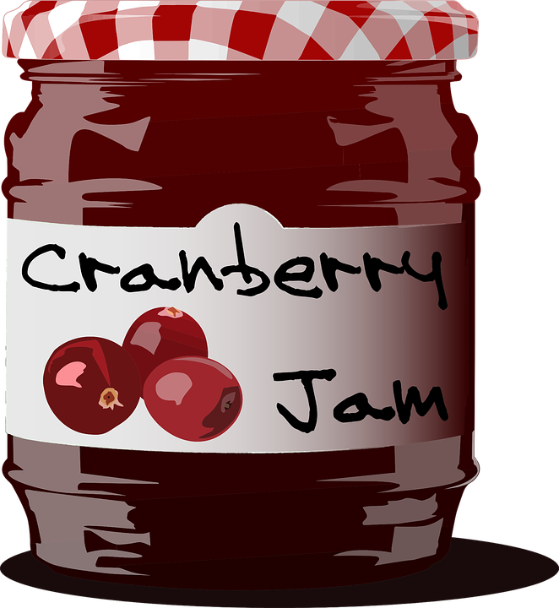
This jar is full.
full

Slide 6
This container is nearly full.
nearly full

Slide 7
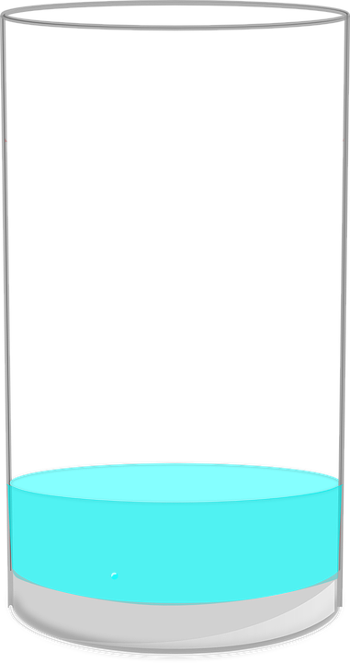
This container is nearly empty.
nearly empty

Slide 8
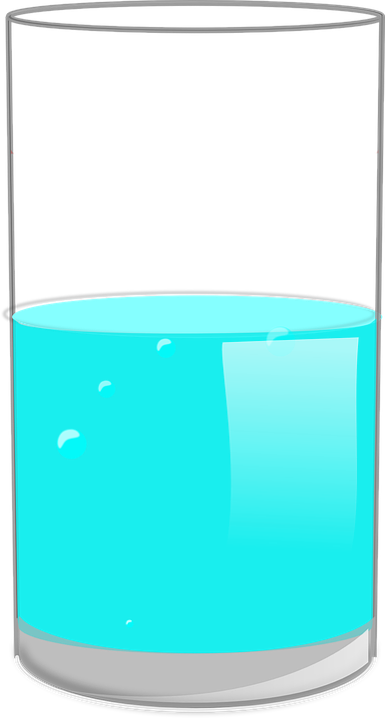
This container is half full.
half full

Slide 9
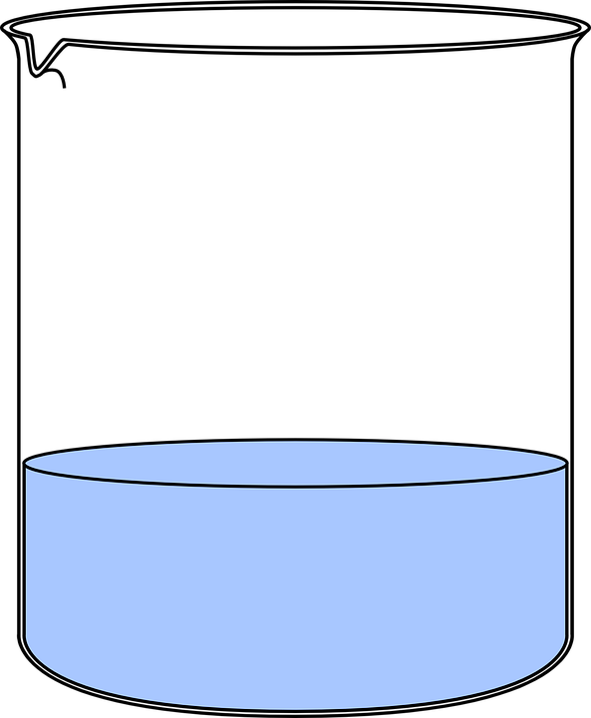
This container is quarter full.
quarter full

Slide 10
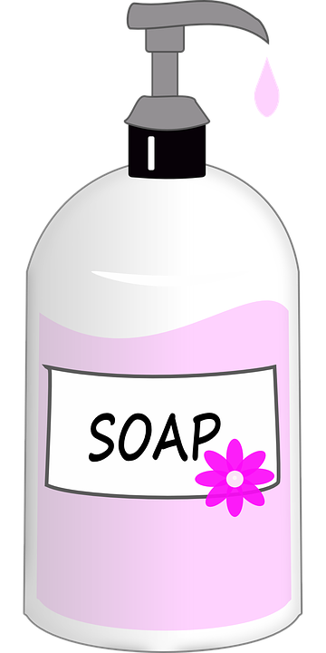
empty
What word or words describe the volume in this container?
nearly empty
quarter full
half full
nearly full
full

Slide 11
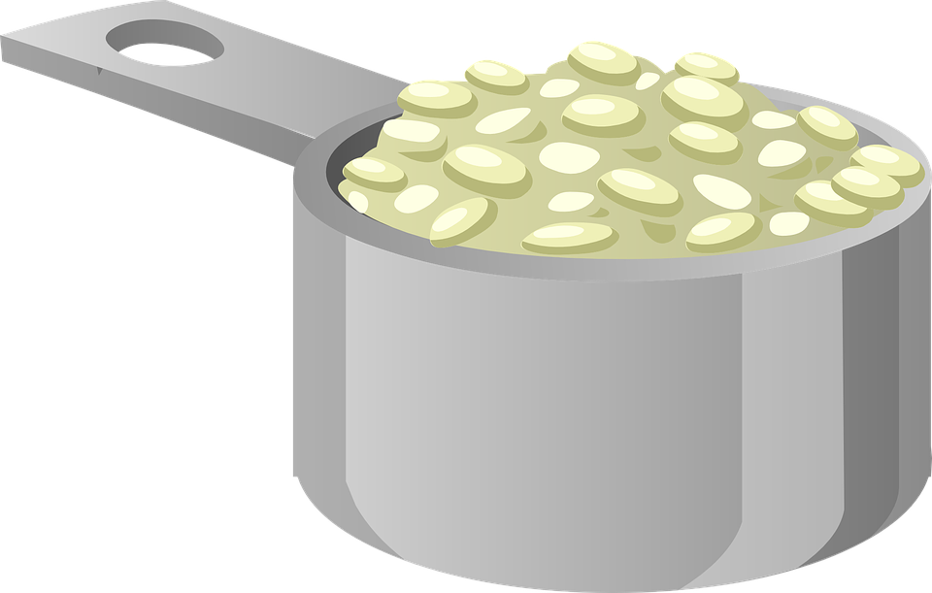
empty
What word or words describe the volume in this container?
nearly empty
quarter full
half full
nearly full
full

Slide 12
empty
What word or words describe the volume in this container?
nearly empty
quarter full
half full
nearly full
full

Slide 13
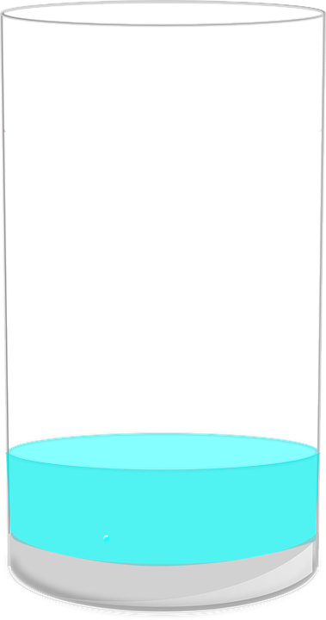
empty
What word or words describe the volume in this container?
nearly empty
quarter full
half full
nearly full
full

Slide 14
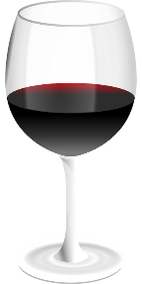
empty
What word or words describe the volume in this container?
nearly empty
quarter full
half full
nearly full
full

