Slide 1
Tuesday
26.5.20
Daily Plan

Slide 2
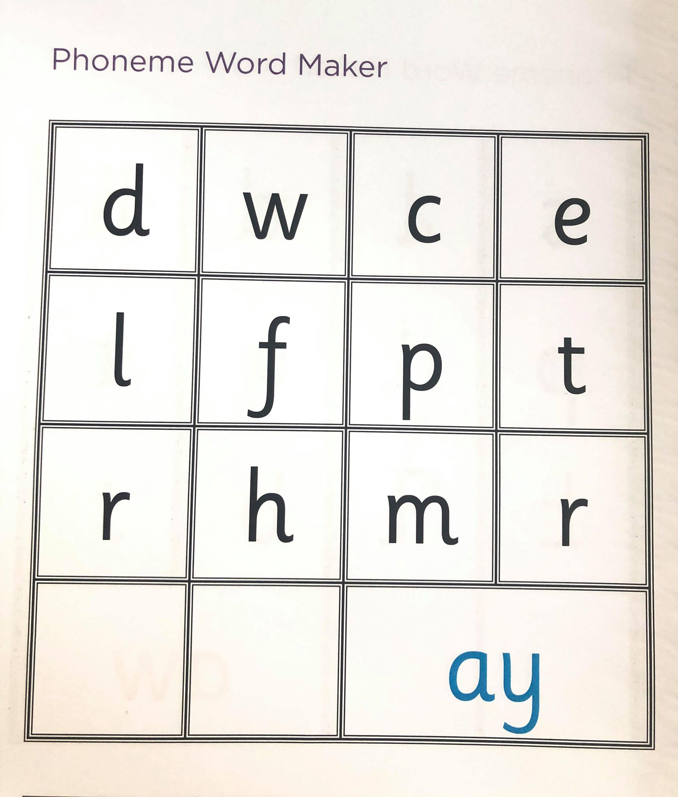
‘ay’ word maker
L.I. I can identify and use spelling patterns.
Tasks
1. Use the grid on this slide to see how many ‘ay’ words you can make.
2. Play ‘ay anagram’ gram where you need to put the letters in order to spell the correct word.
https://games.galacticphonics.com/longvowels/ay/interactive/game/index.html

Slide 3
Handwriting
L.I. I am learning to form letters taking care over entry and exit flicks.
Complete page Level 2- Pg 40- Sentences- in your handwriting revision booklet.
Extension- Fine Motor Skill Challenge cards
Pick a challenge card from the activities on today’s blog. These activities are another way to help with your handwriting.

Slide 4
Snack Time
This Photo by Unknown Author is licensed under CC BY-SA

Slide 5
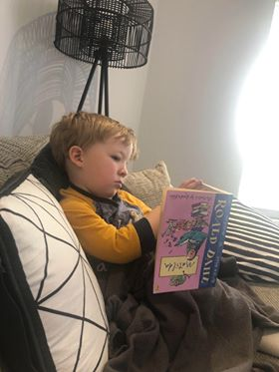
Mid Morning- Reading
Character Study- Matilda Ch14 The First Miracle
https://www.youtube.com/watch?v=IRavXoHbsP0
L.I. I can show my understanding of a text by creating questions to ask others.
Task- Question Writer
Using your understanding of ch 14- create at least 5 questions to test someone on this chapter. Remember question start words- what, where, who, when, why, how?
Should I tell Quinn the book is upside down? ☺

Slide 6
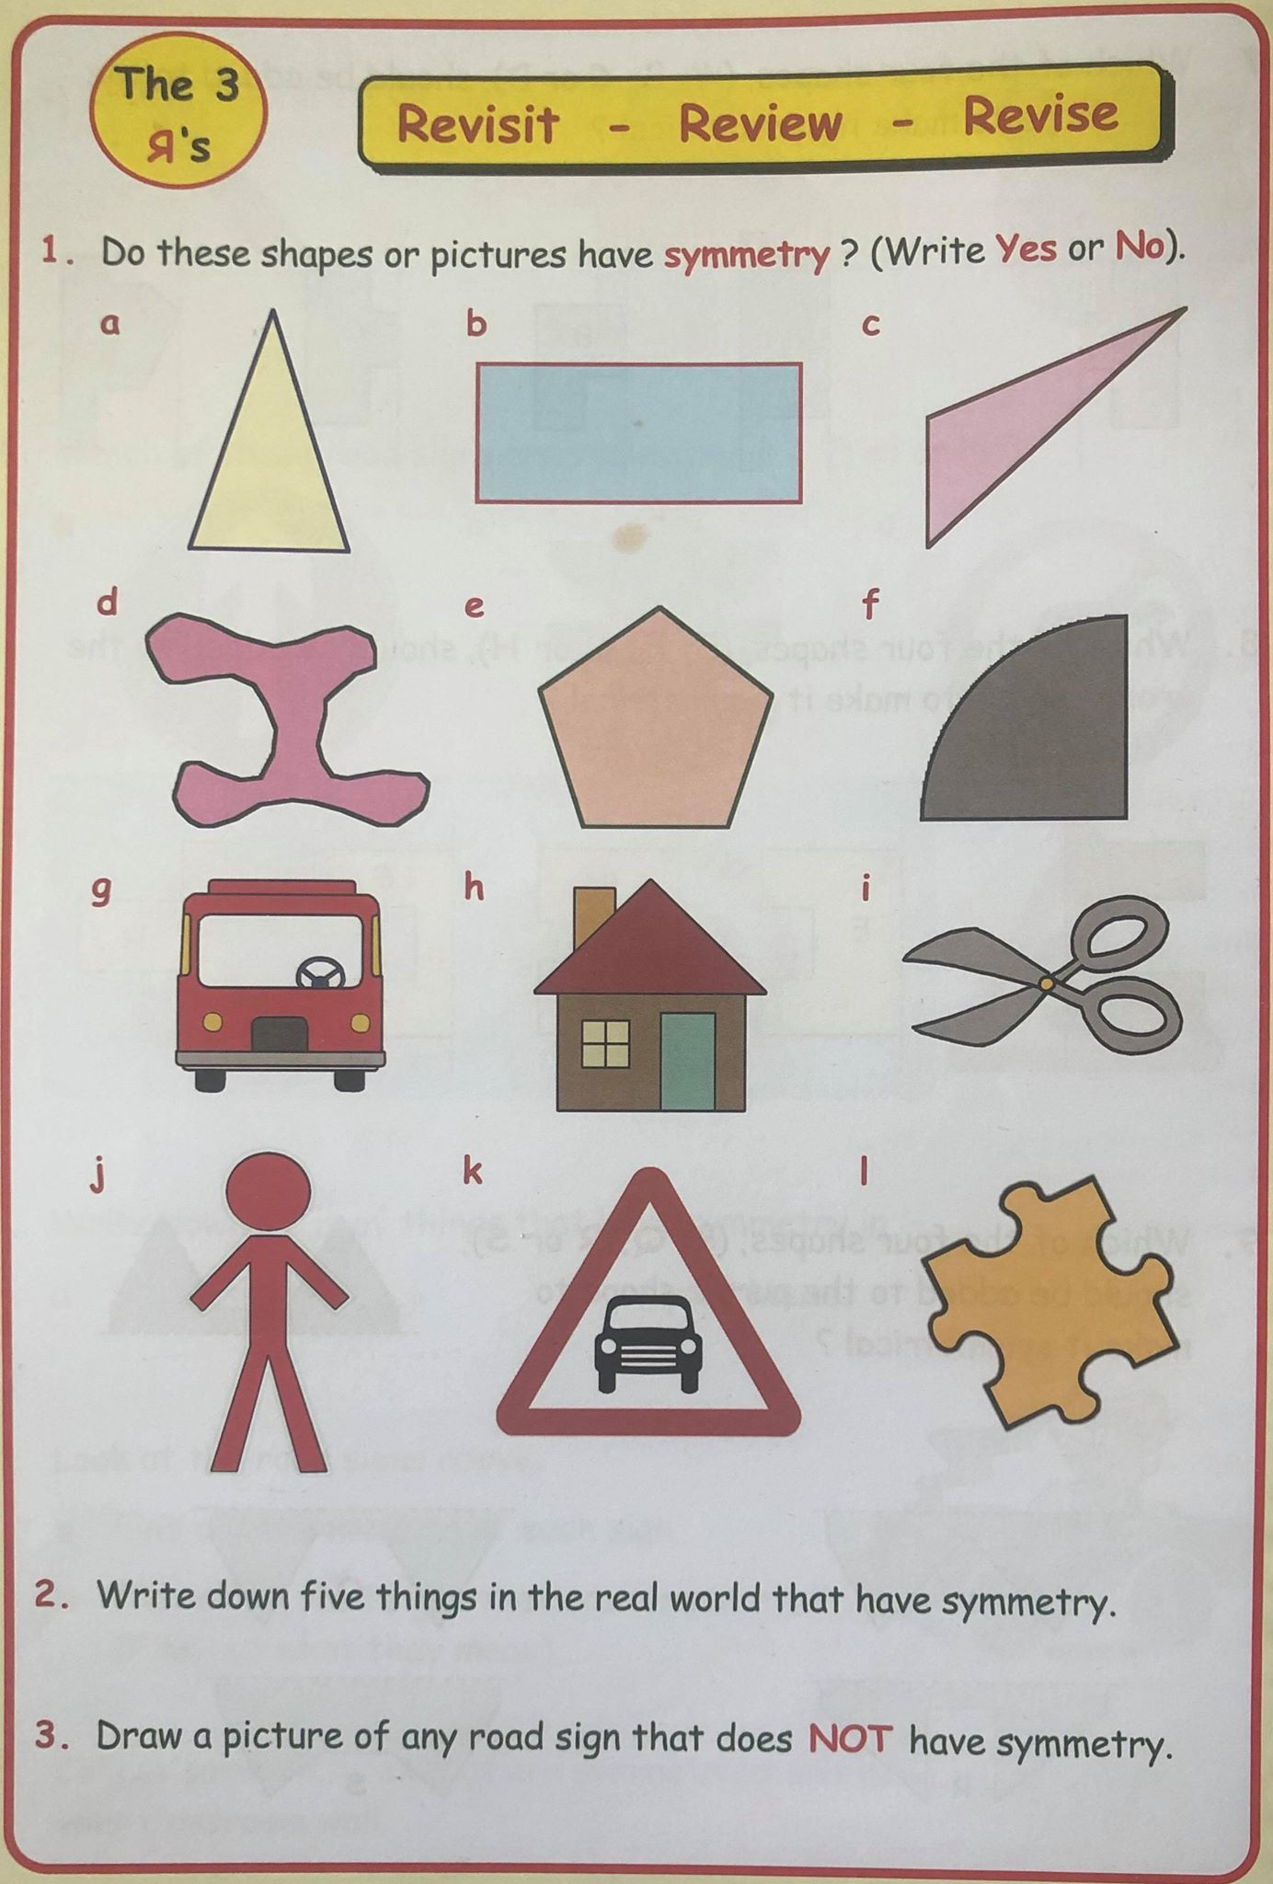
Maths- Symmetry Check- up
L.I. I can identify shapes with symmetry.
.
Complete orally with an adult or write down your answers
one lines of

Slide 7
Maths- Symmetry
L.I. I can identify shapes with one line of symmetry.
.
Task 1- Use materials you can find outside- draw one lines of symmetry and create a nature symmetrical picture.
Task 2- It is not just shapes that have lines of symmetry- some letters of the alphabet have one line of symmetry too. Try the worksheet on the blog.
Extension- If you didn’t give this a try yesterday.
Can you make a poster with pictures of things around your house/garden that have one line of symmetry. You could look through a newspaper or magazine to see if any pictures have one line of symmetry and add these to your poster.

Slide 8
Lunch Time
This Photo by Unknown Author is licensed under CC BY-SA

Slide 9
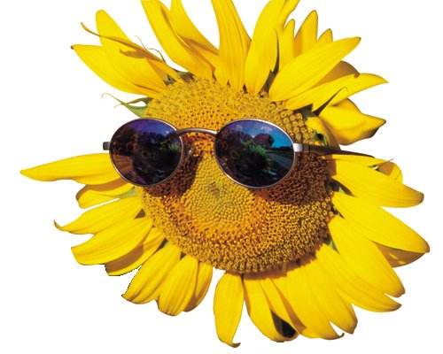
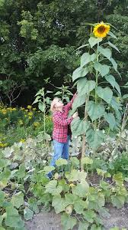
HWB- Living Things
L.I. I am learning what a plant needs to grow and develop.
The Sunflower challenge!
Please keep me updated on the progress of your sunflower over the coming weeks.

Slide 10
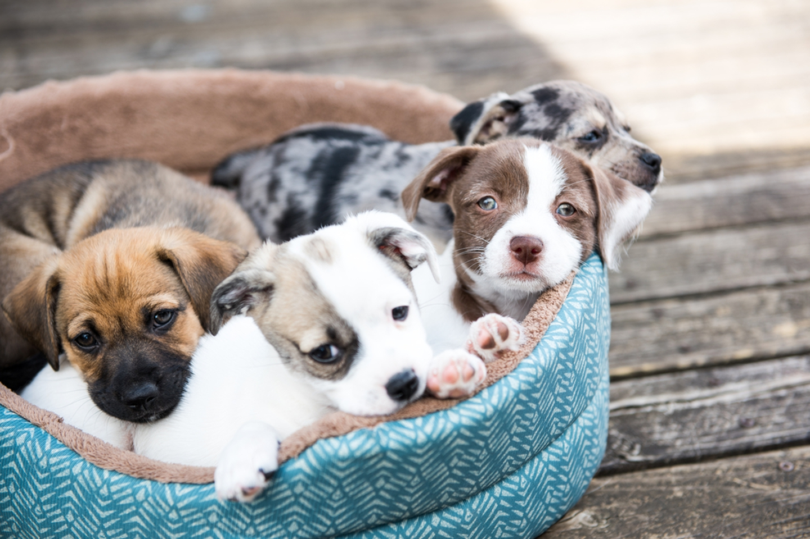
HWB-Caring for Pets
L.I. I can explain some ways in which pets are cared for.
This week in school, we would have had a visit from SSPCA to talk about ‘Children and Dogs’. Here is the video clip and on the blog you will find a range of activities to go alongside it.
https://www.canineconcernscotland.org.uk/schools-and-education

Slide 11
PE and Music
PE with Mrs McMaster
and
Music with Mrs Bain

Slide 12
Music with Mrs Bain
I am learning to Perform a simple rhythm part.
Household Rhythms Go to Youtube and search for Household Rhythms/ Rockin’ Rhythms Friday Episode 3. https://youtu.be/NMZ-C4u-n9U
All you need is a home made shaker, two spoons, two pots and two lids.
Pass the beat. Choose a piece of music you like and identify its time signature, ie how many beats in the bar. Clap beat one and tap knees for beats two/ three/ four.
If others in your house can play the game with you, then take it in turns to clap and tap the beat, remembering beat one is clap, other beats are tap knees. Aim to keep the steady pulse going, with no gaps!
Extra challenge - Change direction on agreed signal, eg when someone stamps their foot!

