Slide 1
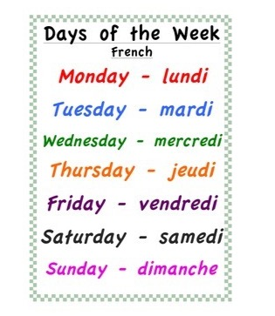


Monday 25th May
Lundi 25 Mai
Good Morning Primary 1!
Bonjour la class!
Click on the picture below to sing our Monday song.

Slide 2
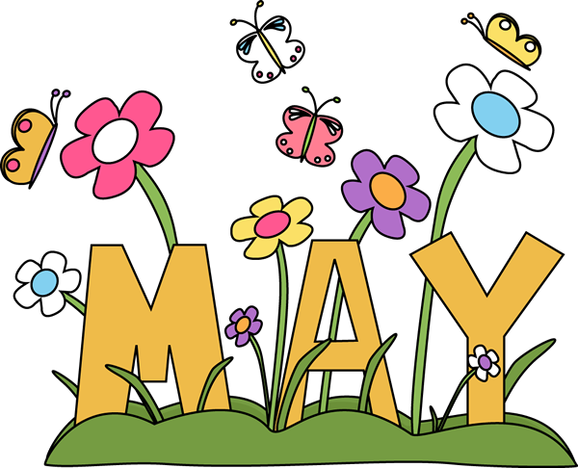
It’s the month of …
Mrs McEwan’s Monday Message
Click on the link in the blog to join in with Mrs McEwan’s Assembly.
Notes:
Welcome to today’s assembly which I am now calling Mrs McEwan’s Monday message! It’s the month of May – a time when we really see the world beginning to burst through with colourful flowers and the trees now full of their Spring Blossom!

Slide 3
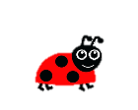

New Sound
oo
I use my knowledge of sounds, letters and patterns to read words.
Can you think of any words that contain the oo sound ?
Can you find this sound in any of your books at home?
Can you spot this sound on any signs when you are out on a walk?
Air Writing
Write the sound in the air, say it quietly.
Write the sound in the air, say it loudly.

Slide 4

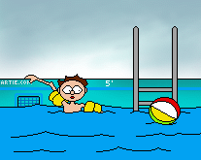

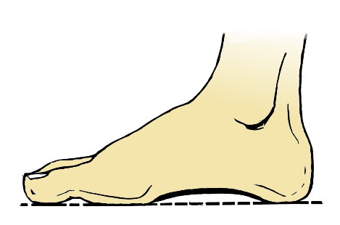


New Sound
I can use knowledge of sounds, letters and patterns to read words.
book
foot
moon
pool
Click on the picture to learn about the oo sound.
I can sound out words containing the ‘oo’ sound
using my ‘sound-box’

Slide 5
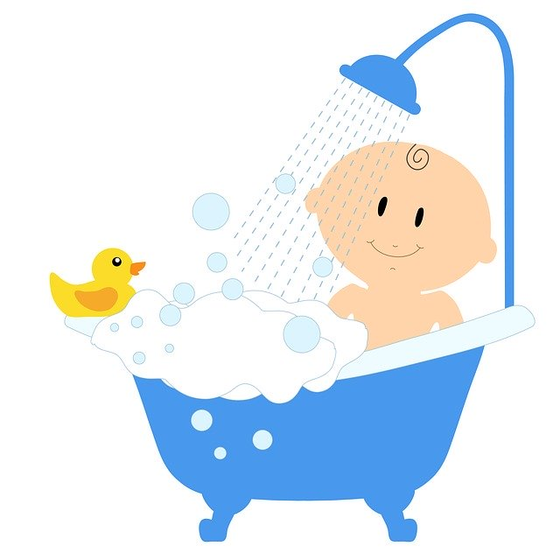
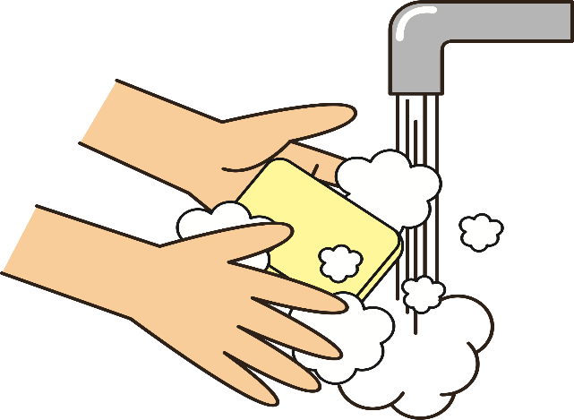
Sentences of the day
I can use knowledge of sounds, letters and patterns to read words.
I put some soap in the bath. Mum can
rub my back with it.
Can you spot the tricky words?
How many did you find?

Slide 6
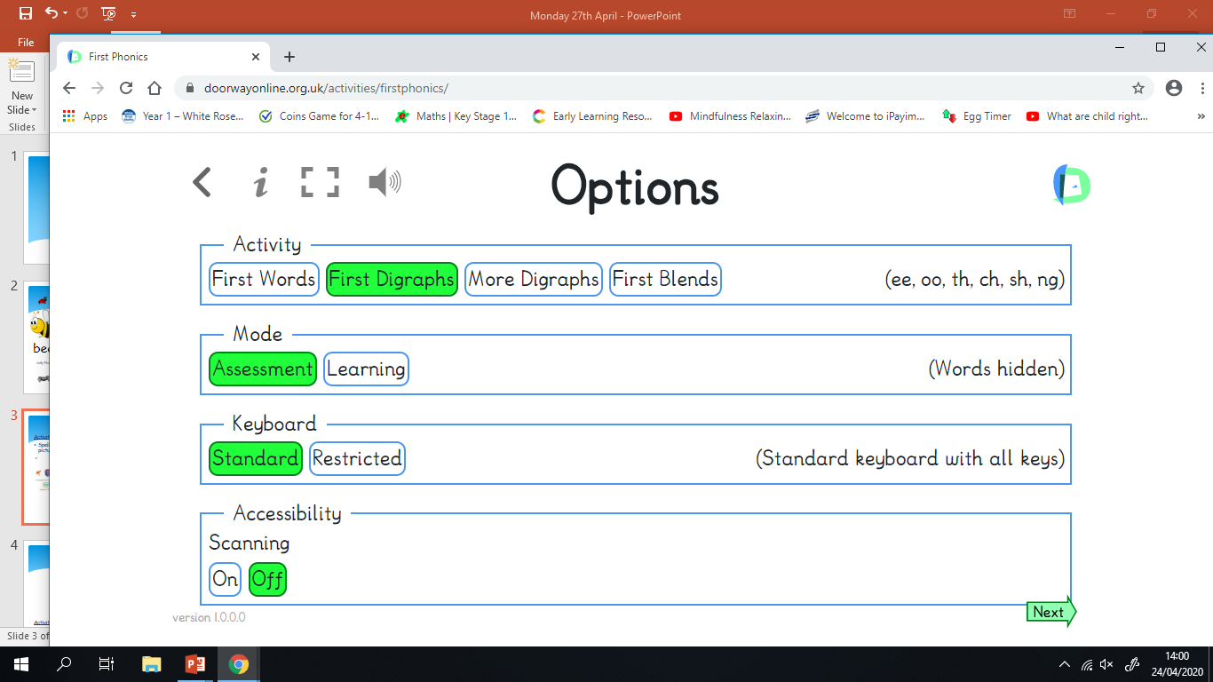
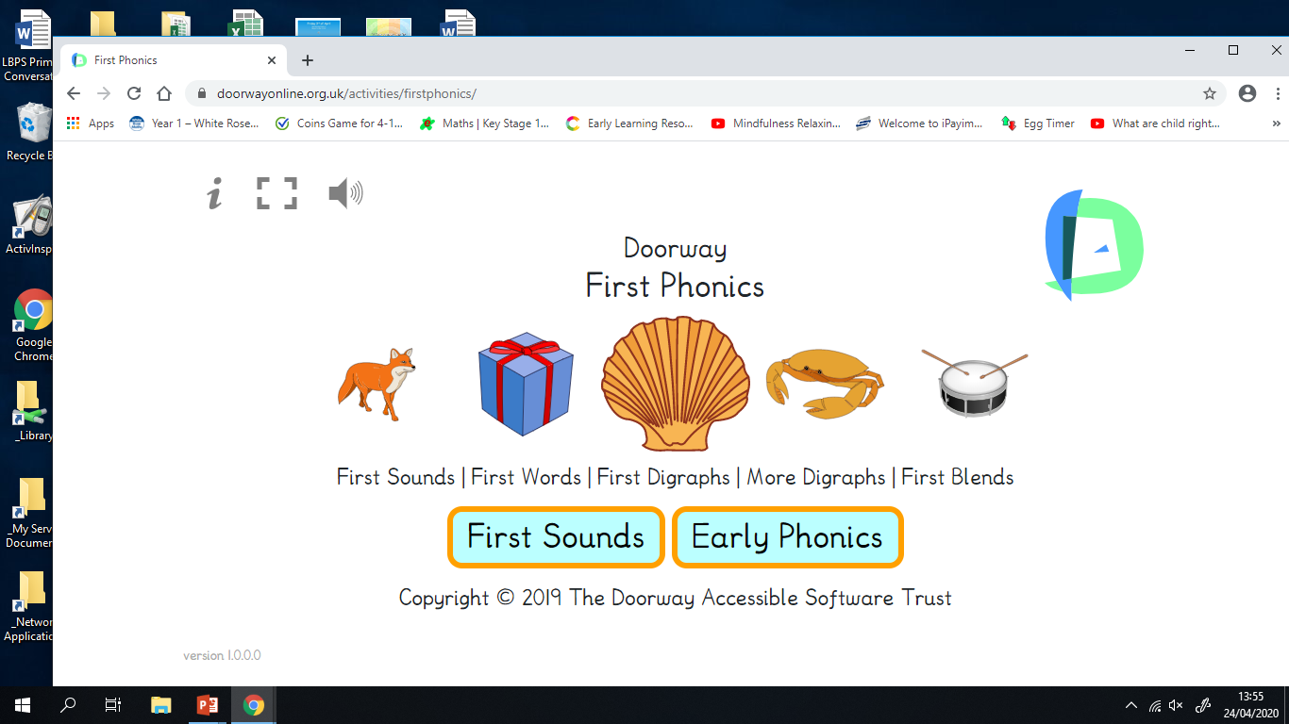
Phonics Activities
Activity
Spelling – Visit Doorway Online by clicking on the first picture. Then select the following, Early Phonics, then, First Digraphs, then the green Next arrow at bottom of the page

Slide 7
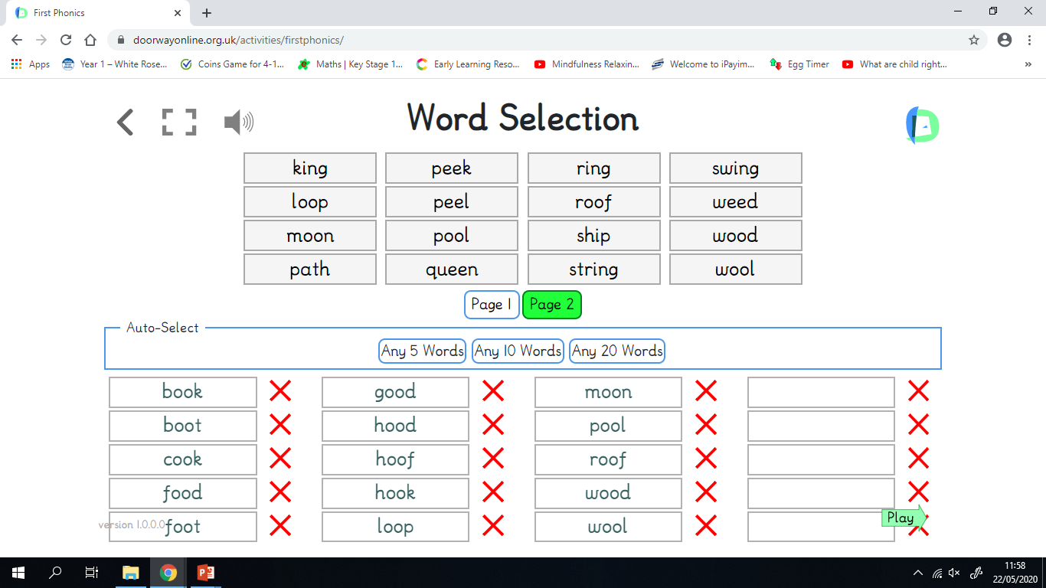
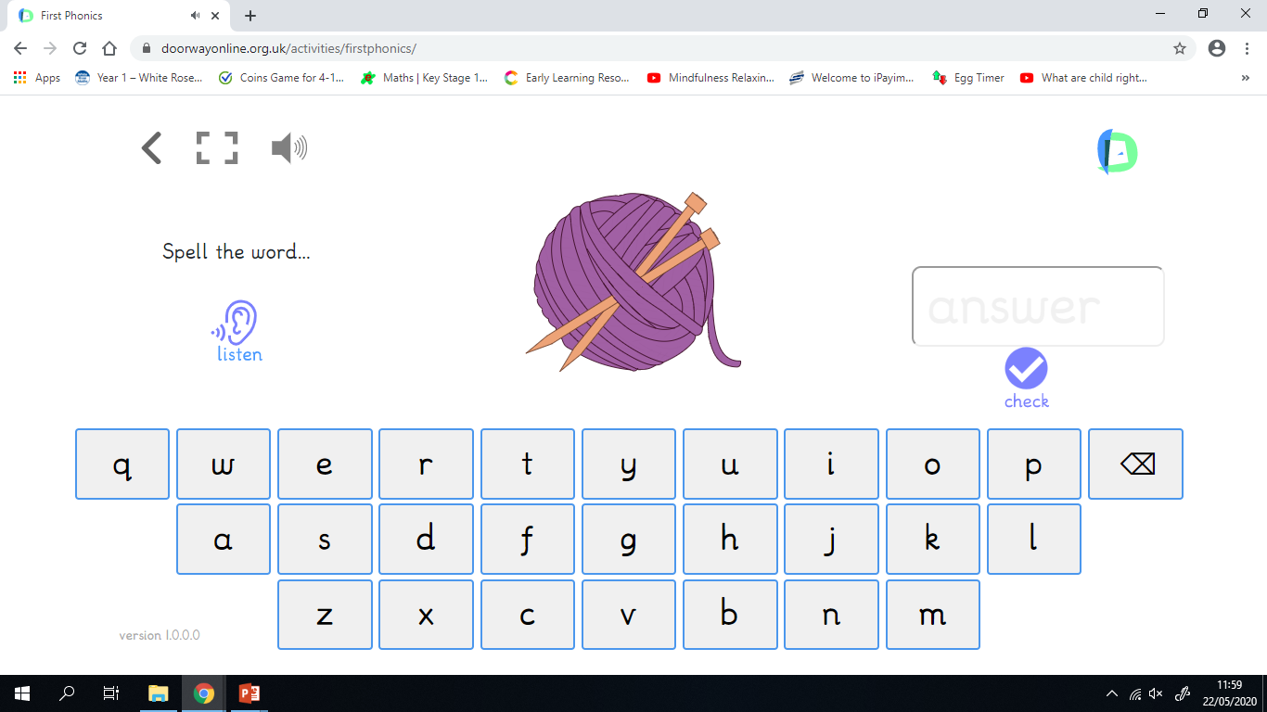
Phonics Activities
Activity
Click on all the ‘oo’ words on pages 1 & 2 to add them to the word list, then click the green Play arrow, on the next page click on the ear and ask your child to listen to the word. Can they spell the word using the letter keys?

Slide 8
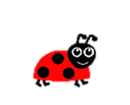
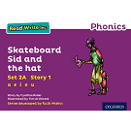
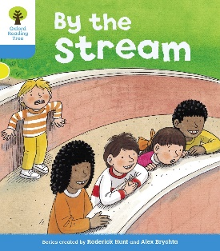
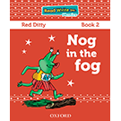
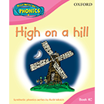
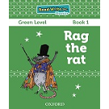
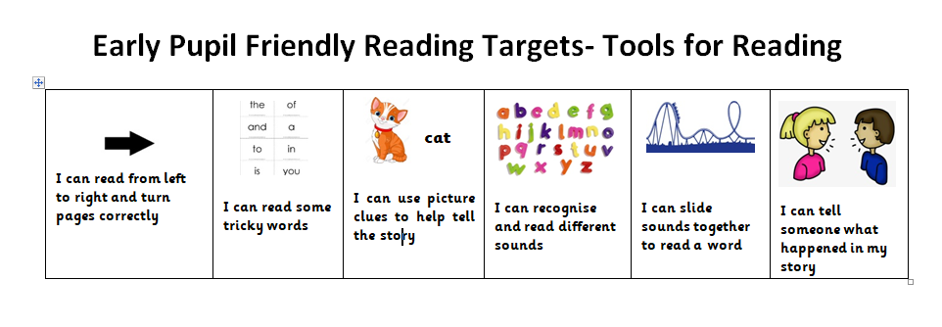
Reading Book
I can use my knowledge of sounds, letters and patterns to read words.
Read the e-book which has been set for you and self-assess using the targets below?

Slide 9
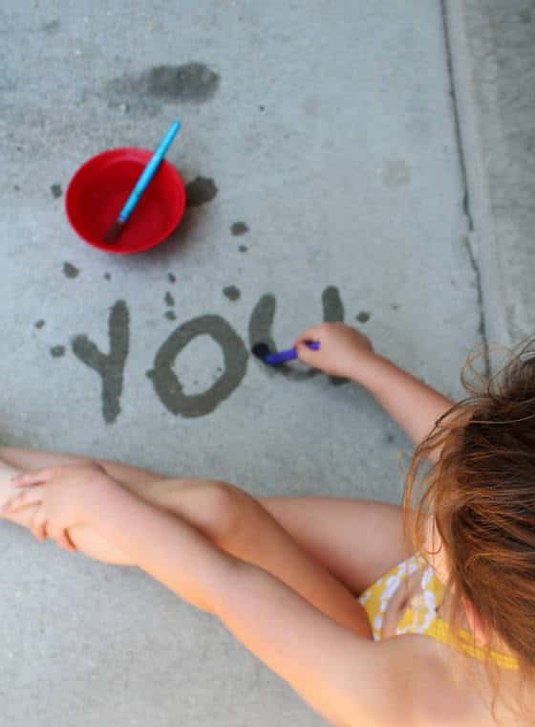
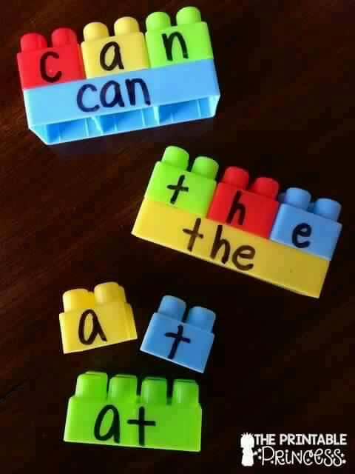
Phonics Activities
Activity
Spelling – Can you use a paintbrush and water to paint 4 ‘oo’ words outside? Or can you use Lego/Duplo to word-build with.

Slide 10
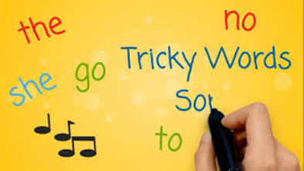
Revision Tricky Words Block 2
Click on the picture to take you to the song.
go we be
she are they
all some come
said one you her

Slide 11
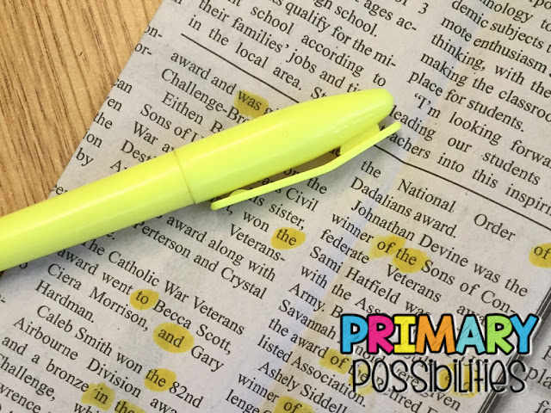
Tricky Word Activities
Activity
Spelling – How many Tricky Words can you find in old newspapers, junk mail or magazines in your house? Can you use a highlighter or felt-tip pen to circle them?

Slide 12
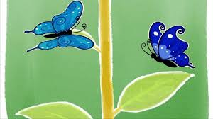
Story Time

Slide 13
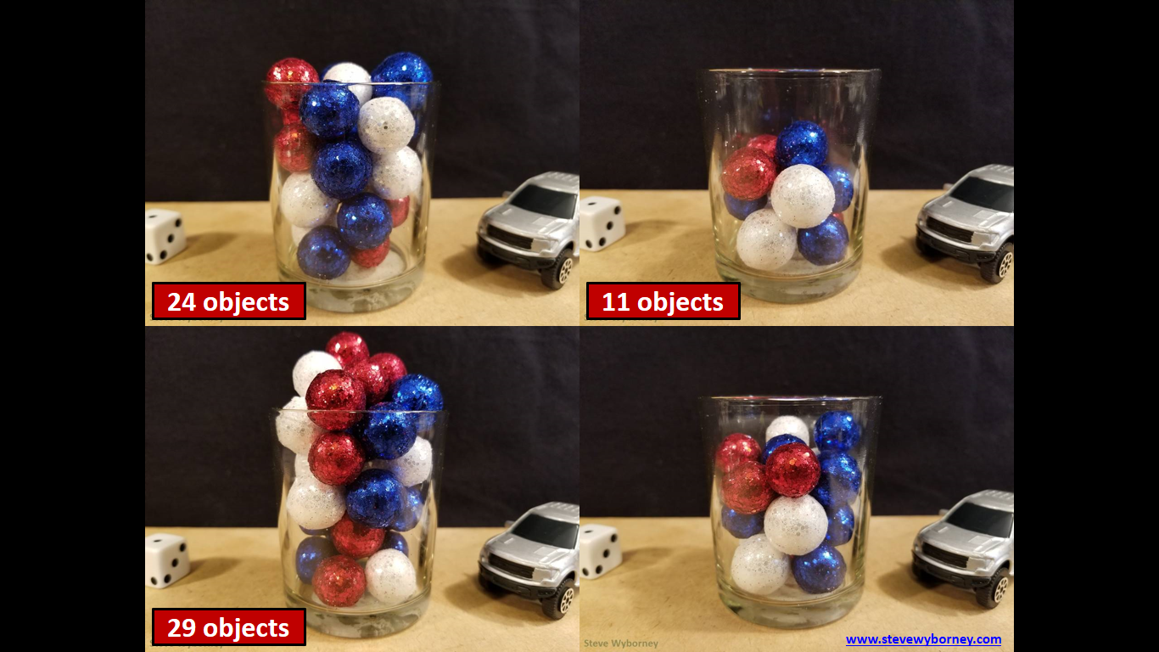
I can use my subitising skills (recognise the amount in a group without counting) to help me estimate the number of objects in a larger group.
How many balls are there?
As the clues appear, use the information to narrow the possibilities to a smaller set. After each clue, use estimation again to determine which of the remaining answers is the most reasonable.
Write down your first estimate. After each clue, you’ll see if your estimate is still a possibility. After each clue, if it is no longer possible write down a new estimate – and be prepared to explain why you chose it.
Steve Wyborney
www.stevewyborney.com

Slide 14
Clue #1
Clue 1
The answer is between 1 and 20.
Clue 2
The answer is smaller than 18.
Clue #2
Clue 2
The answer is bigger than 14.
Clue #3
Clue 3
The answer is bigger than 13.
Clue 4
The answer is a number between 14 and 17.
(once you have clicked on this clue, wait a few seconds).
Clue #4
1 | 2 | 3 | 4 | 5 | 6 | 7 | 8 | 9 | 10 | 11 | 12 | 13 | 14 | 15 | 16 | 17 | 18 | 19 | 20
Steve Wyborney
www.stevewyborney.com

Slide 15
After seeing the clues, you have narrowed the possibilities to a small set of numbers. Before you see the answer, select your final estimate. Write it down, and explain to someone why you chose that number.
Steve Wyborney
www.stevewyborney.com

Slide 16
17 balls
The Reveal
Click to see the answer.
Steve Wyborney
www.stevewyborney.com

Slide 17
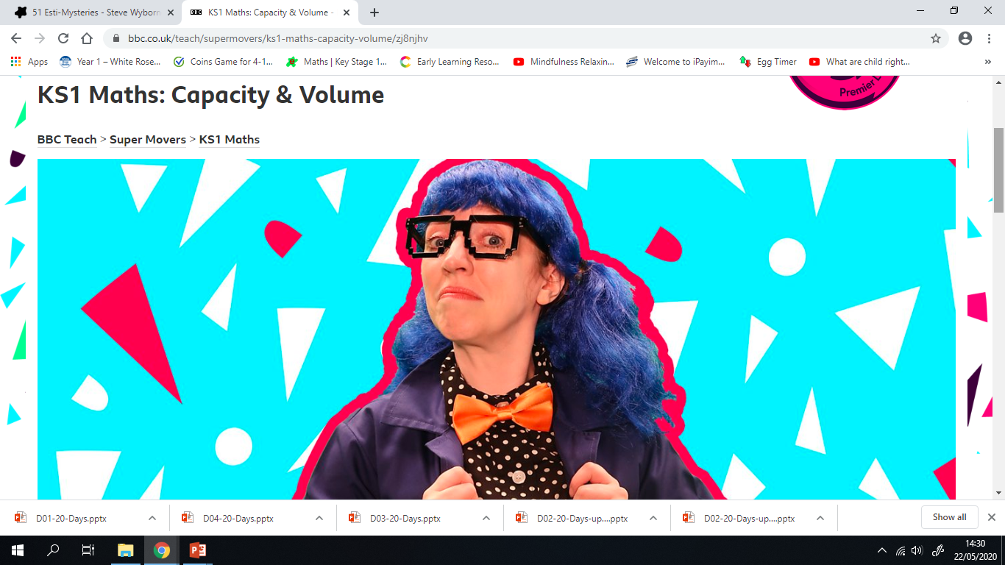
Number Rhyme Time
I can participate actively in songs, rhymes and stories.
Click on the picture below to sing along to a song all about mass and capacity.

Slide 18
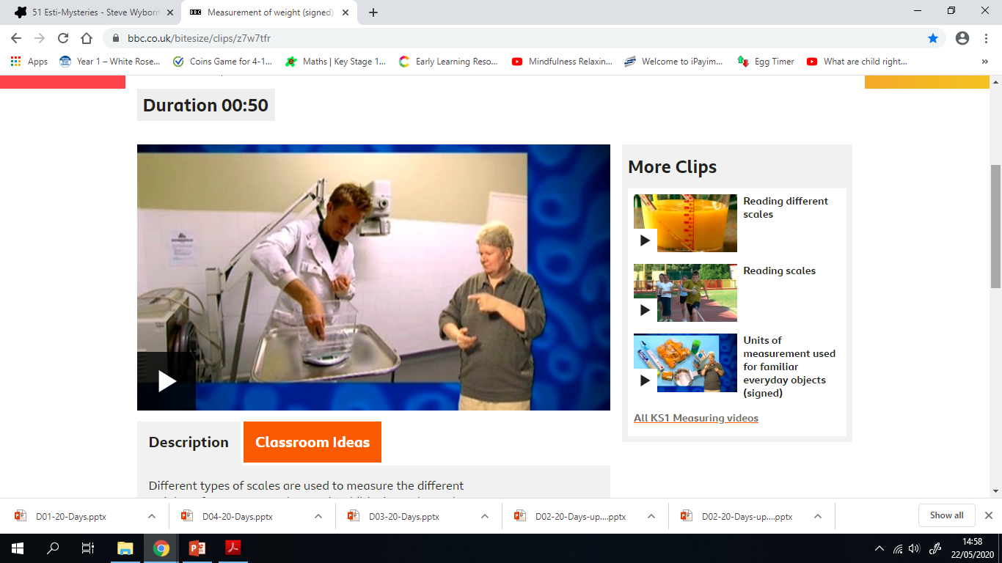
Measure - Weight
Activity
Watch the clip below and see what is used to weigh different animals.
Steve Wyborney

Slide 19
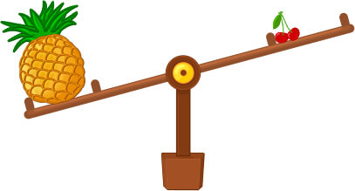

Measure - Weight
How do we compare the mass of objects?
When comparing the mass of objects, we use these words:
heavier and heaviest
lighter and lightest
Top tip
Remember an object can be heavier than something else, even if it looks smaller.
The mass of two objects might be equal to each other, too.
I can describe common objects using appropriate measurement language.
I can use everyday language e.g light, lighter, lightest, heavy, heavier, heaviest, the same as, and equal to, to compare and describe objects and people.

Slide 20
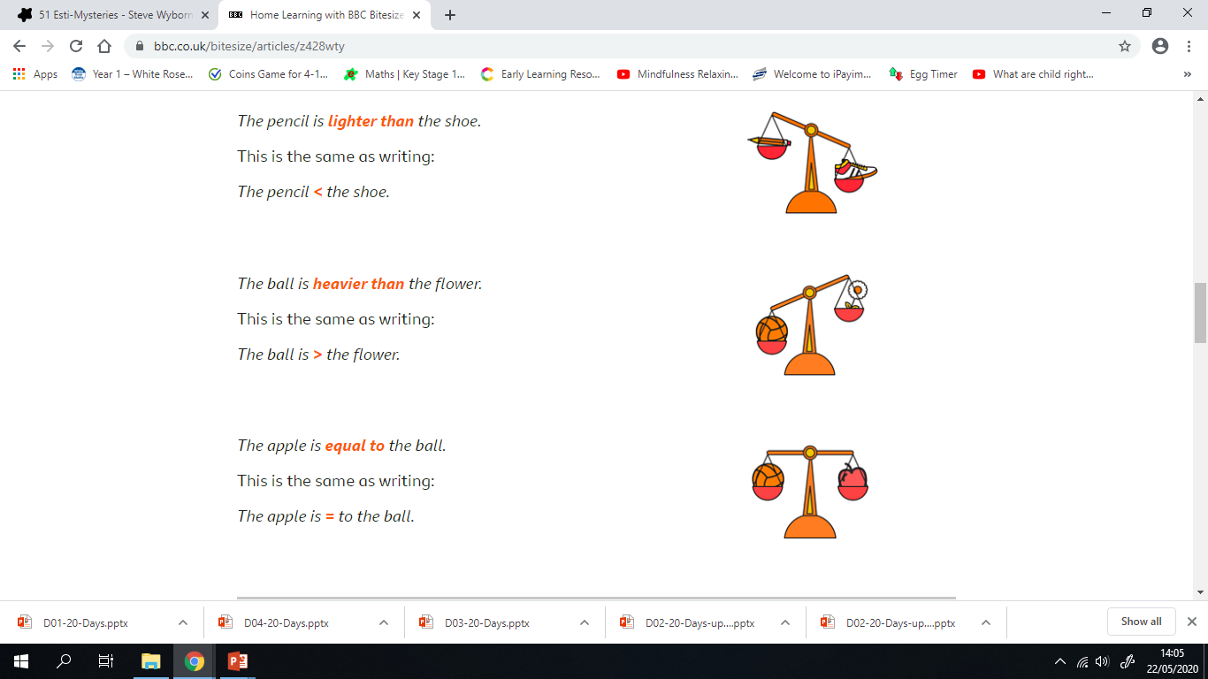
Measure - Weight
I can describe common objects using appropriate measurement language.
The pencil is lighter than the shoe.
The ball is heavier than the flower.
The apple is equal to the ball.

Slide 21
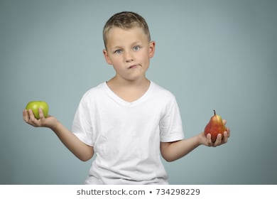
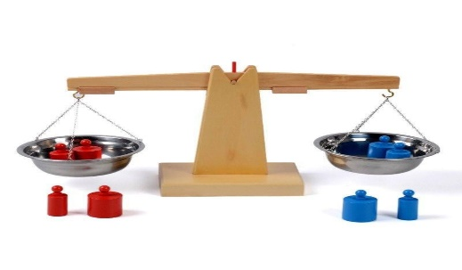
Measure - Weight
Activity
Find pairs of objects around your house to compare and work out which is the lighter of the two and which is the heavier.
Hold one object in each hand and stretch your arms out to the side, so you are standing like a balance scale.
Can you find two objects that are equal to each other in weight?
Remember
Two things can be the same mass. Smaller things can sometimes be heavier than larger things.

Slide 22
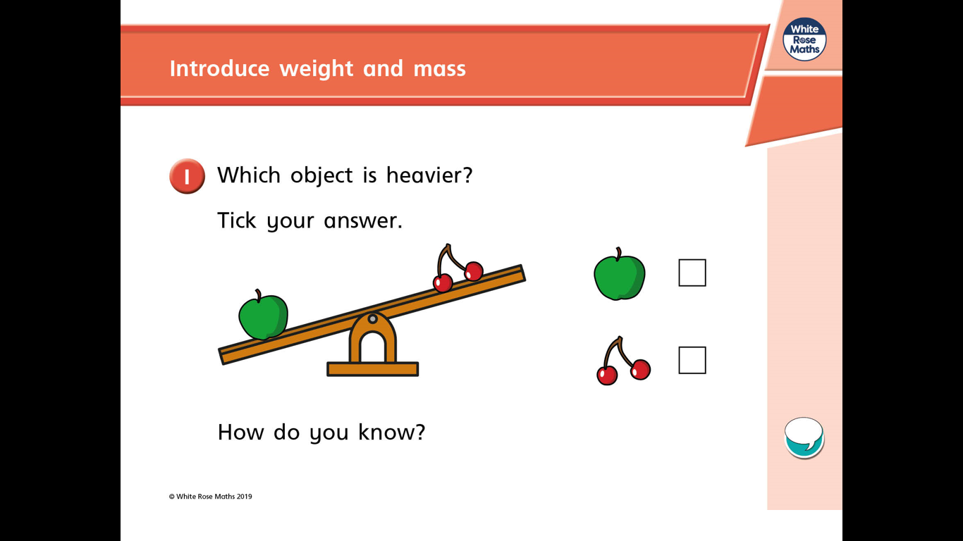
Measure - Weight
I can describe common objects using appropriate measurement language.
Which object is heavier?
How do you know?
Steve Wyborney

Slide 23
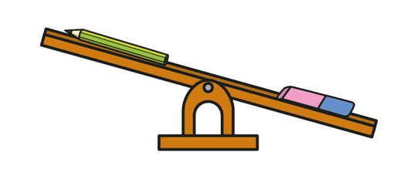
Measure - Weight
I can describe common objects using appropriate measurement language.
Which object is lighter?
How do you know?
Steve Wyborne

Slide 24
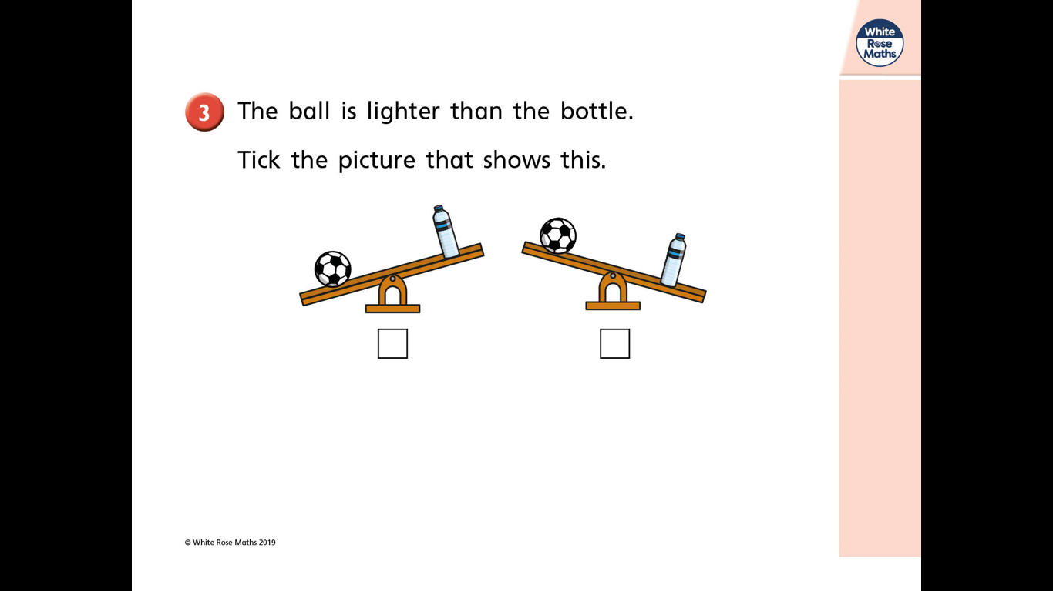
Measure - Weight
I can describe common objects using appropriate measurement language.
The ball is lighter than the bottle. Which picture shows this?
Steve Wyborne

Slide 25
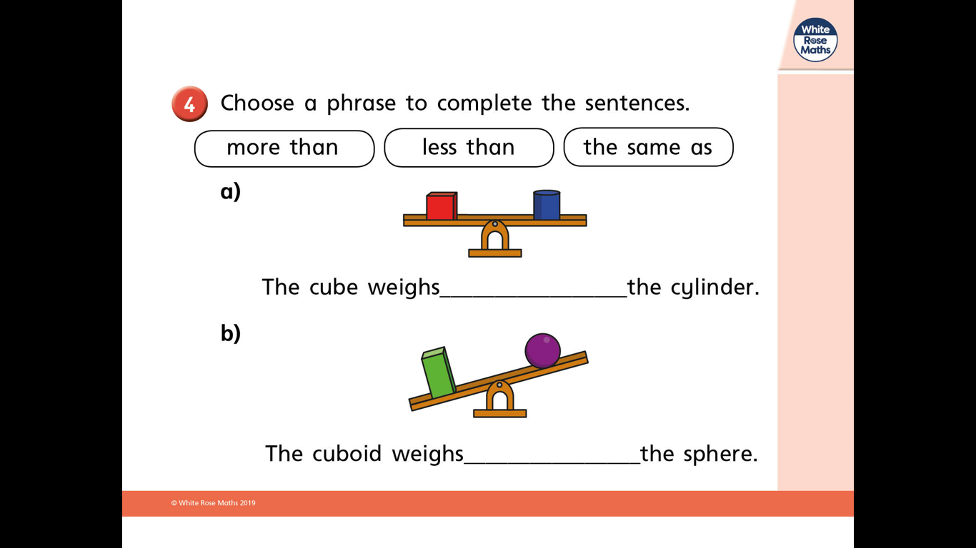
Measure - Weight
I can describe common objects using appropriate measurement language.
Choose a phrase to complete the sentences.
more than less than the same as
Steve Wyborne

Slide 26
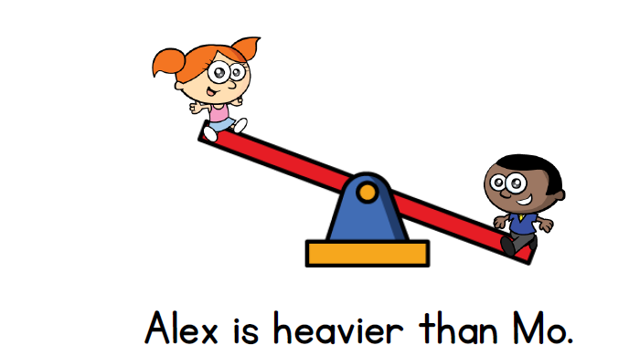
Measure - Weight
True or False ?
Give a reason for your answer

Slide 27

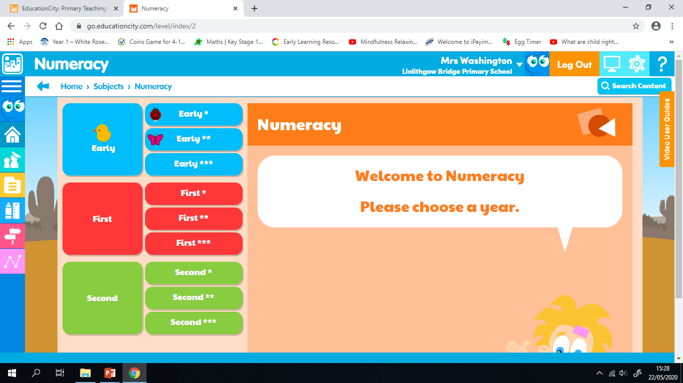
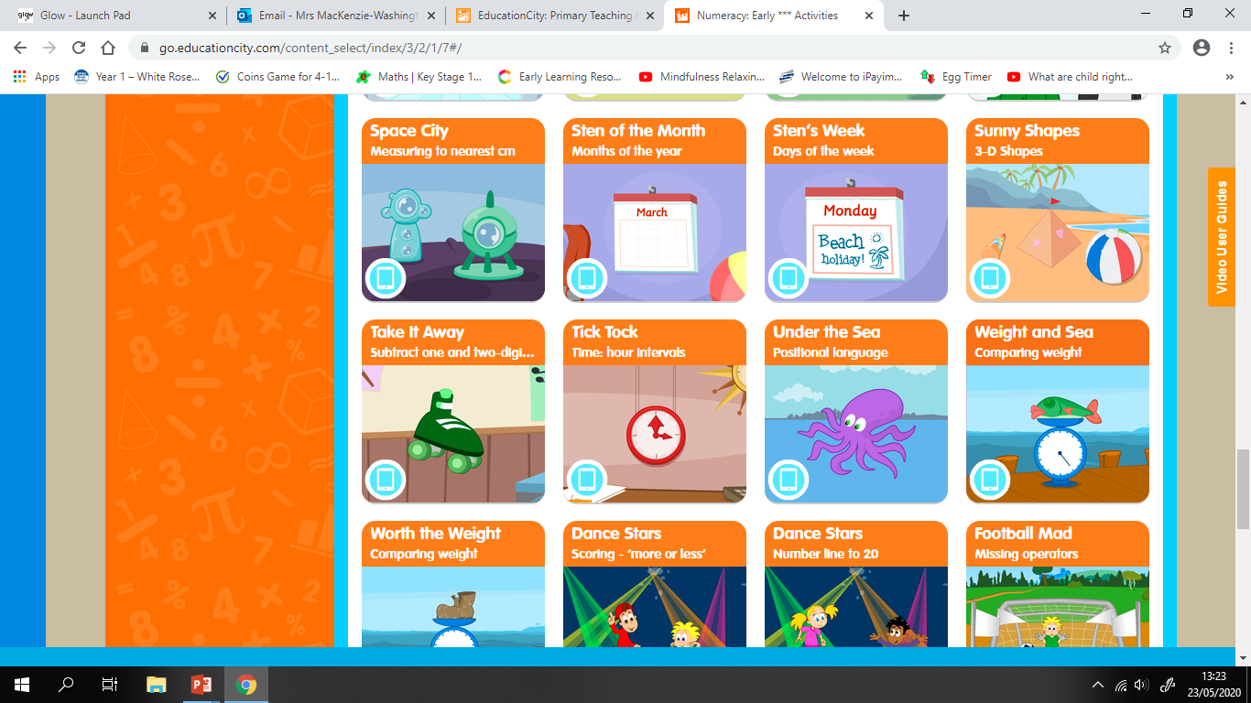
Measure - Weight
I can describe common objects using appropriate measurement language.
Click on ‘Education City’ to log in.
Click on Subjects – Numeracy – Early *** - Activities and scroll down to Weight & See.
I can use everyday language e.g light, lighter, lightest, heavy, heavier, heaviest, the same as and equal to, to compare and describe objects and people.

Slide 28
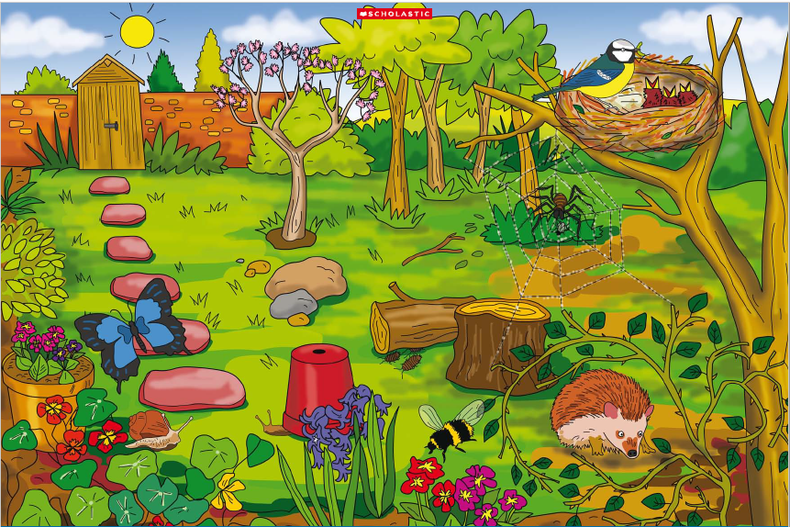
IDL
I can describe characteristics of living things and how they depend on each other.
Click on the picture to take you to the video.
Can you spot the Minibeast habitats in the picture?

Slide 29





IDL
I can describe characteristics of living things and how they depend on each other.
Can you identify the Minibeast habitat?
Bee hive
Ant hill
Spider web
Sitting on leaves
flowers
Activity – Download the worksheet or complete the activity in your jotter
Outdoors – explore your garden or outside area. Use your senses to look, listen and touch around your outside space to find different Minibeast habitats. How many different habitats can you spot?

Slide 30
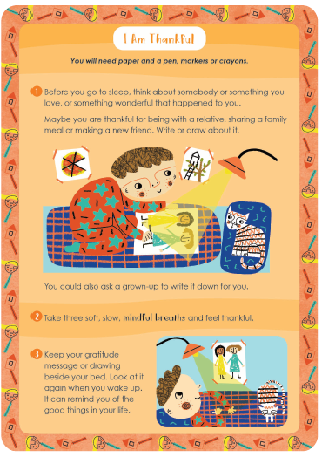
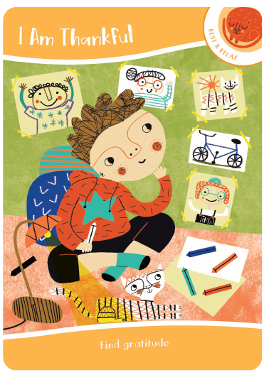
Mindfulness

Slide 31

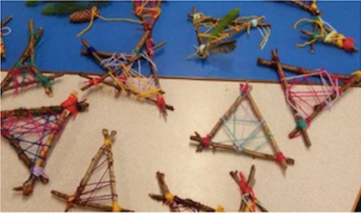
Smile Mile
Go for a Smile Mile around your garden or outside area.
Optional Activity – in this confusing time you might have lots of worries going through your mind and sadness about not being able to visit your friends and family. Let’s stop those worries getting into your dreams by creating a dreamcatcher. Collect 3 sticks on your walk and any other items you might want to use as decoration then use some string or wool to tie together and weave your dreamcatcher.

