Slide 1
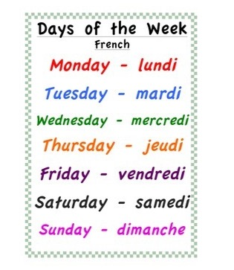
Friday 22nd of May Vendredi 22 Mai
Good Morning Primary 1!
Bonjour la class! Ca Va?
Listen to the days of the week in French
Click on the above picture to listen to the days of the week in French.

Slide 2
Wake up with GoNoodle
I can move my body well, exploring how to manage and control it.
Click on the above link to take you to the song.

Slide 3
Story time
I can participate actively in songs, rhymes and stories.
Click on the
‘Loon on the Moon’ picture to take you to the story.
.

Slide 4
Sounds
OLI - I can use knowledge of sounds, letters and patterns to read words.
Revision of sounds
Click on the sound button, say the sound and the word.
wh
ai
ay
ch
th
sh
ee
ea
igh
y
oa
ow
sound out words containing consonant digraphs sh, ch, th, wh and long vowels ai/ay, ee/ea and igh/y using our 'Fred Fingers’

Slide 5
Mrs Taylor’s Active Spelling Challenge
Choose one of the activities to sound out 4 of our revision words.
Or choose your own way to learn your spelling words.

Slide 6
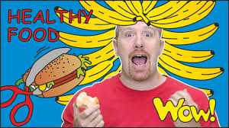
HWB
To understand we need to eat different foods to stay healthy.
Activity – design a healthy lunch. Download the ‘Healthy Lunch’ worksheet or complete in your jotter.
identify some foods that we should eat lots of and less of to be healthy.

Slide 7
Number Blocks
I have explored numbers recognising that they represent quantities.
Click on the Number Blocks picture to take you to the episode.
Activity – use lego blocks or wooden blocks to make double number facts to 10. *challenge , can you make double facts beyond 10?
I can visually represent numbers within 20.

Slide 8
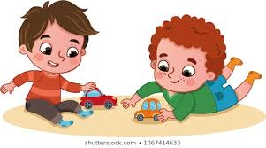
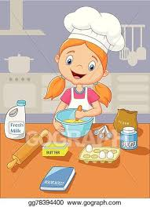
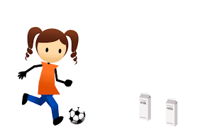
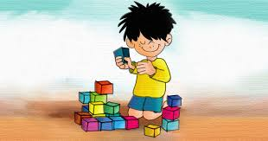
Fun Friday Activities
Article 31 – I have the right to play and relax.

Slide 9
Well Done Primary 1!
Well done Primary 1! You are all stars!
Have a lovely weekend!

