Slide 1
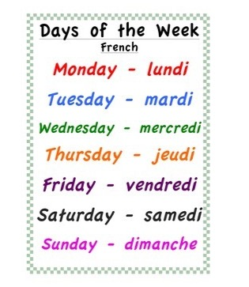
Tuesday 19th of May Mardi 19 Mai
Click on the above picture to listen to the days of the week in French.
Click on the rainbow to listen to our Tuesday song.

Slide 2
Sticky Kids Warm up
I can move my body well, exploring how to manage and control it.

Slide 3
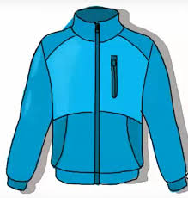
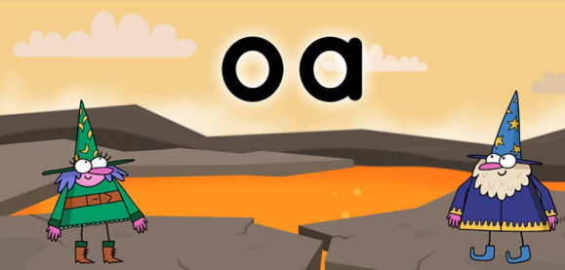
Sounds
OLI - I can use knowledge of sounds, letters and patterns to read words.
boat
coat
road
soap
Click on the picture below to take you to the ‘oa’ clip.
sound out out words containing the ‘oa’ sounds
using our 'Fred Fingers’

Slide 4
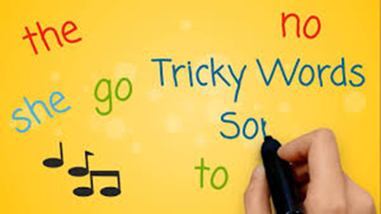
Revison Tricky Words Block 2
Click on the picture to take you to the song.
go we be
she are they
all some come
said one you

Slide 5
New Common Word
her
I use my knowledge of sounds, letters and patterns to read words.
What is the tricky part of the word?
What sounds can you hear?
Air Writing
Write the word in the air saying each sound as you form it.
Carpet Writing
Write the word on the carpet/floor saying each sound as your form it

Slide 6
Speedy Sounds
Read the sound and the word.

Slide 7
Sentence of the day
OLI - I can use knowledge of sounds, letters and patterns to read words.
I saw a ship on the sea. It had one red sail.
Can you spot any tricky words?
Can you spot any words with long vowel sounds?

Slide 8
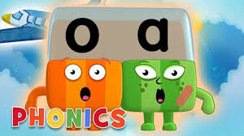
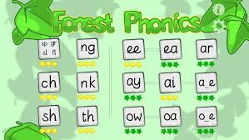
Phonics Activities
Click on the picture to watch an episode of alphablocks.
Activity
Spelling – draw and label a picture with 4 oa words.
ICT – Forest Phonics ‘oa’ word building.
Letter formation –
practise making the ‘oa’ sound
in the air, on the floor, in flour/salt.
‘oa’ letter formation page (home learning pack)
Click on the link below to take you to the letter formation. Follow the magic pencil to form o and a.

Slide 9
Reading Book
I can use my knowledge of sounds, letters and patterns to read words.
Read the e-book which has been set for you and self-assess using the targets below?
Activity – Draw a new front cover for your book.

Slide 10
Story Time
I enjoy engaging with and listening to a story.
Click on the picture to take
you to the story.

Slide 11
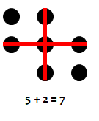
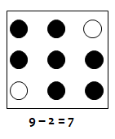
Number Talks
Instead of saying how may dots there are, find as many ways as you can to show how you know what the total is.
Here are some examples:
Now your turn. How many ways can you find to make the total

Slide 12
2 + 3 + 2 = 7
2 + 3 + 2 = 7
4 + 4 – 1 = 7
Number Talks
9 – 2 = 7
5 + 2 = 7
3 + 3 + 1 = 7
Did you come up with any of above ways to find the total ?

Slide 13
Number Rhyme Time

Slide 14
Measure
I can compare and describe length using non-standard units .
Collect these items from around your house. Order them from shortest to longest.
.
I can compare lengths using shortest and longest.

Slide 15
Count the pieces...
Which is longer?
Which is shorter?
Which is the longest?
Which is the shortest?
Notes:
Day 1 Look at different caterpillars on smart board (caterpillar ppt). Which is longer, longest etc. How many pieces does each caterpillar have? Which has the most, least? Which is the biggest, smallest? Etc Hold up a piece of string. Give each of the children another piece of string. Do they think there piece is longer or shorter than my piece? Check with a partner. Compare. Discuss how to make a measurement fair. Hold string straight, not crumpled and start from the same point. How do we know it is longer/shorter?

Slide 16
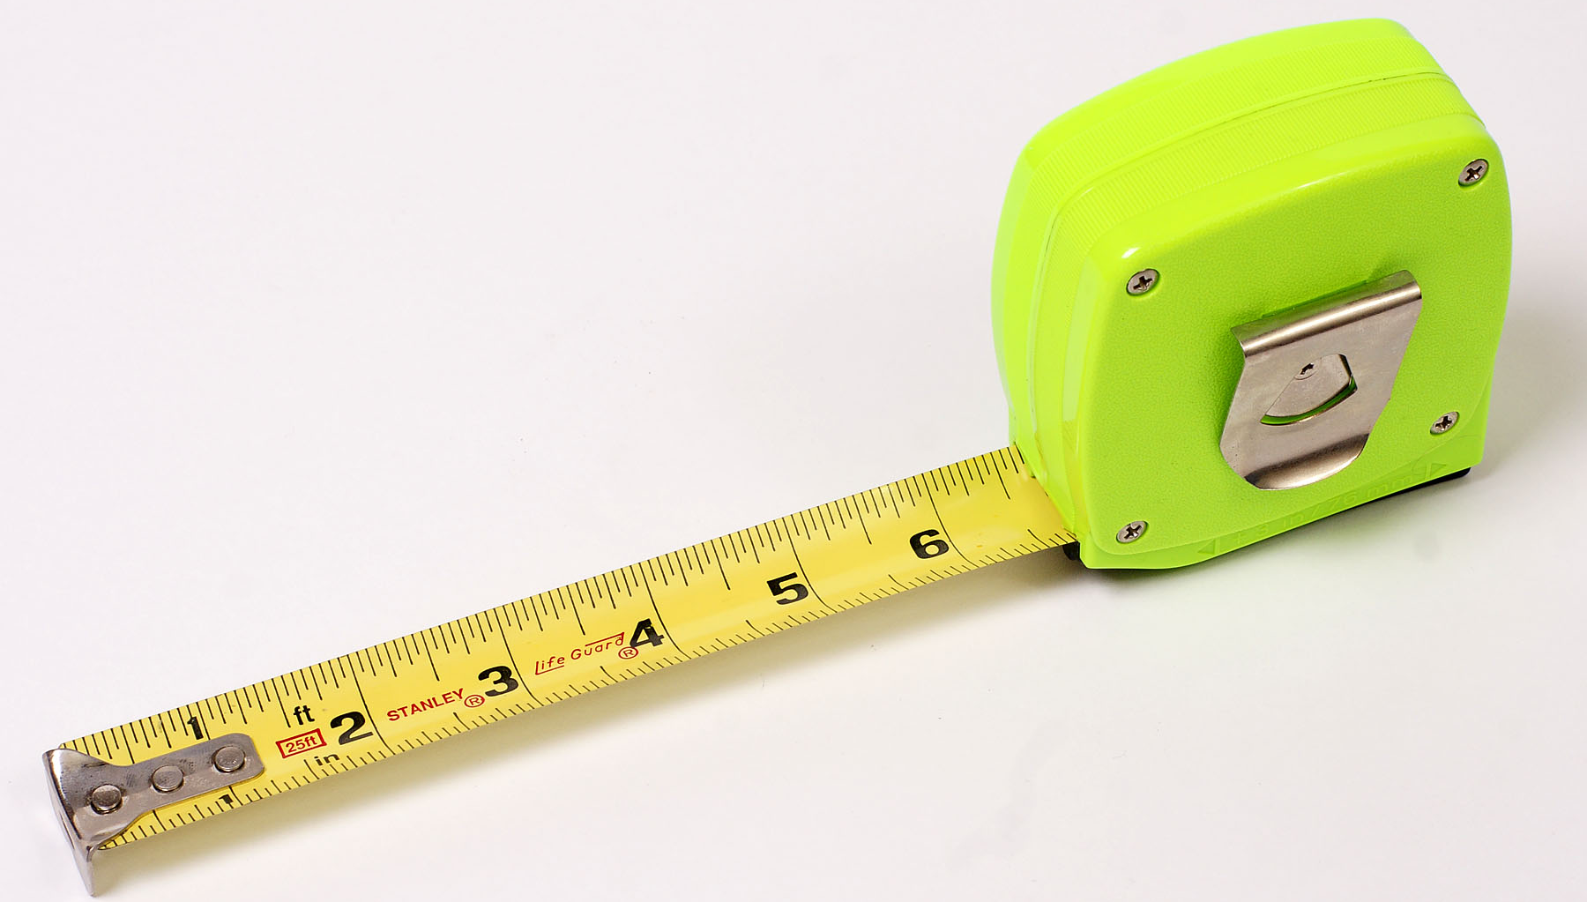
Time to measure...
Something is not right?
Something is still not right?
Notes:
Day 2. Look at slide 2 on PP. How do we know which is longest? Give chn 2 lengths of string 1 btwn 2. Find out which is the longest/shortest. Can they cut a piece that is in-between?

Slide 17
Short to long
Notes:
Day 3 Look at the rest of the slides and order 3 caterpillars. Give chn 3 lengths of string 1btwn 2. Order them short to long/long to short.

Slide 18
Shortest
Longest

Slide 19
Measure
I can compare and describe length .
Click on ‘Education City’ to take you to the game.
Activity – After playing the game, complete the ‘Measure Up’ worksheet either by downloading the worksheet or drawing the item in your jotter.
I can use everyday language e.g longer, shorter, taller, heavier, lighter, larger to compare and describe objects and people.

Slide 20
If You’re Happy and You know it!
Music Time
‘
I enjoy singing along to music of different styles.
Click on the picture to take you to the song.
I can participate actively and use my voice to join in with the song.

Slide 21
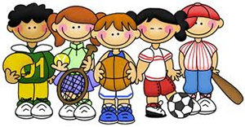
P.E
Take part in Mrs McMaster’s Tuesday activity.

